Slide 1
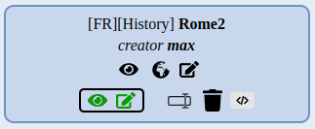
Menu
The menu allows you to log in, create new maps, view public maps and edit your own maps
Manage your maps
View the map
View in 3D
Edit
Export your map as an Iframe
Delete the map
Defined if the map is visible and editable by other users
Rename the map

Slide 2
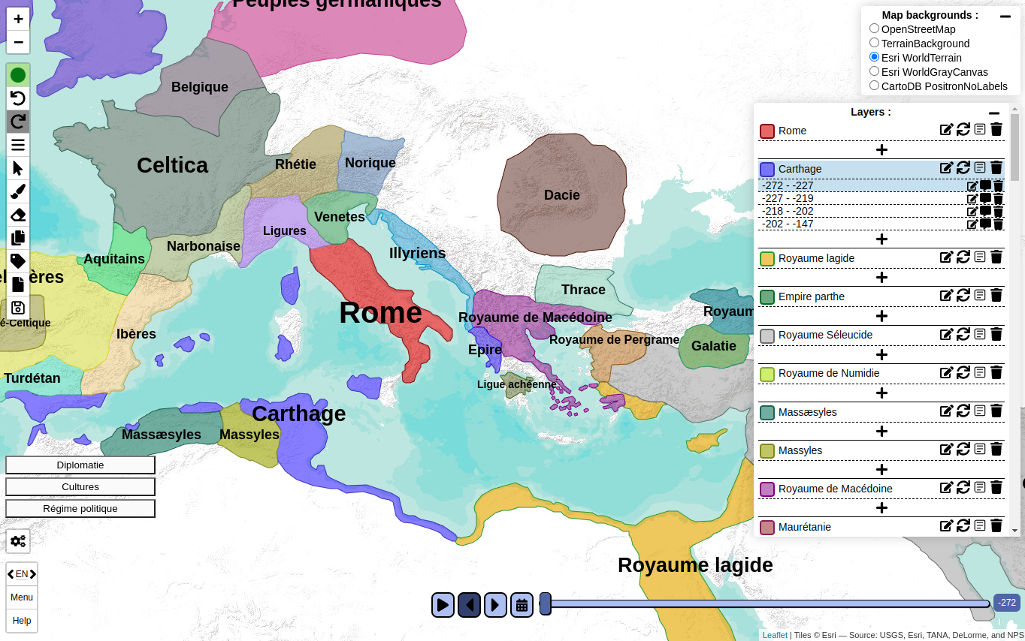
Software content
Choice of active background
Actions bar :
draw, erase, save, ...
Display of the different layers and markers
Button to view themes
Open the settings menu
Time bar, visible if enabled in the settings
Return to the main menu and access the help menu

Slide 3
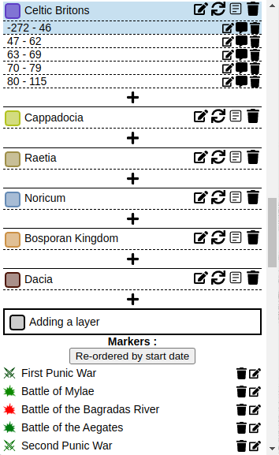
Layers and Markers menu
Layer name and layer design color
Edit start and end date
Add/Modify pop-up
Remove from sub-layers
(visible if time activated)
List of sub-layers corresponding to a time period (if time enabled)
Addition of an sub-layers (visible time zone if time is activated)
Allows you to rename the layer
Re-ordered the sub-layers
Editing properties (thematic)
Delete the layer
Adding a new layer
Delete marker
Edit marker
Marker icon and title

Slide 4



Actions 1/3
User connection status (green = connected, red = not connected)
Drawing mode
Cancel the last action
Exit the drawing menu
Restore last action
Choice of the size of the drawing brush
Selection of a layer, once activated click on a layer of the map to select it
Choice of the drawing color
Choice of the parameters of the drawing border
Activate the drawing mode
Choice of drawing opacity
Enable content removal mode
Filling the area
Activate the copy and paste menu
Automatic border (removing content that overlaps with other layers)
Simplification of the geometry (improves performance)
Activate label options
Import/export menu
When the drawing mode is active, your mouse cursor is replaced by a drawing cursor and when the mouse click is active the drawing layer is updated
Online backup of the current map, available only if the user is logged in

Slide 5



Actions 2/3
Content removal mode
Copy and paste menu
Exit the menu
Exit the menu
If active, remove the content of all layers, otherwise only the selected layer
Copy the selected area
Choice of the size of the content removal brush
Paste the last copied area into the selected layer
When the content removal mode is active, your mouse cursor is replaced by a removal area and when the mouse click is active the drawing layer is updated

Slide 6



Actions 3/3
Menu import/export
Menu label
Exit the menu
Exit the menu
Import a HistoAtlas export file (WARNING: deletes unsaved data)
Export of the current map (download in HistoAtlas format)
Change the size of the layer label, 0 to hide the label
Export to GeoJson format (layers visible at the selected time)
When active, allows to change the position of the label by clicking on the target position
Import of a Geojson file
Save: choose the file name and click on save (storage on the server)

Slide 7
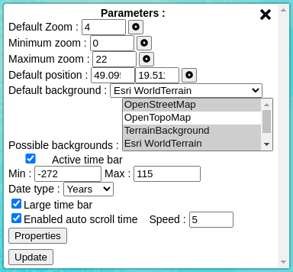

Settings
Default zoom value when loading the map
Minimum possible zoom value
Default background active when the map is loaded
Maximum possible zoom value
Default position when the map is loaded
Choice of plan backgrounds that is possible to choose
Activation of the time bar and choice of minimum and maximum values (see next page)
Enabled the doubling of the size
Types of dates (by year, month and day)
Enabled auto time scroll and speed selection
Open the settings menu
Editing properties
(see "properties" page)
Update the settings

Slide 8

Time management
Visible only if the time bar has been activated in the settings menu
Move forward/backward in time to the next events
Time bar, choose the date to see
Automatically scroll of time
Selected date
Display selection of a time zone with start and end choices and display of all markers in that time zone

Slide 9
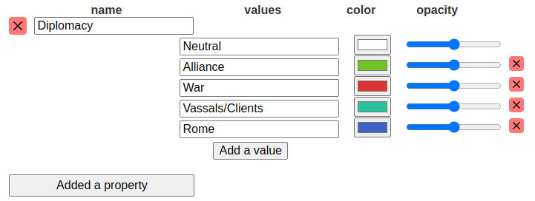
Properties
The menu allows you to define the properties, to use them you must define them via the layer menu
Name of one of the values
Name of the property
Color of the value
Delete the property
Delete the value
Value opacity
Adding a new value
Adding a new property

Slide 10

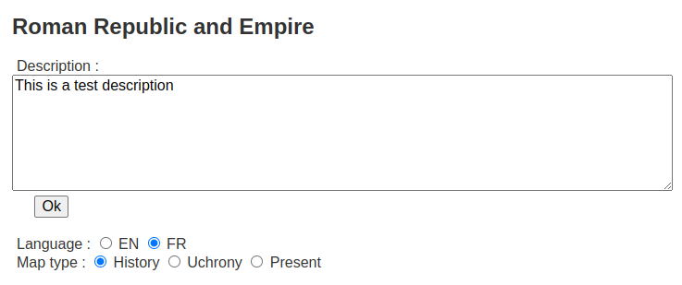
Description Menu
Opening the map description menu
Description of the map (click "Ok" to save)
Language choice (allows users to know the language of the map)
Type of map

Slide 11
You can follow the tutorial videos (in French with subtitles)
If you need help to create your map or a new feature on the software, contact us

