Slide 1
QueryGraph - Help
To create a query you need to draw nodes and links.
The nodes represent data and the edges represent the connections between these data.

Slide 2



There are 3 types of nodes :
Node Element :
  Node representing a variable data with a predefined data type.
  Example : A person
  Properties :
    Name : Name of the item displayed in the query result.
    Label of the type : [OPTIONAL] Type label (informative).
    URI of the type : [OPTIONAL] URI filtering the type of recovered data, if none is defined have recovered all possible data.
Node Data :
  Node corresponding to a fixed data.
  Example : city of Paris
  Properties :
    Label : Label of the data to be displayed (informative).
    URI : URI of the data (ex : wd:Q90 for Paris).
Node Filter :
  Node to filter data.
  Example : Value equal to 5
  Properties :
    Operators : Filter operator.
    Type of values : Type of value (Number, Date ou Text).
    Values : Target value (or list of values for IN filter).

Slide 3
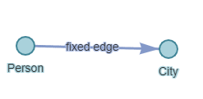
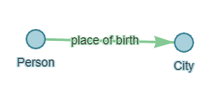
There are 2 types of edges :
Edges Variable :
  Edge whose value is variable., i.e. the query will retrieve all possible links between the two nodes.
  Properties:
    Name : Name of the edge displayed in the query result.
Edges Fixed :
  Lien possédant une valeur fixe, i.e. the query will retrieve only links of this type.
  Example: place of birth
  Properties:
    Label : Label of the data to be displayed (informative).
    URI : URI of the edge (ex : wdt:P19 pour « place of birth »).

Slide 4
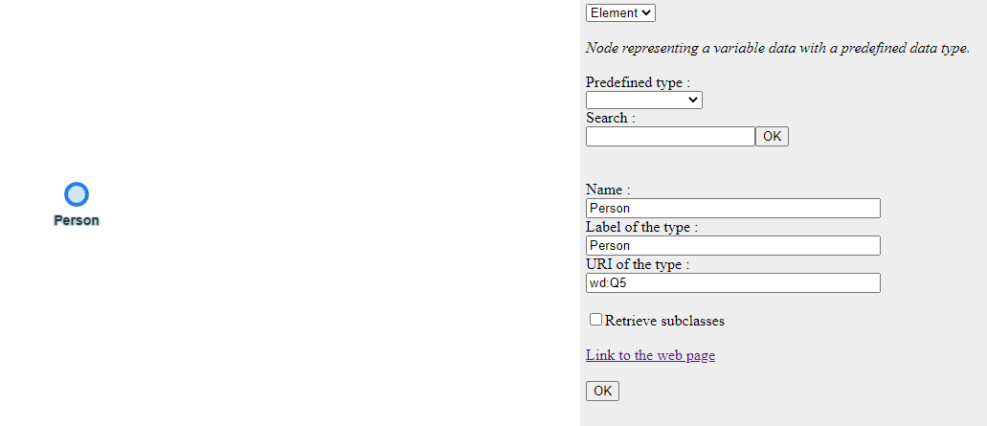
Example of a query for the recovery of persons born in Paris after 01/01/1950: :
First you need to create the node corresponding to a person, to do this use the action "Add node", place your node in the graph area, choose the predefined type "Person", then change the name property to "Person".

Slide 5
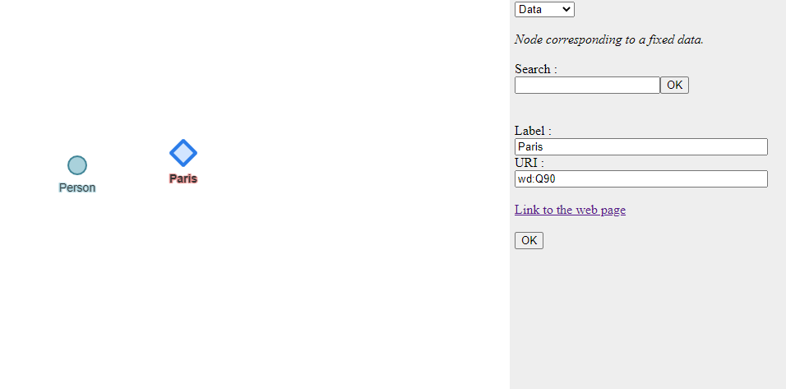
You then have to create a node corresponding to the city of Paris, to do this use the "Add node" action, place your node in the graph area, choose the "Data" type, then in the search bar type "Paris" and press OK on the button next to the search bar. Choose the result corresponding to the city of Paris (Capital of France).

Slide 6
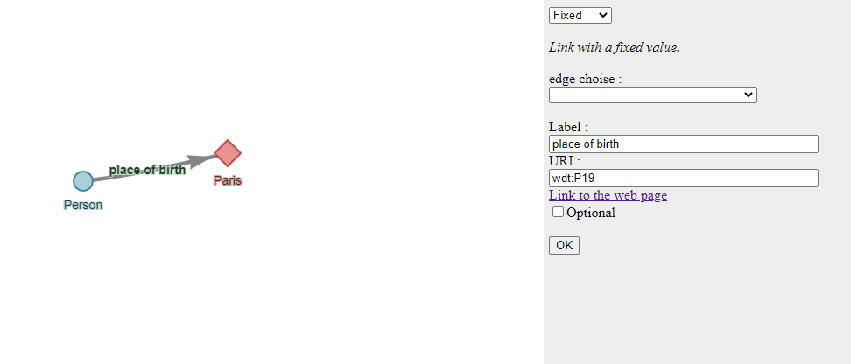
We will now create the edge between the people node and the city of Paris.
Select the person node, do the action "Add edge", click on the node of the city of Paris.
Select the edge you have just created, change the type to "Fixed" and in the "edge choice" property, choose "place of birth".

Slide 7
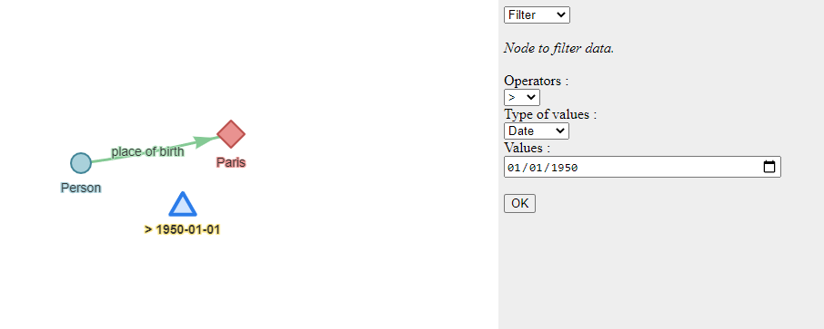
Then create the node to filter the date of birth after 01/01/1950.
To do this, create a new node of type filter :
  Choice of value type "Date".
  Choice of operator ">".
  Fill in the value with "01/01/1950".

Slide 8
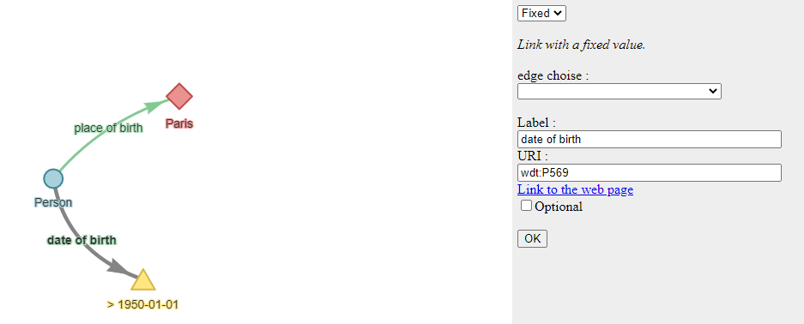
We will create the edge between the people node and the birth date filter node.
Select the person node, do the "Add edge" action, click on the filter node.
Select the link you just created. In the property "edge choice" choose "date of birth".

