Slide 1
Cyclistic 2024 Data Analysis & Key Recommendations
Unlocking Growth: Converting Casual Riders into Loyal Members
Mykyta (Nick) Shevelov
Mar 2025

Slide 2
Problem:
Cyclistic’s finance analysts have identified a potential revenue gap due to the low conversion rate of casual riders to annual members, despite the membership purchase incentive.

Slide 3
Business Task:
To analyze how annual members and casual riders use Cyclistic bikes differently and provide three data-backed recommendations to inform marketing strategies aimed at increasing the conversion of casual riders to annual members.

Slide 4
Data Sources Used in the Analysis:
Cyclistic 2024 Monthly Trip Data (January to December): This dataset includes detailed records of bike usage by both casual riders and annual members, providing insights into ride duration, rideable types, start and end locations, and user categories.
Note: Several fields within the dataset were found to have incomplete or missing values. The most affected fields include —
start_station_name
start_station_id
end_station_name
end_station_id

Slide 5
Data Cleaning & Manipulation
Duplicates — Removed duplicate rows and created a new table with the cleaned data.
Null Values — Identified none; no action needed.
Unrealistic Data — Deleted 7,596 rows with ride durations of 24 hours or longer, as they were considered unrealistic and could skew the analysis.

Slide 6
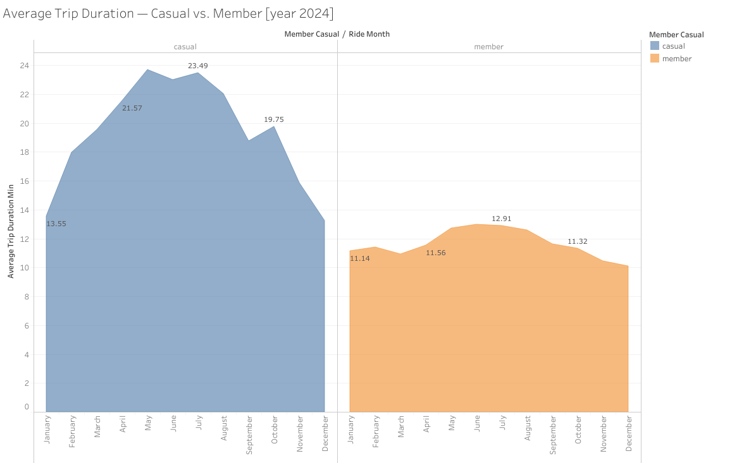
Supporting Visualizations & Key Findings
Displays Average Trip Duration (ATD) by group for each month in 2024.
Numeric labels highlight ATD at the start of each quarter.
Y-axis represents ATD in minutes; X-axis represents the months of the year.

Slide 7
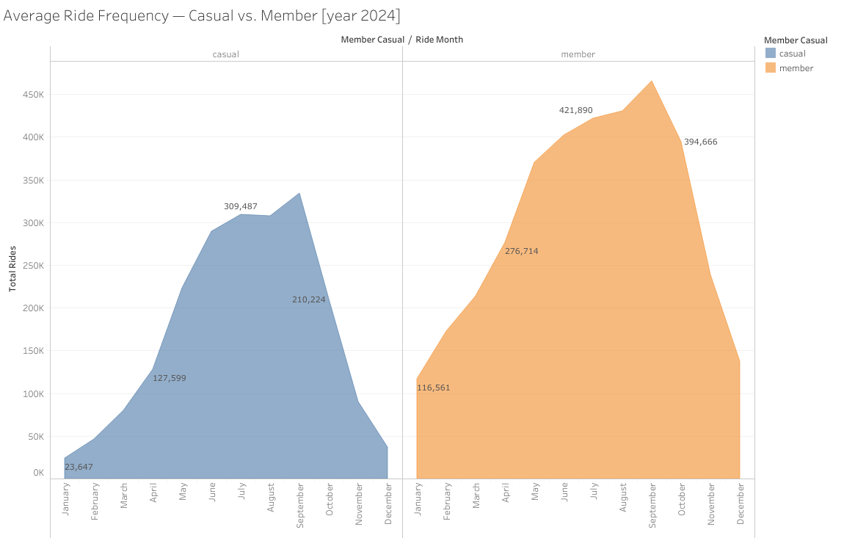
Supporting Visualizations & Key Findings
Displays Average Ride Frequency (ARF) by group for each month in 2024.
Numeric labels highlight ARF at the start of each quarter.
Y-axis represents Total Rides taken by each group; X-axis represents the months of the year.

Slide 8
Summary of Analysis
Key Metrics Analyzed: Average Trip Duration, Average Ride Frequency.
Findings: Casual riders take trips that are approximately 40% longer than members, while members ride 45% more frequently than casual riders.
Trends & Patterns:
Average Trip Duration — Increases from January to May-June, followed by a gradual decline through December for both groups.
Average Ride Frequency — Rises steadily from January to September, then declines rapidly through December, showing similar patterns across both groups.

Slide 9
Conclusion & Next Steps
Summary: The analysis reveals a clear distinction between the two groups — members take shorter, more frequent rides, while casual riders prefer longer, less frequent trips.
Next Steps: Leverage these insights to design a targeted marketing strategy aimed at converting casual riders into annual members.

Slide 10
Recommendations
Recommendation 1: Casual riders take longer trips during March-October — target promotions during these months.
Important: May not be effective during July-September (local downtrend on the chart) and is irrelevant for November-February.
Recommendation 2: March-September casual riders take the most trips — offer limited-time discounts to those taking >3 rides/month.
Important: Avoid this promotion from October to February due to lower ridership during colder months.
Recommendation 3: Improve collection of start/end location data (currently incomplete for 2024) — this will help identify high-demand routes and optimize bike station placement.

Slide 11
Thank you!
Project prepared for the Google Data Analytics Professional Certificate program “Cyclistic” case study by Mykyta (Nick) Shevelov on 2025-03-04.

