Slide 1
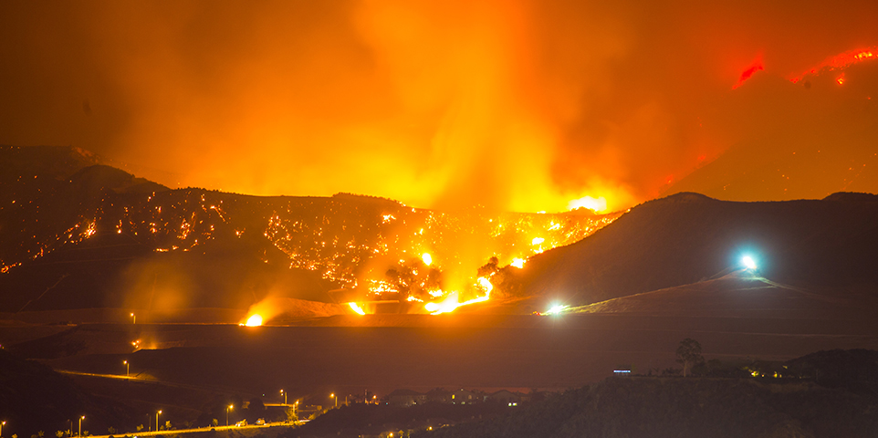
California Fire Sentiments & Costs
Team 6: Safaa, Shey, Shemelis, Shoujun

Slide 2
Background
January – November 2017, 56,186 wildfires
2017 ranked higher in number of acres burnt compared to 10 years average
October, fire in 8 counties, 23 fatalities, 245,000 acres burned, 8700 structures
October, $9 billion in insurance claims, $8.4 billion in residential claims, $790 million in commercial property, $96 million in personal and commercial auto, $110 million from other commercial lines
December was considered the worst wildfire season in the history of modern California where 96 percent of homes were estimated to be endangered by the Thomas fire!

Slide 3
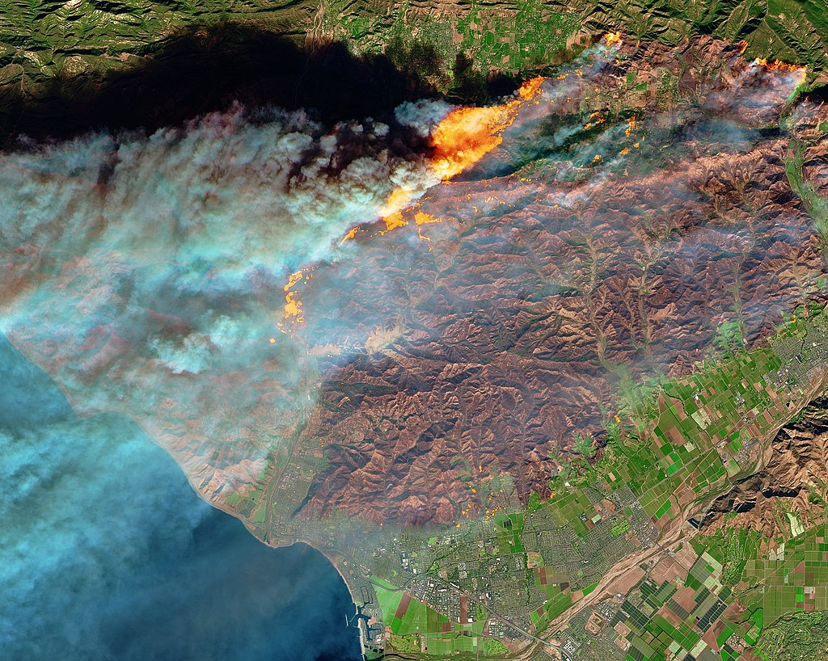
Research Goal
Use publicly available data to assess:
General sentiment of residents in the areas covered by Thomas fire and its surrounding based on their tweets
Estimate the housing damage resulting from the fire in these areas
By NASA - https://twitter.com/NASAEarth/status/938540034449276929, Public Domain, https://commons.wikimedia.org/w/index.php?curid=64739687

Slide 4
Methodology
Compare three groups:
Group 1: Cities where the fire has not been contained- San Fernando and Ojai
Group 2: Cities where the fire has been contained – Beverly Hills/Bel Air and La Crescenta/Crescenta Highlands
Group 3: Cities with no fire – Long Beach and Santa Barbara
To achieve representation, used Google maps to identify city coordinates and then select a random sample of 20 coordinates to assess sentiments of residents of those areas and residential damage costs

Slide 5
Data Sources
Several data sources were used:
Tweeter
Zillow
Census
Zip-codes.com
Google maps
Limitations:
Tweets ➔ Can only access tweets from past week (no older tweets!)
Tweets ➔ can be requested from specific areas but location cannot be stored (only linked to city)
Tweets ➔ Rate of data pull from tweeter limited and number of tweets limited
Tweets with “Thomas Fire” hashtags ➔ Avoid contamination with domestic and other fire incidents, assume that other fires such as Rye, Creek, and Skirball are under the Thomas Fire Hashtag umbrella
Zillow ➔ only provides average price of houses but not number of houses thus not sufficient to estimate loss

Slide 6
Data Management
Data exploration
Intensive review of documentation
Review of variables and data available
Data extraction
PIP Install: tweepy, census, US
Convert Json to csv
Data frames
Multiple data frames: one per data source
Data merging
Aggregation at the city level for each of the 6 cities
Merging data in preparation for analysis
Data cleaning
Drop records with missing values
Filter data to keep only cases with targeted zip codes/cities
Create column names

Slide 7
Analysis
Sentiment analysis per city based on twitter data
Damage cost estimate: average value of residential housing * number of residential housing
Correlation between socio-economic levels, sentiments, and potential losses

Slide 8
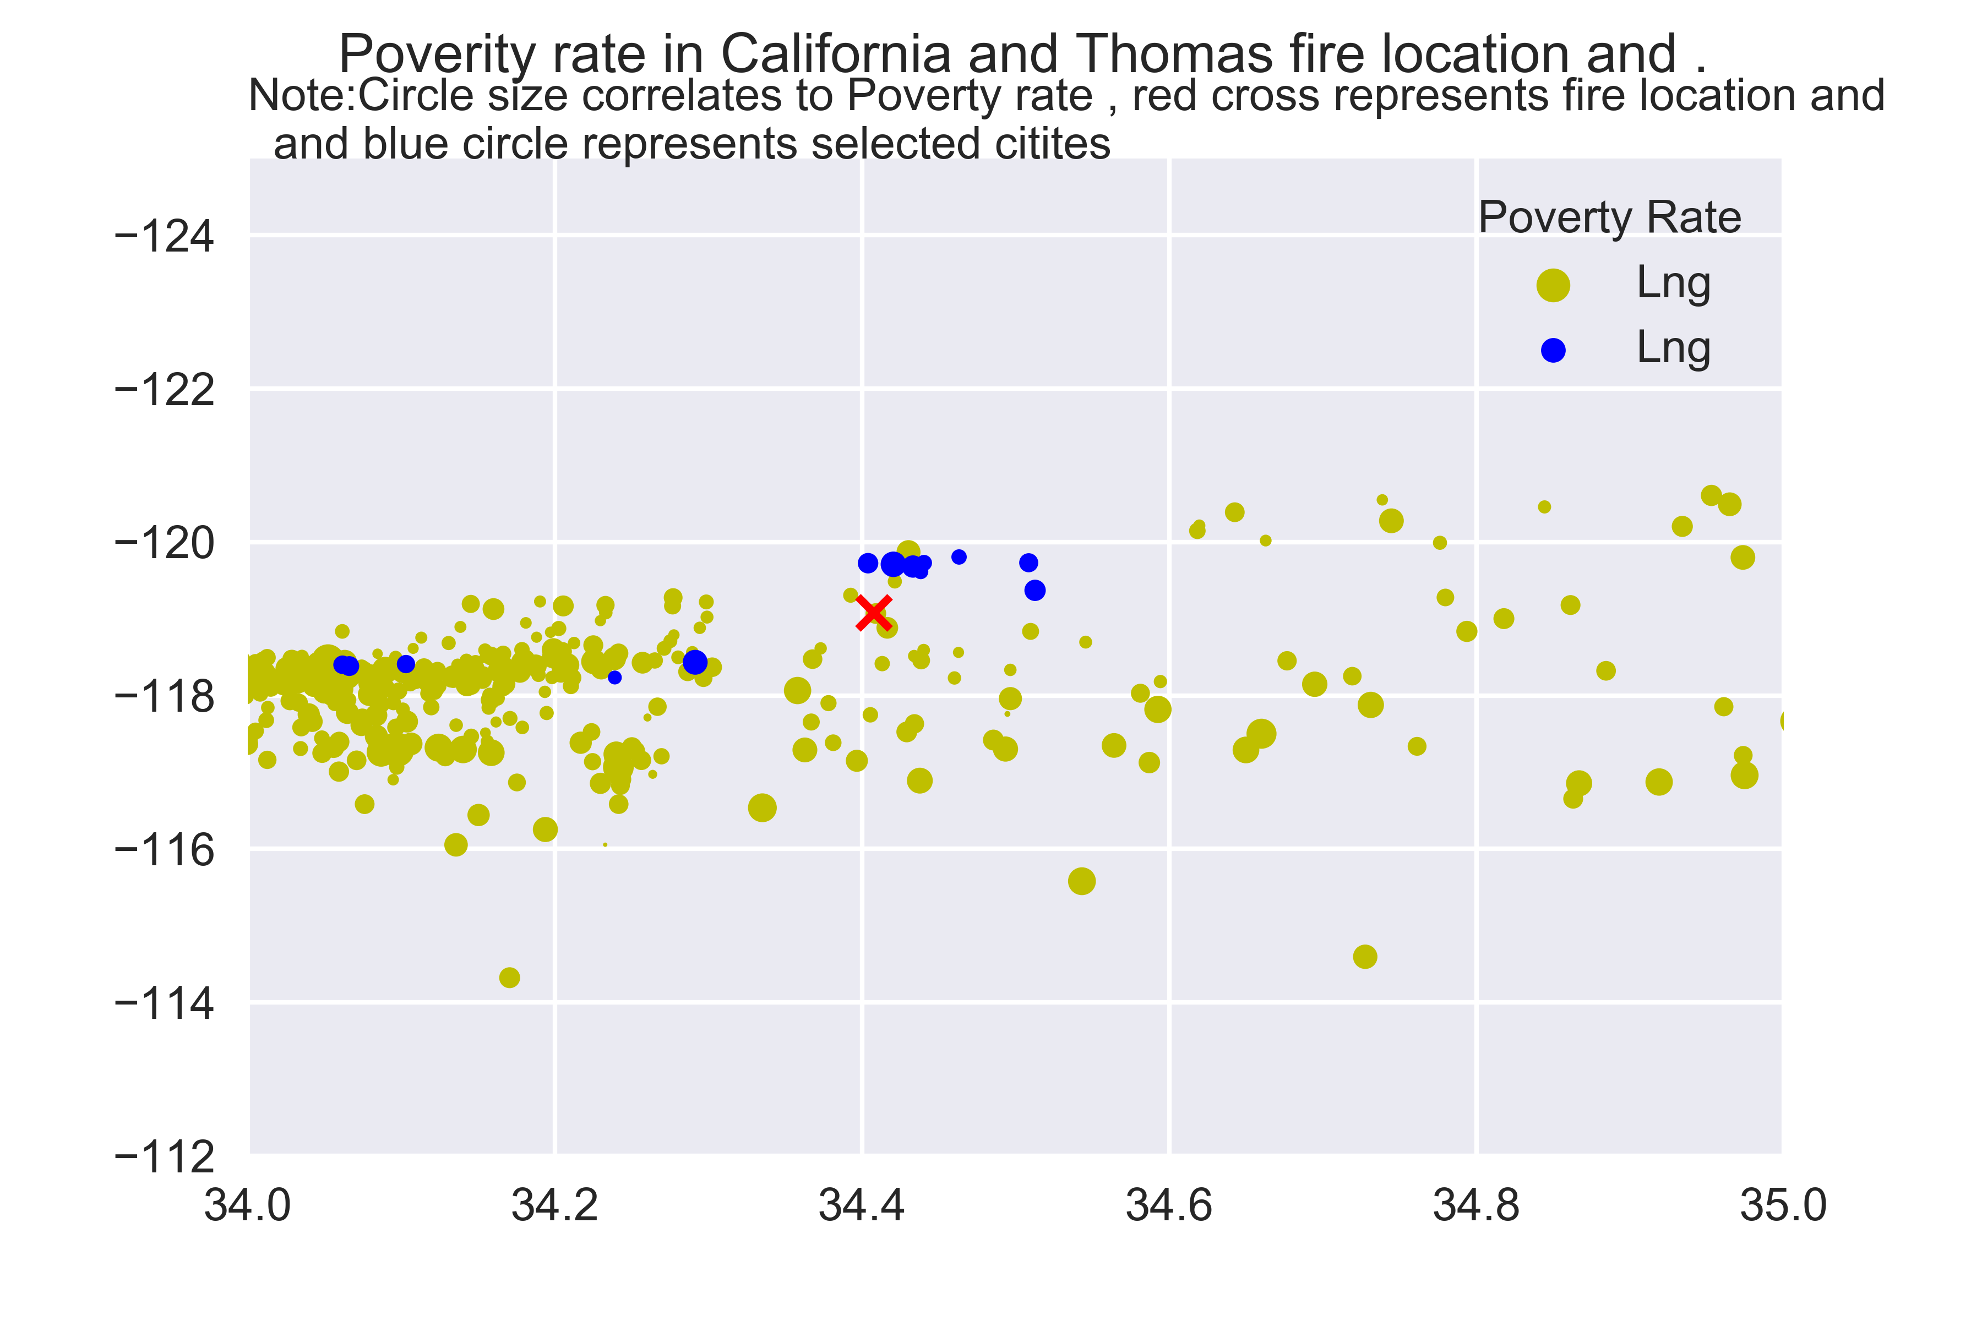
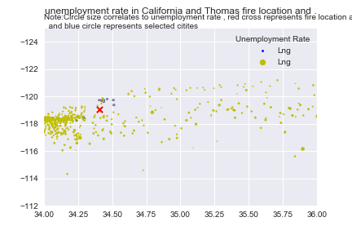
Results
Notes:
Selected cities poverty and unemployment relative to the other cities in California

Slide 9
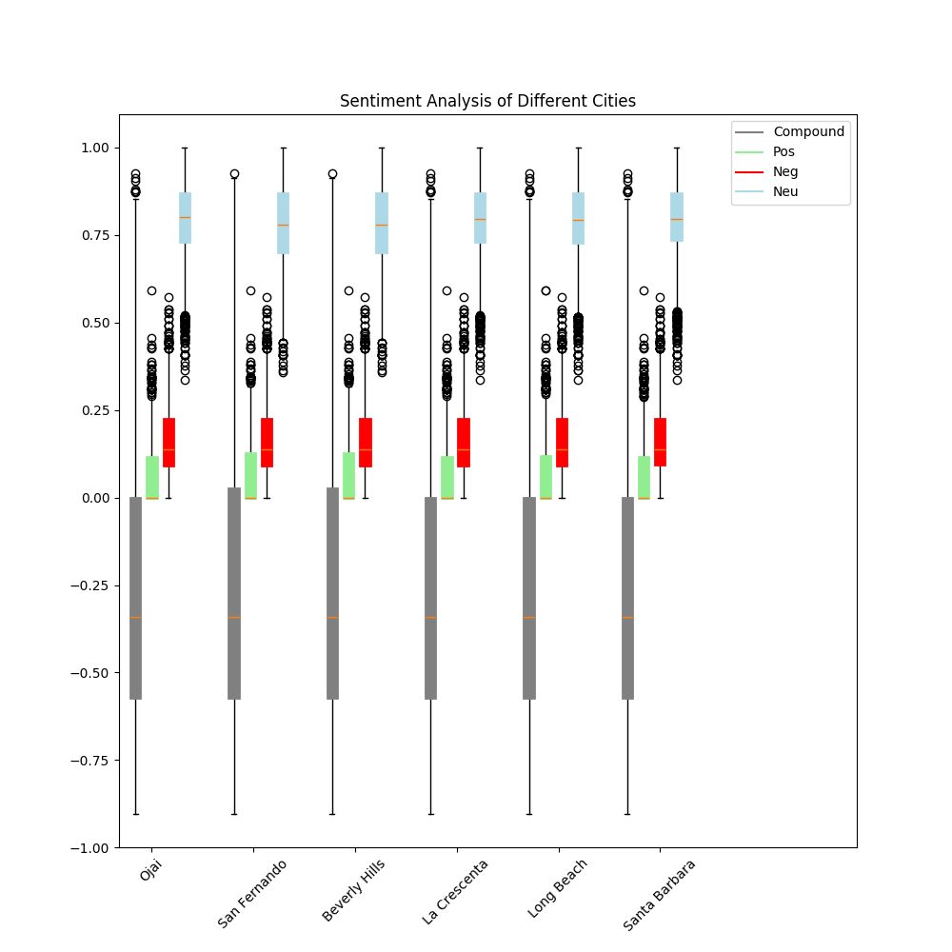
Results
Notes:
Sentiment is negative with no obvious difference between the three groups of cities

Slide 10
Results
Group | City | Total value of residential Housing Units ($)
Fire not contained | San Fernando | 2,949,494,400
 | Ojai | 5,125,423,500
Fire Contained | Beverly Hills/Bel Air | 10,558,125,200
 | La Crescenta/Crescenta | 6,974,147,600
No fire | Long Beach | 7,416.006,700
 | Santa Barbara | 8,188,358,160

Slide 11
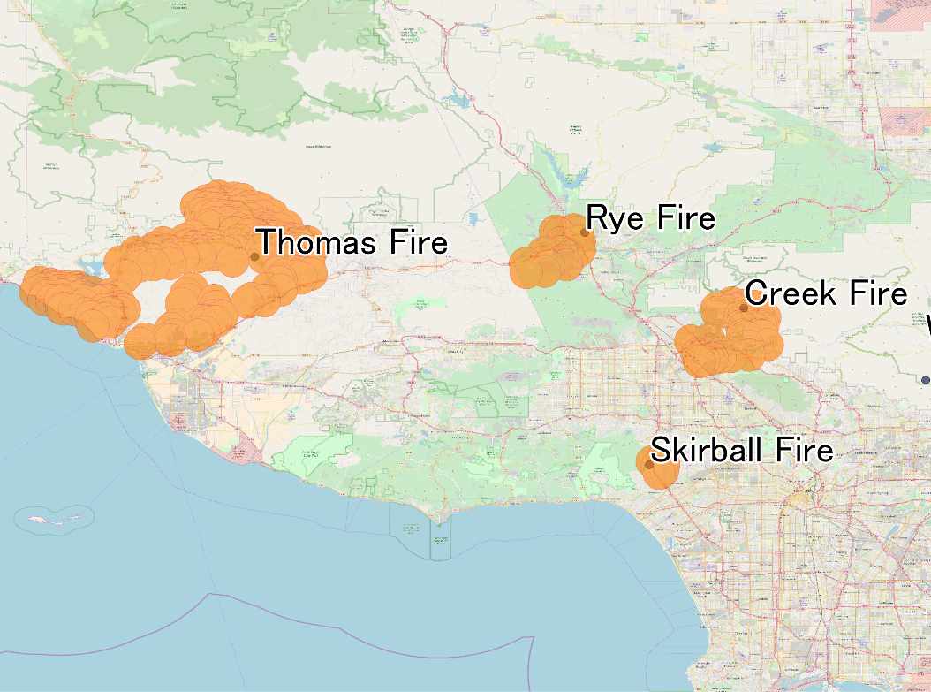
Thank you!

