Slide 1
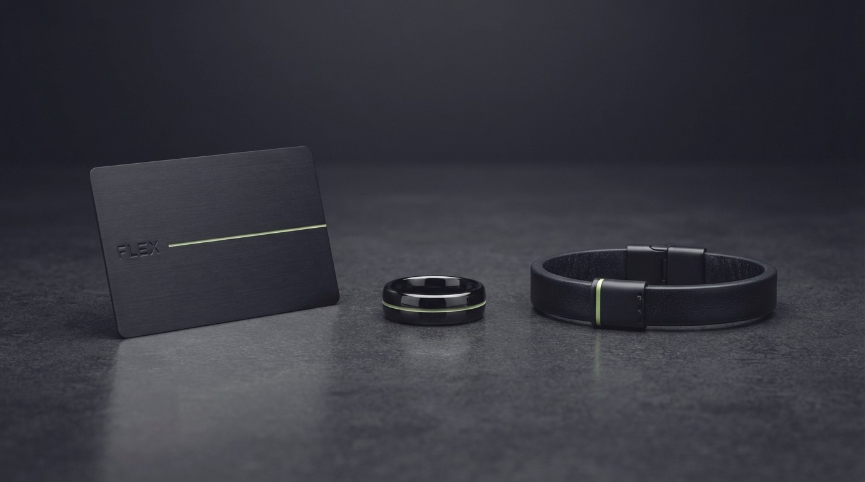
ICT WEEK UZBEKISTAN · 2026 · PRE-SEED
flex
Your number is your identity.
A unique number and an NFC object that opens it. One tap — nothing to install.
Notes:
1/20 · [3-MINUTE CUT]
Good afternoon. I am Javohir, founder of FLEX. We give a person or a business a permanent unique number, and we sell the NFC object that opens it. In three minutes I will tell you what we are building and why it works.

Slide 2








THE PROBLEM
Information still travels
on paper and out loud.
Paper details
No number in the windscreen
A pet goes missing
Keys and things go missing
Company bank details are written out by hand. One wrong digit and the payment lands in the wrong account.
A car is blocking the way. There is no number behind the glass, or there is one, on a scrap of paper.
Nothing on the collar. Whoever finds the animal has no way to reach its owner.
A bag, a key, a suitcase — found, and still it never gets back to anyone.
Card numbers across a counter
Nothing to exchange at a meeting
A small brand is hard to remember
Sending a CV is awkward
The card number is read out loud or written down. That is where both the errors and the risk are.
The cards run out, typing a number takes too long, and afterwards nobody can find anybody.
The name never stays on the customer's phone. Every time you start the introduction again.
A PDF goes out, the link is lost, versions drift. The employer opens the oldest one.
flex.com.uz
1
Notes:
2/20 · [3-MINUTE CUT]
Eight situations, all from one cause: paper is printed once and life keeps changing. The number on the card changes, the price on the menu goes up, and there is no number behind the windscreen at all. We did not invent this list — customers gave us every line of it.

Slide 3
One tap —
and the page opens.
Nothing to install. Nothing to sign up for. The guest taps their own phone, and that is the whole of it.
Notes:
3/20
The answer is one mechanism. A tap, and the page opens. Nothing to install, nothing to sign up for, nothing to download. That sentence explains the whole product.

Slide 4
THE ANSWER
One number, one object,
eight situations.
Every one of them is solved the same way: the phone touches an NFC object or reads a QR code, and the page for that situation opens. Nothing is installed.
Paper details
The details are on the page, with a copy button, spelled right
No number in the windscreen
Car tag: a tap reaches you by call or message
A pet goes missing
Collar tag: whoever finds it opens the owner's page
Keys and things
Object tag: what is found gets back to whom it belongs
Card numbers
A payment page through Payme — no number is read out
Exchanging at a meeting
One tap and the contact is saved to the phone
Building a brand
The page is yours and it stays on the customer's phone
Sending a CV
One link, always the latest version
flex.com.uz
3
Notes:
4/20 · [3-MINUTE CUT]
The eight problems on the left, the answer on the right. Note that none of these is something we intend to build — all of it works today. We are not listing problems and offering one fix; one mechanism works in eight places.

Slide 5
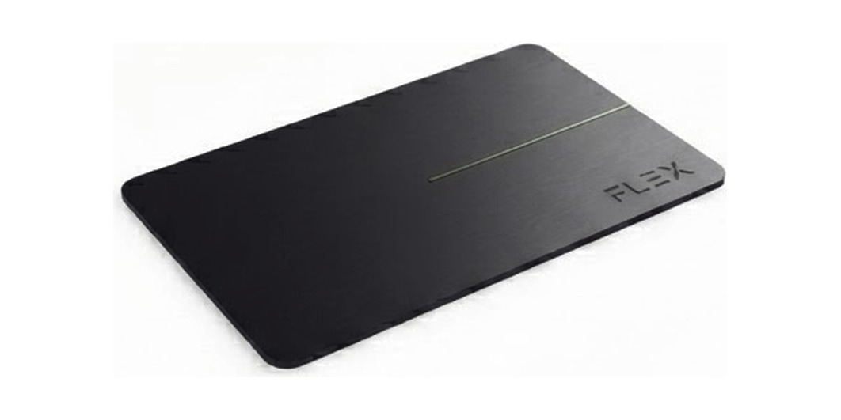
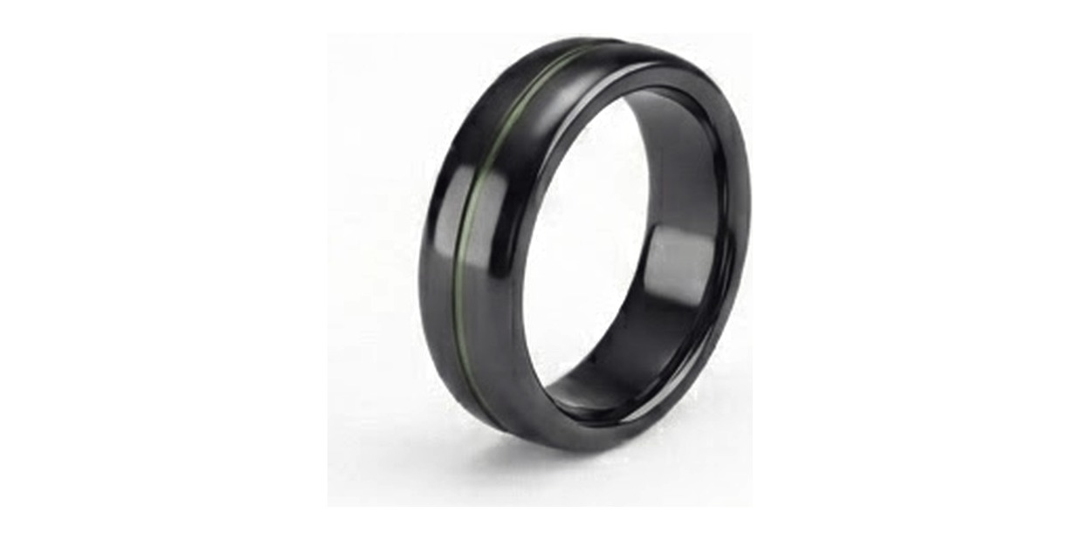
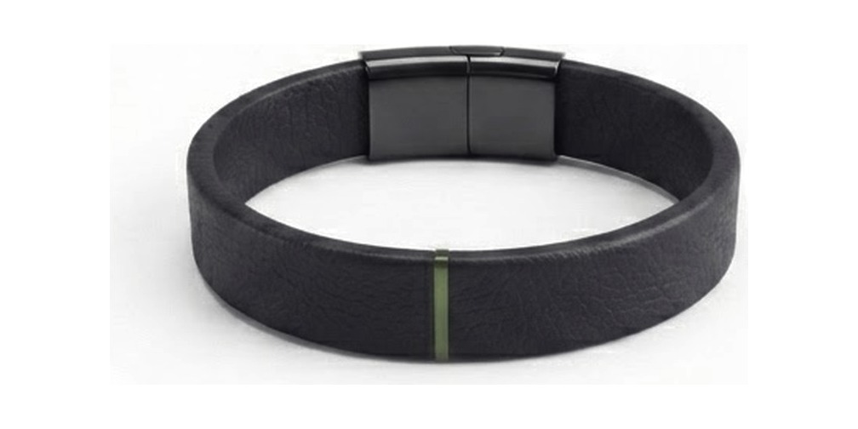
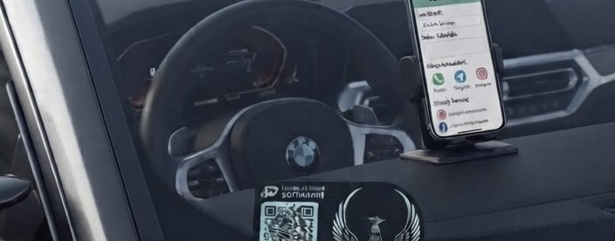
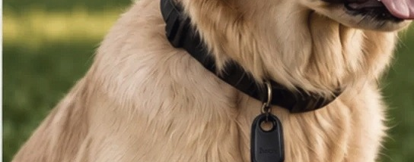
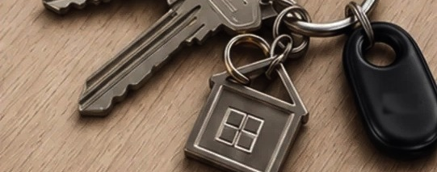
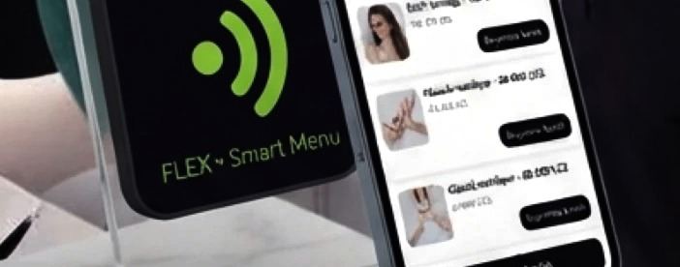
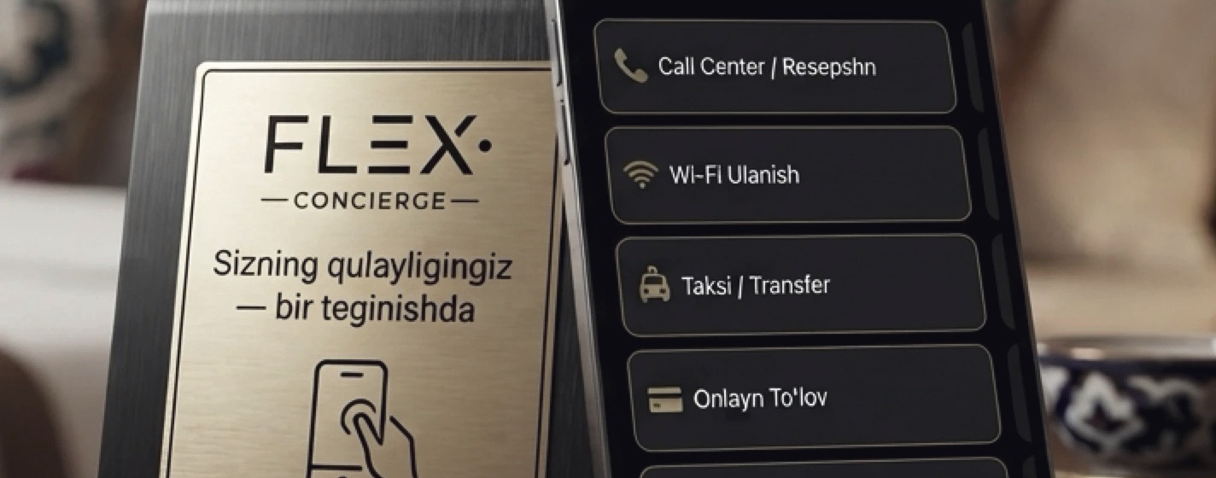
OUR DEVICES
Something you can hold.
Card
Ring
Bracelet
Car card
In a pocket, in a wallet
On a hand, always with you
On a wrist, for events
On the windscreen
200,000 UZS
350,000 UZS
250,000 UZS
On request
Pet tag
Object tag
Table unit
Concierge plate
On the collar — found means reachable
On keys, a bag, a suitcase
On a cafe, salon or clinic table
In a hotel room
On request
On request
In the venue plan
In the venue plan
flex.com.uz
4
Notes:
5/20
This is the part you can hold. Eight form factors, one system. Card, ring and bracelet are a one-off sale. The four below go into venues and come with the subscription. Prices are on the slide.

Slide 6







WHAT IS DIFFERENT
This is not an ordinary NFC card.
There are plenty of NFC cards. The difference is not the card — it is what stands behind it.
The number is yours
The page changes, the object does not
Statistics
Three languages
A unique number in the AAA000 format. A low serial cannot be reproduced — nobody else can print it.
New job, new number, new company: you edit the page. The card stays the card.
How many times it opened, which link was pressed, on which day. A paper card never tells you.
Uzbek, Russian, English. The guest reads it in their own.
NFC and QR together
Local payment
The venue half as well
The data is yours
A phone without NFC still opens it. It works from a printed code.
Payme is connected: subscriptions, invoices, expiry reminders.
Menu, table tags, calling a waiter, a counter screen — one system.
Delete the page whenever you like, or move it to another object.
flex.com.uz
5
Notes:
6/20 · [3-MINUTE CUT]
The question we get most: everybody has an NFC card, what is different. Not the card. The number belongs to the customer, the page changes whenever they like, there are statistics, three languages, Payme is connected — and above all there is the venue half. The card is a piece of metal; the rest is the platform.

Slide 7
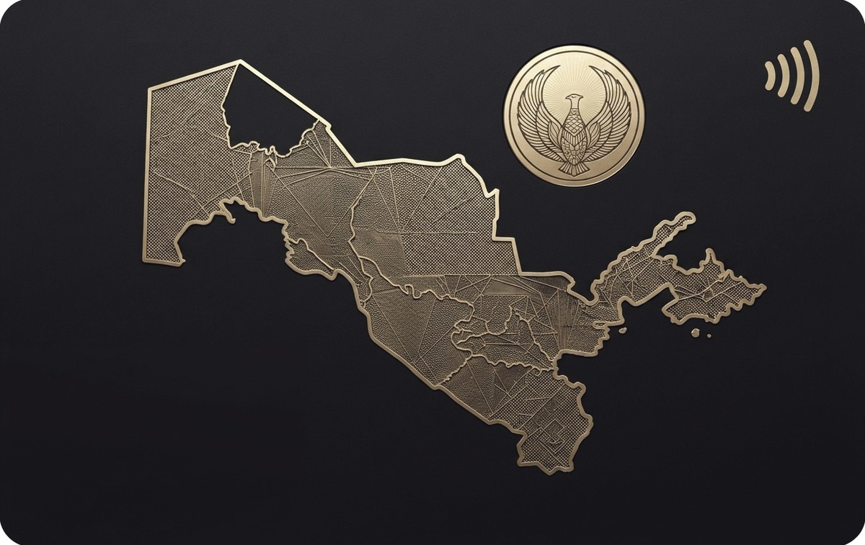



DESIGN
One number, many faces.
The owner picks the card design, and every one of them is drawn by us rather than borrowed. A low serial number cannot be reproduced at all — which is the one thing on the card that is genuinely scarce.
Xarita
Suzani
Rahbar
DevOps
flex.com.uz
6
Notes:
7/20
We drew these designs ourselves. A competitor prints a car marque or a cartoon character — that infringes a registered mark, and anyone with the same printer can copy it. A low serial number cannot be copied at all. Buyers can also describe a design in a sentence and have it drawn.

Slide 8
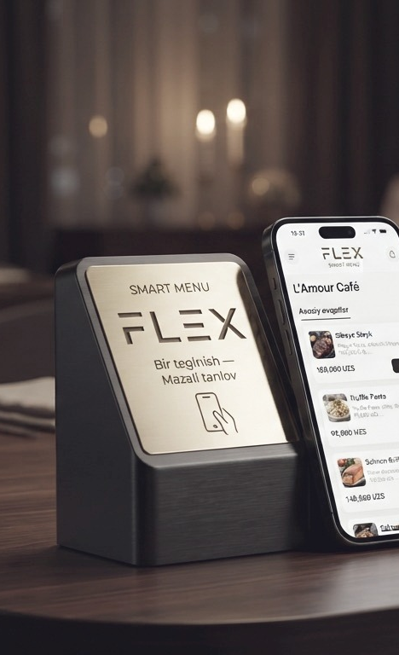
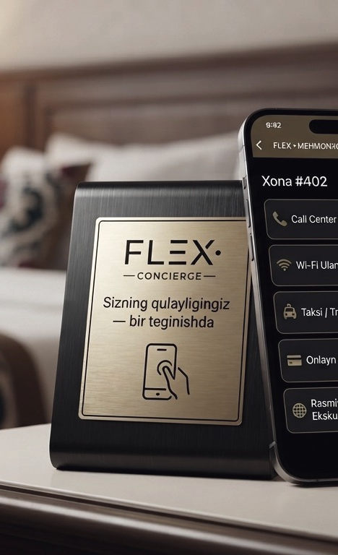
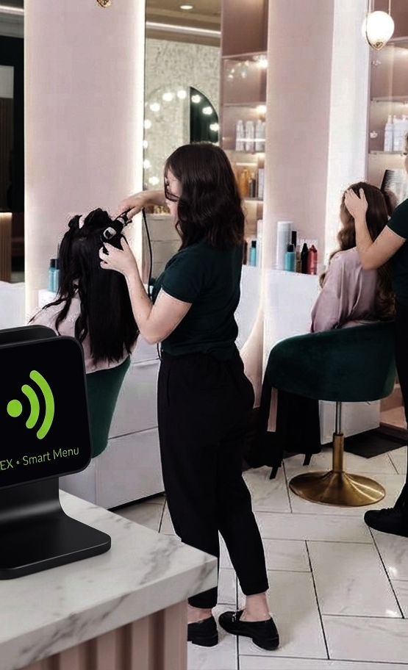
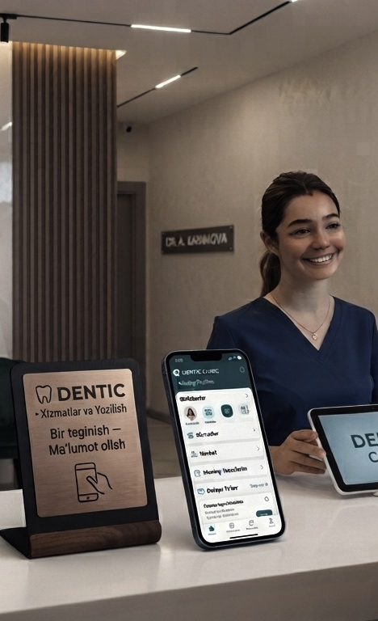



OUR MARKET
Everywhere somebody is served.
Cafes and restaurants
Hotels
Shops and salons
Clinics and services
Menu, table tags, calling a waiter, the bill
Service list, room tags, housekeeping requests
Prices, payment details, calling for help
Services, prices, booking a slot
Notes:
8/20
The rooms we sell into: cafes, hotels, shops and salons, clinics. These are not mockups — every one of them is installed hardware.

Slide 9




MARKET SIZE
Market size, in soum.
29,582
TAM
116,900 venues
catering businesses · 01.08.2026
209bn UZS / year
Every catering, retail and accommodation business in Uzbekistan, at the lowest tariff
86,180
retail businesses · 01.01.2026
SAM
29,000 venues
51.9bn UZS / year
Tashkent and the regional capitals — what we can reach today
1,156
hotels and accommodation · 2021
SOM
1,000 venues
4.98m
1.79bn UZS / year
The three-year target. It is 0.9% of the whole market
vehicles owned by individuals · 01.07.2026
Source: State Committee on Statistics of the Republic of Uzbekistan (stat.uz). Subscription figures use the lowest tariff, 149,000 UZS a month.
flex.com.uz
8
Notes:
9/20 · [3-MINUTE CUT]
The figures are the state statistics committee's, with their dates, so you can check them from where you are sitting. 116,900 venues in total. At the lowest tariff that is 209 billion soum a year. Our three-year target is 0.9% of it. We are not talking about owning a market — we are talking about a thousand venues.

Slide 10
COMPETITION
The competitive picture.
PERSONAL NUMBER
VENUE HALF
LOCAL PAYMENT
STATISTICS
THREE LANGUAGES
flex
Yes · AAA000
Yes
Yes · Payme
Yes
Yes
UNQX
Yes · three letters, three digits
No
Not known
Not known
Not known
Popl, V1CE, Linq
Yes · a link
No
No
Yes
Partly
QR menu services
No
Menu only
Partly
Partly
Yes
A paper card
No
No
No
No
No
UNQX is live in the Fergana Valley with personal profiles. Nobody local sells the venue half: menu, table requests, counter screen and a monthly report in one system.
flex.com.uz
9
Notes:
10/20
Look at the row that matters: the venue half. UNQX sells a personal card and stops there. Popl and V1CE are international, but there is no Uzbek and no invoice. Nobody local sells the venue side. They sell once; we get paid every month.

Slide 11

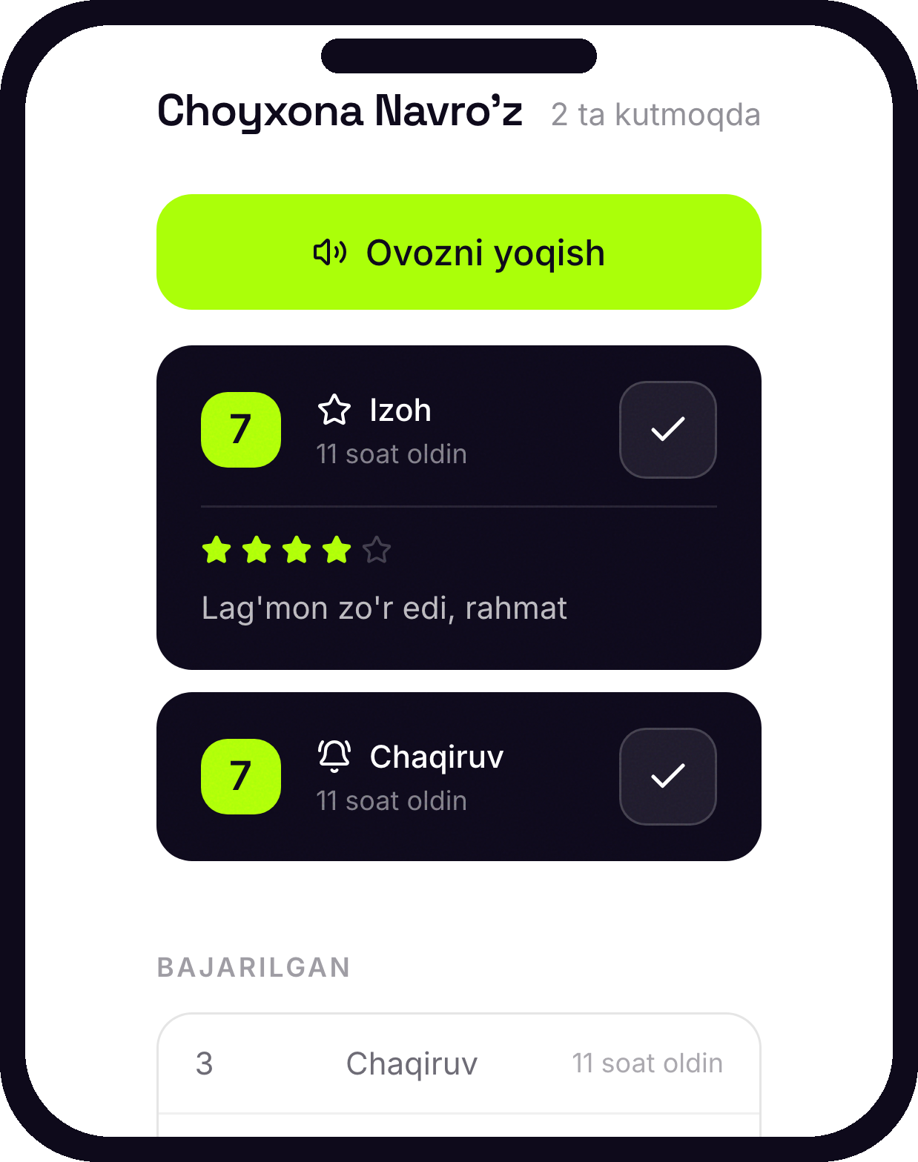
HOW IT WORKS
The half a printed menu cannot do.
1
Every table has its own QR code and its own NFC tag
2
The guest taps it — the menu opens in their language
3
One tap: a waiter, the bill, or a review
4
It lands on the phone by the till with the table number, and it rings
5
Nobody signs in — the phone stays on one link
flex.com.uz
10
Notes:
11/20
How a venue works. Every table has its own code, the guest taps it, and the request lands at the till with the table number and a sound. The waiter is not scanning the room for a raised hand — the screen says which table.

Slide 12
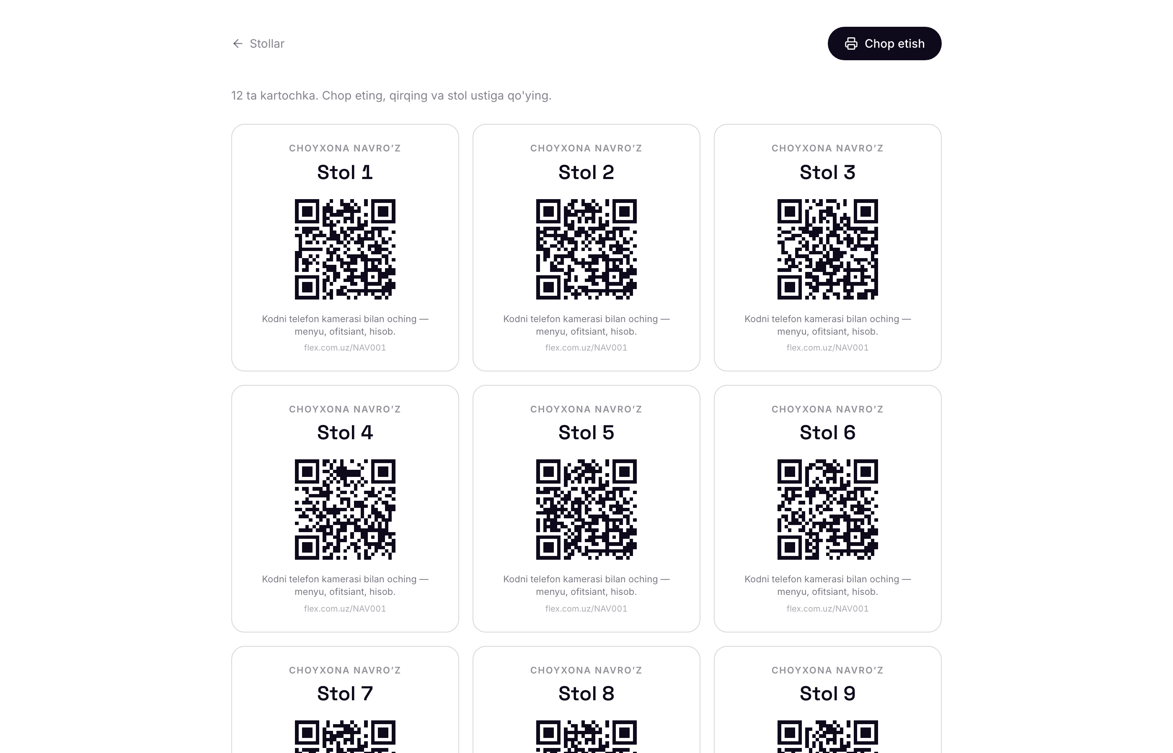





WHAT A VENUE RECEIVES
Printed on Monday, answering by Tuesday.
A QR and NFC tag per table
A sheet ready to print and cut
A counter screen with sound
A monthly report
Uzbek, Russian, English
The owner types the tables, prints the sheet and puts a card on each one. Every code carries its own table number.
flex.com.uz
11
Notes:
12/20
That is the whole installation. The owner types the tables, prints the sheet, and puts one card on each table. No engineer visits. Printed on Monday, answering by Tuesday.

Slide 13

BUSINESS MODEL
A number once.
A venue every month.
Personal number
from 100,000 UZS
Priced by rarity · paid once
How they pay
Device
200,000 – 350,000
Card, ring or bracelet · paid once
Individuals pay by card through Payme. Venues and companies pay by invoice and bank transfer, which is how a business here actually pays.
Venue, up to 15 points
149,000 / mo
A cafe with twelve tables
Venue, up to 40 points
299,000 / mo
A hotel with thirty rooms
flex.com.uz
12
Notes:
13/20
Two kinds of money. The number and the object are one-off. The venue is monthly. Companies pay by invoice, because that is how business pays here; offer a card payment and the accountant refuses.

Slide 14
THE ARITHMETIC
Recurring revenue, at the smallest band.
100 VENUES
500 VENUES
1,000 VENUES
14.9M
74.5M
149M
a month · ≈ 179M UZS a year
a month · ≈ 894M UZS a year
a month · ≈ 1.79B UZS a year
At the entry band of 149,000 UZS and nothing above it — a hotel or a larger restaurant pays twice that. Devices and personal numbers are not counted here at all. These are venue counts, not a market size.
flex.com.uz
13
Notes:
14/20 · [3-MINUTE CUT]
Simple arithmetic. A thousand venues at the lowest tariff is 149 million soum a month. That is the lowest tariff — a hotel or a larger restaurant pays twice that. Hardware and personal numbers are not counted here.

Slide 15




WHO WE ARE
This is not a first attempt.
IT Park resident
Accelerators
Public figures
Official status, with its tax and export regime.
We have been through several accelerator programmes.
Our NFC cards are carried by well-known people.
For cars
B2B sales
Manufacturers
A car-tag series has been manufactured and sold.
We have sold NFC hardware, sites and apps to cafes, shops, clothing stores and clinics.
We work directly with the firms that make the hardware.
flex.com.uz
14
Notes:
15/20
This is not a first attempt. We are an IT Park resident, we have been through accelerators, and we have sold hardware into cafes, shops, clothing stores and clinics. We deal directly with the manufacturers, which means we control what the hardware costs us.

Slide 16
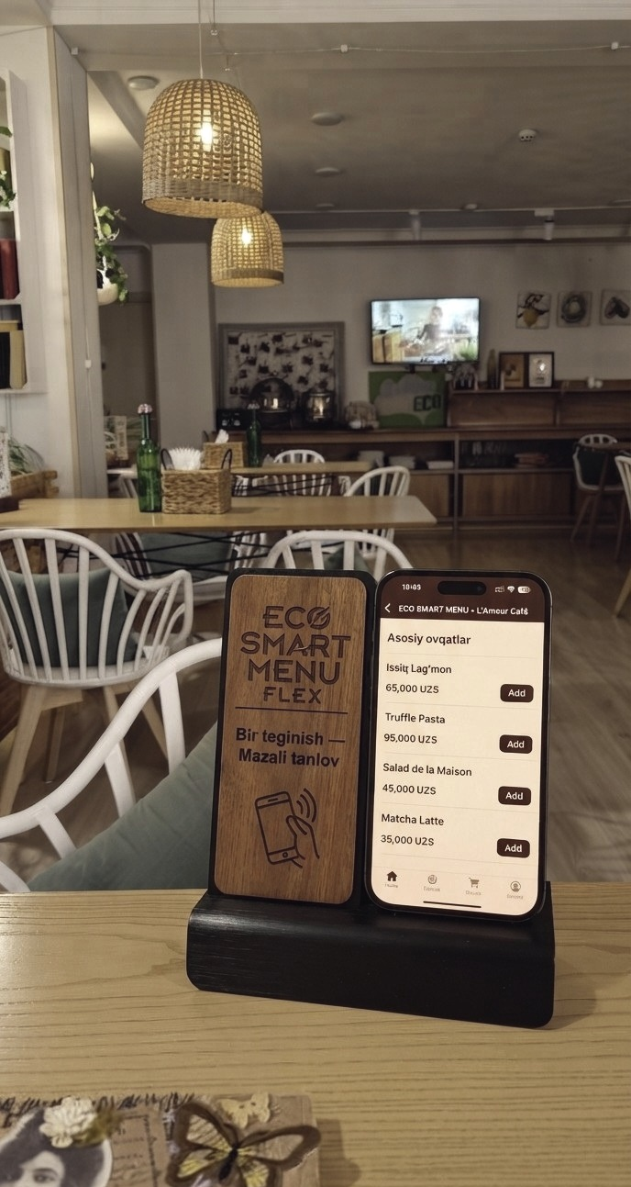

WHERE IT STANDS
Built, deployed, and running.
·
Personal profiles, devices, QR codes and analytics
·
Venue menu and service list — in three languages
·
A separate QR and NFC tag per table, with a printable sheet
Open to anyone, today
·
Guest requests: waiter, bill, housekeeping, reviews
flex.com.uz/NAV001 is a real venue. Open it on your phone, read the menu, call a waiter, and watch it arrive at the till.
·
Counter screen with sound, and a screen that stays awake
·
Monthly report: response time, busiest tables and hours
·
Subscriptions, invoices and expiry reminders
·
Telegram sign-in · Payme integrated
IN A REAL VENUE, TODAY
flex.com.uz
15
Notes:
16/20 · [3-MINUTE CUT]
This is the only real photograph in the deck — the rest are renders. A real cafe, a real table, hardware that is working. The list on the left is what runs today, not what we plan.

Slide 17
ROADMAP
The next eighteen months.
2026 · Q4
2027 · Q1
2027 · Q2
2027 · Q3–Q4
Go live
Widen the product
Scale the selling
Across the border
·
flex.com.uz and Payme certification
·
Mobile app, with the partner team
·
500 venues
·
1,000 venues — the SOM target
·
First 100 venues: cafes, salons, clinics
·
Pet tags and the CV page
·
A dealer network in the regional capitals
·
A pilot in Kazakhstan and Kyrgyzstan
·
Car tags and object tags on sale
·
Invoicing and the monthly report automated
·
Volume agreements with manufacturers
·
Raise the seed round
Dates run from the close of the round.
flex.com.uz
16
Notes:
17/20
Eighteen months. First quarter: Payme certification and a hundred venues. Then widening the product, then a dealer network, then the neighbouring markets. The dates run from the close of the round.

Slide 18


WHY NOW
Three things are true at once.
The phones are ready
Service is the battleground
The rails exist
Every phone sold in recent years reads NFC, and after 2020 a QR code on a table needs no explaining to anyone.
Cafes and hotels no longer compete on price alone. How fast somebody answers a table is a thing guests notice.
Payme and bank transfer make a monthly subscription collectable from a business — what turns this from a gadget into revenue.
flex.com.uz
17
Notes:
18/20
Why now. The phones are ready — NFC is in all of them and nobody needs QR explained. Cafes compete on service, not only price. And the payment rails exist: collecting a monthly subscription from a business is now possible.

Slide 19
TEAM
JA
Javohir Abrorov
MC LEGAL
Who is building it.
Founder · AI engineer
Three people. Product, web and sales, all in-house. The first version was built without an outside team, and it is running today.
ZA
Zoirjon Abduvohidov
Tompson School
Web developer
AA
Abdujabbor Ahmadjonov
Canada
Product manager
flex.com.uz
18
Notes:
19/20
Three people. Product, web and sales, all in-house. The first version was built without an outside team, and it is running today.

Slide 20
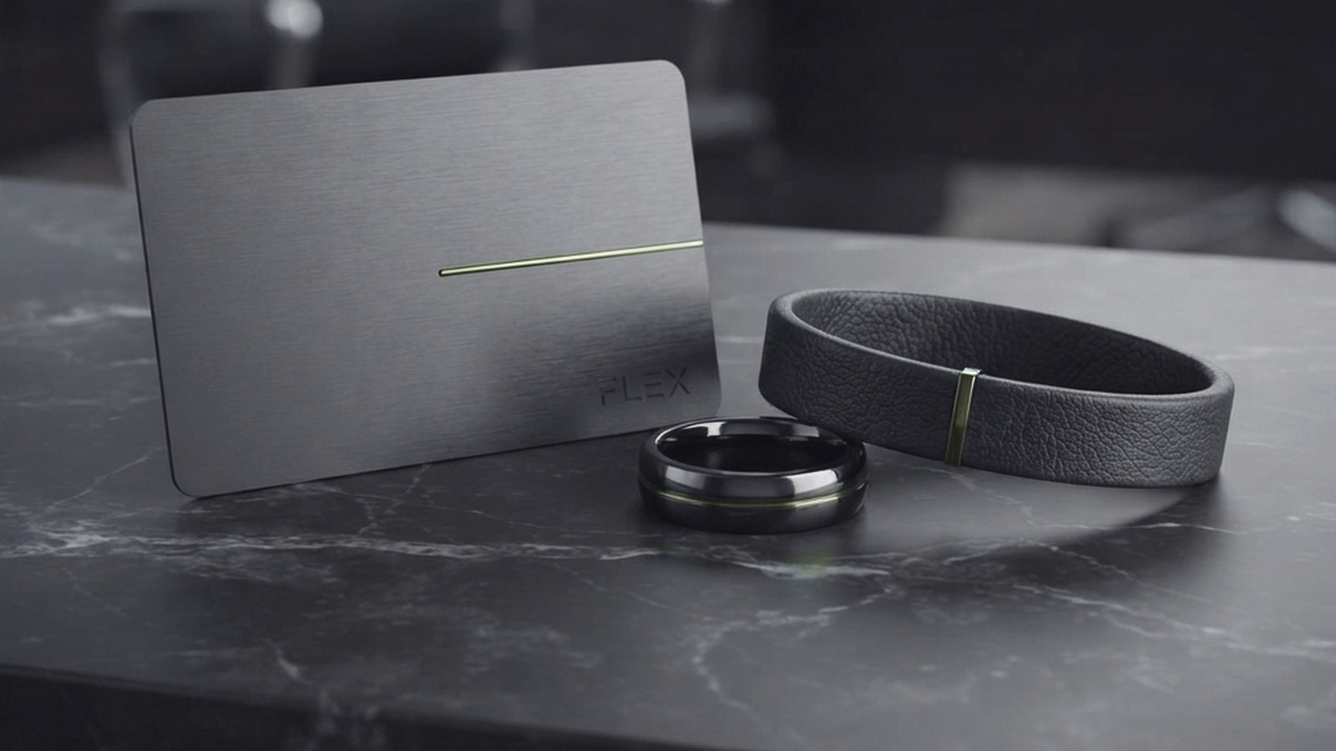
THE ASK
$50,000 – $100,000
Pre-seed · the product is built and running
40%
Device stock: cards, rings, bracelets and table tags
Contact
35%
Sales and installation for the first 100 venues
Javohir Abrorov
sheyx2772@gmail.com
+998 97 724 79 99
flex.com.uz
15%
Team
10%
Marketing and events
Notes:
20/20 · [3-MINUTE CUT]
Fifty to a hundred thousand dollars, pre-seed. More than half goes to hardware stock and installing the first hundred venues — that is to selling, not to building. The product is already built. Thank you.

