Slide 1
第六章 回归分析
统计建模与R软件

Slide 2
R语言线性模型相关函数

Slide 3
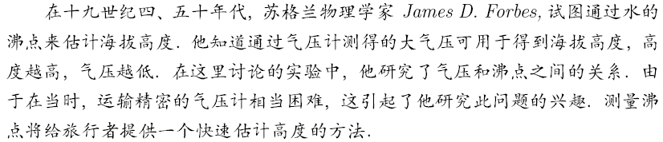
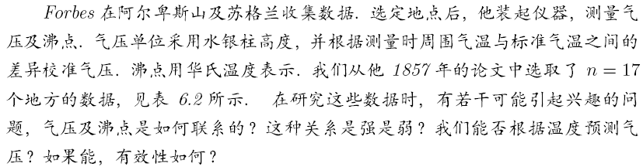
6.1.7 计算实例
194.5 | 20.79 | 1.3179 | 131.79
194.3 | 20.79 | 1.3179 | 131.79
197.9 | 22.4 | 1.3502 | 135.02
198.4 | 22.67 | 1.3555 | 135.55
199.4 | 23.15 | 1.3646 | 136.46
199.9 | 23.35 | 1.3683 | 136.83
200.9 | 23.89 | 1.3782 | 137.82
201.1 | 23.99 | 1.38 | 138
201.4 | 24.02 | 1.3806 | 138.06
201.3 | 24.01 | 1.3805 | 138.05
203.6 | 25.14 | 1.4004 | 140.04
204.6 | 26.57 | 1.4244 | 142.44
209.5 | 28.49 | 1.4547 | 145.47
208.6 | 27.76 | 1.4434 | 144.34
210.7 | 29.04 | 1.463 | 146.3
211.9 | 29.88 | 1.4754 | 147.54
212.2 | 30.06 | 1.478 | 147.8
数据取扩大100倍再取对数，是为避免小数据对大数据的扰动

Slide 4
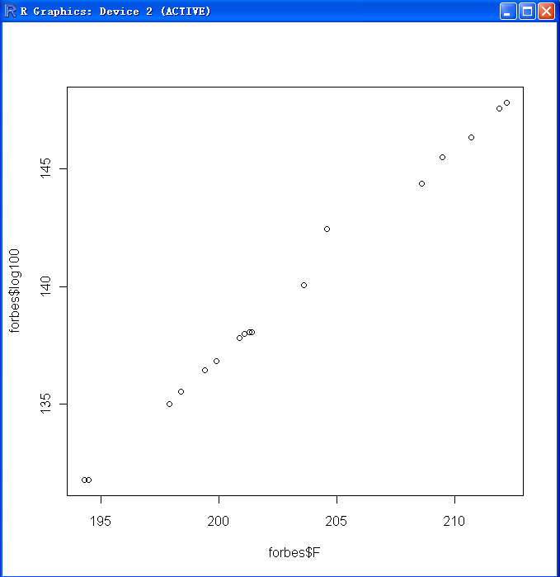
求解：
x=matrix(c(194.5,20.79,1.3179,131.79,194.3,20.79,1.3179,131.79,197.9,22.40,1.3502,135.02,198.4,22.67,1.3555,135.55,199.4,23.15,1.3646,136.46,199.9,23.35,1.3683,136.83,200.9,23.89,1.3782,137.82,201.1,23.99,1.3800,138.00,201.4,24.02,1.3806,138.06,201.3,24.01,1.3805,138.05,203.6,25.14,1.4004,140.04,204.6,26.57,1.4244,142.44,209.5,28.49,1.4547,145.47,208.6,27.76,1.4434,144.34,210.7,29.04,1.4630,146.30,211.9,29.88,1.4754,147.54,212.2,30.06,1.4780,147.80),ncol=4,byrow=T,dimnames=list(1:17,c('F','h','log','log100')))
#以上为数据录入工作
forbes=as.data.frame(x)
plot(forbes$F,forbes$log100)
lm.sol=lm(log100~F,data=forbes)
summary(lm.sol)

Slide 5
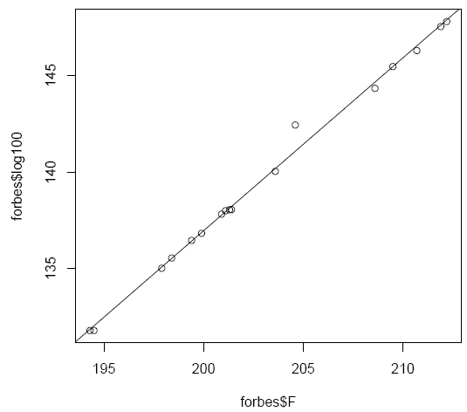
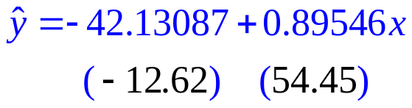
结果：
Call:
lm(formula = log100 ~ F, data = forbes)
Residuals:
Min 1Q Median 3Q Max
-0.32261 -0.14530 -0.06750 0.02111 1.35924
Coefficients:
Estimate Std. Error t value Pr(>|t|)
(Intercept) -42.13087 3.33895 -12.62 2.17e-09 ***
F 0.89546 0.01645 54.45 < 2e-16 ***
---
Signif. codes: 0 ‘***’ 0.001 ‘**’ 0.01 ‘*’ 0.05 ‘.’ 0.1 ‘ ’ 1
Residual standard error: 0.3789 on 15 degrees of freedom
Multiple R-squared: 0.995, Adjusted R-squared: 0.9946
F-statistic: 2965 on 1 and 15 DF, p-value: < 2.2e-16

Slide 6
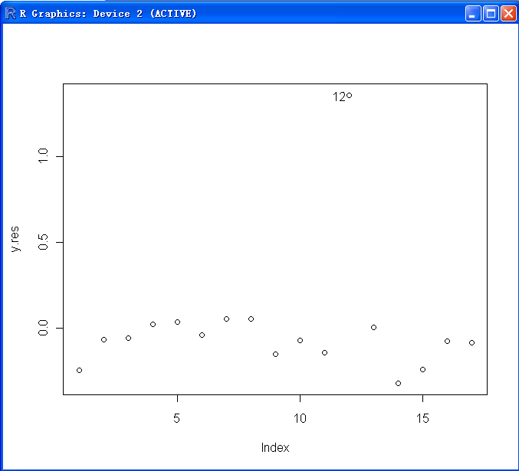
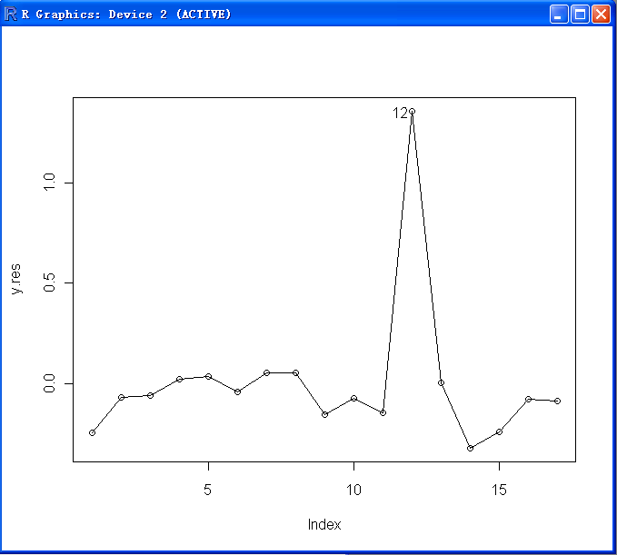
残差分析：
y.res=residuals(lm.sol);
plot(y.res)
text(12,y.res[12],labels=12,adj=1.2)
lines(y.res)

Slide 7
奇异点处理：
lm12=lm(log100~F,data=forbes,subset=-12)
summary(lm12)
Call:
lm(formula = log100 ~ F, data = forbes, subset = -12)
Residuals:
Min 1Q Median 3Q Max
-0.21175 -0.06194 0.01590 0.09077 0.13042
Coefficients:
Estimate Std. Error t value Pr(>|t|)
(Intercept) -41.30180 1.00038 -41.29 5.01e-16 ***
F 0.89096 0.00493 180.73 < 2e-16 ***
---
Signif. codes: 0 ‘***’ 0.001 ‘**’ 0.01 ‘*’ 0.05 ‘.’ 0.1 ‘ ’ 1
Residual standard error: 0.1133 on 14 degrees of freedom
Multiple R-squared: 0.9996, Adjusted R-squared: 0.9995
F-statistic: 3.266e+04 on 1 and 14 DF, p-value: < 2.2e-16
Residual standard error: 0.3789

Slide 8
6.2 R相关函数
计算方差分析表：
> anova(lm.sol)
Analysis of Variance Table
Response: log100
Df Sum Sq Mean Sq F value Pr(>F)
F 1 425.61 425.61 2964.8 < 2.2e-16 ***
Residuals 15 2.15 0.14
---
Signif. codes: 0 ‘***’ 0.001 ‘**’ 0.01 ‘*’ 0.05 ‘.’ 0.1 ‘ ’ 1
提取模型系数：
> coef(lm.sol)
(Intercept) F
-42.1308708 0.8954625

Slide 9
计算残差平方和
> deviance(lm.sol)
[1] 2.153319
提取模型公式：
> formula(lm.sol)
log100 ~ F

Slide 10
Print()显示模型拟合结果
> print(lm.sol)
Call:
lm(formula = log100 ~ F, data = forbes)
Coefficients:
(Intercept) F
-42.1309 0.8955

Slide 11


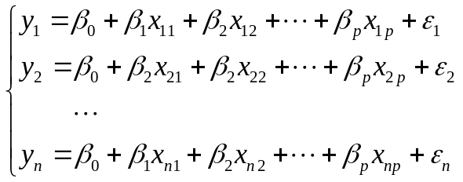

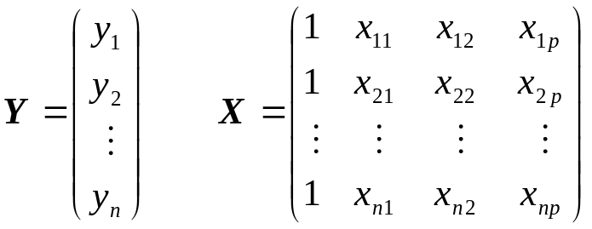
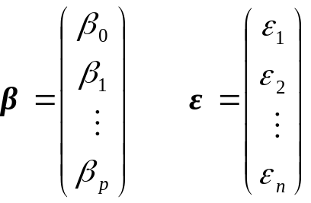
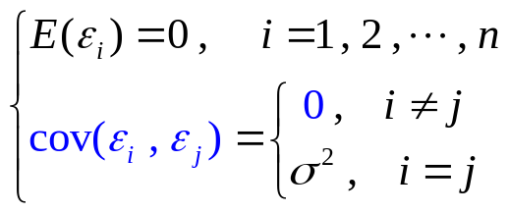

6.3 多元线性回归分析
多元线性回归模型的一般形式
为模型的参数，称偏回归系数.
设已取得样本量为 n 的随机样本
,则多元线性回归模型可以表示为:
多元线性回归模型的矩阵形式:
注：每次样本采样都会产生（随机）误差；
其中:
基本假定:
样本自变量的值大小对因变量的值不产生影响，即样本的大小不对模型的误差产生影响；
1．误差项ε满足:
2．误差项服从正态分布:
误差彼此不相关(不向后传播)；

Slide 12


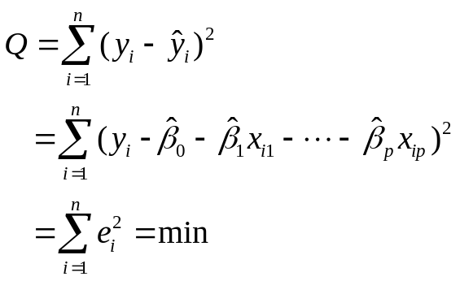
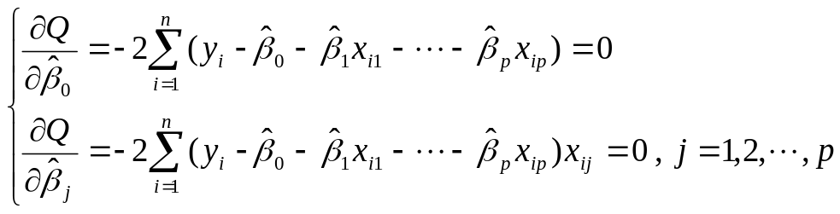
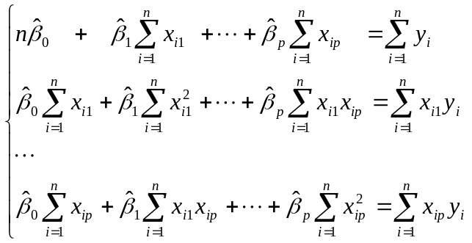







回归系数的估计：
使因变量的观察值 y 与估计值 之间的离差平方和达到最小来求 ，即使
正规方程组的矩阵形式为
当 的逆矩阵 存在时，则有
σ²的估计：

Slide 13

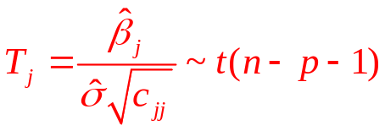

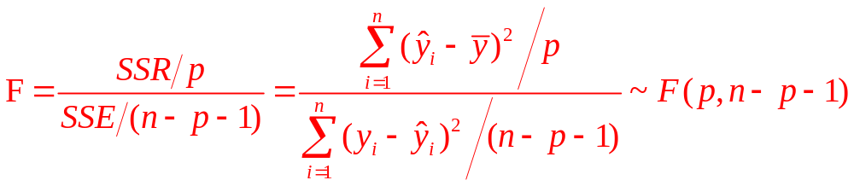

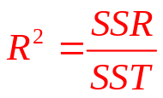
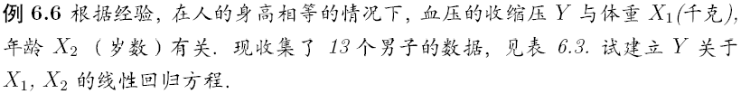
6.3.3 显著性检验
1.回归系数的显著性检验：
统计量：
拒绝域：
2.回归方程的显著性检验：
统计量：
拒绝域：
可决系数：

Slide 14

R实现：
blood=data.frame(
x1=c(76.0,91.5,85.5,82.5,79.0,80.5,74.5,79.0,85.0,76.5,82.0,95.0,92.5),
x2=c(50,20,20,30,30,50,60,50,40,55,40,40,20),
y=c(120,141,124,126,117,125,123,125,132,123,132,155,147))
lm.sol=lm(y~x1+x2,data=blood)
summary(lm.sol)
Call:
lm(formula = y ~ x1 + x2, data = blood)
Coefficients:
Estimate Std. Error t value Pr(>|t|)
(Intercept) -62.96336 16.99976 -3.704 0.004083 **
x1 2.13656 0.17534 12.185 2.53e-07 ***
x2 0.40022 0.08321 4.810 0.000713 ***
---
Signif. codes: 0 ‘***’ 0.001 ‘**’ 0.01 ‘*’ 0.05 ‘.’ 0.1 ‘ ’ 1
Residual standard error: 2.854 on 10 degrees of freedom
Multiple R-squared: 0.9461, Adjusted R-squared: 0.9354
F-statistic: 87.84 on 2 and 10 DF, p-value: 4.531e-07

Slide 15
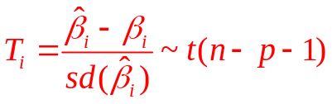

参数β的区间估计：
因此，β_{i}的区间估计为：
> beta.int(lm.sol)
Estimate Left Right
(Intercept) -62.9633591 -100.8411862 -25.0855320
x1 2.1365581 1.7458709 2.5272454
x2 0.4002162 0.2148077 0.5856246

Slide 16


6.3.5 预测
点预测：
区间预测：
> new=data.frame(x1=80,x2=40)
> lm.pred=predict(lm.sol,new,interval='prediction',level=0.95)
> lm.pred
fit lwr upr
1 123.9699 117.2889 130.6509

Slide 17
修正拟合模型：
new.model=update(old.model,new.formula)
在new.formula中，其相应的名字用点“.”组成，可以被用作表示“旧模型公式中相应的部分”
例如：
fm5=lm(y~x1+x2+x3+x4+x5,data=production)
fm6=update(fm5,.~.+x6)
增加一个解释变量x6；
smf6=update(fm6,sqrt(.)~.)
将被解释变量改为根号y

Slide 18
举例：
blood=data.frame(
x1=c(76.0,91.5,85.5,82.5,79.0,80.5,74.5,79.0,85.0,76.5,82.0,95.0,92.5),
x2=c(50,20,20,30,30,50,60,50,40,55,40,40,20),
y=c(120,141,124,126,117,125,123,125,132,123,132,155,147))
fm5=lm(y~x1,data=blood)
fm6=update(fm5,.~.+x2)
fm7=lm(fm6,data=blood)
summary(fm7)
Estimate Std. Error t value Pr(>|t|)
(Intercept) -62.96336 16.99976 -3.704 0.004083 **
x1 2.13656 0.17534 12.185 2.53e-07 ***
x2 0.40022 0.08321 4.810 0.000713 ***
Multiple R-squared: 0.9461, Adjusted R-squared: 0.9354
F-statistic: 87.84 on 2 and 10 DF, p-value: 4.531e-07

Slide 19
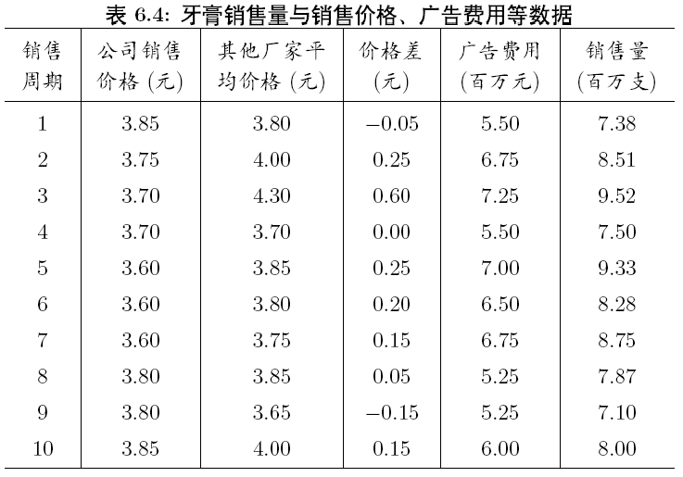
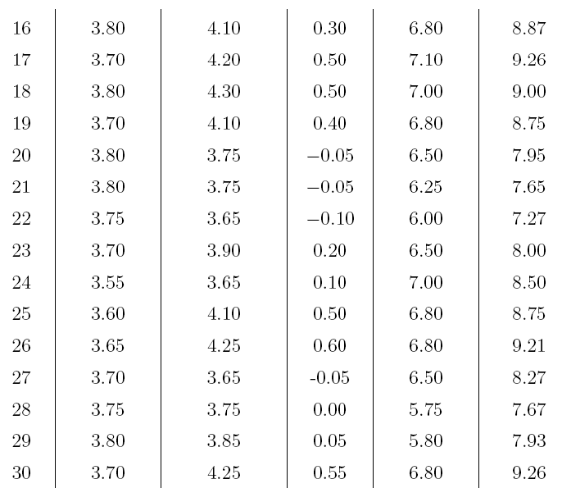
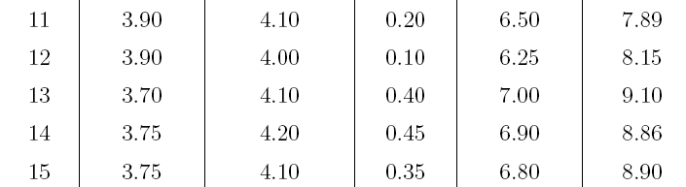
6.3.7 计算实例
例6.9 某大型牙膏制造企业为了更好地拓展产品市场、有效地管理库存，公司董事会要求销售部门根据市场调查，找出公司生产的牙膏销售量与销售价格、广告投入等之间的关系，从而预测出在不同价格和广告费用下的销售量。为此，销售部门的研究人员收集了过去30个销售周期（每个销售周期为4周）公司生产的牙膏的销售量、销售价格、投入的广告费用，以及周期内其他厂家生产同类牙膏的市场平均销售价格，如表6.4所示。试根据这些数据建立一个数学模型，分析牙膏销售量与其他因素的关系，为制定价格策略和广告投入策略提供数量依据。

Slide 20
R实现：
toothpaste=data.frame(
x1=c(-0.05,0.25,0.60,0,0.25,0.20,0.15,0.05,-0.15,0.15,0.20,0.10,0.40,0.45,0.35,0.30,0.50,0.50,0.40,-0.05,-0.05,-0.10,0.20,0.10,0.50,0.60,-0.05,0,0.05,0.55),
x2=c(5.50,6.75,7.25,5.50,7.00,6.50,6.75,5.25,5.25,6.00,6.50,6.25,7.00,6.90,6.80,6.80,7.10,7.00,6.80,6.50,6.25,6.00,6.50,7.00,6.80,6.80,6.50,5.75,5.80,6.80),
y=c(7.38,8.51,9.52,7.50,9.33,8.28,8.75,7.87,7.10,8.00,7.89,8.15,9.10,8.86,8.90,8.87,9.26,9.00,8.75,7.95,7.65,7.27,8.00,8.50,8.75,9.21,8.27,7.67,7.93,9.26)
)
lm.sol=lm(y~x1+x2,data=toothpaste)
summary(lm.sol)
#数据录入部分

Slide 21

结果：
Call:
lm(formula = y ~ x1 + x2, data = toothpaste)
Residuals:
Min 1Q Median 3Q Max
-0.497785 -0.120312 -0.008672 0.110844 0.581059
Coefficients:
Estimate Std. Error t value Pr(>|t|)
(Intercept) 4.4075 0.7223 6.102 1.62e-06 ***
x1 1.5883 0.2994 5.304 1.35e-05 ***
x2 0.5635 0.1191 4.733 6.25e-05 ***
---
Signif. codes: 0 ‘***’ 0.001 ‘**’ 0.01 ‘*’ 0.05 ‘.’ 0.1 ‘ ’ 1
Residual standard error: 0.2383 on 27 degrees of freedom
Multiple R-squared: 0.886, Adjusted R-squared: 0.8776
F-statistic: 105 on 2 and 27 DF, p-value: 1.845e-13
#可决系数偏小，模型具有一定的误差，下面尝试改进

Slide 22
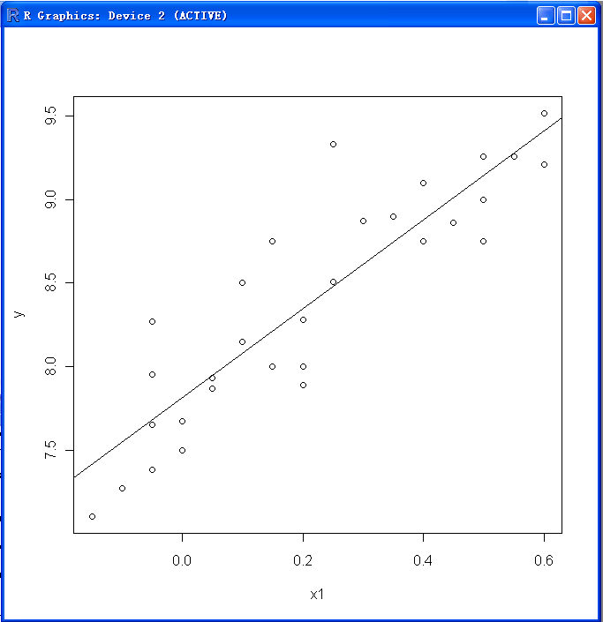

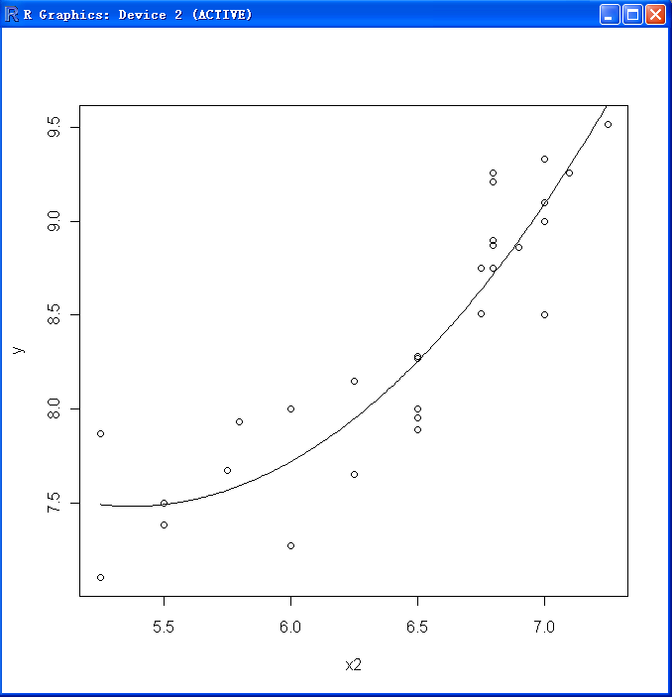
改进：
attach(toothpaste)
plot(y~x1);abline(lm(y~x1))
lm2.sol=lm(y~x2+I(x2^2))
x=seq(min(x2),max(x2),len=200)
y1=predict(lm2.sol,data.frame(x2=x))
plot(y~x2);lines(x,y1)
#将变量x2替换为x，并把属性改为数据框
考虑x2平方项模型：

Slide 23
改进： lm.new=update(lm.sol,y~.+I(x2^2))
Call:
lm(formula = lm.new, data = toothpaste)
Coefficients:
Estimate Std. Error t value Pr(>|t|)
(Intercept) 17.3244 5.6415 3.071 0.004951 **
x1 1.3070 0.3036 4.305 0.000210 ***
x2 -3.6956 1.8503 -1.997 0.056355 .
I(x2^2) 0.3486 0.1512 2.306 0.029341 *
---
Signif. codes: 0 ‘***’ 0.001 ‘**’ 0.01 ‘*’ 0.05 ‘.’ 0.1 ‘ ’ 1
Residual standard error: 0.2213 on 26 degrees of freedom
Multiple R-squared: 0.9054, Adjusted R-squared: 0.8945
F-statistic: 82.94 on 3 and 26 DF, p-value: 1.944e-13
#x2变量表现出不显著
#与改进前的残差和可决系数比较
Residual standard error: 0.2383
Multiple R-squared: 0.886, Adjusted R-squared: 0.8776

Slide 24

进一步改进：
lm2.new=update(lm.new,.~.-x2)
summary(lm2.new)
#删除不显著变量
Call:
lm(formula = y ~ x1 + I(x2^2), data = toothpaste)
Coefficients:
Estimate Std. Error t value Pr(>|t|)
(Intercept) 6.07667 0.35531 17.102 5.17e-16 ***
x1 1.52498 0.29859 5.107 2.28e-05 ***
I(x2^2) 0.04720 0.00952 4.958 3.41e-05 ***
---
Signif. codes: 0 ‘***’ 0.001 ‘**’ 0.01 ‘*’ 0.05 ‘.’ 0.1 ‘ ’ 1
Residual standard error: 0.2332 on 27 degrees of freedom
Multiple R-squared: 0.8909, Adjusted R-squared: 0.8828
F-statistic: 110.2 on 2 and 27 DF, p-value: 1.028e-13
#与最初的残差和可决系数比较
Residual standard error: 0.2383
Multiple R-squared: 0.886, Adjusted R-squared: 0.8776

Slide 25
再改进：考虑交叉影响
lm3.new=update(lm.new,.~.+x1*x2)
summary(lm3.new)
Call:
lm(formula = y ~ x1 + x2 + I(x2^2) + x1:x2, data = toothpaste)
Coefficients:
Estimate Std. Error t value Pr(>|t|)
(Intercept) 29.1133 7.4832 3.890 0.000656 ***
x1 11.1342 4.4459 2.504 0.019153 *
x2 -7.6080 2.4691 -3.081 0.004963 **
I(x2^2) 0.6712 0.2027 3.312 0.002824 **
x1:x2 -1.4777 0.6672 -2.215 0.036105 *
---
Signif. codes: 0 ‘***’ 0.001 ‘**’ 0.01 ‘*’ 0.05 ‘.’ 0.1 ‘ ’ 1
Residual standard error: 0.2063 on 25 degrees of freedom
Multiple R-squared: 0.9209, Adjusted R-squared: 0.9083
F-statistic: 72.78 on 4 and 25 DF, p-value: 2.107e-13
#前一次算法的残差和可决系数：Residual standard error: 0.2332 Multiple R-squared: 0.8909

Slide 26
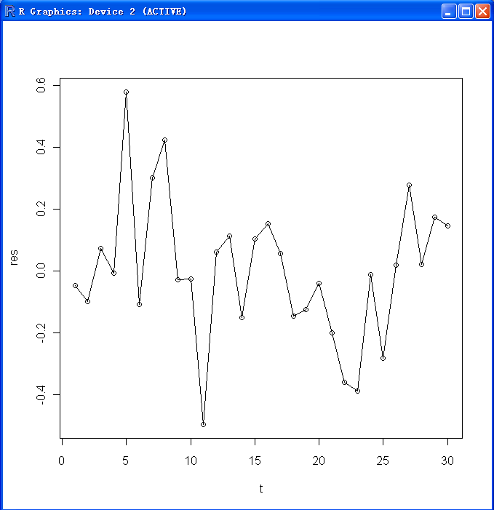
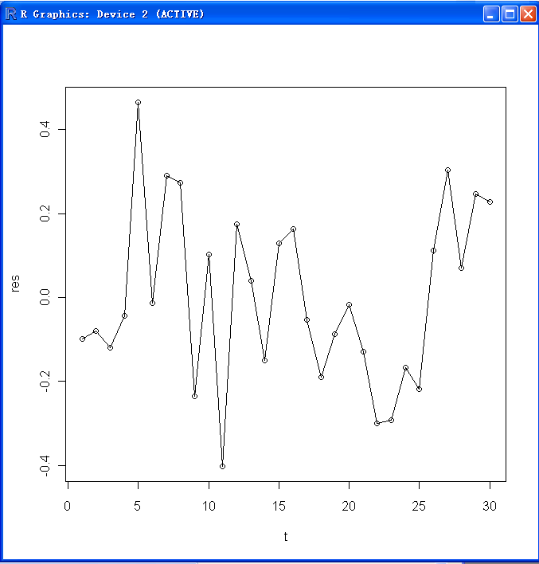
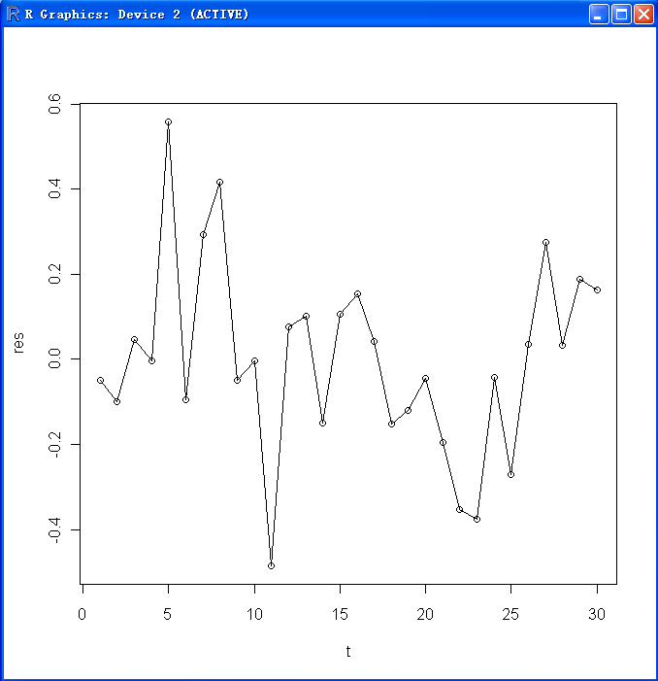
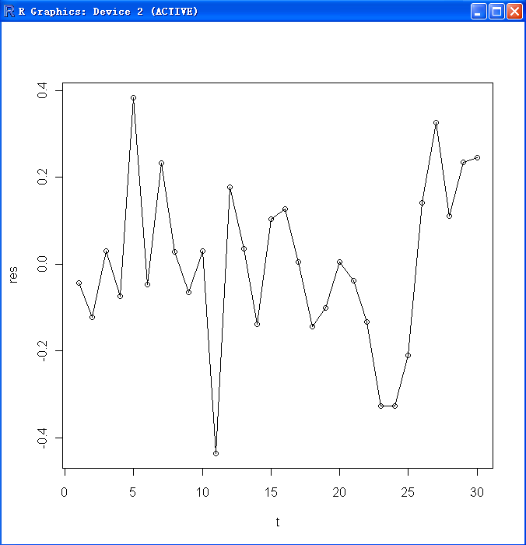

基于残差的回归效果比较：
残差标准差:0.2383
残差标准差: 0.2213
残差标准差: 0.2063
残差标准差: 0.2332

Slide 27
6.4 逐步回归方法
首先，求出一个基本回归方程，然后，逐步添加解释变量，根据添加解释变量对拟合优度的改进和对其它回归系数的影响等决定是否保留添加的解释变量。
1.如果新添加的解释变量改进拟合优度，并且其它回归系数在统计上仍是显著的，那么，保留添加的解释变量。新添加解释变量不引起多重共线性；
2.新添加的解释变量未能改进拟合优度，且对其它回归系数也没有影响，则新添加解释变量不予保留，不产生多重共线性；
3.如果新添加的解释变量，不仅影响拟合优度，而且显著地影响其它回归系数的显著性、符号、数值，甚至使参数符号反号到不能接受的地步，则认为新添加的解释变量可能是引起多重共线性的原因。

Slide 28
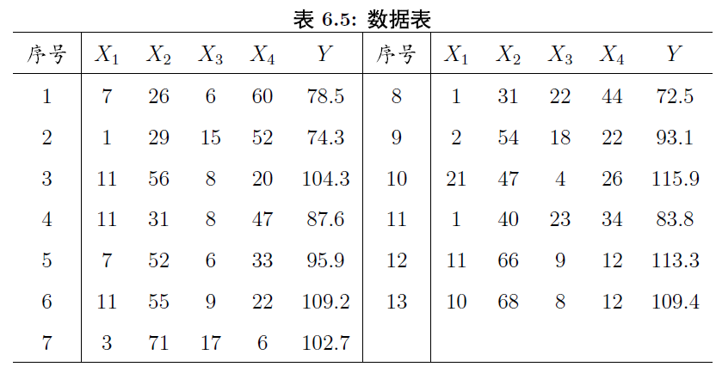
例6.10
某种水泥在凝固时放出的热量Y与水泥中四种化学成分X1,X2,X3,X4有关，现测得13组数据，如表所示。希望从中选出主要的变量，建立Y关于他们的线性回归方程。
cement=data.frame(x1=c(7,1,11,11,7,11,3,1,2,21,1,11,10),x2=c(26,29,56,31,52,55,71,31,54,47,40,66,68),x3=c(6,15,8,8,6,9,17,22,18,4,23,9,8),x4=c(60,52,20,47,33,22,6,44,22,26,34,12,12),y=c(78.5,74.3,104.3,87.6,95.9,109.2,102.7,72.5,93.1,115.9,83.8,113.3,109.4))
lm.sol=lm(y~x1+x2+x3+x4,data=cement)
summary(lm.sol)

Slide 29
结果
Call:
lm(formula = y ~ x1 + x2 + x3 + x4, data = cement)
Coefficients:
Estimate Std. Error t value Pr(>|t|)
(Intercept) 62.4054 70.0710 0.891 0.3991
x1 1.5511 0.7448 2.083 0.0708 .
x2 0.5102 0.7238 0.705 0.5009
x3 0.1019 0.7547 0.135 0.8959
x4 -0.1441 0.7091 -0.203 0.8441
---
Signif. codes: 0 ‘***’ 0.001 ‘**’ 0.01 ‘*’ 0.05 ‘.’ 0.1 ‘ ’ 1
Residual standard error: 2.446 on 8 degrees of freedom
Multiple R-squared: 0.9824, Adjusted R-squared: 0.9736
F-statistic: 111.5 on 4 and 8 DF, p-value: 4.756e-07
#解释变量不显著

Slide 30
Step处理：
lm.step=step(lm.sol)
Start: AIC=26.94
y ~ x1 + x2 + x3 + x4
Df Sum of Sq RSS AIC
- x3 1 0.1091 47.973 24.974
- x4 1 0.2470 48.111 25.011
- x2 1 2.9725 50.836 25.728
<none> 47.864 26.944
- x1 1 25.9509 73.815 30.576
Step: AIC=24.97
y ~ x1 + x2 + x4
Df Sum of Sq RSS AIC
<none> 47.97 24.974
- x4 1 9.93 57.90 25.420
- x2 1 26.79 74.76 28.742
- x1 1 820.91 868.88 60.629
#和其他软件不同，R软件根据AIC准则，自动选择合适的解释变量.
> summary(lm.step)
Coefficients:
Estimate Std. Error t value Pr(>|t|)
(Intercept) 71.6483 14.1424 5.066 0.000675 ***
x1 1.4519 0.1170 12.41 0 5.78e-07 ***
x2 0.4161 0.1856 2.242 0.051687 .
x4 -0.2365 0.1733 -1.365 0.205395
Residual standard error: 2.309 Multiple R-squared: 0.9823

Slide 31

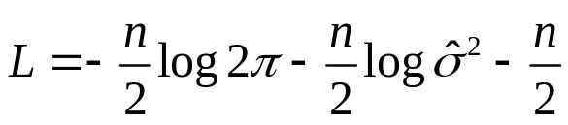

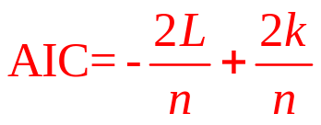
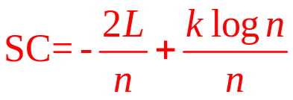
关于AIC-SC(赤池信息准则和Schwarz准则)
根据假设误差项服从正态分布:
对数似然函数为:
残差越小， 越小，L越大；但是残差的大小与自变量的数目有关。
k越小(模型越简洁)AIC越小，L越大(模型越精确)AIC越小
与AIC准则类似

Slide 32
Add1（）与drop1（）
## S3 method for class 'lm':
add1(object, scope, scale = 0, test = c("none", "Chisq", "F"), x = NULL, k = 2, ...)
Description
Compute all the single terms in the scope argument that can be added to or dropped from the model, fit those models and compute a table of the changes in fit.
Scope:a formula giving the terms to be considered for adding or dropping.
Scale:an estimate of the residual mean square to be used in computing Cp. Ignored if 0 or NULL.
Test:should the results include a test statistic relative to the original model? The F test is only appropriate for lm and aov models or perhaps for glm fits with estimated dispersion. The Chisq test can be an exact test (lm models with known scale) or a likelihood-ratio test or a test of the reduction in scaled deviance depending on the method.

Slide 33
drop1(lm.step)与改进：
删除变量会改变根据AIC最小准则得到的step结果，根据drop1分析，删除x4使AIC值上升最小，为尽量遵守AIC准则的同时，提高解释变量的显著性，删除x4是“无奈之举”。
Single term deletions
Model:
y ~ x1 + x2 + x4
Df Sum of Sq RSS AIC
<none> 47.97 24.974
x1 1 820.91 868.88 60.629
x2 1 26.79 74.76 28.742
x4 1 9.93 57.90 25.420
newsol=lm(y~x1+x2,data=cement)
summary(newsol)
Call:
lm(formula = y ~ x1 + x2, data = cement)
Coefficients:
Estimate Std. Error t value Pr(>|t|)
(Intercept) 52.57735 2.28617 23.00 5.46e-10 ***
x1 1.46831 0.12130 12.11 2.69e-07 ***
x2 0.66225 0.04585 14.44 5.03e-08 ***
Residual standard error: 2.406 on 10 degrees of freedom
Multiple R-squared: 0.9787, Adjusted R-squared: 0.9744
F-statistic: 229.5 on 2 and 10 DF, p-value: 4.407e-09
step()处理后的残差和可决系数：Residual standard error: 2.309
Multiple R-squared: 0.9823

