Slide 1
REST API Automation
Overview:
REST API Automation using Rest Assured, Cucumber, JUnit, Apache Maven and Java.
Cucumber supports BDD testing, it uses Gherkin language which is easy to read and understood.
Cucumber: Features, Step Definitions and Runners
Cucumber has built-in reporting capability.
Test cases/scenarios can be separated into features and can be executed in one go.
REST Assured is a Java library used to test REST APIs with Java programming language.
REST Assured API has a capability to support XML and JSON. Also supports different authentication mechanism like
basic authentication and OAuth.
For Build : Apache Maven is used.
For Logging: Log4j to be used (This task is in progress)

Slide 2
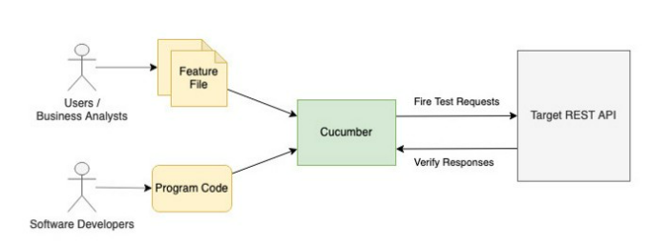
REST API Automation
High Level Flow:

Slide 3
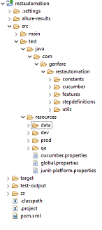
REST API Automation
  Project Structure:
  Standard Apache Maven structure is used

Slide 4
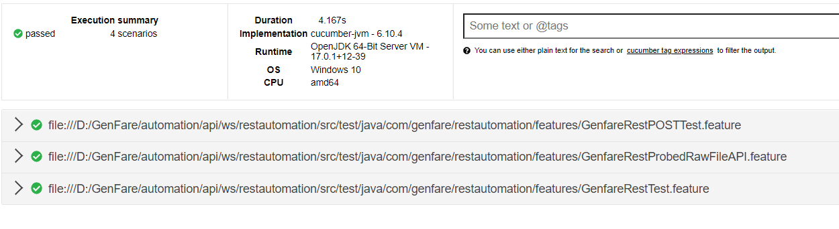
REST API Automation
  Test Report

