Slide 1
YouTube Comment Sentiment Analysis using Spark and Kafka
Group-3 Members:-
Riya Dave(202318011)
Shubham Gupta(202318052)
Mayan Bhut(202318043)

Slide 2

Introduction
YouTube comments offer rich insights into viewer sentiments and reactions.
Understanding these sentiments aids content creators, marketers, and platform administrators.
Our project aims to utilize Spark and Kafka for real-time sentiment analysis, providing actionable insights into viewer engagement and preferences.

Slide 3
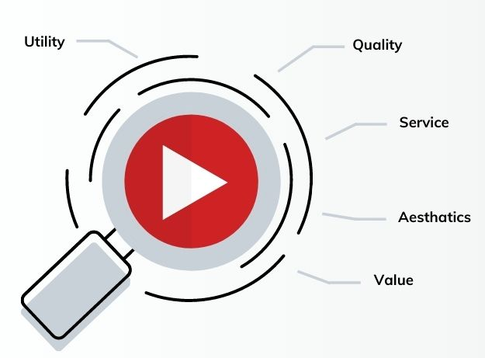
Project Overview
Our project aims to conduct real-time sentiment analysis on YouTube comments using Apache Spark and Kafka.
By leveraging these technologies, we intend to extract valuable insights into viewer sentiments.
It can help content creators, marketers, and platform administrators in enhancing audience engagement, optimizing content strategies, and improving the overall user experience on YouTube.

Slide 4
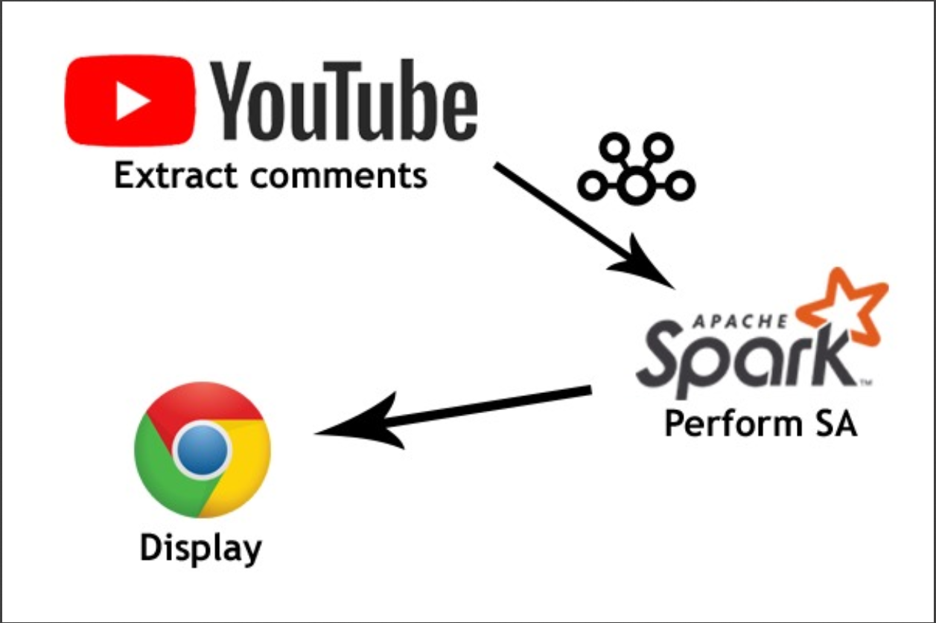
System Architecture

Slide 5
How it works
The Web App starts the CommentsProvider, WebServer and the Sentiment Analysis Consumer each on a different Thread.
The CommentsProvider starts the YoutubeScraper that fetches videos using a Search Term then monitors the videos.
The Spark App loads the trained pickled models, starts a Kafka Consumer that listens to incoming comments, performs sentiment analysis then sends the results using a Kafka Producer (The WebApp will then send the results to clients connected in the WebServer).
The HTML app connects to the WebServer, listens to incoming results and shows them in the page (it will also fetch the video's title if needed)

Slide 6
Components in Detail

Slide 7
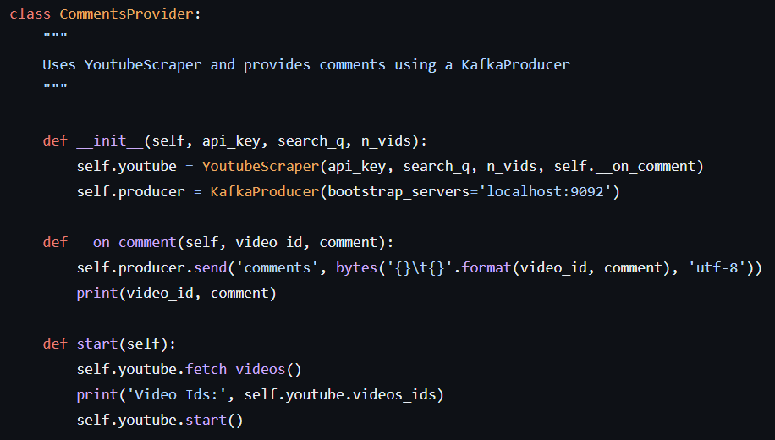
CommentsProvider Functionality
The YoutubeScraper component retrieves videos from YouTube based on video-ids search terms.
It interacts with the YouTube Data API to gather metadata like titles, descriptions and comments, ensuring comprehensive coverage through filtering.
Extracted video IDs are then passed to the KafkaProducer which acts as intermediary.

Slide 8
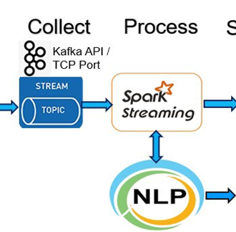
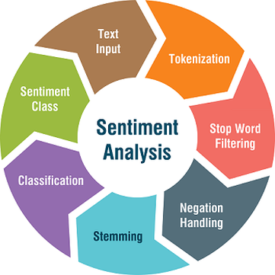
Spark App and Sentiment Analysis
The Spark App is the central component of our sentiment analysis pipeline, analyzing YouTube comments data in real-time.
It preprocesses data, applies sentiment analysis algorithms, and categorizes comments as positive, negative, or neutral.
With scalable capabilities and integration with Kafka for smooth data streaming, it ensures timely insights into audience sentiments.
Additionally, it may incorporate a feedback loop to refine analysis accuracy over time

Slide 9
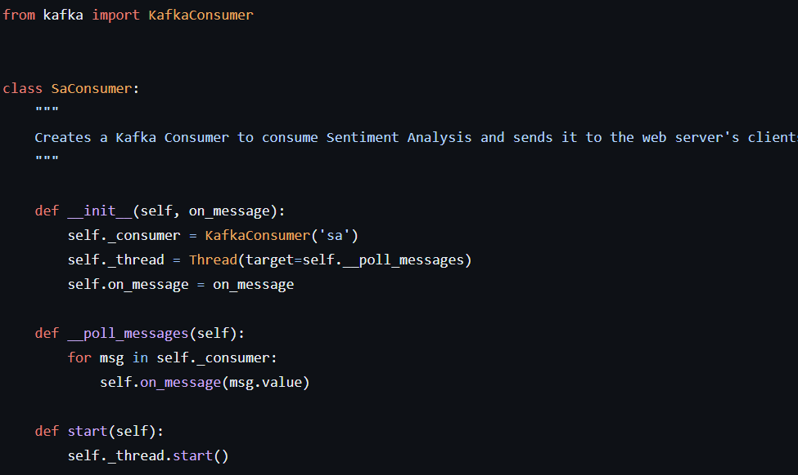
Kafka Messaging
Kafka Messaging serves as the backbone of real-time sentiment analysis by efficiently streaming comments data from sources like YouTube to processing components such as Spark.
Its reliability, scalability, and fault tolerance ensure that sentiment analysis can be conducted seamlessly, even under high data loads.
Reliability and scalability for timely insights into audience sentiments.

Slide 10
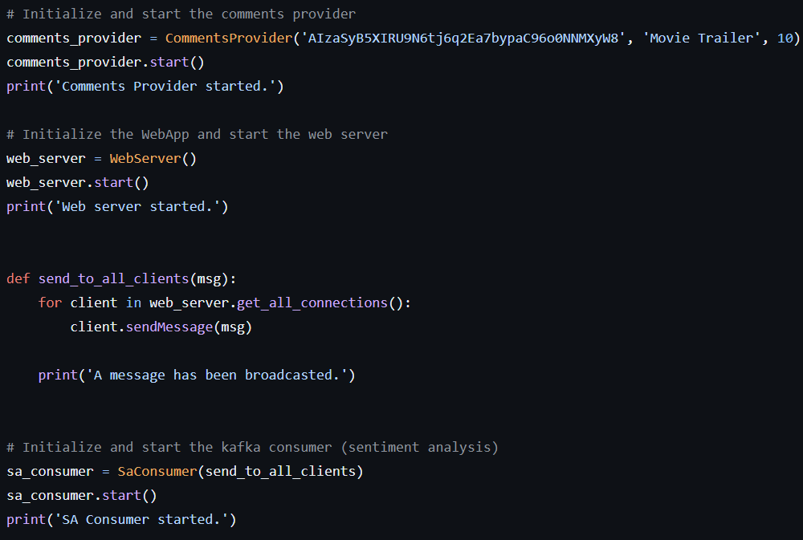
WebServer and HTML App
The WebServer manages user requests and authentication, facilitating communication between users and the sentiment analysis system.
HTML App presents sentiment analysis results visually, allowing users to explore and analyze data conveniently.
Together, they form an intuitive interface for users to interact with the system effectively

Slide 11
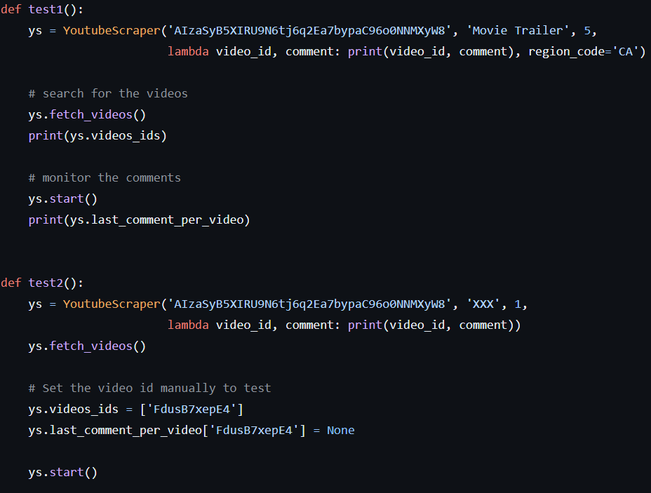
System Testing
These tests validate the functionality of the `YoutubeScraper` class in fetching videos and monitoring comments.
Test1 fetches videos based on a search query and monitors their comments.
Test2 focuses on monitoring comments for a specific video.

Slide 12
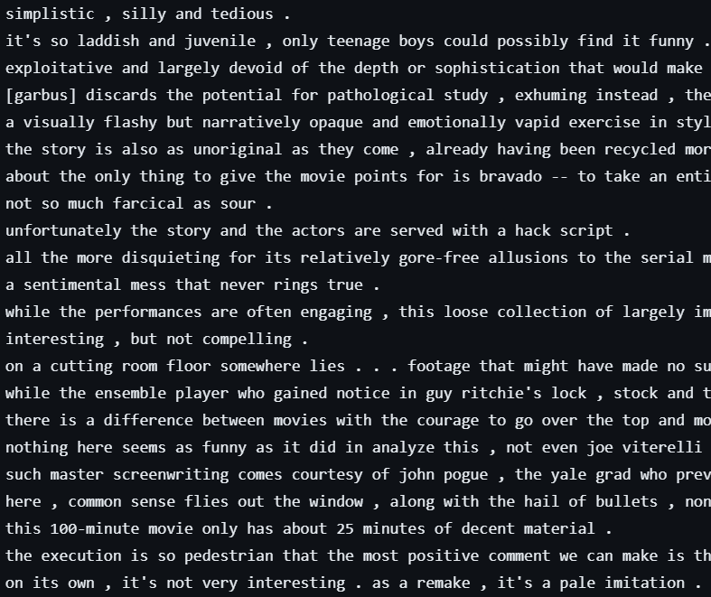
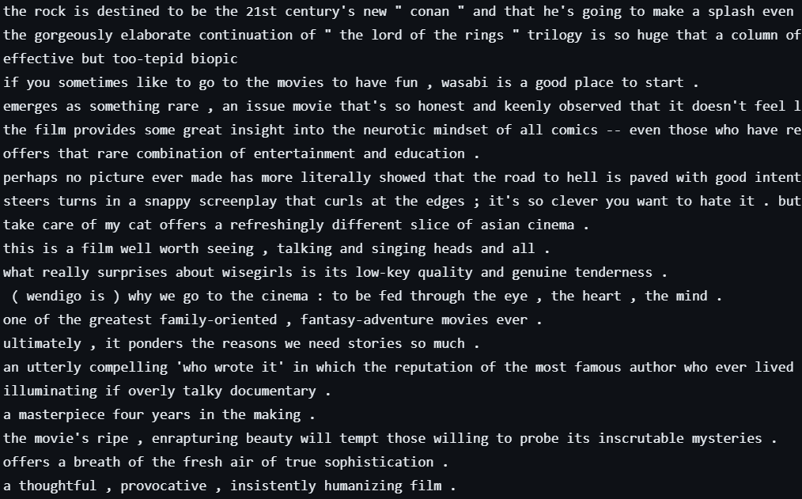
Output Results
Negative_Reviews.txt
Positive_Reviews.txt

Slide 13
Solutions Implemented
Distributed processing (e.g., Apache Spark) for managing large data volumes
Filtering algorithms for data quality assurance
Real-time analysis using streaming frameworks (e.g., Apache Kafka, Spark Streaming)
Iterative model refinement with machine learning techniques
User experience enhancements (i.e web_app)

Slide 14
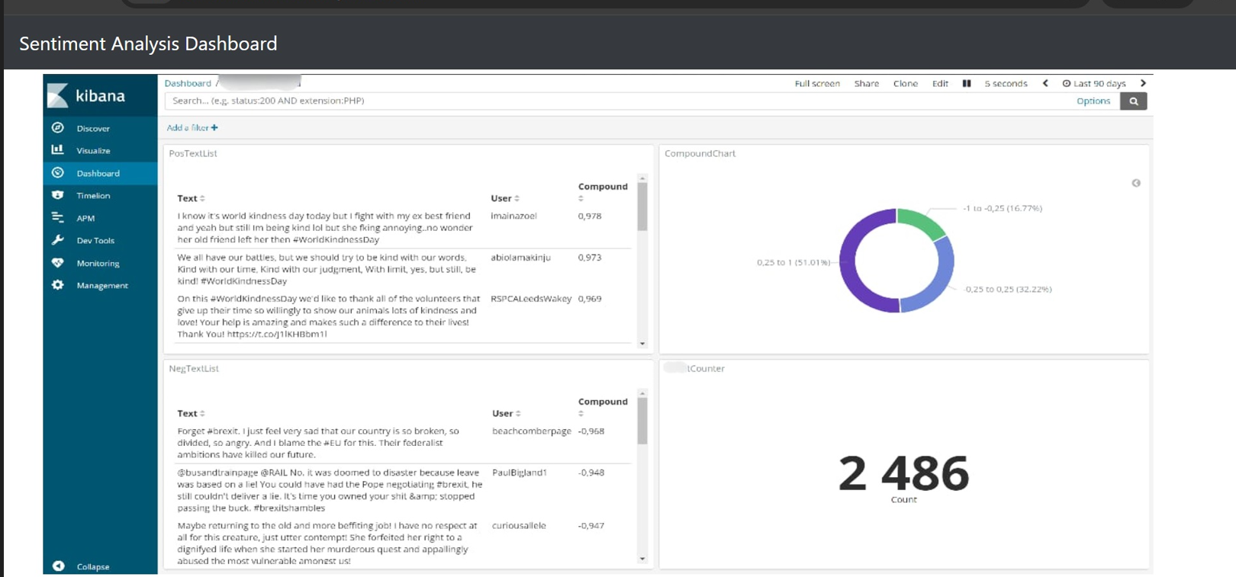
Demonstration

Slide 15
Conclusion
Effective Real-Time Analysis: Apache Spark and Kafka enable efficient real-time sentiment analysis of YouTube comments, processing large data volumes swiftly for valuable user sentiment insights.
Scalability and Flexibility: The Spark and Kafka-based architecture offers scalability and adaptability, crucial for managing dynamic workloads and varying data volumes from user-generated content.
Future Directions: Enhance sentiment analysis with more sophisticated models, expand to include other social media platforms, and improve user interface for enhanced usability and experience.

Slide 16
THANK YOU

