Slide 1

NAVIGATION-BY-PREFERENCE: A NEW CONVERSATIONAL RECOMMENDER WITH PREFERENCE-BASED FEEDBACK
Group 5
DAIICT | 2024

Slide 2
1
MOTIVATION
Traditional systems offer a single shot of recommendations.
This can be limiting if users aren't satisfied with their top n recommendation
(Eg = users with different short term and long term preferences)
Hence, to overcome the drawback of single shot recommendations we use conversational recommenders.

Slide 3
2
INTRODUCTION
In a conversational recommendation system, a set of n recommendation is suggested
Then the user is asked to choose one of the recommendations
This item becomes query for next cycle
May take several cycles

Slide 4
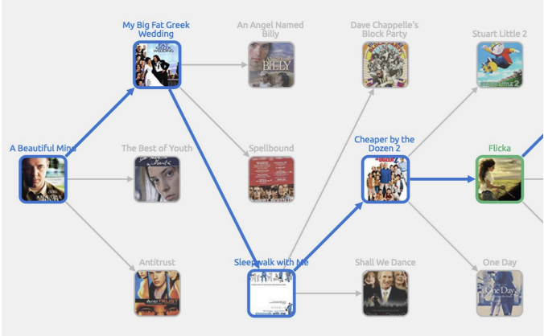
3

Slide 5
4
NOVELTIES
Works for unstructured feature values
Takes into account the combination of short term as well as the long term goals instead of just short term goals
Evaluation done combining both offline experiments and user trial

Slide 6
5
NAVIGATION BY PREFERENCE
It is a conversational recommendation system that used feedback based on user preferences (i.e short term /long term).
The most important advantage of this system is its ability to work in domains that have unstructured item representations.
It does not involve learning of models from the training sets of session data.

Slide 7


6
NAVIGATION BY PREFERENCE
50 items
USER PROFILE
High level working of n-by-p
stop and consume if satisfied
picks
1 item
(s)
if not satisfied
picks again
n by p
recommends
n-candidate items
R

Slide 8
7
NOTATIONS
P - user profile of active user
(set of items liked by user) P ⊆
- set of all items (movies)
I - all items that might me recommended to user (candidate items).
I = {i : i ∈ I \ P}
fi - set of features (tags) for item i
sim(i, j) = |fi∩fj |
|fi∪fj |
Ni - set of related items
(i.e candidate items that are neighbours of i)
Ni = {j ∈ I, j , i : sim(i, j) > θ }

Slide 9
8
WHICH ITEMS TO RECOMMEND IN NEXT CYCLE ?
Candidates that are similar to s i.e Ns.
But not every member of Ns should be recommended
WHY ?
It is because we will not recommend an item more than once in whole dialog.
Also the items not selected in previous round might be treated as negative feedback

Slide 10
9
Since the user’s most recent choice is s ∈ R
To reflect negative feedback (i.e R \ {s}), we have to discard some members of Ns.
We refer to this subset of Ns as S ⊆ Ns. This is called the selection consistent candidate set.
L = ∪ Ni (i.e User’s long term preferences)
i ∈P
(candidate items that are neighbours of each item i in user profile)

Slide 11
10
GOALS OF SET “R”
To reflect long term preferences of user
(measure how much Ni overlaps with L)
To reflect short term preferences of user
(measure how much Ni overlaps with S as a whole)
To ensure diversity
(make sure that Ni covers parts of S that were not covered in previous recommendation cycles)

Slide 12
11
TYPES
n-by-i-p
n-by-c-p
In this, only feedback from the most recent cycle of recommendation affects the next cycle.
In this, feedback from the earlier cycles of recommendation also affects the next cycle.

Slide 13
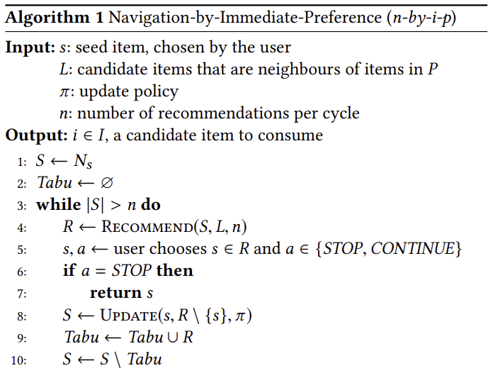
12
N-BY-I-P
1 item
(s)
neighbourss
Ns
50 items
S ⊆ Ns
40 items
USER PROFILE
recommends
n-candidate items
stop and consume if satisfied
Update(S,R,pi)
picks again
R
if not satisfied
https://github.com/shgupta1461/RPIP_Group5/blob/main/RPIP_nbyip.ipynb

Slide 14
13
RECOMMENDING
Greedily selects n items from S with highest score
score(i, S, L, R) = (1 − η) · ovrlp(i, S, R) + η · ovrlp(i, L \ S, R)
prevents double counting of item in both S and L
ovrlp(i,X, R) = 2 · |(Ni \ cov(X, R)) ∩ X |
to exclude items that are already covered by neighbours of R
|Ni \ cov(X, R)| + |X \ cov(X, R)|
No explicit reference to features

Slide 15
14
HOW TO UPDATE SET “S”
Strict
Open
If any member of Ns is neighbour of any member of R’ then we remove that member from Ns and the updated set Ns is assigned to S
i.e we don’t recommend items from R’ in next recommendation
Relaxed
It simply means that we don’t remove any members of set Ns.
i.e we don’t take negative feedback into account.
We remove member of Ns if it is neighbour of every (all) member of R’

Slide 16
HOW TO UPDATE SET “S”
15
Mean
If similarity of member of Ns with s is less than MEAN of similarity of Ns with Rejected members then we remove those members from Ns
S ← Ns \ {j ∈ Ns : sim(j,s) < mean(Sims(j))}
Max
If similarity of member of Ns with s is less than MAX of similarity of Ns with Rejected members then we remove those members from Ns
S ← Ns \ {j ∈ Ns : sim(j,s) < max(Sims(j))}

Slide 17
16
PROBLEM WITH N-BY-I-P
Current set R may contain items which are not related to previously selected items by users.
Current set R may contain items which are related to previously rejected items by users.

Slide 18
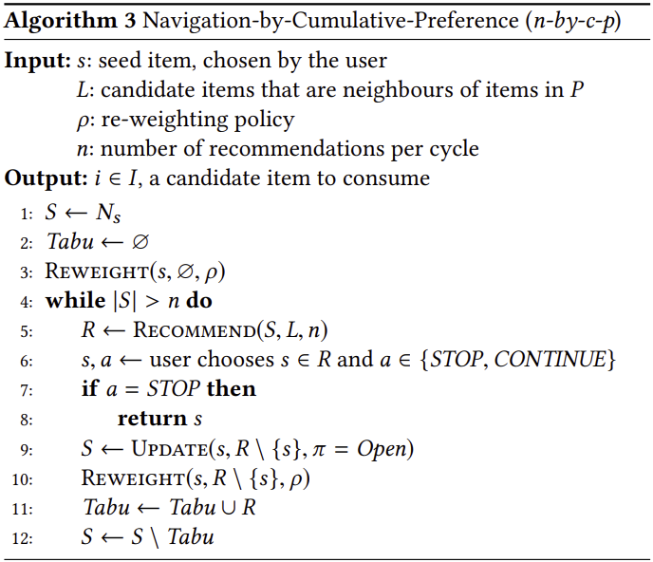
17
N-BY-C-P
1 item
(s)
neighbourss
Ns
50 items
S ⊆ Ns
40 items
USER PROFILE
recommends
n-candidate items
stop and consume if satisfied
Update(S,R’, OPEN)
picks again
R
Re-Weight(s, R’, rho)
if not satisfied
https://github.com/shgupta1461/RPIP_Group5/blob/main/RPIP_nbycp.ipynb

Slide 19

18
RECOMMENDING
Greedily selects n items from S with highest score
wscore(i, S, L, R) = (1 − η) · wovrlp(i, S, R) + η · wovrlp(i, L \ S, R)
prevents double counting of item in both S and L
wovrlp(i,X, R) = 2 · wj
insted of counting items directly, it counts the weights assigned to each item.
j ∈(Ni \cov(X,R))∩X
|Ni \ cov(X, R)| + |X \ cov(X, R)|
No explicit reference to features

Slide 20
19
RE-WEIGHTING
wi ← wi + ∆wi ∀i ∈ I (all candidate items)
Cij = 1 ; i ∈ Ns
0 ; otherwise
check whether i and neighbours of j are related
∆wi is Increased - when i is related to item just selected by user (Cis)
∆wi is Decreased - when i is related to item just rejected by user (Cij)

Slide 21
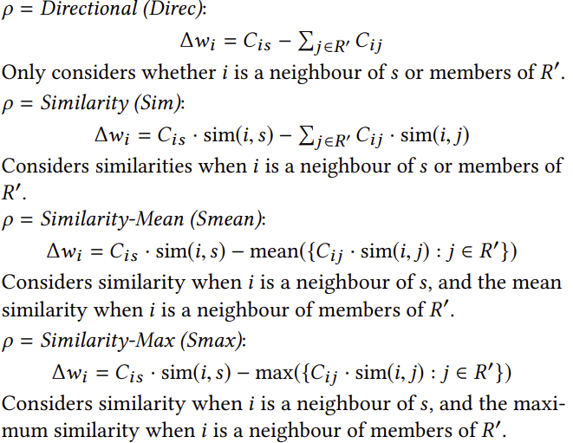
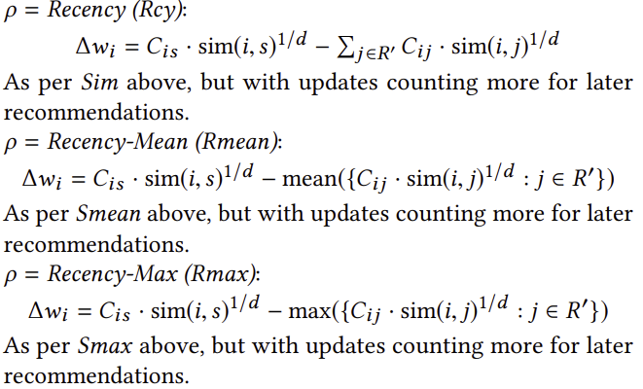
20
RE-WEIGHTING

Slide 22
21
NOTION OF ‘JUMP’
It is possible that no item in current set R suits to user but the one from previous cycle is more suitable.
User can select either to consume that previous item or create a new set of recommendations based on that item.

Slide 23
OFFLINE EXPERIMENTS
22
The goal for the Offline Experiments conducted are:
"n-by-i-p" versus "n-by-c-p": These represent different ways of considering user feedback, either focusing on the most recent feedback or all feedback across dialog cycles.
Different update and re-weighting policies for handling negative feedback.
The influence of a parameter called η, which controls the balance between short-term and long-term user preferences.
These experiments were used to decide which configurations to use in user trial.

Slide 24
23
EXPERIMENT SETTINGS
The hetrec dataset included over 2000 users, 6000 movies, 80000 keywords and half a million ratings.
500 randomly chosen users are taken and profiles were created for users based on movies they liked (rated 4 or 5).
Simulated dialogs were created between users and different configurations of the n-by-p system (maximum cycles for recommendations =15).

Slide 25
HOW TO CAPTURE SHORT TERM PRFERENCES
24
Randomly choose a target item t from Ns
Recommend n-most similar items to target t
Stop the simulated dialog when t ∈ R
(i.e target item is one of the recommendation.
Measure Hit rate for each cycle

Slide 26
25
EXPERIMENT METRICS
Hit-rate: The proportion of simulated users who found their target item within 15 cycles.
Jaccard similarity: A measure of similarity between the item selected by the simulated user and their target.
Diversity and surprise: Metrics indicating the variety and unexpectedness of recommendations ( Div_cont and S_cont).

Slide 27
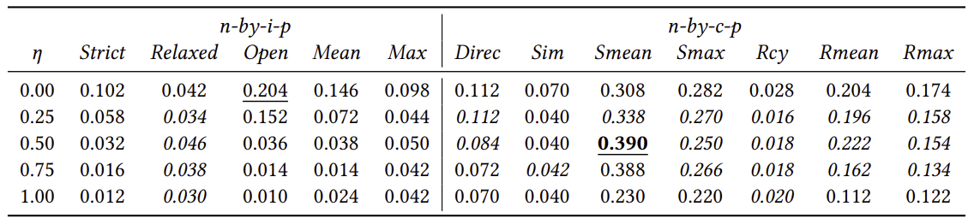
26
EXPERIMENT RESULTS

Slide 28
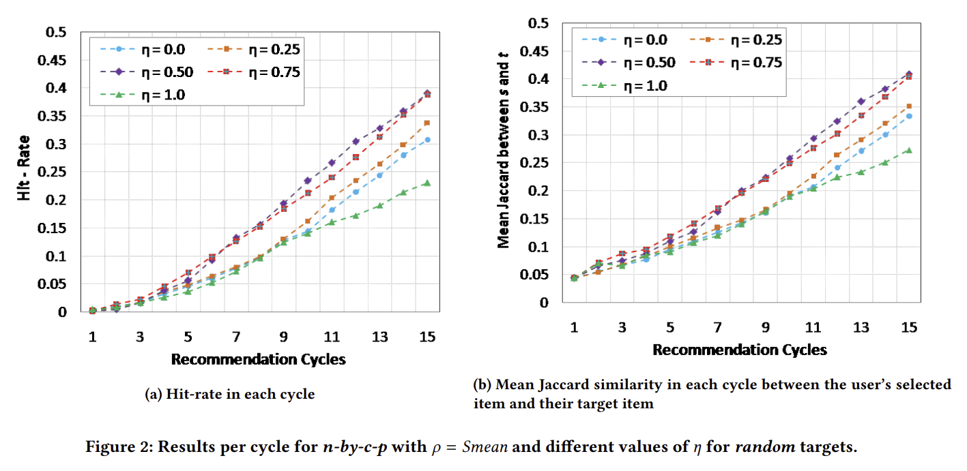

Slide 29
USER TRIAL
28
Purpose
Systems Compared
To evaluate the effect of incorporating long-term preferences alongside short-term preferences in recommendation accuracy and user satisfaction.
Smean@0.5: Utilizes a mix of short-term and long-term preferences (η = 0.5) as the best-performing setup from previous offline experiments.
Smean@0.0 Baseline: Similar to Smean@0.5 but exclusively focuses on short-term preferences (η = 0.0), serving as the control group.

Slide 30
29
TRIAL DATA
A total of 102 people participated in trial.
Trial used a subset of the dataset from previous offline experiments.
Featured 1851 movies released between 2000 and 2011, to maximize participant familiarity.
Random user assignment to either Smean@0.5 or Smean@0.0.
Goal: Assess how the integration of long-term preferences affects user interactions and system performance.

Slide 31
USER TRIAL PROTOCOL
30
Participants begin by selecting 10 movies they like, establishing their long-term preferences.
Users select a movie from their profile they think is best to watch with a selected family member with differing tastes.
Users select from a list of eight family members for whom they think movie preferences differ.
They then choose a movie they believe both would enjoy.
Process may be repeated up to three times to refine the ephemeral goal.

Slide 32
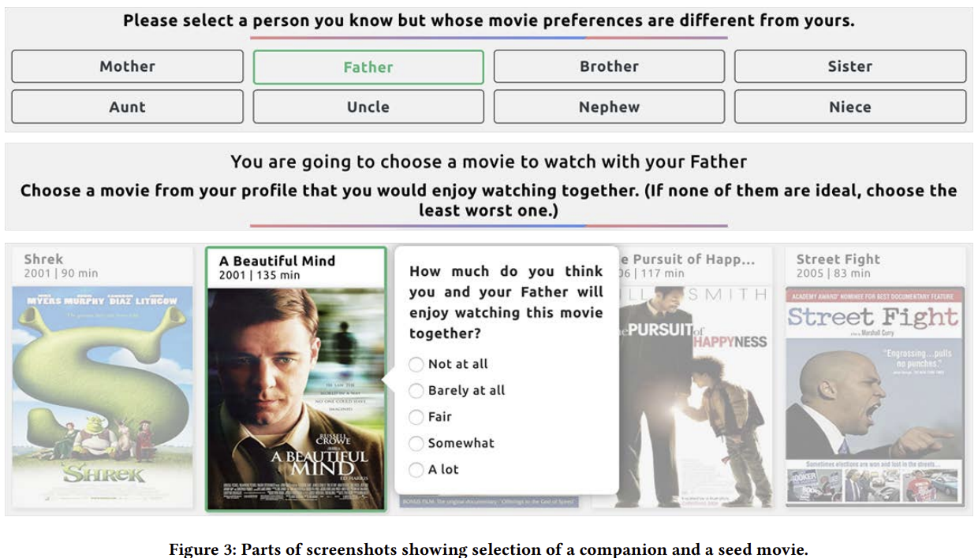

Slide 33
32
TRIAL
Eight-cycle dialog where the system presents three movie recommendations in each cycle.
After eight cycles, users are presented with a tree of 24 movies.
They select the movie believed to best suit the viewing with their companion.
Maintains consistency across trials, allowing for fair comparison despite possible discovery of an 'ideal' movie early in the session.

Slide 34
33
USER EXPERIMENT
Evaluation Metrics:
Familiarity: Whether users had seen the movie before.
Relevance: Users' judgment on potential enjoyment of the movie with a companion.
Serendipity: Surprise element of the recommendation.
Effectiveness: Helpfulness of the recommendations.
Satisfaction: Overall enjoyment of using the system.
Statistical Analysis:
One-sided Z-test and t-test used to determine significance of differences.

Slide 35
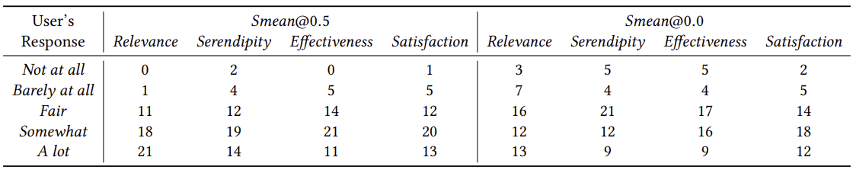
34
USER TRIAL RESULTS
Responses to survey questions in the user trial.

Slide 36

35
IMPROVEMENT FORMULA
Formula:
Measures how much the system improved the satisfaction from the initial movie to the recommended final movie.
A higher value indicates more significant improvement relative to the best possible outcome.

Slide 37
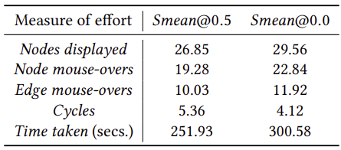
36
USER EFFORT
All values are averaged over participants who liked their final selected movie Somewhat or A lot.

Slide 38
37
CONCLUSIONS
Preference based feedback does not use features explicitly.
n-by-p is highly configurable (i.e 60 configurations)
The system is interpretable and easy to understand the relationship between pairs of consecutive items in preference chain.
User efforts are minimal.

Slide 39
THANK YOU
Presented By :
Shubham Gupta (202318052)
Kavisha Madani (202318007)
Shashwat Parikh (202318062)
Mayan Bhut (202318043)

