Slide 1
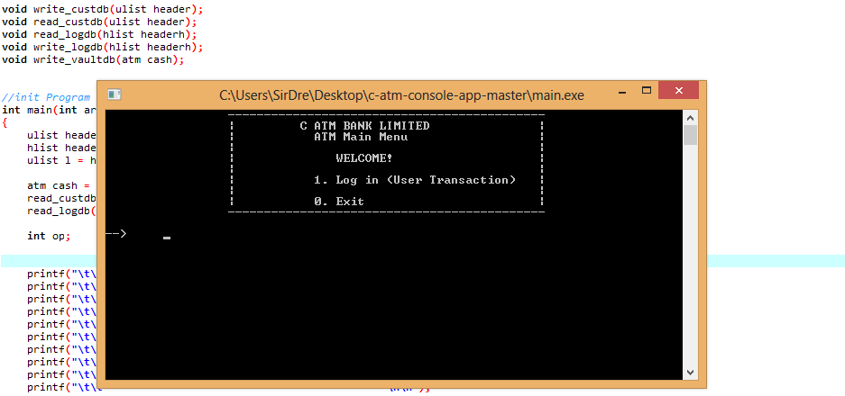
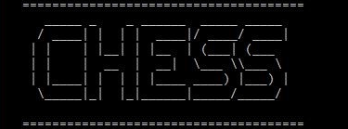
به نام خدا
by Shaker , Hosseini

Slide 2
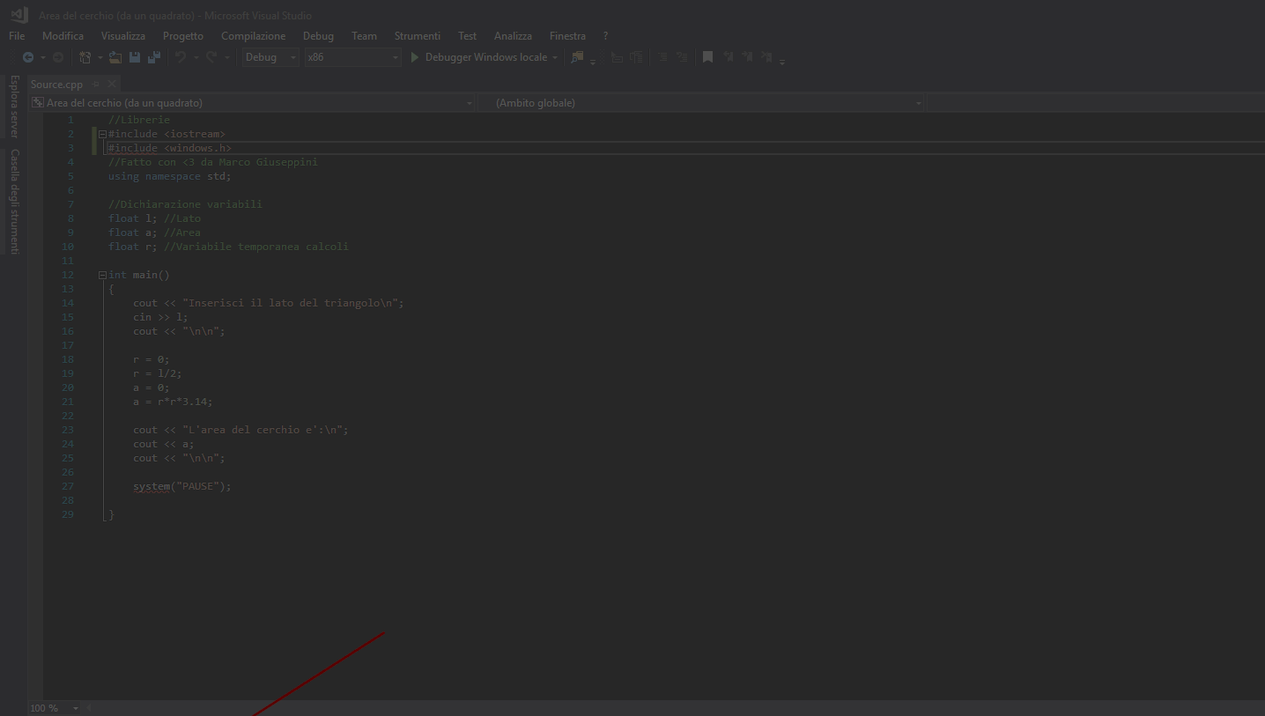
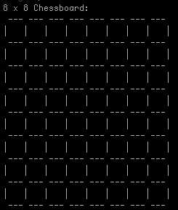
1 - Chessboard

Slide 3
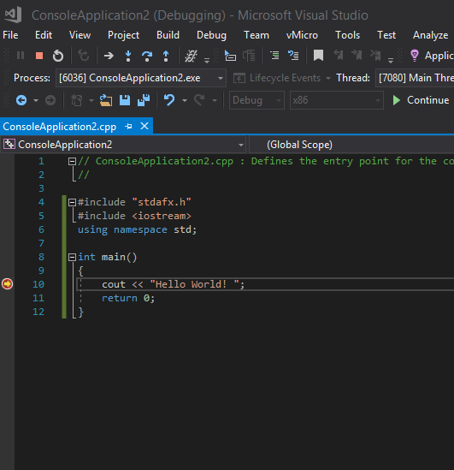
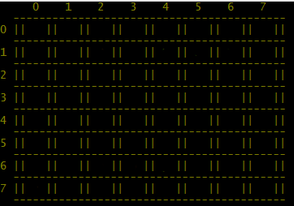
char board[8][8] = {
{ 'R' , 'H' , 'C' , 'K' , 'Q' , 'C' , 'H' , 'R' },
{ 'P' , 'P' , 'P' , 'P' , 'P' , 'P' , 'P' , 'P' },
{ ' ' , ' ' , ' ' , ' ' , ' ' , ' ' , ' ' , ' ' },
{ ' ' , ' ' , ' ' , ' ' , ' ' , ' ' , ' ' , ' ' },
{ ' ' , ' ' , ' ' , ' ' , ' ' , ' ' , ' ' , ' ' },
{ ' ' , ' ' , ' ' , ' ' , ' ' , ' ' , ' ' , ' ' },
{ 'p' , 'p' , 'p' , 'p' , 'p' , 'p' , 'p' , 'p' },
{ 'r' , 'h' , 'c' , 'k' , 'q' , 'c' , 'h' , 'r' }
};
void display()
{
int i , j , k ;
printf( " " ) ;
for( i=0 ; i<8 ; i++ ) printf( " %d" , i ) ; printf( "\n" ) ;
for( k=0 ; k<8 ; k++ )
{
printf( " " ) ;
for( i=0 ; i<42 ; i++ ) { printf( "-" ) ; } printf( "\n" ) ; printf( "%d " , k ) ;
for( j=0 ; j<8 ; j++ ) { printf( "|| %c " , board[k][j] ) ; }
printf( "|| \n" ) ;
}
printf( " " ) ;
for( i=0 ; i<42 ; i++ ) { printf( "-" ) ; } printf( "\n" ) ;
}

Slide 4






2 - Piece
The basic building block of the system,
every piece will be placed on a spot.
Piece function is an abstract function

Slide 5
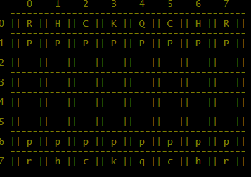
void rook( int r1 , int c1 )
{
int i , j , n , k=0;
printf( "Available are: \n" ) ;
n=c1;
printf( "Horizontally: \n" ) ;
while( board[r1][n-1] == ' ' || check3(r1,n-1) )
{
if( n == 0 ) { break ; }
printf( "%d%d , " , r1 , n-1 ) ;
lim[k]=(r1*10)+(n-1);
++k;
n-- ;
}
void horse( int r1 , int c1 )
{
int i=0;
printf( "Available are: " ) ;
if( board[r1+2][c1+1] == ' ' || check3(r1+2,c1+1) ){
printf( "%d%d, " , r1+2 ,c1+1) ;
lim[i]=((r1+2)*10)+(c1+1);
++i;
}
if( board[r1+2][c1-1] == ' ' || check3(r1+2,c1-1) ) {
if( (c1-1) > -1 ){
printf( "%d%d, " , r1+2, c1-1 ) ;
lim[i]=((r1+2)*10)+(c1-1);
++i;
} ++i;
void camel( int r1 , int c1 )
{
int a , b , c , d , i=0;
printf( "Available are: \n" ) ;
a = 1 , b = 1 ;
while( board[r1-a][c1+b] == ' ' || check3(r1-a,c1+b) )
{
if( (r1-a) == -1 || (c1+b) == 8 ) break ;
printf( "%d%d , " , r1-a , c1+b ) ;
lim[i]=((r1-a)*10)+(c1+b);
++i;
a++ ;
b++ ;
}
void pawn(int , int ) ;
void rook(int , int ) ;
void horse(int , int ) ;
void camel( int , int ) ;
void king( int , int ) ;
void queen( int , int ) ;
void pawnb( int , int ) ;
void king( int r1 , int c1 )
{
int i=0;
printf( "Available are: " ) ;
if( board[r1][c1+1] == ' ' || check3(r1,c1+1) ) {
printf( "%d%d , " , r1 , c1+1 ) ;
lim[i]=((r1)*10)+(c1+1);
++i;
}
if( board[r1][c1-1] == ' ' || check3(r1,c1-1) ) {
printf( "%d%d , " , r1 , c1-1 ) ;
lim[i]=((r1)*10)+(c1-1);
++i;
void pawn( int r1 , int c1 ) // paido
{
int i;
pwstatus[c1]++;
for (i=0;i<100;++i){
lim[i]=0;
}
i=0;
printf( "Available are: \n" ) ;
if( pwstatus[c1] == 1 )
{
if( board[r1+1][c1] == ' ' ){
printf( "%d%d , " , r1+1 , c1 ) ;
lim[i]=((r1+1)*10)+c1;

Slide 6
PLAYER 1 - Big Case
3 - Player
Player function represents one of the
participants playing the game.
PLAYER 2 - Small Case

Slide 7
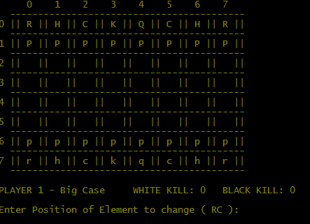
void player1()
{
int p1 , p2 , c1 , r1 , c2 , r2 , i , j;
printf( "\nPLAYER 1 - Big Case" ) ;
printf("\tWHITE KILL: %d\tBLACK KILL: %d\n",killw,killb);
again1:
printf( "\nEnter Position of Element to change ( RC ): " ) ;
scanf( "%d" , &p1 ) ;
c1 = p1 % 10 ;
r1 = p1 / 10 ;
for (i=0 ; i<100 ; ++i) {
lim[i]=0
void player2()
{
int p1 , p2 , c1 , r1 , c2 , r2 , i , j;
printf( "\nPLAYER 2 - Small Case") ;
printf("\tWHITE KILL: %d\tBLACK KILL: %d\n",killw,killb);
again2:
printf( "\nEnter Position of Element to change ( RC ): " ) ;
scanf( "%d" , &p1 ) ;
c1 = p1 % 10 ;
r1 = p1 / 10 ;
for (i=0 ; i<100 ; ++i) {
lim[i]=0;
}
switch( board[r1][c1] )

Slide 8
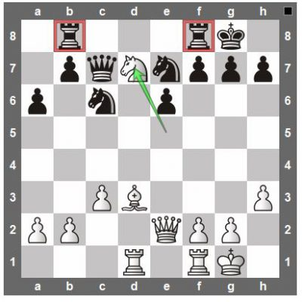
4 – The problems
1- نشان دادن موقعیتی که قابلیت کشتن دارد

Slide 9
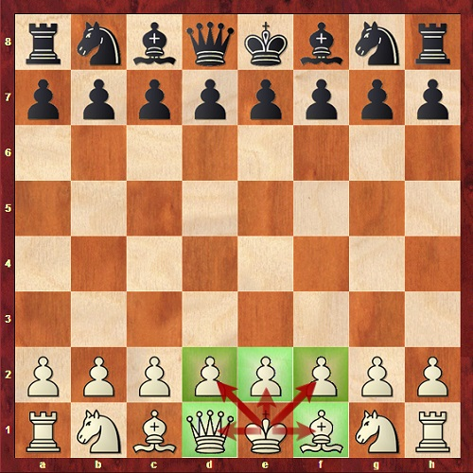
4 – The problems
2 – قابلیت حذف نکردن خودی

Slide 10
4 – The problems
3 – قابلیت ممنوعیت حرکت نکردن در نوبت

Slide 11
4 – The problems
4- قابلیت ممنوعیت انتخاب موقعیت خالی

Slide 12
4 – The problems
5- قابلیت محدودیت حرکت

Slide 13
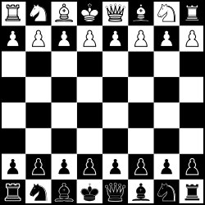
5 – Features
1 – اضافه کردن بخش اسان و سخت

Slide 14
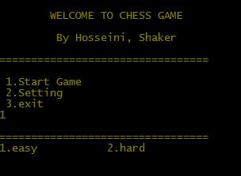
void difficulty()
{
int b;
printf("\n=================================\n");
printf("1.easy \t\t 2.hard\n");
scanf("%d",&b);
switch(b)
{
case 1 :
printf("You choose easy We will show you \nthe full movements of each elemnts\n To choose the easiest for you \n now ENTER TO START GAME ");
ctr = 1;
getch();
break;
case 2 :
printf("You choose hard \n now ENTER TO START GAME ");
getch();
system( "cls" );
break;

Slide 15

5 – Features
2- اضافه کردن تنظیمات توی بازی

Slide 16

printf(" CHANGE COLOR AS YOU LIKE ... \n
1.Background . \n 2.Text . \n 3.Both of Them . \n \
0.Current color .\n");
fflush(stdin);
scanf("%d",&user);
printf("\n=================================\n");
switch(user)
{
case 1:
help();
printf(" \n\n Color code for background... = ");
fflush(stdin);
scanf("%c",&x[6]);
while(x[7] == '\0'){x[7] = '0';}
system(x);
break;
=
case 2:
help();
printf(" \n\n Color code for text... = ");
while(x[6] == '\0'){ x[6] = '0';}
fflush(stdin);
scanf("%c",&x[7]);
system(x);
break;
case 3:
help();
printf(" \n\n Color code for background... = ");
fflush(stdin);
scanf("%c",&x[6]);
printf(" \n\n Color code for text... = ");
fflush(stdin);
scanf("%c",&x[7]);
system(x);
break;
case 0:

Slide 17
5 – Features
3- اضافه کردن هوش مصنوعی
single player
Two player

