Slide 1

Tech Eximius 2.0 / Team codehackers
Together
A flood relief request that residents can follow.
Source code
GitHub repository
Prototype
Open the judge exercise
Demo video
Watch the walkthrough
Adapted from Team Sisyphus’s DevDay Exchange New Delhi prototype.
Notes:
The three underlined labels are clickable. Use fictional details in the exercise.
Sources
https://github.com/shhhivam12/together-tech-eximius
https://together-tech-eximius.shiiim.chatgpt.site/demo
https://together-tech-eximius.shiiim.chatgpt.site/walkthrough.mp4
https://github.com/shhhivam12/openai-devday-delhi

Slide 2

A request can disappear between handoffs
Four people at a school need drinking water.
A resident has enough signal to draft a message, then loses the connection. They cannot tell whether the relief desk received it.
The coordinator faces the other half of the problem. Is a second message a new household or a retry?
Notes:
This is a fictional exercise scenario used to explain the product. It makes no claim about response times or actual relief operations.
Sources
https://github.com/shhhivam12/openai-devday-delhi/blob/main/docs/evaluation.md
https://github.com/shhhivam12/openai-devday-delhi/tree/main/public/illustrations

Slide 3
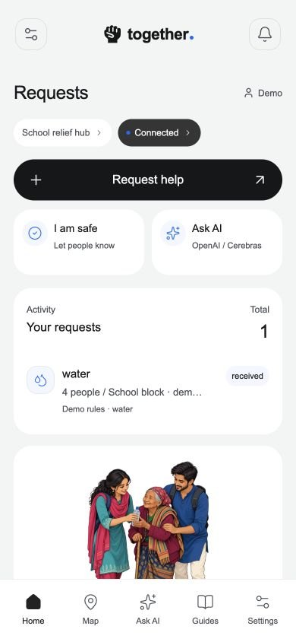
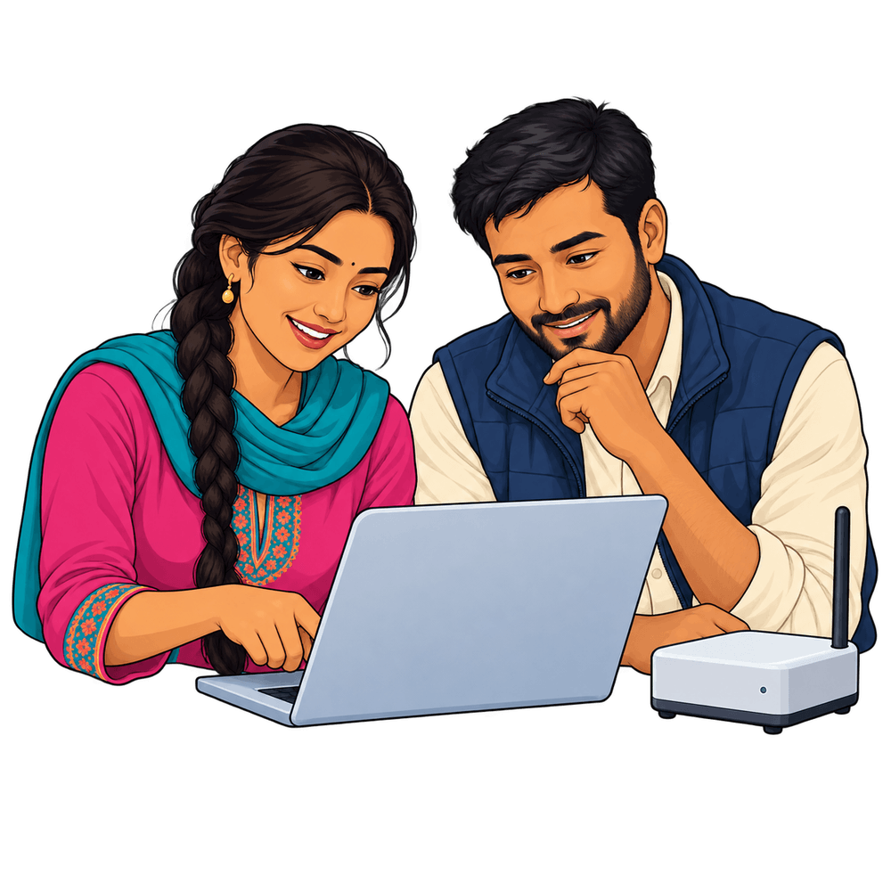
One request, visible on both sides
01
A resident records a need
Choose water, enter four people and add the school as a landmark.
02
The relief desk acknowledges it
A coordinator opens the shared queue and marks the request acknowledged.
03
The resident sees the update
The phone shows the same record as the desk assigns it and marks it complete.
Notes:
The resident PWA and nodal console use the same D1-backed request record. Status refreshes by polling. Acknowledgement records an operator action.
Sources
https://github.com/shhhivam12/together-tech-eximius/blob/main/docs/network.md
https://github.com/shhhivam12/together-tech-eximius/blob/main/docs/images/mobile-app.jpg

Slide 4
What survives a lost connection?
While disconnected
When the signal returns
After setup, the phone can open six saved guides and a local map. A new request stays in the device’s outgoing queue.
The resident retries the same request ID. The server records it once, and the coordinator sees one household in the queue.
An offline draft is visibly unsent until the server accepts it.
Notes:
Service worker cache, Cache Storage and localStorage retain prepared content and pending events. D1 operation IDs support idempotent replay. The exercise does not use offline inter-hub transmission.
Sources
https://github.com/shhhivam12/together-tech-eximius/blob/main/public/sw.js
https://github.com/shhhivam12/together-tech-eximius/blob/main/docs/network.md

Slide 5
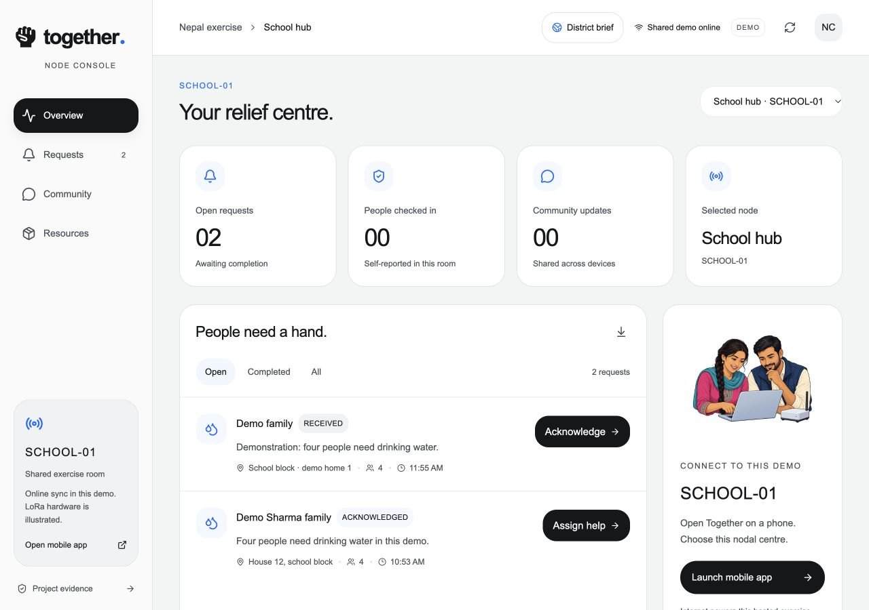
How the prototype works
On the phone
React and TypeScript power the resident PWA. A service worker caches the app and guides.
At the relief desk
A Cloudflare Worker validates updates. D1 stores the request and its status. The console reads the same record.
Notes:
The core workflow uses the network route and D1 schema. Source also contains optional OpenAI, Cerebras and Exa adapters. Paid AI is disabled for this judge deployment.
Sources
https://github.com/shhhivam12/together-tech-eximius/blob/main/app/api/network/route.ts
https://github.com/shhhivam12/together-tech-eximius/blob/main/db/schema.ts
https://github.com/shhhivam12/together-tech-eximius/blob/main/docs/images/nodal-console.jpg

Slide 6
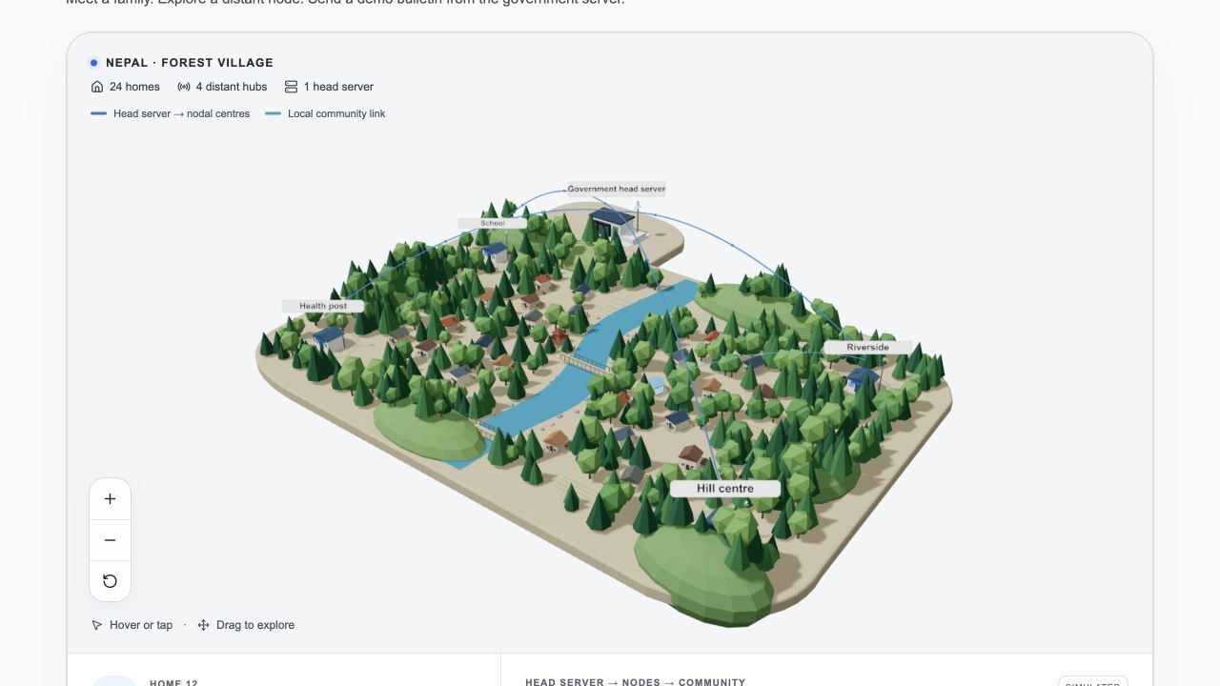
A relief drill can test the impact
Can residents tell when someone has seen their request?
Run a drill with residents and a coordinator. Interrupt connectivity after a water request, restore it, then acknowledge it at the desk.
Measure time to acknowledgement, count duplicate requests after retries, and ask residents to identify the current status.
The pilot would test these outcomes. Radio links and physical community hubs remain proposed.
Notes:
The proposed drill and metrics are a validation plan. There are no measured field outcomes. The 3D village, physical hub and LoRa transport are simulations or roadmap items.
Sources
https://github.com/shhhivam12/together-tech-eximius/blob/main/docs/evaluation.md
https://github.com/shhhivam12/together-tech-eximius/blob/main/docs/images/village.jpg

