Slide 1



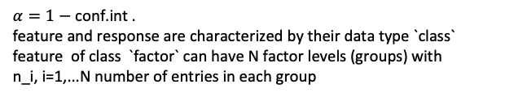






$α=1−$ conf.int .
feature and response are characterized by their data type `class`
feature of class `factor` can have N factor levels (groups) with
n_i, i=1,...N number of entries in each group
feature: factor
response: numeric or integer a
feature: N=2 levels with $n_{1}$ resp $n_{2}$
entries in each level
feature: N>2 levels
Check for normaliy of residuals of aov() with shapiro.test()
Both $n_{1}$ and $n_{2}>30$
$n_{1}$ or $n_{2}≤30:$
$$p<α$$
$$p≥α$$
Check for normality of both feature levels: shapiro.test():
Check for homoscedacity of residuals: bartlett.test() :
$p_{1}<α$or $p_{2}<α$
$p_{1}≥α$ and $p_{2}≥α$
$$p<α$$
$$p≥α$$
t.test()
wilcox.test()
t.test()
kruskal.test()
oneway.test()
aov()
pairwise.wilcox.test()
TukeyHSD()
TukeyHSD()
Colour codes:
Post-hoc
Non-parametric tests
Notes:
Note that a t-test is a special case of regression, & that, since the predicted value is the mean, the sample distribution w/in each group is the distribution of the residuals. The 2 groups taken together do not need to be normally distributed, however. If you are interested in the dependent samples t-test, the distribution of the differences is assumed to be normal. For more info on the assumption pertaining only to the residuals, this thread may be helpful: what-if-residuals-are-normally-distributed-but-y-is-not. – gung - Reinstate Monica
Mar 14, 2013 at 5:02
https://stats.stackexchange.com/questions/45671/normality-of-residuals-vs-sample-data-what-about-t-tests
https://www.theanalysisfactor.com/checking-normality-anova-model/

Slide 2

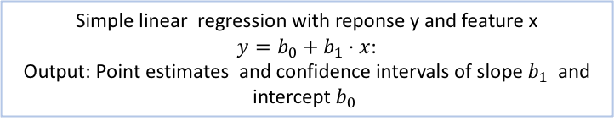





response: numeric or integer:
feature: numeric or integer:
feature: more than two levels
Simple linear regression with reponse y and feature x $y=b_{0}+b_{1}⋅x$:
Output: Point estimates and confidence intervals of slope $b_{1}$ and intercept $b_{0}$
check for normaliy of residuals: shapiro.test(), ad.test():
Check for normaliy of residuals of linear regression
$$p<α$$
$$p>α$$
$$p<α$$
$$p>α$$
Check for homoscedacity of residuals: bartlett.test() :
$$p<α$$
$$p>α$$
Show regression and prognosis bands in grap
kruskal.test()
oneway.test()
aov()
pairwise.wilcox.test()
TukeyHSD()
TukeyHSD()

Slide 3





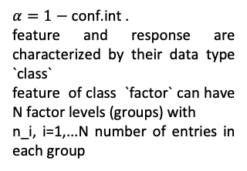







$α=1−$ conf.int .
feature and response are characterized by their data type `class`
feature of class `factor` can have N factor levels (groups) with
n_i, i=1,...N number of entries in each group
feature: factor
response: numeric or integer
feature: N=2 levels with $n_{1}$ resp $n_{2}$
entries in each level
feature: N>2 levels
Check for normaliy of residuals: shapiro.test()
$$p<α$$
$$p≥α$$
Both $n_{1}$ and $n_{2}>30$
$n_{1}$ or $n_{2}≤30$
Check for normaliy : shapiro.test():
Check for normaliy of residuals: ad.test():
Check for normaliy of residuals: ad.test():
$p_{1}<α$or $p_{2}<α$
$p_{1}≥α$ and $p_{2}≥α$
$$p<α$$
$$p≥α$$
$$p<α$$
$$p≥α$$
Check for homoscedacity of residuals: bartlett.test() :
$$p<α$$
$$p≥α$$
t.test()
wilcox.test()
t.test()
kruskal.test()
oneway.test()
aov()
pairwise.wilcox.test()
TukeyHSD()
TukeyHSD()

