Slide 1
Profiteren
Its time to trade

Slide 2

Problem
Different crypto exchanges have different gas rates for different cryptocurrencies.
No platform for real-time detection of price advantage.

Slide 3

The Utopia
Our twitter bot tracks DODO’s price advantage and tweets about it in real-time.
It compares the exchange prices of two exchanges, chain-link and DODO.

Slide 4
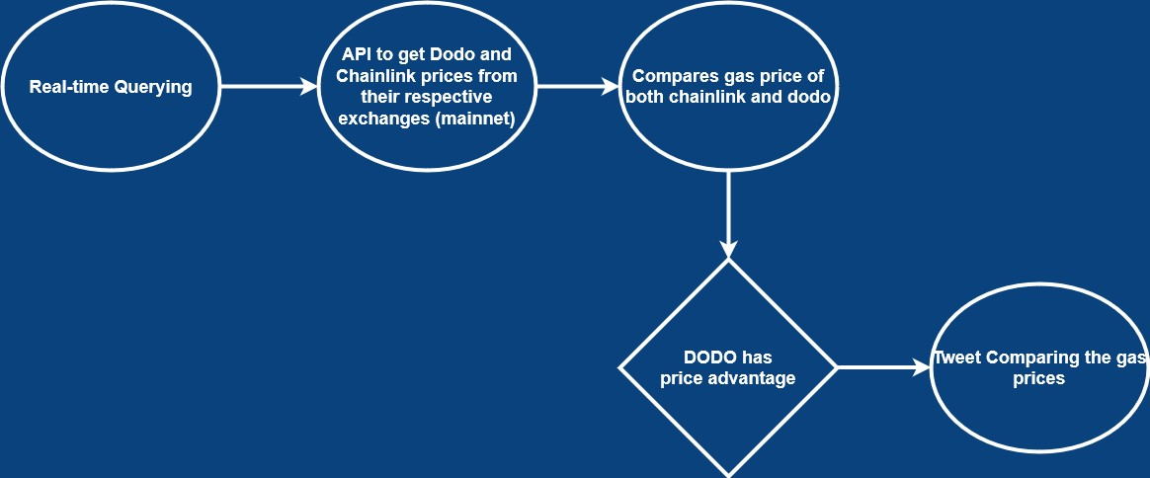

Slide 5

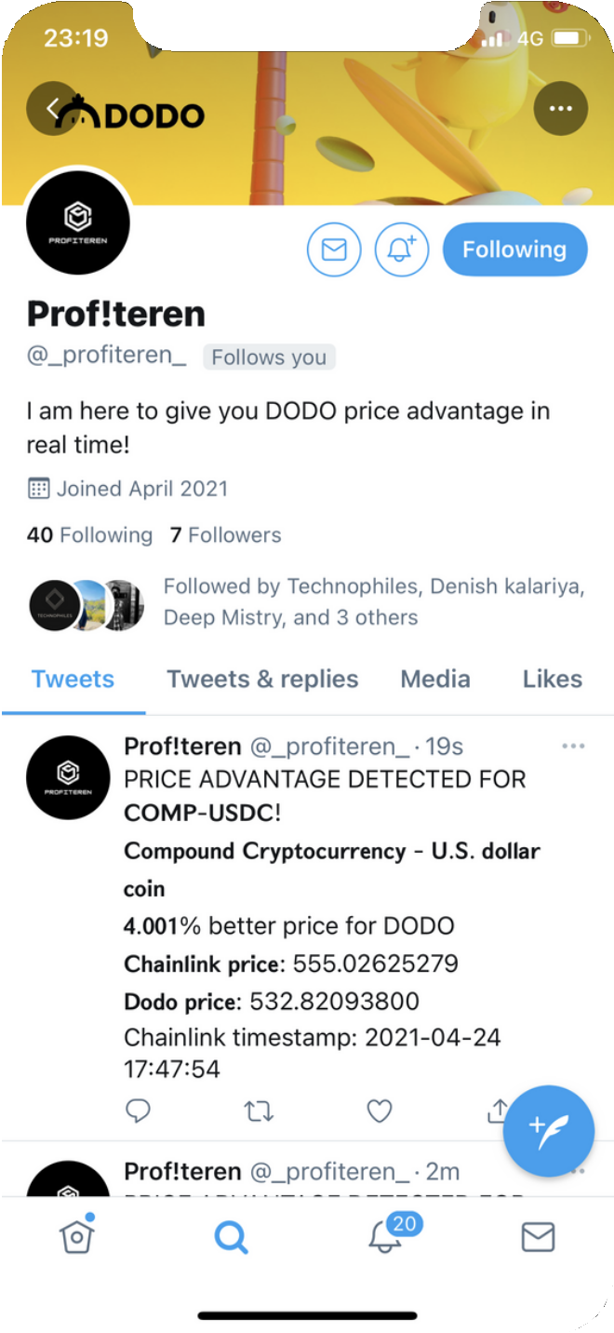

Slide 6

Target Market
Who will attract profiteren ?
Target Market 1
Crypto Users.
Target Market 2
Tie up with other exchange platforms.

Slide 7
Why us ?
Our platform compares realtime exchange prices and provides advantage

Slide 8
Step 1
Give price advantage comparing multiple exchanges.
Step 2
Cryptocurrency Wallet
Future Roadmap
Step 3
Transaction Integrating transaction functionality in our platform
Step 4
Token-erc 20 token Benefit: bot reach will increase
If the token is taken

Slide 9





The Team
Denish Kalariya
Yug Thakkar
Shubham Vyas
Rushabh Thakkar
Divy Patel

