Slide 1
Coded MapReduce
Presentor : Cao Haiwen
(Short version: Allerton 2015; Arxiv)
Songze Li *, Mohammad Ali Maddah-Ali†, and A. Salman Avestimehr* *University of Southern California, Los Angeles, CA, USA †Bell Labs, Holmdel, NJ, USA

Slide 2
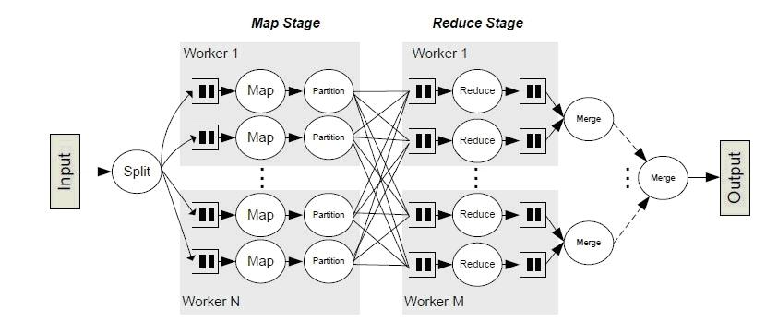
What is MapReduce?
Data shuffling
In fact, as observed in [6], using a Hadoop [5] cluster, 33% of the job execution time is spent on data shuffling.
[5] “Apache Hadoop,” http://hadoop.apache.org.
[6] M. Chowdhury, M. Zaharia, J. Ma, M. I. Jordan, and I. Stoica, “Managing data transfers in computer clusters with orchestra,” ACM SIGCOMM Computer Communication Review, vol. 41, no. 4, pp. 98–109, Aug. 2011.

Slide 3
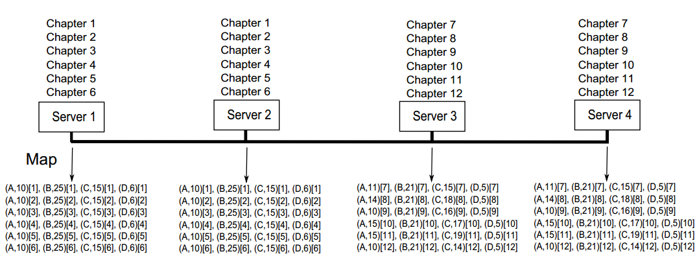
Example: Word-Counting (Tranditional MapReduce)
Data Shuffling
Reduce
A: 135
B
C
D

Slide 4
Example: Word-Counting (Uncoded Shuffling)
Data Shuffling
Reduce
A: 135
B
C
D

Slide 5
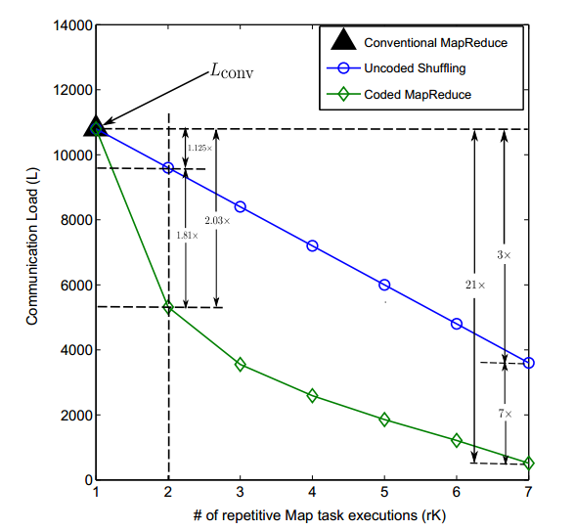




Gain from Repetitive Mapping
$$\frac{K−1}{K−r} ≈1−r$$
As K goes large, the repetitive gain $\frac{K−1}{K−r} ≈1−r$
Can we get a non-vanishing gain as K goes infinite ?
Like this
Parameters: K, Q, N, r

Slide 6
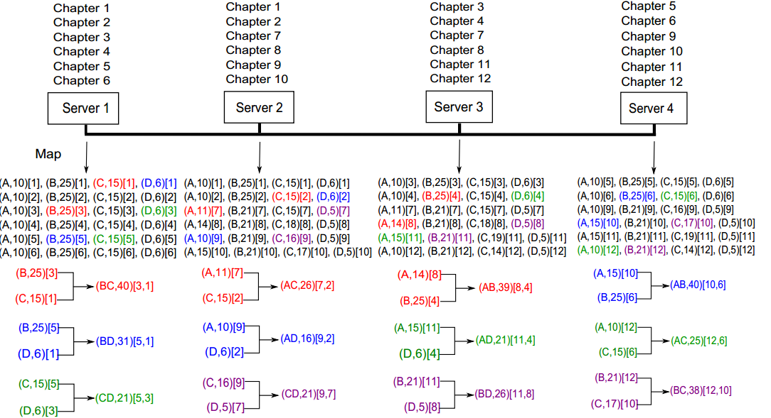
Example: Word-Counting (Coded Shuffling)
A: 135
B
C
D

Slide 7




Coded MapReduce : Coding Gain
Parameters: K, Q, N, r
$$≈1−r$$
Repetitive Gain
$$≈rK$$
Coding Gain

Slide 8
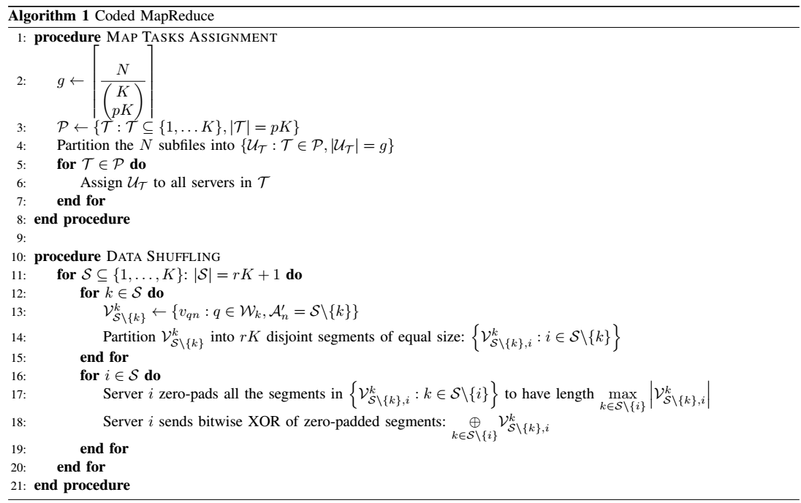
Scheme: Coded MapReduce
A: 135
B
C
D

Slide 9
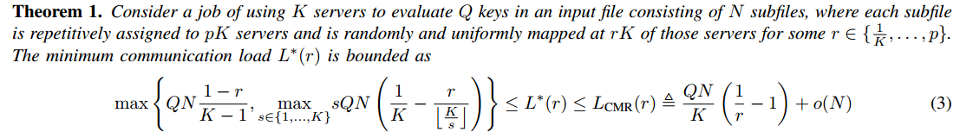
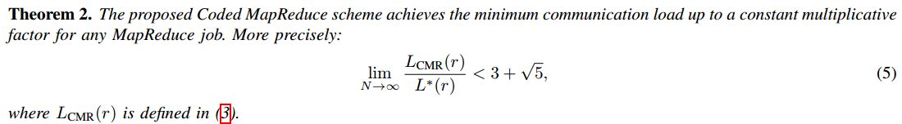
Main Results:
Cut-Set Bounds

Slide 10
Related Works
Distributed Computing
[2] J. Dean and S. Ghemawat, “MapReduce: Simplified data processing on large clusters,” Sixth USENIX Symposium on Operating System Design and Implementation, Dec. 2004.
[8] A. Greenberg, J. R. Hamilton, N. Jain, S. Kandula, C. Kim, P. Lahiri, D. A. Maltz, P. Patel, and S. Sengupta, “VL2: a scalable and flexible data center network,” ACM SIGCOMM computer communication review, vol. 39, no. 4, pp. 51–62, Oct. 2009. [9] M. Al-Fares, S. Radhakrishnan, B. Raghavan, N. Huang, and A. Vahdat, “Hedera: Dynamic flow scheduling for data center networks,” 7th USENIX Symposium on Networked Systems Design and Implementation, Apr. 2010. [10] S. Zhang, J. Han, Z. Liu, K. Wang, and S. Feng, “Accelerating MapReduce with distributed memory cache,” 15th IEEE International Conference on Parallel and Distributed Systems (ICPADS), pp. 472–478, Dec. 2009. [11] J. Ekanayake, H. Li, B. Zhang, T. Gunarathne, S.-H. Bae, J. Qiu, and G. Fox, “Twister: a runtime for iterative MapReduce,” Proceedings of the 19th ACM International Symposium on High Performance Distributed Computing, pp. 810–818, June 2010. [20] K. Lee, M. Lam, R. Pedarsani, D. Papailiopoulos, and K. Ramchandran, “Speeding up distributed machine learning using codes,” e-print arXiv:1512.02673, 2015.
Coded Caching
[12] M. A. Maddah-Ali and U. Niesen, “Fundamental limits of caching,” IEEE Transactions on Information Theory, vol. 60, no. 5, pp. 2856–2867, Mar. 2014. [13] ——, “Decentralized coded caching attains order-optimal memory-rate tradeoff,” IEEE/ACM Transactions on Networking, Apr. 2014.
[14] M. Ji, G. Caire, and A. F. Molisch, “Fundamental limits of caching in wireless D2D networks,” e-print arXiv:1405.5336, 2014.

Slide 11
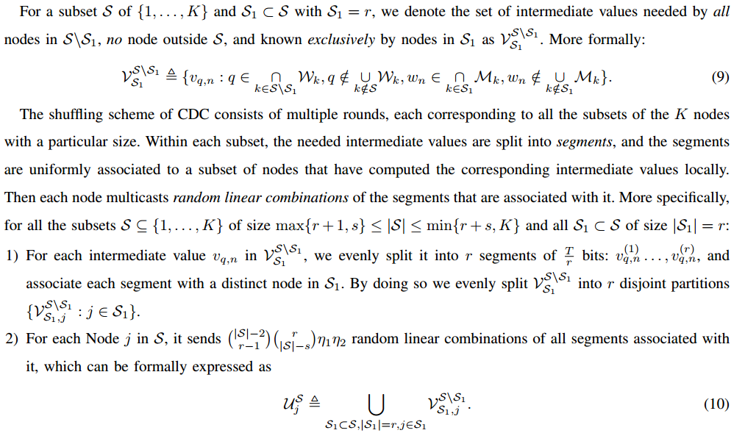
Further Work:
S. Li, M. A. Maddah-Ali, Q. Yu and A. S. Avestimehr “A Fundamental Tradeoff between Computation and Communication in Distributed Computing”

