Slide 1
Locally Relax the Value Restriction by Control Flow Analysis
Team 17, b00902064 宋昊恩, b00902107 游書泓
Reference
Simple Imperative Polymorphism
Andrew K. Wright
Lisp and Symbolic Computation - Special issue on state in programming languages (part I) archive Volume 8 Issue 4, Dec. 1995 Pages 343 - 355

Slide 2
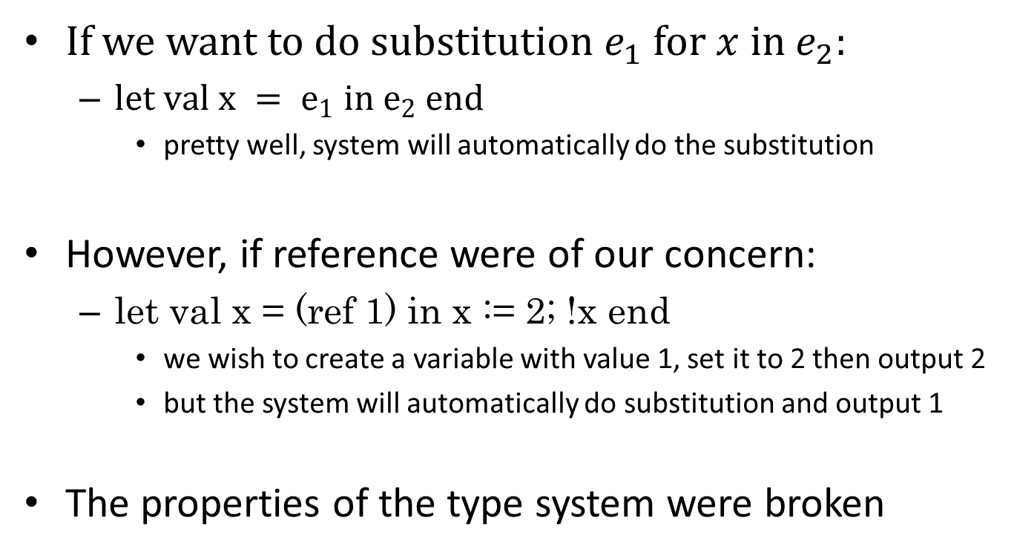
Problem statement
If we want to do substitution $e_{1}$ for $x$ in $e_{2}$:
$let val x = e_{1} in e_{2} end$
pretty well, system will automatically do the substitution
However, if reference were of our concern:
let val x = (ref 1) in x := 2; !x end
we wish to create a variable with value 1, set it to 2 then output 2
but the system will automatically do substitution and output 1
The properties of the type system were broken

Slide 3
Problem statement (cont.)
Is the problem clearly defined?
The author provides 3 counterexamples to the original type system were there references in the program
Is it a good research problem?
Yes, as the interaction between side-effects and higher-order features is non-trivial
Is the problem relevant to your research or interests?
Yes, it provides an innovative direction for our research.

Slide 4
Proposed solution
Limit polymorphism to values
the former sample will not type check
the type system will be sound
However, it causes many false alarm
compiler alerts non-existent error
treat type variables too strictly than it should be
Three new scenarios that need to be fixed

Slide 5
Proposed solution (cont.)
Are they stated clearly? Can you describe them in a short paragraph?
This solution is simple and understandable.
It can be briefly described.
Are the solutions sound and reasonable?
Yes; though there are some exceptions, the author provides explicitly solutions and claims that they rarely occur.
Can you use/modify their solutions to solve your problem?
The provided solution can be strengthen.

Slide 6
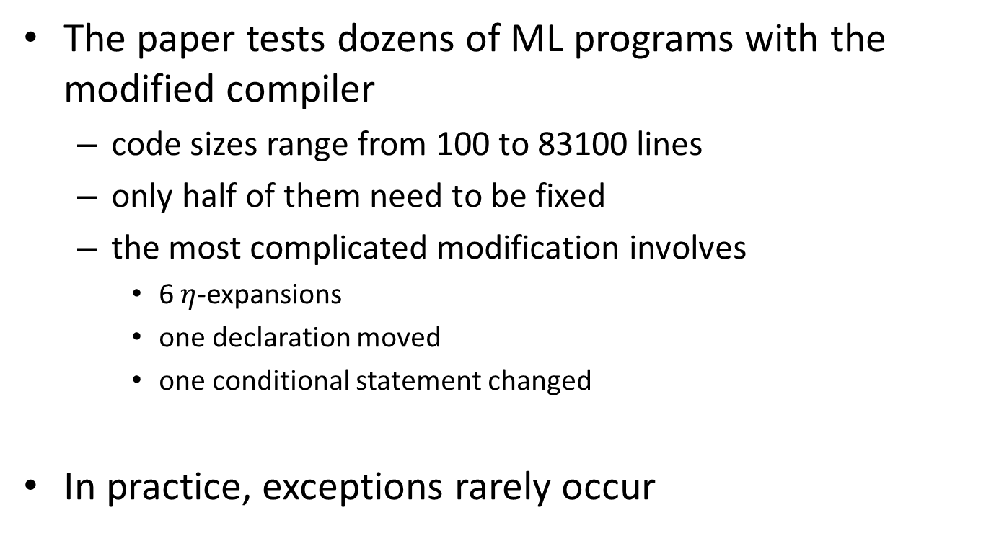
Evaluation
The paper tests dozens of ML programs with the modified compiler
code sizes range from 100 to 83100 lines
only half of them need to be fixed
the most complicated modification involves
6 $η$-expansions
one declaration moved
one conditional statement changed
In practice, exceptions rarely occur

Slide 7
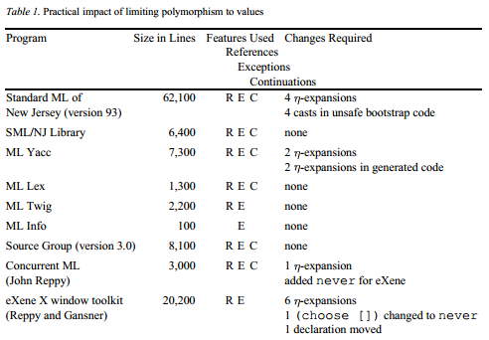
Evaluation (cont.)
Are their solutions carefully evaluated?.
Evaluation method and statistics are compact and convincing.

Slide 8
Applications and Future work
Type system plays a key role in functional programming language.
Concept of functional programming has become prevailing in C++, Java, Ruby, Python, etc.
A more compatible compiler will shorten the gaps between static and runtime behavior.

Slide 9
Applications and Future work (cont.)
Why people care about such applications? Where does its value come from?
The usage of type system becomes ubiquitous.
How big is the gap there between the existing theory and its final application? Is there any research value hiding behind such gap?
The theory derived from the author can be directly implemented in practice.
The solution can be strengthened more advancedly.

Slide 10
Locally Relax the Value Restriction by Control Flow Analysis
Team 17, b00902064 宋昊恩, b00902107 游書泓
Reference
A Practical and Flexible Flow Analysis for Higher-Order Languages
J. Michael Ashley and R. Kent Dybvig.
ACM Transactions on Programming Languages and Systems 20, 4, 845-868, July 1988.

Slide 11
The Problem 1/2
Control Flow Analysis
Find the function call at a given program point (together with the relevant bindings)
Inseparable from data flow analysis, in contrast to non-higher-order languages

Slide 12
The Problem 2/2
Control flow analysis
It's impossible to determine the exact control flow
The approximation ought to be safe
Precision versus long run time
Type system and control flow analysis are both one sort of abstract interpretation

Slide 13
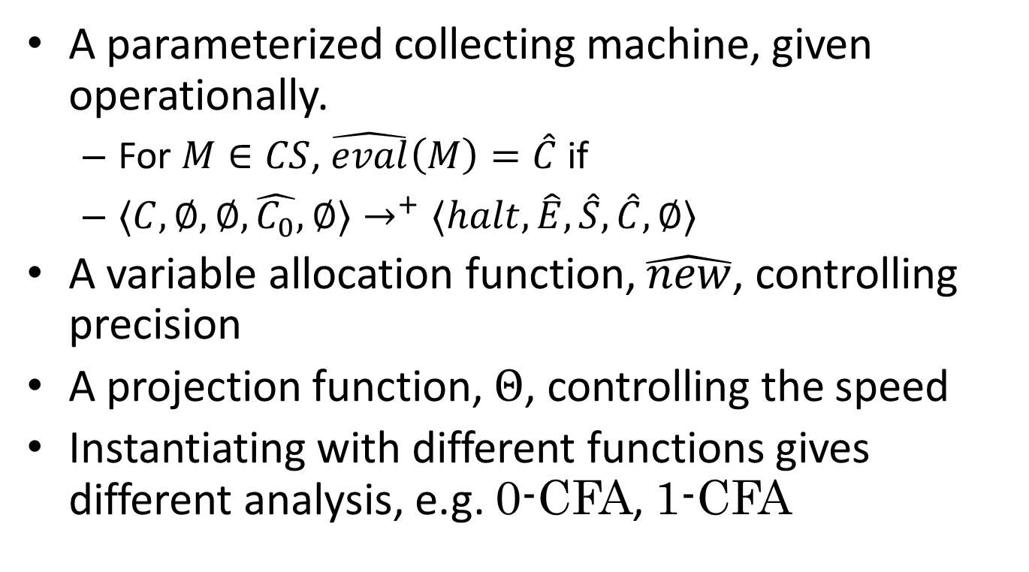
Methodology 1/2
A parameterized collecting machine, given operationally.
For $M∈CS$, $\hat{eval}\left(M\right)=\hat{C}$if
$⟨C,∅,∅,\hat{C_{0}},∅⟩→^{+}⟨halt,\hat{E},\hat{S},\hat{C},∅⟩$
A variable allocation function, $\hat{new}$, controlling precision
A projection function, $Θ$, controlling the speed
Instantiating with different functions gives different analysis, e.g. 0-CFA, 1-CFA

Slide 14
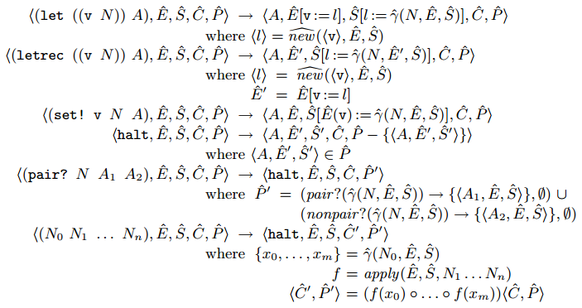
Methodology 2/2
The collecting machine is sound, and is a unified framework.
We may probably infer the pureness of the expression from the control flow information.

Slide 15
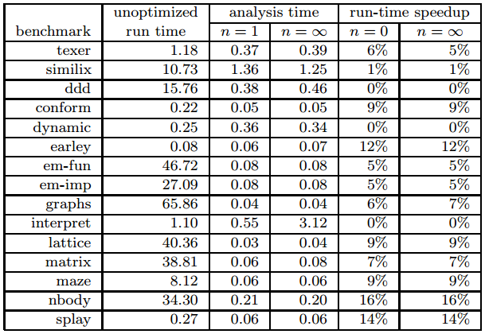
Evaluation 1/2
Use the control flow information to enable more optimizations

Slide 16
Evaluation 2/2
The benchmarks indeed included
Impact on compile-time and run-time speedup
Optimized procedures calls -- which is enabled by the proposed CFA
Eliminated closure construction, also requires control flow informations

Slide 17
Applications and Future Work 1/2
Being parameterized, the proposed framework is applicable to a wide range of analysis. The compiler may freely choose between precision and speed.
Control flow information is essential to a plenty number of optimizations
Also possible to analyse OO languages
Higher-order languages are common nowaday: Scheme, Haskell, Standard ML, javascript, Python, Ruby, ...

Slide 18
Applications and Future Work 2/2
Can also statically check the safety of scripting languages
Optimizations for both scripting language and compiled languages are desired
Between theory and application: Compile-time consumption and precision; many analysis requires tuning

