Slide 1
Locally Relax the Value Restriction by Control Flow Analysis
Team 17
b00902064 資訊四 宋昊恩
b00902107 資訊四 游書泓

Slide 2
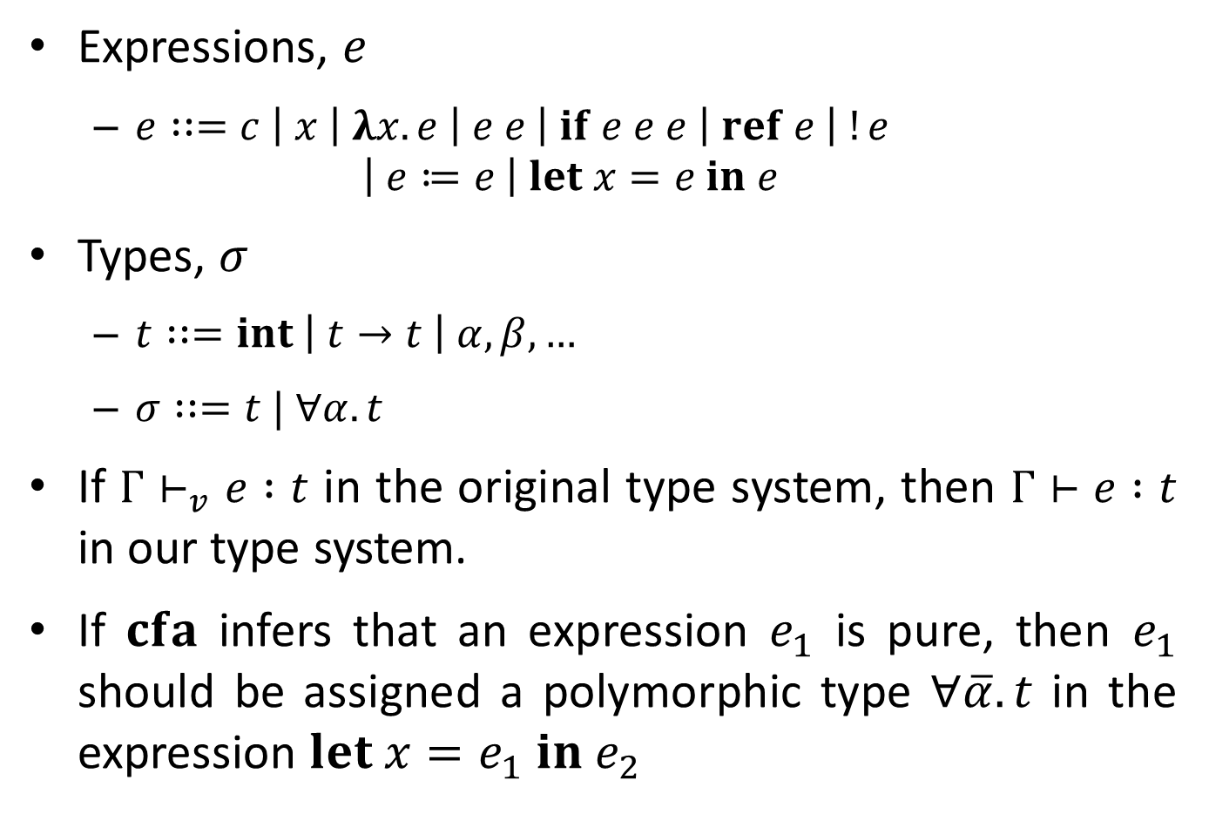
Problem Definition
Expressions, $e$
$e∷=c \left| x \right| λx.e \left| e e \right| if e e e \left| ref e \right| !e$ $\left| e≔e \right| let x=e in e$
Types, $σ$
$t∷=int \left| t→t \right| α, β, …$
$σ∷=t | ∀α.t$
If $Γ⊢_{v}e :t$ in the original type system, then $Γ⊢e :t$ in our type system.
If $cfa$ infers that an expression $e_{1}$ is pure, then $e_{1}$ should be assigned a polymorphic type $∀\overline{α}.t$ in the expression $let x=e_{1} in e_{2}$

Slide 3
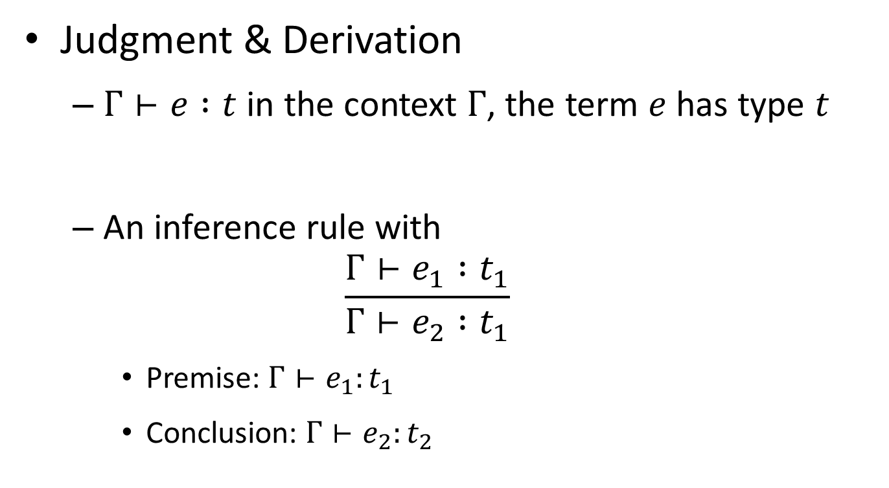
Our Approach – Backgrounds
Judgment & Derivation
$Γ⊢e :t$ in the context $Γ$, the term $e$ has type $t$
An inference rule with
$$\frac{Γ⊢e_{1} :t_{1}}{Γ⊢e_{2} :t_{1}}$$
Premise: $Γ⊢e_{1}:t_{1}$
Conclusion: $Γ⊢e_{2}:t_{2}$

Slide 4
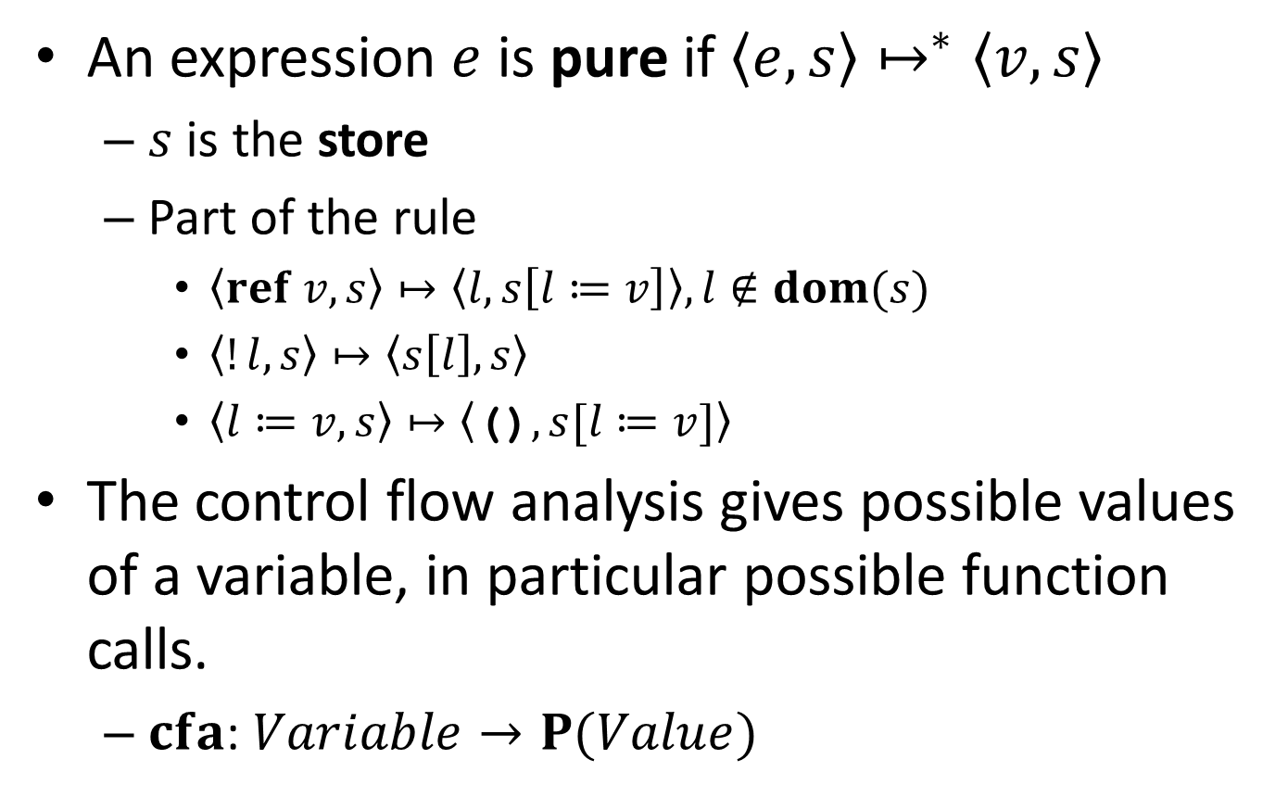
Our Approach
An expression $e$ is pure if $〈e,s〉↦^{∗}〈v,s〉$
$s$ is the store
Part of the rule
$〈ref v, s〉↦〈l, s\left[l≔v\right]〉, l∉dom(s)$
$〈!l, s〉↦〈s\left[l\right], s〉$
$〈l≔v,s〉↦〈\text{()},s[l≔v]〉$
The control flow analysis gives possible values of a variable, in particular possible function calls.
$cfa$: $Variable→P(Value)$

Slide 5
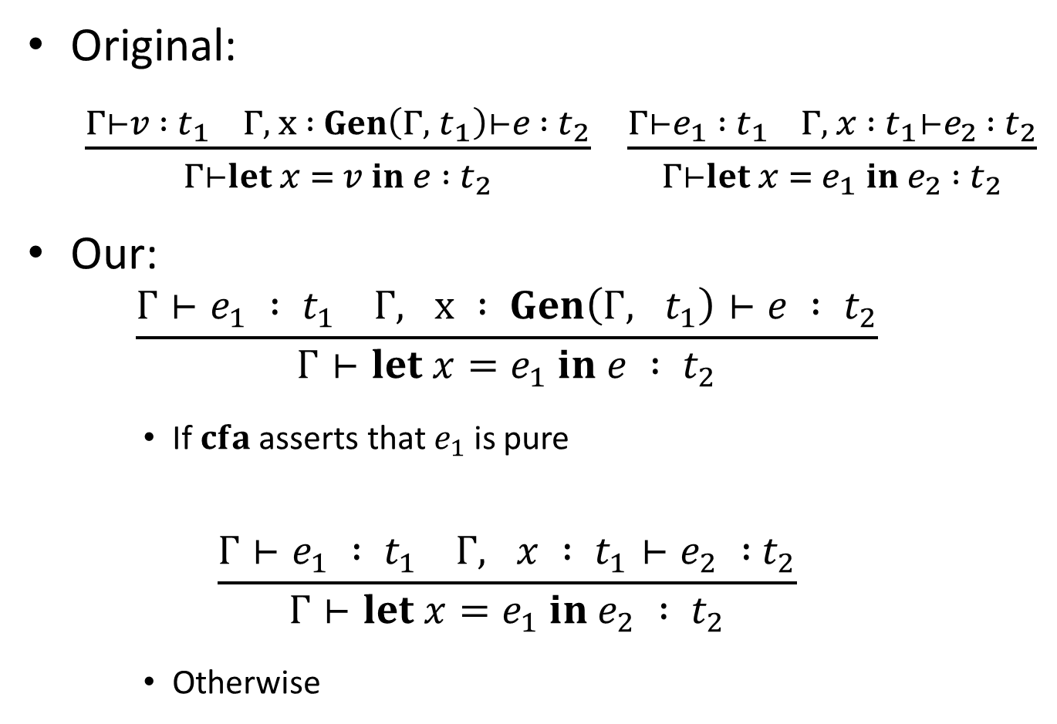
Our Approach
Original:
$\frac{Γ⊢v : t_{1} Γ, x : Gen\left(Γ, t_{1}\right)⊢e : t_{2}}{Γ⊢let x = v in e : t_{2}}$ $\frac{Γ⊢e_{1} : t_{1} Γ, x : t_{1}⊢e_{2 } : t_{2}}{Γ⊢let x = e_{1} in e_{2} : t_{2}}$
Our:
$$\frac{Γ⊢e_{1} : t_{1} Γ, x : Gen\left(Γ, t_{1}\right)⊢e : t_{2}}{Γ⊢let x=e_{1} in e : t_{2}}$$
If $cfa$ asserts that $e_{1}$ is pure
$$\frac{Γ⊢e_{1} : t_{1} Γ, x : t_{1}⊢e_{2} :{ t}_{2}}{Γ⊢let x=e_{1} in e_{2} : t_{2}}$$
Otherwise

Slide 6
Check points
Is the method of investigation clearly defined?
✓The type system is formally defined
✗Which CFA is not specified
Is it appropriate?
Type system and CFA are both one sort of abstract interpretation
Does it ignore something?
✗We believe that our solution is robust

