Slide 1
Locally Relax the Value Restriction by Control Flow Analysis
Team 17
b00902064 資訊四 宋昊恩
b00902107 資訊四 游書泓

Slide 2
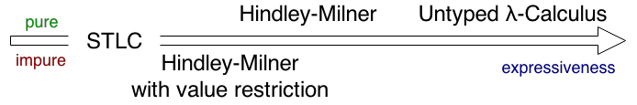
Abstract
This project is aiming at relaxing the value restriction locally via flow analysis, where the value striction has long been the standard yet too restrictive solution to integrating Hindler-Milner style polymorphism with imperative features.

Slide 3
Motivation
The value restriction refuses to generalize all non-value terms, hence rejecting procedures that compute polymorphic functions.
Also rejects polymorphic data structures
The use of imperative features is rare; most of the computations are functionally pure.

Slide 4
Challenges
The value restriction is actually at a balance point that any extension could probably be unwillingly complex and break the module abstraction.
Polymorphism has a bad interaction with imperative features such as mutable variables.

Slide 5
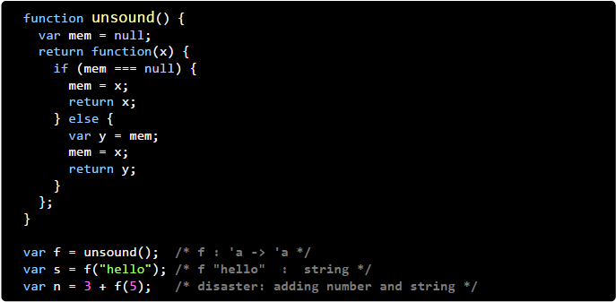
Challenges (cont.)

Slide 6
Potential Solutions
Apply techniques from static program analysis, tracking type information together with the use of imperative features.
The analysis shall basically be syntax-directed.
Any spotted safe type variables should be generalized.

Slide 7
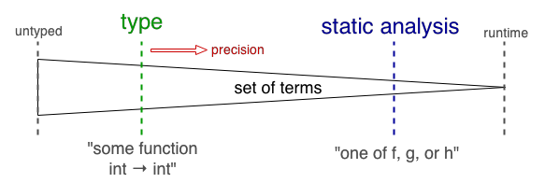
Novelty
Static analysis have been used to identify potential errors in the program, while type systems can prove the absence of certain runtime errors.
This project is an attempt to bring the two together so that some safe but non-provable programs could be allowed without much modification to the original type system.

Slide 8
Evaluation
Our concerns include
Accept more terms in practice, i.e. improve expressiveness
Impact on compilation time

