Slide 1
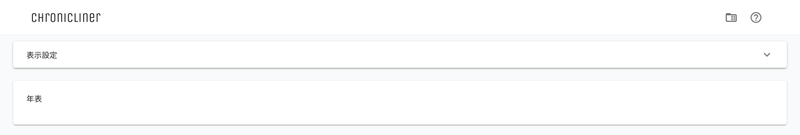
①
②

Slide 2
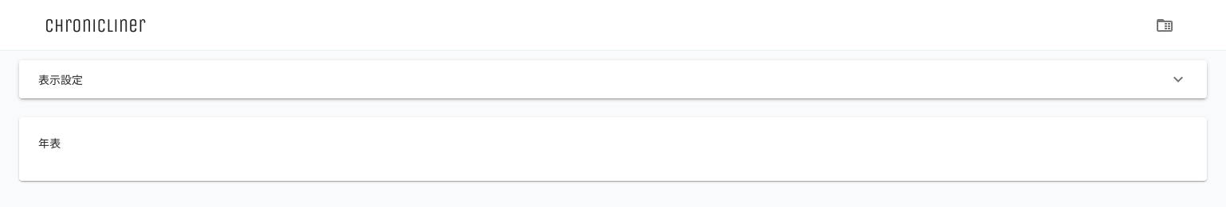
①

Slide 3
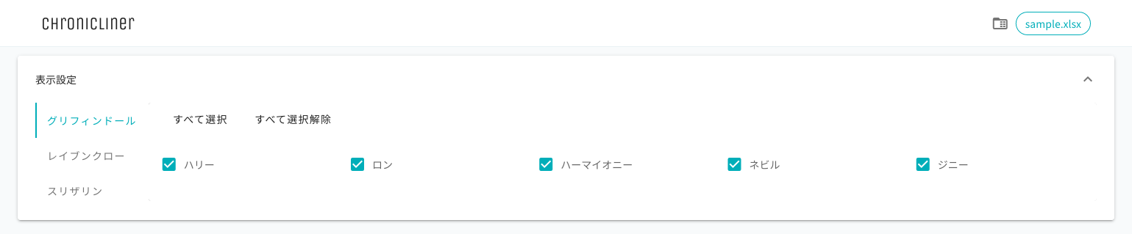
②
③
①
④
⑤
⑥

Slide 4
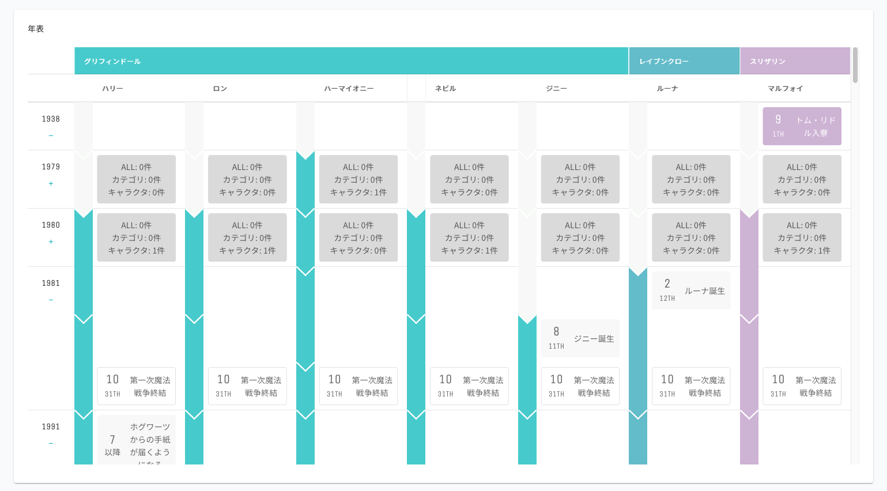
①
③
②
④
⑤
⑧
⑥
⑩
⑨
⑪
⑦

