Slide 1
22HZ
Software Architecture of sensor fusion
Measurement
time stamp
management
Track management
(Track init. included)
Book
Keeping
Confidence assessment
Ego Motion
Senor
data
adaptor
Vision Detection
Association
State update
Barrier
estimation
Radar Detection

Slide 2



Coordinate system & Motion of fusion object
Curvature (1/m)
Object Vehicle(fusion result)
V, a *
Y
Heading angle
x, y
Yaw Rate
Ego Speed
X
Vy, ay *
rear-axle coordinate system
Host (Ego) Vehicle
x, y
Vx, ax
*Over ground speed and acceleration are requested for fusion object, ego motion compensated in Fusion
Object Pedestrian(fusion result)

Slide 3
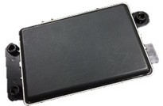
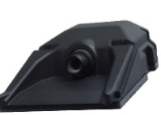
Motion of object from sensor
Object motion from Camera
Object motion from Radar
Vision
angle θ
Radar
angle θ
Vx
X
Range rate
Vy
Y
Range
Radar track
Vision b-box
X
Host vehicle
Y

Slide 4
22HZ
Software Architecture of sensor fusion
Measurement
time stamp
management
Track management
(Track init. included)
Book
Keeping
Confidence assessment
Ego Motion
Senor
data
adaptor
Vision Detection
Association
State update
Barrier
estimation
Radar Detection

Slide 5
Senor data adaptor
22HZ
Input:
  Vision track structure
  Vision sensor healthiness signal
  Radar track structure
  Radar sensor healthiness signal
  Vehicle motion
Radar double bounce
Output:
  Processed vision track structure
  Processed radar track structure
Dmin
Dmax
Function:
Read in the radar/vision sensor data
Convert the information from sensor coordinate system to vehicle coordinate system.
Compute the over-the-ground velocity (if necessary) based on relative velocity
Filter out some low quality/suspicious track
Radar double bounce detector
Radar range-rate de-aliasing
range-rate aliasing

Slide 6
22HZ
Software Architecture of sensor fusion
Measurement
time stamp
management
Track management
(Track init. included)
Book
Keeping
Confidence assessment
Ego Motion
Senor
data
adaptor
Vision Detection
Association
State update
Barrier
estimation
Radar Detection

Slide 7
Measurement time stamp management
Timestamp sanity check. Comparing with previous timestamp, see if current timestamp is correct, otherwise issue a system fault.
Predict the existing fusion track to current timestamp
Predict radar/vision input to current timestamp
Predict the track by
The delta time dT
Velocity estimate
Yaw-rate estimate
Posn(T-1)
Posn(T) =Posn(T-1)+dT*V
Vision
Radar
Fusion

Slide 8
Measurement time stamp management, continued
Input:
  Fusion object structure
  Vision track structure
  Radar track structure
  Fusion system structure
  Host vehicle motion
Output:
  Fusion object structure
  Fusion system structure

Slide 9
22HZ
Software Architecture of sensor fusion
Measurement
time stamp
management
Track management
(Track init. included)
Book
Keeping
Confidence assessment
Ego Motion
Senor
data
adaptor
Vision Detection
Association
State update
Barrier
estimation
Radar Detection

Slide 10
Track to track association
Multiple-to-one association
Association between radar tracks and vision tracks
For each vision track, we could associate multiple radar tracks to it.
  Position
  Velocity
  TTC
  Previous association
If the probability of some previous association dropped too low, they will be split up.
For each vision track, a list of association probabilities of radar tracks is maintained. Radar tracks with probability high enough will be associated to the vision.
Association to empty
Radar tracks
Vision tracks

Slide 11
Track to track association, continued
Input:
  Fusion object structure
  Vision track structure
  Radar track structure
  Fusion system structure
  Cals
Output:
  Fusion object structure
  Fusion system structure

Slide 12
22HZ
Software Architecture of sensor fusion
Measurement
time stamp
management
Track management
(Track init. included)
Book
Keeping
Confidence assessment
Ego Motion
Senor
data
adaptor
Vision Detection
Association
State update
Barrier
estimation
Radar Detection

Slide 13
Measurement Update
Target
Target
Select radar reference point on the target body.
  Corner points
  Face center
  Centroid
Based on association results:
  Generate a “combined measurement”
  Update the state of the reference point based on KF/EFK
  Estimate the target extension (i.e., size), if the information is not enough to estimate the size, give a default value.
Reference point
Host
Host
The reference point is chosen by comparing the vectors from sensor to the target centroid and to the candidate reference points

Slide 14
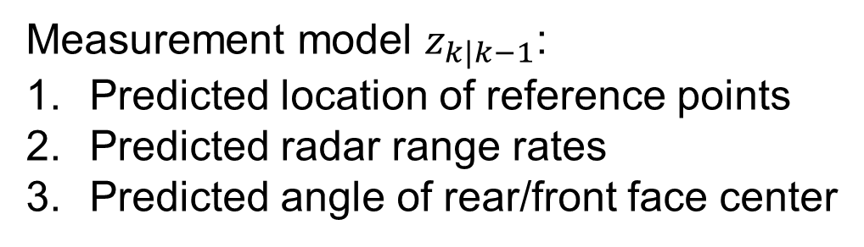
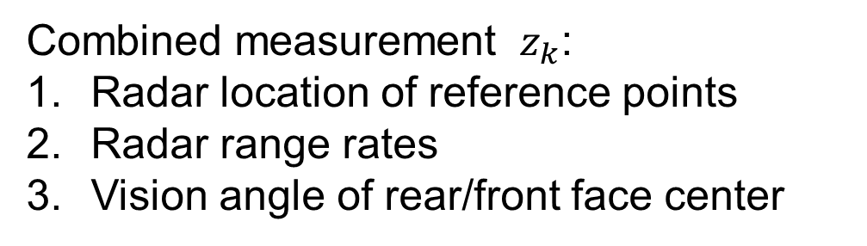
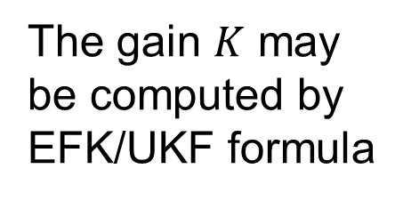


Measurement Update, continued
Combined measurement ${ z}_{k}$:
Radar location of reference points
Radar range rates
Vision angle of rear/front face center
Innovation:
$${{\tilde{z}}_{k}= z}_{k}−z_{k|k−1}$$
State update:
Measurement model $z_{k|k−1}$:
Predicted location of reference points
Predicted radar range rates
Predicted angle of rear/front face center
$${x_{k}=x}_{k|k−1}+K{\tilde{z}}_{k}$$
The gain $K$ may be computed by EFK/UKF formula
Nonlinear filter update:
EKF (probably good enough)
UKF (Worth to try, see how much difference)

Slide 15
Measurement Update, continued 2
Input:
  Fusion object structure
  Vision track structure
  Radar track structure
  Fusion system structure
  Cals
Output:
  Fusion object structure
  Fusion system structure

Slide 16
Software Architecture of sensor fusion
Measurement
time stamp
management
Track management
(Track init. included)
Book
Keeping
Confidence assessment
Ego Motion
Senor
data
adaptor
Vision Detection
Association
State update
Barrier
estimation
Radar Detection

Slide 17
Track management
Fusion track initialization from radar
All the unused vision tracks will initialize a new vision-only FUSION track
All the unused radar tracks should be clustered together first and then initialize radar-only FUSION track based these clusters.
Grouping similar tracks into one track.
  We want one track for each object, especially for truck.
  After grouping, the ID, state and extension of the track need to be updated again.
  Split the track if it gets too big.
Fusion
Track i
Initialization
Clusters
Initialization
Fusion
Track j
Radar track
Grouping
Fusion track

Slide 18
Track management, continued
22HZ
4. Prune tracks
  Low quality tracks
  Suspicious tracks
5. Maintain the alive ID list and available ID list
  New track generated
  Track terminated
  Tracks get grouped
Fusion tracks
Split
Fusion track
Track killed
return the ID
Input:
  Fusion object structure
  Vision track structure
  Radar track structure
  Fusion system structure
  Cals
1
3
4
…
15
18
30
…
New Track
get an ID
Output:
  Fusion object structure
  Fusion system structure
Alive ID list
Available ID list

Slide 19
Software Architecture of sensor fusion
Measurement
time stamp
management
Track management
(Track init. included)
Book
Keeping
Confidence assessment
Ego Motion
Senor
data
adaptor
Vision Detection
Association
State update
Barrier
estimation
Radar Detection

Slide 20
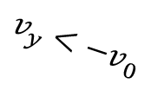


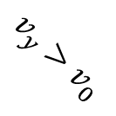




22HZ
Book Keeping
Update track status: updated, coasted, etc.
Update track motion status: static, moving, stopped, etc
Update track classification
Update system active track IDs
Motion status state machine
Static (Default state)
Moving
$$v≈0$$
$$v_{y}<−v_{0}$$
$$v_{y}>v_{0}$$
Incoming
Input:
$$v≈0$$
$$v≈0$$
Fusion object structure
Cals
$$v_{y}<−v_{0}$$
Stopped
$$v≈0$$
Output:
Receding
$$v_{y}>v_{0}$$
Fusion object structure

Slide 21
Book Keeping, continue
22HZ
Track status
No radar/vision update
NEW
INVALID
Initialized from radar/vision
Radar/vision
update
If suspicious in some sense
UPDATED
Radar/vision
update
No radar/vision
update
No radar/vision
update for short time
No radar/vision
update for too long
COASTED

Slide 22
Software Architecture of sensor fusion
Measurement
time stamp
management
Track management
(Track init. included)
Book
Keeping
Confidence assessment
Ego Motion
Senor
data
adaptor
Vision Detection
Association
State update
Barrier
estimation
Radar Detection

Slide 23
Confidence Estimation
Update each track’s confidence based on:
  Fusion type: radar-only, vision-only or radar-vision
  Radar/vision track quality
  Radar/vision matching quality
  Fusion track trajectory smoothness
  If suspicious in any sense
  Sensor healthiness
For each track we may provide multiple confidence support different functionalities, e.g., ACC, AEB and LKA
Input:
  Fusion object structure
  Vision track structure
  Vision sensor healthiness signal
  Radar track structure
  Radar sensor healthiness signal
  Fusion system structure
  Cals
Output:
  Fusion object structure

Slide 24
Software Architecture of sensor fusion
Measurement
time stamp
management
Track management
(Track init. included)
Book
Keeping
Confidence assessment
Ego Motion
Senor
data
adaptor
Vision Detection
Association
State update
Barrier
estimation
Radar Detection

Slide 25

$$x=a_{0}+a_{1}y+a_{2}y^{2}+a_{3}y^{3}$$
Barrier Estimation
Selection stationary radar tracks
Initialize a 3rd order polynomial bases on stationary radar tracks
Updating the polynomial coefficients based on least squares or Kalman Filter
Input
Radar detections (of current scan) structure
Barrier structure of previous results
Cals
Vehicle delta motion
Y
Output
Barrier structure of current results
X

Slide 26
Fusion system variables
Fusion object structure (array)
  Object ID, status, motion status,…
  Position, velocity, acceleration,…
  Size, associated radar/vision tracks,…
  Any information about each fusion object should go here
Barrier structure: polynomial coefficients, confidence, max range, etc.
Fusion system structure:
  Current/previous cycle timestamp, delta T
  Number of active tracks,
  Alive ID list, available ID list
  Any information about fusion system property should go here
System Cals/Parameter structure
  Max number of objects.
  All kinds of thresholds
  Any constant, parameters should go here

