Slide 1
PROJECT REVIEW 1
01 / 10
Switch-Based CMOS Charge Pump for PLL Control
UP/DN charge redistribution creates a controllable Vop within the supply range.
Vop does not boost above VDD.
Reference paper
• M. Sivasakthi and P. Radhika
• High-Speed MCML Charge Pump Design at 10 GHz Frequency in 45 nm CMOS Technology for PLL Application
• Paper reference: 1 V supply, 0-980 mV control-voltage swing
• Those are reference-paper results, not results claimed for this project
The selected S1-S4 circuit adds or removes small packets of charge at the loop-filter output.
CONTROL COMMAND
OUTPUT RANGE
PROJECT SCOPE
UP / DN
0 ≤ Vop < VDD
Cadence only
Team: Pragyan Jain (24BLC1100), Shivam Kumar (24BLC1103), K Navin Aakash (23BLC1238)
Switch-Based CMOS Charge Pump - Review 1
Cadence Virtuoso

Slide 2
THEORY AND PLL CONTEXT
02 / 10
From UP/DN Decisions to a Control Voltage
The phase-frequency detector requests correction. The charge pump translates that request into Vop.
Signal chain
What UP, DN, and hold mean
Core relation
• PFD creates UP or DN pulses
• S1-S4 select the charge route
• Ci transfers a small charge packet
• CL stores and smooths Vop
• Vop controls the PLL loop path
• UP: deliver charge to CL
• DN: remove charge from CL
• Hold: isolate Vop as much as possible
• Vop always remains below VDD
• A capacitor stores charge
• Q = C V
• More transferred charge produces a larger Vop step
• CL trades fast response for smooth output
Switch-Based CMOS Charge Pump - Review 1
Cadence Virtuoso

Slide 3
VLSI IMPLEMENTATION
03 / 10
What Will Be Built in Cadence Virtuoso
The project recreates the selected transistor-switch circuit and tests it with a reusable schematic symbol and testbench.
Circuit implementation
Testbench
Simulation-only scope
• Individual NMOS and PMOS switches for S1-S4
• Internal capacitor Ci and output capacitor CL
• VDD, ground, UP, DN, and complementary controls
• Clearly labelled Vop measurement node
• DC supply and synchronized pulse sources
• Complementary inputs and optional timing gap
• Adjustable output load
• Vop and supply-current probes
• Transient analyses in Cadence Virtuoso
• No chip fabrication or laboratory testing
• No final waveform claim in Review 1
• Later reviews add measured Cadence evidence
Switch-Based CMOS Charge Pump - Review 1
Cadence Virtuoso

Slide 4
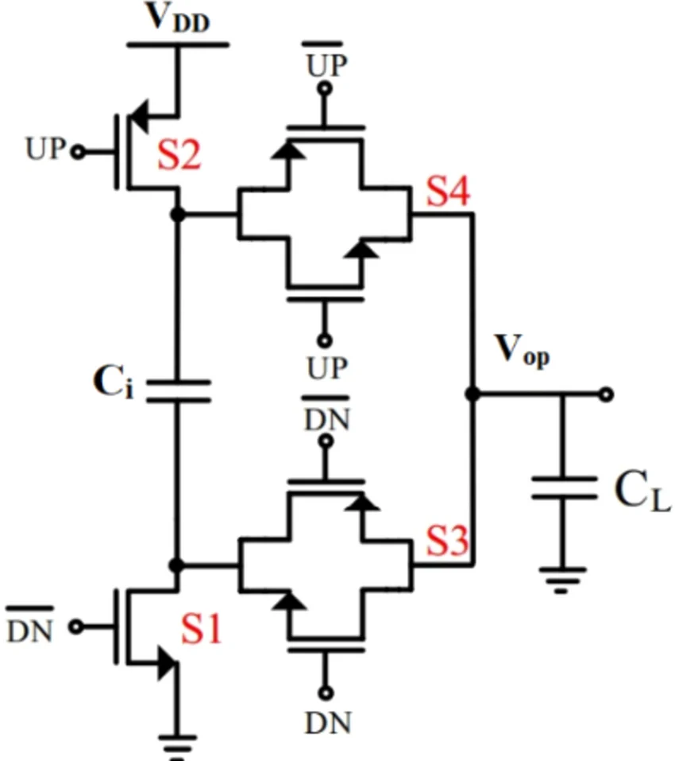
SELECTED TOPOLOGY
04 / 10
The S1-S4 Switch-Based PLL Charge Pump
Ci moves charge through controlled paths. CL stores the resulting Vop below VDD.
VDD and ground
• Energy source and lower reference for the switching network
UP / DN
• Commands that request controlled upward or downward Vop movement
Ci / CL
• Transfer capacitor and output storage capacitor, respectively
Switch-Based CMOS Charge Pump - Review 1
Cadence Virtuoso

Slide 5
OPERATING SEQUENCE
05 / 10
UP, DN, and Hold Control Vop
The waveform below is a conceptual explanation of the planned simulation, not a completed Cadence result.
UP
DN
Hold
CONCEPTUAL
• UP and its complement activate the upper transfer arrangement
• Charge is delivered toward CL
• Vop rises by a small amount but stays below VDD
• DN and its complement activate the lower transfer arrangement
• Charge leaves CL through the controlled path
• Vop falls by a small amount
• Neither transfer is requested
• The output is isolated as much as possible
• CL holds charge, while leakage can cause slow drift
UP
DN
Vop
0 ≤ Vop < VDD
Switch-Based CMOS Charge Pump - Review 1
Cadence Virtuoso

Slide 6
DESIGN VARIABLES
06 / 10
What We Will Change, One Item at a Time
A documented base case makes every comparison explainable.
S1-S4 size
Ci
CL
• Response speed, power, and switching disturbance
• Charge moved per UP or DN action
• Ripple, hold behavior, and settling time
UP/DN timing
Output load
VDD, temperature, model
• Pulse width, rate, safe gap, and overlap
• Step size, drift, and stability
• Robustness across PVT conditions
Switch-Based CMOS Charge Pump - Review 1
Cadence Virtuoso

Slide 7
CADENCE ANALYSIS PLAN
07 / 10
Measurements That Define Useful PLL Charge-Pump Behavior
The final choice will balance response, smoothness, hold performance, and power use.
UP / DN step
Rise / fall / settling
Ripple / spikes
• Vop movement for a command
• Speed of the requested response
• Output smoothness and switching disturbance
Hold drift
Supply current
Energy comparison
• Vop change with no active command
• Current from VDD during each state
• Fair comparison under identical test conditions
Fair comparison rule: keep the same starting Vop, load, input sequence, simulation length, and measurement points.
Switch-Based CMOS Charge Pump - Review 1
Cadence Virtuoso

Slide 8
ROBUSTNESS PLAN
08 / 10
PVT and Repeated-Run Checks
After individual trade-offs are understood, promising settings will be tested under changing conditions.
Process model
Voltage and temperature
Combined and statistical checks
• Typical, faster, and slower models from the selected Cadence library
• Observe correct UP/DN direction, step size, ripple, drift, and power
• Lower, normal, and higher VDD
• Cold, room, and hot settings
• Check that Vop remains controlled within the supply range
• Example: low VDD with slow devices
• Example: hot temperature with heavier load
• Repeated runs only if supported by the library
Switch-Based CMOS Charge Pump - Review 1
Cadence Virtuoso

Slide 9
SIMULATION METHOD
09 / 10
From a Base Waveform to a Final Simulated Setup
The base transient makes UP, DN, and hold visible before any parameter sweep begins.
1
2
3
4
5
Quiet
UP
Hold
DN
Hold
Start from a known Vop condition.
Apply a group of UP pulses.
Observe ripple and drift after UP.
Apply a group of DN pulses.
Observe final stability and supply current.
Save this waveform as the base case. Then vary one main parameter per simple comparison.
Switch-Based CMOS Charge Pump - Review 1
Cadence Virtuoso

Slide 10
PROJECT ROADMAP
10 / 10
Three Reviews: Plan, Evidence, and Final Comparison
Review 1 does not claim completed simulation results. Results are introduced only after Cadence runs are completed and checked.
Review 1 - Current
Review 2 - Implementation
Review 3 - Conclusion
• Explain the selected S1-S4 charge pump
• Define the Cadence-only scope
• Prepare the test procedure and analysis list
• Deliverable: approved design and simulation plan
• Build the schematic, symbol, and testbench
• Run the first real UP, DN, and hold waveforms
• Begin switch, capacitor, timing, and load comparisons
• Deliverable: initial simulation results
• Complete PVT and combined-condition checks
• Compare useful cases and select the final simulated setup
• Present waveforms, measured trade-offs, and limitations
• Deliverable: final Cadence simulation report
Reference paper: Sivasakthi and Radhika, A High-Speed MCML Charge Pump Design at 10 GHz Frequency in 45 nm CMOS Technology for PLL Application.
Switch-Based CMOS Charge Pump - Review 1
Cadence Virtuoso

