Slide 1
GRANTED ROBOTICS
When the plan breaks,
what happens next?
A safety and recovery workbench
for bimanual manipulation.
Shivam Gupta / AI Infra Summit Hackathon
Notes:
A robot setting a table looks impressive. But move a cup after the plan starts, and the real test begins. Can it notice the change, stop an unsafe action, and still finish the job? This is Granted Robotics, created by Shivam Gupta.
Implementation statements are based on the project source. Commercial statements are hypotheses.

Slide 2
THE PROBLEM
The failure is where
the work begins
A displaced object. A slipped grasp.
An obstacle in the workspace.
Engineers need a repeatable way to
inspect the response.
02 / GRANTED ROBOTICS
Notes:
For robotics teams, the difficult work often starts after a demonstration fails. What changed? Which action caused the problem? Did the recovery actually complete the task? Granted makes that investigation visible through a familiar two arm table setting scenario.
Implementation statements are based on the project source. Commercial statements are hypotheses.

Slide 3
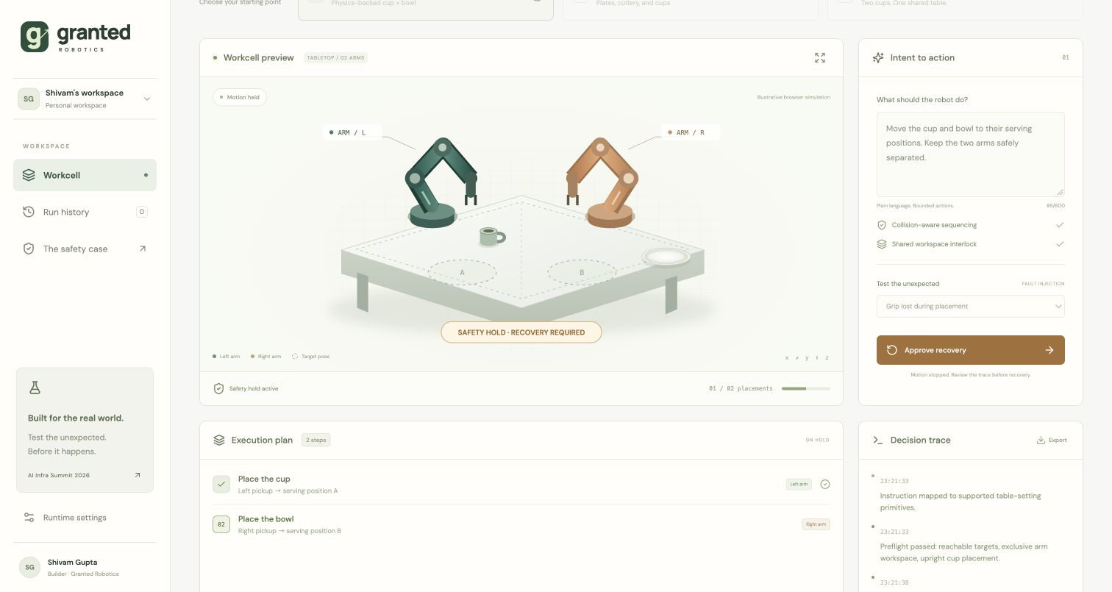
THE WORKBENCH
The recovery workbench
03 / GRANTED ROBOTICS
Notes:
The workbench puts the mission, workspace, and execution evidence together. A reviewer can explore the task, inspect a disturbance, and understand the recovery sequence. The goal is to make the important decisions readable, instead of asking a judge to trust a success animation.
Implementation statements are based on the project source. Commercial statements are hypotheses.

Slide 4
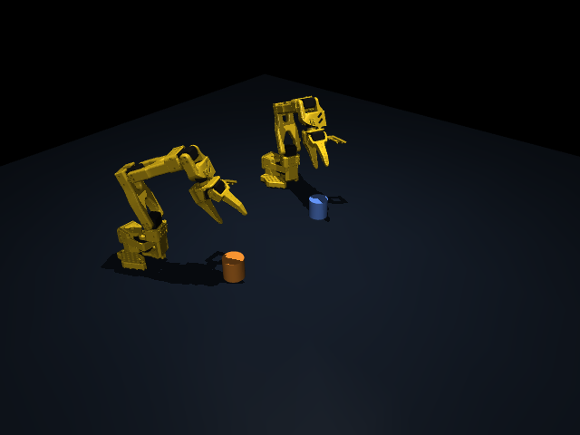
THE IMPLEMENTATION
MuJoCo execution with two SO101 arms
04 / GRANTED ROBOTICS
Notes:
Under the interface, a Python backend uses MuJoCo for articulated arms, tabletop objects, and simulated grasp constraints. An OpenVINO graph evaluates geometric safety signals. The browser is the presentation layer. Simulation evidence is separate from that visual explanation.
Implementation statements are based on the project source. Commercial statements are hypotheses.

Slide 5
RECORDED MUJOCO EVIDENCE
Recovery changed
the outcome
Grip loss, across 10 randomized seeds
With recovery: 10 / 10 completed
Without recovery: 0 / 10 completed
50 simulation runs. Local Apple CPU.
No Intel Core Ultra hardware claim.
05 / GRANTED ROBOTICS
Notes:
Across ten randomized seeds, grip loss completed ten out of ten times with recovery, and zero out of ten without it. We varied object placement, mass, and friction. These are fifty local simulation runs, with deterministic control. We have not yet demonstrated on Intel Core Ultra hardware.
Implementation statements are based on the project source. Commercial statements are hypotheses.

Slide 6
THE BUSINESS
Less time reproducing
the same failure
First customer: robotics integrators
First pilot: one task and its recurring faults
Success measure: time to diagnose a regression
06 / GRANTED ROBOTICS
Notes:
The first customer hypothesis is robotics integrators. A paid pilot would import one task and reproduce its recurring failures. We would measure engineering time spent diagnosing regressions. A five hundred dollar monthly workspace is a pricing experiment, not a claim of customer demand or revenue.
Implementation statements are based on the project source. Commercial statements are hypotheses.

Slide 7
GRANTED ROBOTICS
Before the next action,
show the evidence
granted-robotics.web.app
Explore the workbench.
Reproduce the simulation.
Created by Shivam Gupta / MIT licensed
Notes:
Granted Robotics makes the recovery part of the product. It gives teams a clear place to inspect what failed, how the system responded, and what the evidence supports. Explore the workbench and the open source implementation. Created by Shivam Gupta for the AI Infra Summit Hackathon.
Implementation statements are based on the project source. Commercial statements are hypotheses.

