Slide 1
GRANTED ROBOTICS
When the plan breaks,
what happens next?
A recovery workbench for bimanual manipulation.
Shivam Gupta
AI Infra Summit Hackathon
01 / GRANTED ROBOTICS
Notes:
A robot setting a table looks impressive. But a moved cup or a failed grasp can break that plan. Granted Robotics makes the recovery inspectable. Created by Shivam Gupta, it combines a clear operator workbench with reproducible simulation evidence.

Slide 2
THE CUSTOMER PROBLEM
A failure should become a reproducible test
Recurring failure
The product response
A cup moves after planning.
A grasp slips during transport.
An obstacle blocks the workspace.
Configure a bounded task.
Inject a known disturbance.
Inspect the result and export evidence.
Pilot success means less engineer time per diagnosed regression.
02 / GRANTED ROBOTICS
Notes:
Our initial customer hypothesis is a robotics integrator. When a customer demonstration fails, engineers need to reproduce the fault, understand the intervention, and check whether a change improved the outcome. Granted puts that investigation into one readable workflow.

Slide 3
SYSTEM ARCHITECTURE
The interface and the physics have separate jobs
Layer | Responsibility
React and Firebase Hosting | Task entry, playback, evidence export, account UI
FastAPI contract | Schema validation, bounded workers, explicit failures
Camera and task validator | Optional image plus instruction, constrained output
MuJoCo and OpenVINO | SO101 control, fault handling, geometric separation
Evidence | Events, sampled states, placement errors, seeded trials
Browser animation illustrates the workflow. Backend evidence records actual simulation.
03 / GRANTED ROBOTICS
Notes:
The React workbench accepts a task and shows the evidence. A FastAPI service validates requests, then runs the MuJoCo fixture. Optional camera and language validation can approve only the supported contract. The controller and geometric monitor execute the task. Results include events and measured errors.

Slide 4
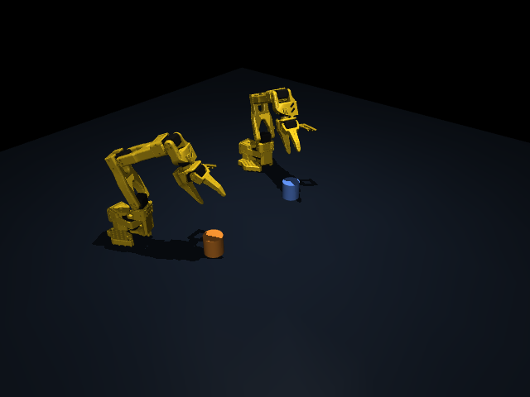
LANGUAGE AND CAMERA INPUT
A bounded contract keeps intent inspectable
Camera + language validator
Raw image, instruction, strict schema
Joint-target imitation policy
480 training / 120 held-out samples
OpenVINO FP32 proposals
Mandatory numerical correction
Held-out joint RMSE: 0.196 rad. State-based policy, not an end-to-end VLA.
04 / GRANTED ROBOTICS
Notes:
A real camera image and instruction go to the constrained language validator. Separately, we trained a small joint target imitation policy on four hundred eighty inverse kinematics examples, with one hundred twenty held out. OpenVINO runs its proposals. Mandatory numerical correction remains part of control. This is not an end to end VLA.

Slide 5
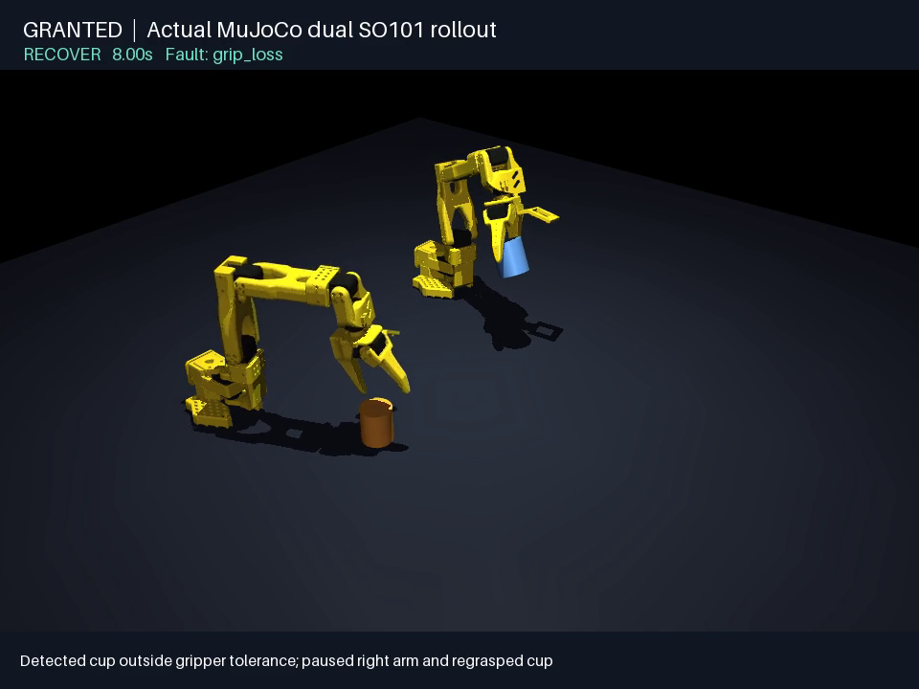
ACTUAL PHYSICS
Two SO101 arms, with a recoverable grasp fault
Fault: grip loss
Detect the displaced object
Regrasp
Verify target error
Video evidence: backend/evidence/so101-recovery.mp4
05 / GRANTED ROBOTICS
Notes:
This is actual MuJoCo rendering, separate from the browser illustration. Both SO101 arms move objects to predefined targets. An injected grip loss breaks the initial attempt. The controller detects the displaced object and follows a recovery path. Simplified grasp attachment and simulator state remain important limitations.

Slide 6
50-RUN CONTROLLED EVALUATION
Recovery changed the result in the same fixture
Condition | Completed | Blocked | Mean cup error
Nominal | 10 / 10 | 0 / 10 | 15.71 mm
Object moved, recovery on | 10 / 10 | 0 / 10 | 9.09 mm
Grip loss, recovery on | 10 / 10 | 0 / 10 | 14.05 mm
Grip loss, recovery off | 0 / 10 | 0 / 10 | 160.96 mm
Obstacle present | 0 / 10 | 10 / 10 | 169.10 mm
Randomized XY, mass, friction, cylinder size, lighting, and table color.
06 / GRANTED ROBOTICS
Notes:
We evaluated ten seeds in five conditions, for fifty runs. Nominal tasks and displaced object recovery completed all ten trials. Grip loss completed ten out of ten with recovery, and zero without it. All ten obstacle cases blocked execution. A safe stop is reported separately from task completion.

Slide 7
PER-SEED EVIDENCE
Every recovered seed retains its measured error
Seed | Cup error | Bowl error
0 | 15.11 mm | 13.16 mm
1 | 12.73 mm | 12.56 mm
2 | 15.67 mm | 12.62 mm
3 | 15.09 mm | 12.67 mm
4 | 12.81 mm | 12.26 mm
5 | 12.53 mm | 12.72 mm
6 | 16.68 mm | 12.97 mm
7 | 13.72 mm | 13.50 mm
8 | 12.35 mm | 12.95 mm
9 | 13.79 mm | 13.11 mm
Mean cup error, mm
Source: backend/evidence/evaluation.json
07 / GRANTED ROBOTICS
Notes:
The per seed records make the result inspectable. Every grip loss recovery trial completed, but errors still vary by initial condition. The comparison shows mean cup error falling from about one hundred sixty millimeters to about fifteen. This is a small controlled benchmark, not generalization to new tasks.

Slide 8
OPENVINO MICROBENCHMARK
Learned proposals reduce numerical correction work
Measurement | Result
Policy runtime | OpenVINO CPU, FP32, Apple M4 Pro
Policy latency, median / p95 | 0.03704 ms / 0.04384 ms
Mean correction iterations | 4,528.1 baseline / 4,288.2 learned
Mean local compute time | 271.05 ms baseline / 255.76 ms learned
Recovery completion | 10/10 baseline and 10/10 learned
No Intel Core Ultra, GPU, NPU, or quantization performance claim.
08 / GRANTED ROBOTICS
Notes:
OpenVINO runs both the geometric graph and the learned joint target policy. In ten recovery trials, learned proposals plus correction reduced average numerical iterations by five point three percent. Both approaches completed every trial. The learned policy median inference was thirty seven microseconds on Apple hardware. Intel validation remains open.

Slide 9
RUBRIC AND REPRODUCIBILITY
Evidence maps to the brief, with visible gaps
Track criterion | Points | Current evidence and limit
Task and bimanual manipulation | 30 | Cup/bowl placement, limited task vocabulary
VLA and multimodal reasoning | 20 | Camera validator + learned joint proposals, no VLA
Robustness and generalization | 15 | 10 seeds, physics + size + light + color variations
OpenVINO and Intel optimization | 20 | Policy + graph IR, Intel execution missing
Quality and reproducibility | 10 | Setup, tests, seeded evaluation, raw artifacts
Innovation and demonstration | 5 | Visible recovery and an explicit ablation
29 backend tests passed: task rejection, provider failures, safety checks, policy-reference parity.
09 / GRANTED ROBOTICS
Notes:
The repository includes simulation assets, evaluation commands, a device benchmark, and tests. We map each judging category to its evidence and limitations. The largest gaps are trained policy reasoning, more complex complementary manipulation, and final Intel hardware execution. We do not hide those gaps behind a generic production ready claim.

Slide 10
COMMERCIAL VALIDATION PLAN
One integrator. One recurring failure. A measured pilot.
Pilot design
Pricing hypothesis
Interview 5 integrators.
Import one existing task.
Reproduce their recurring faults.
Measure time to diagnose a regression.
$500 / month per team
$75 / engineer hour assumed
7 hours saved would cover the fee
No validated demand or revenue. Local execution limits compute costs. Hosted jobs need quotas.
10 / GRANTED ROBOTICS
Notes:
The business starts with a small paid pilot, not a market size claim. We would import one integrator task and its recurring failure cases. We would measure diagnosis time before and after. A five hundred dollar monthly workspace is a pricing test. At an assumed seventy five dollars an engineer hour, seven saved hours covers that fee.

Slide 11
LIMITATIONS AND NEXT MILESTONES
The next release needs stronger evidence
Current boundary | Next verifiable milestone
Fixed two-object task | Complementary manipulation with measurable success
State-based imitation with correction | Vision-language-action policy and held-out tasks
Bounded proxy-object randomization | Novel objects, larger pose shifts, and held-out tasks
Apple development measurements | Intel Core Ultra end-to-end run and device benchmark
Demo infrastructure | Durable storage, tenant isolation, quotas, monitoring
Simulation evidence supports this fixture. It does not certify a physical robot.
11 / GRANTED ROBOTICS
Notes:
The next milestone is a policy that reasons directly over vision and language. We also need a richer dual arm task, broader randomization, and an Intel Core Ultra run. Before commercial use, the product needs durable tenant storage, workload controls, and operational monitoring. Hardware safety validation is a separate effort.

Slide 12
GRANTED ROBOTICS
Before the next action,
show the evidence
granted-robotics.web.app
github.com/shi1720/AI-Infra-Summit-Hackathon
Created by Shivam Gupta
MIT licensed project
12 / GRANTED ROBOTICS
Notes:
Granted Robotics makes the recovery part of the product. Review the workbench, replay the actual physics, and inspect the per seed records. The repository and demo are public. Created by Shivam Gupta for the AI Infra Summit Hackathon.

