Slide 1
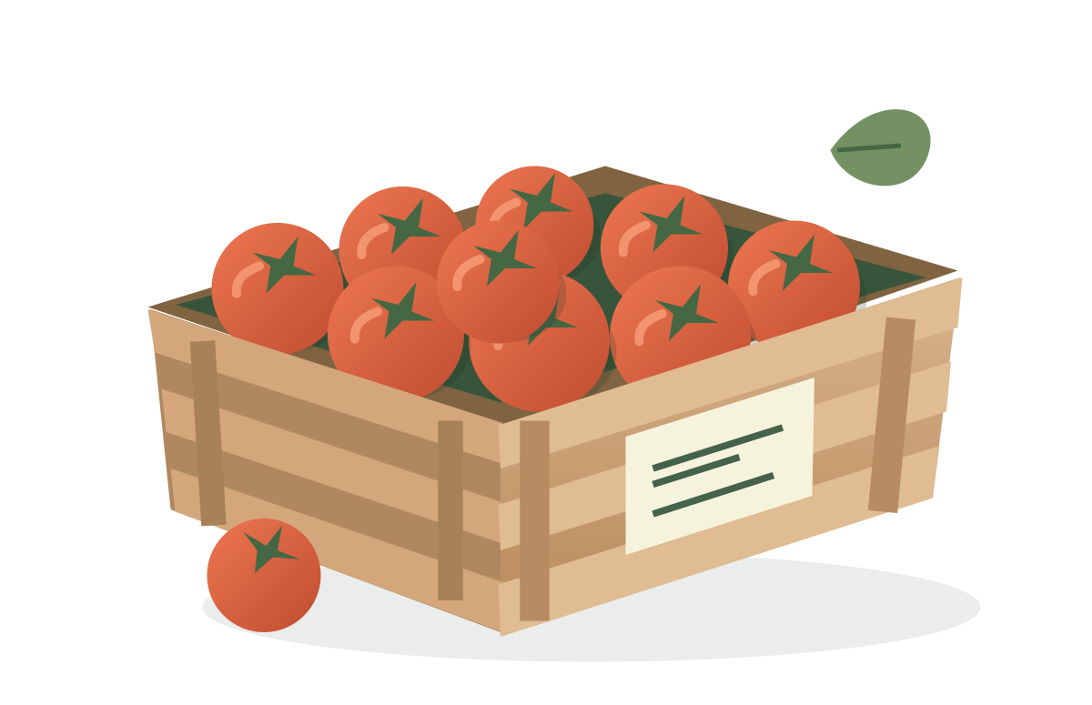
SecondCrate
Every good lot
deserves a buyer
Recovery for cancelled
wholesale produce orders
Shivam Gupta
AWS CDS Agentic AI Partner Hackathon
SECONDCRATE
01
Notes:
Creator: Shivam Gupta. This is a new hackathon project. Original produce artwork comes from src/client/Produce.tsx. All Northstar Produce demo data is synthetic. Deployable architecture; cloud validation pending.

Slide 2
A cancelled order leaves a clock running
40
An order cancels
The lot is already at the depot
crates of cherry tomatoes
200 kg already at the depot
Dispatch approaches
The operator sets the available window
Who can take the lot within the existing plan?
Illustrative London scenario. The operator sets the dispatch cutoff and releases the stock.
SECONDCRATE
02
Notes:
Illustrative scenario. Northstar Produce is fictional. 40 crates x 5 kg = 200 kg. Dispatch cutoff is operational, not a food-safety judgement. Prices: £24 original, £18 recovery offer, £16 floor, £12 book cost.

Slide 3
The buyer can answer in their own words
“Twelve crates at seventeen pounds,
if you can deliver before two.”
Cancellation
Buyer reply
Rule checks
Order
Operator releases stock
Agent interprets intent
Price, capacity, delivery
Commit available stock
One shared inventory ledger across connected channels
WhatsApp, SMS and email adapters. Illustrative workflow. Live provider validation pending.
SECONDCRATE
03
Notes:
Illustrative workflow, not a screenshot. Example request: 12 crates at £17 before 14:00. Deterministic checks enforce the £16 floor, buyer capacity and delivery limits. AWS channels remain simulated until configured and verified.

Slide 4
Two buyers can claim the final eight
8
Leila requests 8
One order
The other claim sees 0
Priya requests 8
crates remain
Conditional state update
Version checks and event IDs protect stock
when replies race or providers retry.
SECONDCRATE
04
Notes:
Illustrative concurrent-claim scenario, reproduced by the project concurrency test before release. A conditional workspace update protects the remaining stock. Event IDs prevent repeated inbound events creating another order. The model proposes an intent; deterministic application code enforces all transactional limits.

Slide 5
Deployable AWS architecture
Bedrock
Constrained intent
Browser
CloudFront
API + Lambda
SES / EUM
Session cookie
HTTPS entry
Validated order service
Email, WhatsApp, SMS
Private S3
DynamoDB
SNS + SQS
Static application
Snapshot + CAS head
Inbound events and DLQ
Cloud validation pending. Secrets Manager, CloudWatch and queued-send recovery support the application.
Current provider-event configuration routes to one live workspace. Full diagram accompanies this deck.
SECONDCRATE
05
Notes:
Cloud validation pending. Read infra/stack.ts and src/server/lambda.ts for the complete implementation. CloudFront serves private S3 web assets and routes /api/* to API Gateway and Lambda. Lambda calls Bedrock, DynamoDB and CDS SDKs. SES/Social/SMS events use an SNS topic, SQS queue and dead-letter queue. SES can store inbound MIME in private S3. Secrets Manager supplies the CloudFront origin verification secret. CloudWatch alarms publish to an operational SNS topic. DynamoDB uses snapshot chunks and a conditional transactional head, bounded to 2 MB. EventBridge periodically retries queued outbox work only, never unknown provider outcomes. Provider inbound routing currently binds to one configured live workspace; this is a stated scaling limitation.

Slide 6
The example books £708 in sales
Buyer | Crates | Price | Sales
Olive & Rye | 12 | £17 | £204
The Sunday Table | 20 | £18 | £360
Final-stock winner | 8 | £18 | £144
Total | 40 |  | £708
£228
above £480 book cost
200 kg
allocated to orders
Handling, transport and software reduce the spread. Booked sales are distinct from cash collected.
SECONDCRATE
06
Notes:
Synthetic example: 12 crates x £17 = £204; 20 x £18 = £360; 8 x £18 = £144. Total 40 crates, £708 booked sales, £480 book cost and £228 spread before handling, transport and software. 200 kg is allocated, not verified waste prevented. Proposed subscription £299/depot/month includes 25 workflows within stated messaging limits. With £5 contribution per additional crate, 60 additional crates cover £299. Hypotheses in docs/BUSINESS_CASE.md, not customer results.

Slide 7
The first buyer is a depot manager
One depot. Existing buyers.
A missed order to recover.
191,000
tonnes redistributed
in the UK in 2023
A proposed £299 monthly subscription
WRAP redistribution survey [1]
60 additional crates at £5 contribution
would cover the monthly price.
Choco handles wholesale ordering. Too Good To Go sells surplus to consumers.
SecondCrate focuses on cancellation recovery within an existing B2B network. [2, 3]
Sources: [1] WRAP, 2023 survey. [2] Choco OrderAgent, July 2026. [3] Too Good To Go Parcels.
SECONDCRATE
07
Notes:
Primary sources checked 22 September 2026. WRAP: https://www.wrap.ngo/taking-action/food-drink/actions/surplus-food-waste-redistribution . Reports approximately 191,000 tonnes received by UK redistribution organisations in 2023. Historical sector context, not SecondCrate TAM or impact. Choco https://help.choco.com/en/articles/15821057-order-agent-whatsapp-and-email-forwarding already offers AI wholesale order capture. Too Good To Go https://www.toogoodtogo.com/en-gb/surplus-food-parcels already sells manufacturer/wholesaler surplus to consumers. SecondCrate proposes a focused cancelled-order recovery workflow through existing B2B relationships.

Slide 8
A paid pilot will test the business case
01
Understand the last three cancellations
02
Measure two weeks of the current process
03
Run a four-week paid pilot at three depots
Renewal and incremental contribution decide what happens next.
Shivam Gupta / AI-assisted development / Cloud validation pending
SECONDCRATE
08
Notes:
Proposed pilot only. No customer interviews, pilots, revenue or customer outcomes claimed. Plan: ten distributor interviews, two-week baseline and four-week paid pilot with three depots. Continue if at least two renew at £299, median incremental benefit exceeds £598/month, coordinator effort falls at least 30%, no oversells/below-floor/unwanted sends occur, and support approaches one hour per depot per month. All thresholds are internal hypotheses in docs/BUSINESS_CASE.md. Deployment and live AWS validation remain pending. Creator Shivam Gupta.

