Slide 1
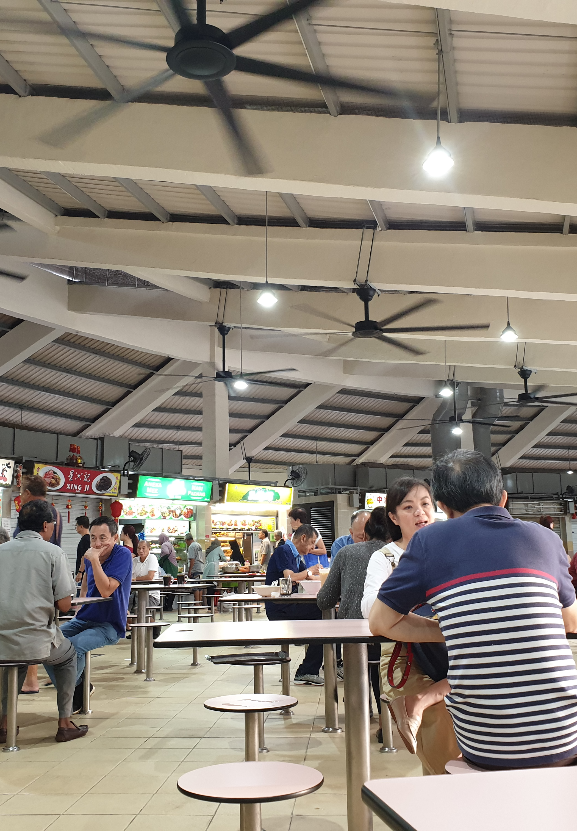
HawkerBridge
A closure continuity desk
for Singapore
Shivam Gupta
DAISI Singapore 2026
C3 KopilamAI
Photo: Kagenlim, Tampines Round Market (2020), cropped
creativecommons.org/licenses/by-sa/4.0
Notes:
Project owner: Shivam Gupta. No institution or student enrollment is implied. Context photograph only. Photo: Kagenlim, 12 February 2020, Tampines Round Market and Food Centre. Cropped for layout. https://commons.wikimedia.org/wiki/File:Hawker_Center,_Singapore.jpg . License: https://creativecommons.org/licenses/by-sa/4.0/ . Photo crop retains CC BY-SA 4.0. No endorsement by the photographer or depicted people. Product scope: https://daisi.online/guide .

Slide 2
A closure notice leaves a planning gap
28 September 2026
17
1,025
scheduled centre closures
listed food stalls inside those centres
A coordinator still needs to decide
where temporary support is feasible.
Source: NEA schedule archived 22 Sep 2026. Stall counts describe infrastructure, not measured meal capacity.
02
Notes:
Verified snapshot counts for 2026-09-28: {"total_centres":123,"closed_centres":17,"food_centres":120,"total_residents":4044340,"total_seniors":614900,"baseline_covered_residents":2304650,"remaining_covered_residents":2213470,"newly_exposed_residents":91180,"newly_exposed_seniors":17120,"affected_zones":6,"food_stalls_closed":1025}. Full data provenance: data/processed/snapshot.json. NEA source: https://data.gov.sg/datasets/d_bda4baa634dd1cc7a6c7cad5f19e2d68/view. Published closures may change. Do not claim all stalls are normally open or that every customer needs assistance. NEA closure responsibilities: https://www.nea.gov.sg/our-services/hawker-management/announcements .

Slide 3
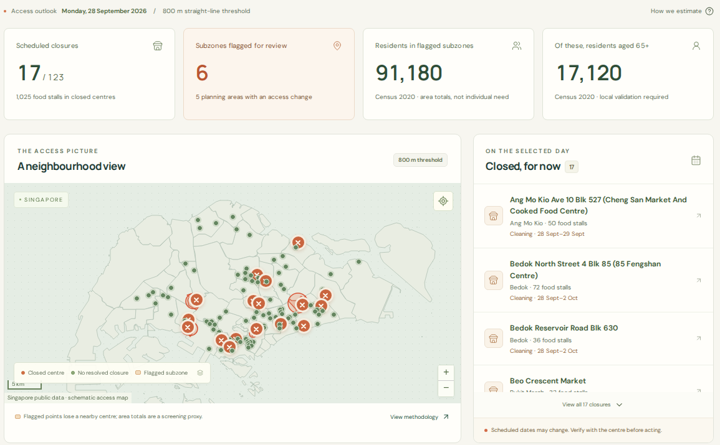
The coordinator’s working view
Test cleaning changes
Compare nearby
hawker coverage
before funding support.
Inspect the assumptions
Census 2020
800 m straight line
Subzone points
Actual local application. Cleaning-date changes are hypothetical. Area exposure is a screening proxy.
03
Notes:
Screenshot provenance is recorded in scripts/presentations/assets/README.md. Product code: frontend/src/App.tsx and backend/hawkerbridge/engine.py. This is the working application, not a design mockup. The cleaning counterfactual removes a chosen adjustable event from the selected day for comparison. It does not modify a published government closure schedule or choose an operationally valid replacement date. For the dated 28 Sep 2026 model at 800 m, six populated subzones contain 91,180 census residents and 17,120 seniors whose representative points lose listed hawker coverage. These are not observed hungry residents. The screen omits coffee shops, food courts, individual needs and accessible walking routes. Dates of Hawker Centres Closure: https://data.gov.sg/datasets/d_bda4baa634dd1cc7a6c7cad5f19e2d68/view
Resident Population by Planning Area/Subzone, Age and Sex (Census 2020): https://data.gov.sg/datasets/d_d95ae740c0f8961a0b10435836660ce0/view
Master Plan 2019 Planning Area Boundary (No Sea): https://data.gov.sg/datasets/d_4765db0e87b9c86336792efe8a1f7a66/view
Master Plan 2019 Subzone Boundary (No Sea): https://data.gov.sg/datasets/d_8594ae9ff96d0c708bc2af633048edfb/view
Waste Management and Overall Recycling Rates, Annual: https://data.gov.sg/datasets/d_daf568968ab40dc81e7b08887a83c8fa/view

Slide 4
Five public sources, visible uncertainty
Official source | Coverage | Role in the model
NEA closure calendar | 2026, 123 centres | Dates, coordinates, stall counts
SingStat census | 2020, 332 subzones | Resident and senior counts
URA planning areas | 2019, 55 areas | Area scope and grouping
URA subzones | 2019, 332 boundaries | Geographic joins and points
SingStat / NEA waste | 2000–2025 national series | Context only
507
32
resolved closure intervals
quarantined date records
Archived raw responses and SHA-256 provenance. Failed refreshes retain the last good publication.
04
Notes:
Dates of Hawker Centres Closure: https://data.gov.sg/datasets/d_bda4baa634dd1cc7a6c7cad5f19e2d68/view
Resident Population by Planning Area/Subzone, Age and Sex (Census 2020): https://data.gov.sg/datasets/d_d95ae740c0f8961a0b10435836660ce0/view
Master Plan 2019 Planning Area Boundary (No Sea): https://data.gov.sg/datasets/d_4765db0e87b9c86336792efe8a1f7a66/view
Master Plan 2019 Subzone Boundary (No Sea): https://data.gov.sg/datasets/d_8594ae9ff96d0c708bc2af633048edfb/view
Waste Management and Overall Recycling Rates, Annual: https://data.gov.sg/datasets/d_daf568968ab40dc81e7b08887a83c8fa/view
Quality: {"centres":123,"resolved_closure_intervals":507,"quarantined_closure_intervals":32,"demand_zones":332,"populated_demand_zones":286,"planning_areas":55,"unassigned_centres":0,"population_join_coverage_percent":100,"resident_sum_subzones":4044340,"senior_sum_subzones":614900}. Unknown dates and block-specific ambiguity are quarantined. Older repair dates remain in the archive but do not falsely imply current closure. 123 centres include three zero-food-stall markets excluded from meal-access distances. National food-waste statistics are not centre waste estimates. Singapore Open Data Licence: https://data.gov.sg/open-data-licence .

Slide 5
Databricks architecture
Layer | Databricks component | What the run records
Ingestion | Serverless Lakeflow Job | Official responses and checksums
Bronze / Silver | Delta tables in Unity Catalog | Raw archive, typed rows, quarantine
Gold | Published snapshot and SQL views | Access model, allocations, audit
Evaluation | MLflow experiment | Parameters and baseline comparisons
Application | Databricks App + SQL warehouse | Platform sign-in and saved proposals
Workspace execution pending
Local execution verified. Cloud run evidence remains the next gate.
A publication record exposes completed outputs. A failed run cannot silently replace the current snapshot.
05
Notes:
Implemented code: databricks/notebooks/01_pipeline.py, databricks.yml, resources/, backend/hawkerbridge/databricks_store.py and docs/databricks-deployment.md. Execution status at deck build: {"local_app_tested":true,"databricks_workspace_execution_verified":false,"databricks_app_url":null,"successful_pipeline_run_url":null,"mlflow_run_url":null,"public_or_unlisted_video_url":null,"note":"This records actual evidence, not intended architecture. Populate cloud links only after successful workspace execution."}. Unity Catalog governance and explicit lineage records are implemented. Do not claim unverified automatic column lineage. Publication uses staging plus a final pointer record, not cross-table ACID. Archived replay is explicitly labeled if used. Cloud mode fails closed rather than silently displaying local data. Free Edition limitations: https://docs.databricks.com/aws/en/getting-started/free-edition-limitations .

Slide 6
Capacity limits the September 28 proposal
Objective improvement over largest-demand-first
450
planned meals at both
S$3,000 and S$6,000
3 localities × 150 meals
S$2,700 allocated
More capacity changes the ceiling.
15 / 15 unique scenarios passed an independent constraint audit
800 m, 5% uptake, S$4/meal, S$300 setup, 3 localities, 150 meals each, senior weight 2. Mixed-integer optimisation. Welfare outcomes remain unmeasured.
06
Notes:
Complete 9-row primary grid plus radius sensitivity totals 15 unique solves. Source: data/processed/evaluation.json and docs/evaluation.md. Benchmark input source SHA-256: 5b7aaf83b6cdc25fb4262eaa99ee116925d4c5ab8a634647f46f35d21acde783. Primary data: [{"id":"2026-09-22-sgd1500-r800","summary":{"budget":1500,"spent":1500,"unspent":0,"total_meals":225,"estimated_demand":19520,"unmet_demand":19295,"sites_selected":2,"weighted_benefit":271.31,"baseline_weighted_benefit":251.19,"improvement_pct":8,"solver_status":"optimal"}},{"id":"2026-09-22-sgd3000-r800","summary":{"budget":3000,"spent":2700,"unspent":300,"total_meals":450,"estimated_demand":19520,"unmet_demand":19070,"sites_selected":3,"weighted_benefit":542.205,"baseline_weighted_benefit":498.537,"improvement_pct":8.8,"solver_status":"optimal"}},{"id":"2026-09-22-sgd6000-r800","summary":{"budget":6000,"spent":2700,"unspent":3300,"total_meals":450,"estimated_demand":19520,"unmet_demand":19070,"sites_selected":3,"weighted_benefit":542.205,"baseline_weighted_benefit":498.537,"improvement_pct":8.8,"solver_status":"optimal"}},{"id":"2026-09-28-sgd1500-r800","summary":{"budget":1500,"spent":1500,"unspent":0,"total_meals":225,"estimated_demand":4561,"unmet_demand":4336,"sites_selected":2,"weighted_benefit":271.003,"baseline_weighted_benefit":266.466,"improvement_pct":1.7,"solver_status":"optimal"}},{"id":"2026-09-28-sgd3000-r800","summary":{"budget":3000,"spent":2700,"unspent":300,"total_meals":450,"estimated_demand":4561,"unmet_demand":4111,"sites_selected":3,"weighted_benefit":538.909,"baseline_weighted_benefit":537.275,"improvement_pct":0.3,"solver_status":"optimal"}},{"id":"2026-09-28-sgd6000-r800","summary":{"budget":6000,"spent":2700,"unspent":3300,"total_meals":450,"estimated_demand":4561,"unmet_demand":4111,"sites_selected":3,"weighted_benefit":538.909,"baseline_weighted_benefit":537.275,"improvement_pct":0.3,"solver_status":"optimal"}},{"id":"2026-12-14-sgd1500-r800","summary":{"budget":1500,"spent":1500,"unspent":0,"total_meals":225,"estimated_demand":25473,"unmet_demand":25248,"sites_selected":2,"weighted_benefit":273.258,"baseline_weighted_benefit":251.19,"improvement_pct":8.8,"solver_status":"optimal"}},{"id":"2026-12-14-sgd3000-r800","summary":{"budget":3000,"spent":2700,"unspent":300,"total_meals":450,"estimated_demand":25473,"unmet_demand":25023,"sites_selected":3,"weighted_benefit":544.261,"baseline_weighted_benefit":498.537,"improvement_pct":9.2,"solver_status":"optimal"}},{"id":"2026-12-14-sgd6000-r800","summary":{"budget":6000,"spent":2700,"unspent":3300,"total_meals":450,"estimated_demand":25473,"unmet_demand":25023,"sites_selected":3,"weighted_benefit":544.261,"baseline_weighted_benefit":498.537,"improvement_pct":9.2,"solver_status":"optimal"}}]. Optimisation and baseline use the same constraints and explicit senior policy. Optimality is within 0.1% configured MIP gap, not an absolute proof for every possible input. Scenario uplift is not the number of meals delivered or the number of additional people helped. Nine tiny test cases also compare MILP with exhaustive enumeration. The September 28 S$1,500 scenario plans 225 meals for S$1,500. S$3,000 and S$6,000 scenarios each plan 450 for S$2,700. No operator has verified these capacities.

Slide 7
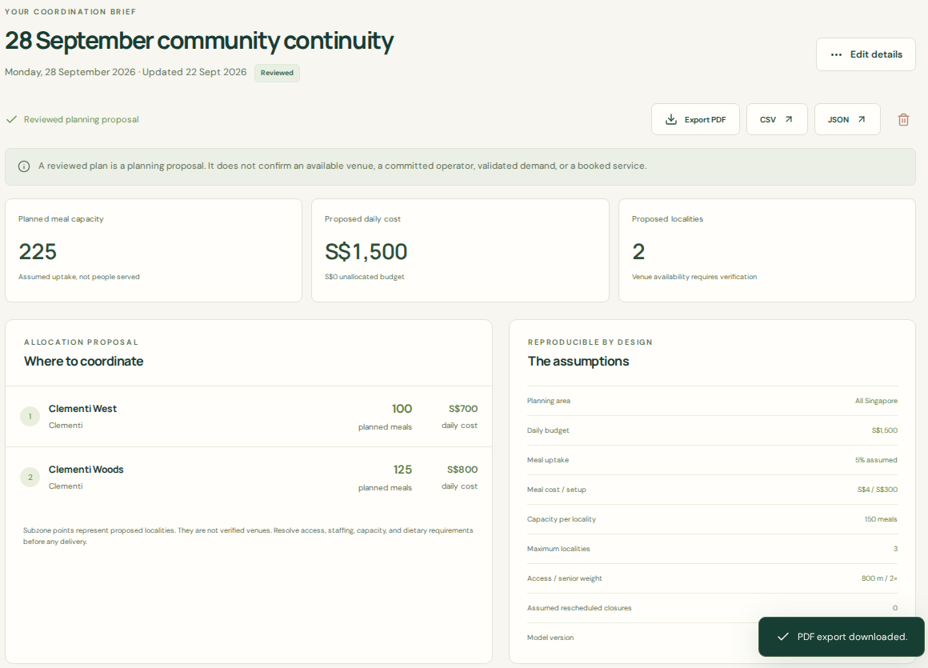
A proposal carries its assumptions into review
Before any service runs
Confirm resident need
and accessible routes.
Verify the venue, operator,
meal cost and capacity.
Save the decision record.
Export PDF, CSV or JSON.
Browser-test proposal. A review flag does not book a venue, approve an agency service or dispatch meals.
07
Notes:
Screenshot provenance: scripts/presentations/assets/README.md and screenshots.json. Real executed browser-test workflow, 28 Sep 2026, S$1,500 budget, 225 planned meals. The automated test exercises the review checklist and PDF download. No real venue verification, operator review or delivery occurred. The application preserves source fingerprints and parameters in saved plans and exports. Owner filtering is application-enforced in the Databricks store. It is not a claim of database row-level tenant isolation against workspace administrators. Human review is an operational gate, not an automated authorisation. No personal beneficiary records are required by the product.

Slide 8
One operator pilot tests the business
Buyer hypothesis
S$1,000
Estate operators and funded
community organisations
scoped pilot
The paid job: prepare a reliable closure plan
and reduce coordination time.
S$250–500
monthly organisation
subscription hypothesis
The data is public. Defensibility would come from verified capacity
and a workflow operators choose to reuse.
No customers or willingness-to-pay validation yet. Commercial use needs paid hosting. The current product requires no LLM API.
08
Notes:
Price hypotheses and full sensitivity: docs/business-case.md. Proposed S$1,000 pilot creditable to S$250–500 subscription. These are not validated prices or revenue. Example downside: 5 organisations × S$250, 5 support hours each × assumed S$30/hour, S$600 assumed hosting = −S$100 before development and other costs. Hosting numbers are planning allowances, not Databricks quotes. Public sources are not proprietary advantage. Existing alternatives include NEA myENV, SGMakan closure dates and coordinator spreadsheets. NEA operating context: https://www.nea.gov.sg/our-services/hawker-management/announcements . Databricks Free Edition is noncommercial and has no SLA: https://docs.databricks.com/aws/en/getting-started/free-edition-limitations .

Slide 9
The next test is an operator’s decision
1 operator
1 scheduled closure
4–6 weeks
Prospective pilot target
30%
less preparation time,
with no increase in critical omissions
Every venue verified before use.
Support time and repeat payment measured.
Targets remain unachieved. Shivam Gupta owns the project. github.com/shi1720/DAISI
09
Notes:
Prospective validation protocol: submission/whats-next.md, submission/buyer-interview-guide.md and docs/business-case.md. No stakeholder interview, actual pilot, commercial commitment or measured welfare outcome is claimed. At least three non-leading interviews and observation of an existing workflow should precede a funded engagement. Compare equal preparation tasks, record corrections, venue rejection, support hours and willingness to repeat a paid engagement. The small pilot cannot establish national causal impact. Platform prerequisite status: {"local_app_tested":true,"databricks_workspace_execution_verified":false,"databricks_app_url":null,"successful_pipeline_run_url":null,"mlflow_run_url":null,"public_or_unlisted_video_url":null,"note":"This records actual evidence, not intended architecture. Populate cloud links only after successful workspace execution."}. Newer compatible demographics and real operator capacity are prioritised inputs. Project owner: Shivam Gupta. Confirm eligibility and full team details separately; the deck does not imply IHL enrollment.

