Slide 1
PACTSHIFT
01
Pactshift
Scope changes your
clients can approve
Shivam Gupta / Founder and builder
Notes:
Pactshift is software for fixed-fee agencies to turn a new client request into an explicit add, swap, or defer decision. Founder and builder: Shivam Gupta. Development uses AI assistance. This deck presents the product implementation and business hypotheses, without claiming customer traction.

Slide 2
PACTSHIFT
02
The cost of “one more thing”
“Could we add Spanish pages
before launch?”
A 12-hour request adds $720
of estimated delivery labor.
A fixed fee stays fixed until
someone changes the agreement.
Margin after delivery labor (illustrative)
$12,000 fee, 96h at $60/h delivery cost.
Notes:
Illustrative example only, not observed customer results. Assumptions: budget USD 12000, baseline 96 hours, delivery cost USD 60/hour, extra request 12 hours. Original gross margin = (fee - baseline hours * cost rate)/fee. Absorbed margin = (fee - (baseline hours + extra hours)*cost rate)/fee. Gross margin excludes overhead, taxes, and non-labor cost. Source: product demonstration scenario and docs/BUSINESS.md. Upwork's fixed-price freelancer field guide independently describes scope creep and add/swap/defer responses: https://www.upwork.com/mc/documents/caf2f4f2e8dab00fc04b3408465eedb3

Slide 3
PACTSHIFT
03
A request becomes a clear choice
Client choice | Trade-off | Project result
Add | +$1,500 for 12 hours | Budget and scope increase
Swap | Replace 16 hours of eligible work | New scope, same budget
Defer | Keep the current plan | Baseline stays unchanged
Pactshift applies the accepted choice to the project baseline.
A share link records the decision. Version checks stop conflicting approvals.
Notes:
Source: docs/BUILD_CONTRACT.md, shared/types.ts, server domain model. Amounts are illustrative demonstration values. The swap option requires planned, unlocked deliverables with sufficient estimated capacity and no active dependents. Add inserts the requested deliverable and increases budget. Swap retires selected deliverables and adds the request at the existing budget. Defer leaves the baseline unchanged. The decision receipt records the current version, client name, and selected option. This is an operational acknowledgment, not a claim of a certified digital signature.

Slide 4
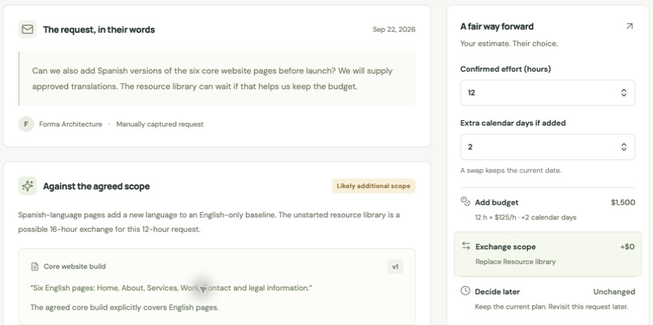
PACTSHIFT
04
The request beside the agreement
Actual product workflow using a fictional demonstration project
Notes:
Source: docs/images/request.png, a native browser capture from the working local Pactshift application. This slide crops the image to the request, scope evidence and proposed options. The demonstration workspace is fictional and isolated from real customer data. This is the owner review screen, not the client offer. The screenshot remains a raster image and the surrounding text remains editable. Live application: https://pactshift-wh46bdeima-uc.a.run.app

Slide 5
PACTSHIFT
05
An approval changes the system
01
02
03
Review
Validate
Commit
An agency reviews scope
evidence and effort. The
client picks an option.
The API checks tenant,
price, capacity, expiry
and baseline version.
One transaction updates
the baseline and records
the audit event.
AI suggests. People decide. The server enforces the agreement.
Notes:
Architecture and implemented controls are documented in docs/BUILD_CONTRACT.md and source. React/Vite client, Express/TypeScript API, Firestore durable storage adapter, and local JSON adapter. Tenant checks apply to private routes. Public offers expose a limited client view. Server-side arithmetic controls prices. Acceptance validates the current baseline and mutates the workspace atomically. SHA-256 chained audit events help detect edits but are not externally anchored or tamper-proof against privileged rewriting. AI analysis may use Vertex Gemini with validated citations, or a disclosed rules fallback. Neither engine accepts agreements or sets prices. Current product boundaries include one owner per workspace, 30 requests per project, 100 audit events per project, 50 baseline versions per project, and 720,000 bytes of workspace storage. Stored-project quotas include archived projects. Client approvals are included within these bounds, not unlimited. The product makes no compliance certification claim.

Slide 6
PACTSHIFT
06
A flat subscription for each workspace
Plan | Monthly price | Stored projects | Analyses / month
Free | $0 | 3 | 30
Studio | $29 | 15 | 300
Agency | $79 | 60 | 1,500
No percentage fee on the changes a client accepts.
Proposed pricing. Archived projects count toward the limit. Client approvals are included.
Notes:
Source: docs/BUSINESS.md and the implementation plan. Prices are USD per workspace per month, a launch hypothesis rather than validated willingness to pay. Stripe checkout and signed webhook integration require merchant configuration. No live payment or revenue claim. Stored-project quotas include archived projects. Client approvals are included within explicit storage limits: 30 requests, 100 audit events and 50 baseline versions per project, and 720,000 bytes per workspace. A project allowance does not promise every project can reach every object limit simultaneously. Illustrative AI cost: Gemini 2.5 Flash-Lite at USD 0.10/1M input tokens and USD 0.40/1M output tokens yields USD 0.001 per analysis at 6,000 input plus 1,000 output tokens. At full included allowance this is USD 0.30 Studio or USD 1.50 Agency before retries, hosting, storage, support, payment processing, and tax. Source: https://cloud.google.com/vertex-ai/generative-ai/pricing accessed 2026-09-22. Rates and providers can change.

Slide 7
PACTSHIFT
07
Built for the next
fixed-fee change
Initial buyer
Validation plan
Small web and design agencies
with repeated scope negotiations.
Five design partners using real
requests. Measure paid renewals
and time to agreement.
Shivam Gupta / Founder and builder
pactshift-wh46bdeima-uc.a.run.app
Notes:
Commercial hypothesis: begin with small agencies selling web/design work at fixed fees. Recruit five design partners with consent, run real requests, and measure time to a client decision, accepted value, repeat use, and willingness to pay. These are planned validation steps, not completed traction. Competitive differentiation is the executable add/swap/defer baseline workflow with explicit capacity checks and a flat subscription. Similar products already exist, including ScopeGuardian, ScopeApproval, and ScopePilot. Source links and comparison limits: docs/MARKET.md. Founder and builder: Shivam Gupta. AI-assisted engineering and content production. Repository: https://github.com/shi1720/Galuxium-Nexus-V2. Live application: https://pactshift-wh46bdeima-uc.a.run.app

