Slide 1
Batchlight
Recall rehearsal for small food makers
See what your records prove,
and what they don’t.
Shivam Gupta / HACK47: OFFGRID 2026
Batchlight
01
Notes:
Shivam Gupta is project creator and product owner. Built with substantial AI assistance for research, design, implementation, testing, and writing. This deck presents a working hackathon product and an unvalidated commercial hypothesis. Source repository: https://github.com/shi1720/HACK47

Slide 2
The supplier message
“Please investigate paprika lot PAP-2409.”
The maker has already cooked a base sauce,
filled several runs, and shipped some jars.
One production sheet has a missing spice entry.
Synthetic scenario. The uncertainty is the point of the rehearsal.
Batchlight
02
Notes:
Opening story is fictional and uses the synthetic Ember & Oak fixture. PAP-2409 flows into BASE-1809, then three finished batches. CHL-1909-X has an incomplete spice record. No customer incident is represented. All Ember & Oak records and quantities are synthetic. Batchlight does not determine food safety or certify compliance.

Slide 3
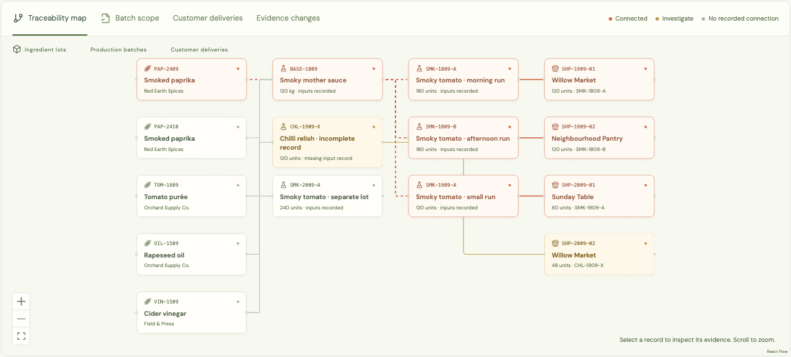
A trace you can inspect
Synthetic records. Source references remain available throughout the trace.
Batchlight
03
Notes:
The screenshot, when present, is captured from the real Batchlight interface with synthetic records. The recorded path starts at PAP-2409, passes through BASE-1809, and reaches three finished runs totalling 480 units. Recorded shipments total 300 units to three synthetic customers. The remaining 180 units are on hand. Do not treat these figures as customer outcomes. All Ember & Oak records and quantities are synthetic. Batchlight does not determine food safety or certify compliance.

Slide 4
Three answers, with honest limits
480
Recorded connection
The records contain a path from this lot.
120
Needs investigation
A missing input leaves a possible connection unresolved.
240
No recorded connection
No path appears in these records. This does not mean safe.
Finished jars in the synthetic demonstration. Intermediate bulk quantities are separate.
Batchlight
04
Notes:
Classification is based on stored records. The trace engine preserves explicitly incomplete records and propagates uncertainty through downstream production. A recorded connection does not establish contamination. A missing connection does not establish safety. Quantities are synthetic fixture outputs, not field measurements. All Ember & Oak records and quantities are synthetic. Batchlight does not determine food safety or certify compliance.

Slide 5
New evidence changes the live scope
Before the missing entry is resolved
120 jars need investigation
The maker adds a source reference confirming PAP-2410.
The current trace shows no recorded connection
for those 120 jars. It still makes no safety judgment.
The earlier saved rehearsal retains the original uncertainty.
Batchlight
05
Notes:
Synthetic evidence-repair demonstration. Save a PAP-2409 rehearsal before resolving the incomplete input in CHL-1909-X to a different supplier lot, PAP-2410. The earlier snapshot remains unchanged. The live investigation group then drops from 120 to 0 finished units, while the no-recorded-connection group grows from 240 to 360. No safety claim follows. The public GitHub Pages demo runs on the device. The full self-hosted application adds isolated accounts, transactional server validation, revision checks, idempotent commands, and queued offline synchronization. A stale pending rehearsal preserves its original device snapshot and pauses for reconciliation rather than silently recomputing. See repository tests. No claim that competitors lack equivalent workflows.

Slide 6
A focused place in an existing market
Traceability software already exists.
Lotpath and LotThread already sell recall drills.
Stocksmith and FourFoxes serve the same makers.
Our product hypothesis
A maker will value closing a record gap without
losing its history. New evidence updates the live
scope, while earlier reports keep their original basis.
Batchlight
06
Notes:
Competitor primary sources checked 22 September 2026: https://lotpath.tekinworks.com/ ; https://lotthread.com/pricing/ ; https://stocksmith.io/pricing/ ; https://fourfoxes.io/ . These sources describe vendor capabilities, not independent test results. We have not tested private competitor applications and do not claim they lack unlisted features. The differentiation and willingness to switch are hypotheses, not validated findings.

Slide 7
A price worth testing
$29
A narrow first customer
An owner-operated sauce maker
supplying a few retail or
wholesale customers.
per producer / month
Proposed hosted plan
Economics hypothesis
Free local rehearsal
No payments implemented
$19.83 monthly contribution
under stated cost assumptions.
Support time is the biggest risk.
Batchlight
07
Notes:
All money is in US dollars and is hypothetical. Proposed monthly revenue $29 less $3 allocated infrastructure/backups, assumed payment cost 3%+$0.30 ($1.17), and 10 minutes of support at $30/hour ($5) gives $19.83 before acquisition, engineering, tax, and overhead. With 30 minutes of support it falls to $9.83. Not a provider quote or forecast. No customers, revenue, payment integration, or validated willingness to pay. See docs/BUSINESS.md.

Slide 8
The next proof comes from makers
5 observed rehearsals
Use consenting producers’ own records.
Measure correct recipients, unresolved evidence,
setup burden, repeated use, and support time.
Offer a paid pilot only after the workflow earns trust.
Planned validation. No customer interviews or paid pilots have taken place.
Batchlight
08
Notes:
Proposed decision gates: three of five target makers complete a rehearsal with their own records, two accept a paid pilot, and no critical false exclusions emerge. These are planned thresholds, not results. A five-person study does not establish market demand. Before operational use, perform independent security review, hosted backup-restore verification, and qualified food-safety workflow review.

Slide 9
A recall should not be
the first time you test
your records.
Batchlight
github.com/shi1720/HACK47
Batchlight
09
Notes:
Creator and product owner: Shivam Gupta. Built with substantial AI assistance for research, design, implementation, testing, and writing. Complete disclosure in docs/THIRD-PARTY.md. Demonstration data is synthetic. Batchlight supports traceability and rehearsal but does not detect contamination, determine food safety, or certify legal compliance.

