Slide 1
GROUNDPROOF
Yesterday’s approval.
Today’s evidence.
Operational evidence for drone inspection coordinators
Shivam Gupta
PROOF Aviation Futures Challenge 2026
01
Notes:
GroundProof by Shivam Gupta, founder and product lead. AI-assisted development and research. The current product is Demo Ready. Fictional jobs and controlled source changes demonstrate application behavior, not flight performance.

Slide 2
GROUNDPROOF
An approval depends on facts that can change
08:00
16:30
Tomorrow
The coordinator approves tomorrow’s inspection.
The site owner changes access conditions.
Which approved jobs now need another decision?
Illustrative scenario. Frequency and cost still need operator validation.
02
Notes:
This scenario is fictional. The separation of ground-use conditions and aviation permissions is supported by FAA and NPS context: https://www.faa.gov/uas/resources/policy_library/UAS_Fact_Sheet_2023.pdf and https://www.nps.gov/articles/uncrewed-aircraft-in-the-national-parks.htm . Neither source establishes customer pain frequency or willingness to pay.

Slide 3
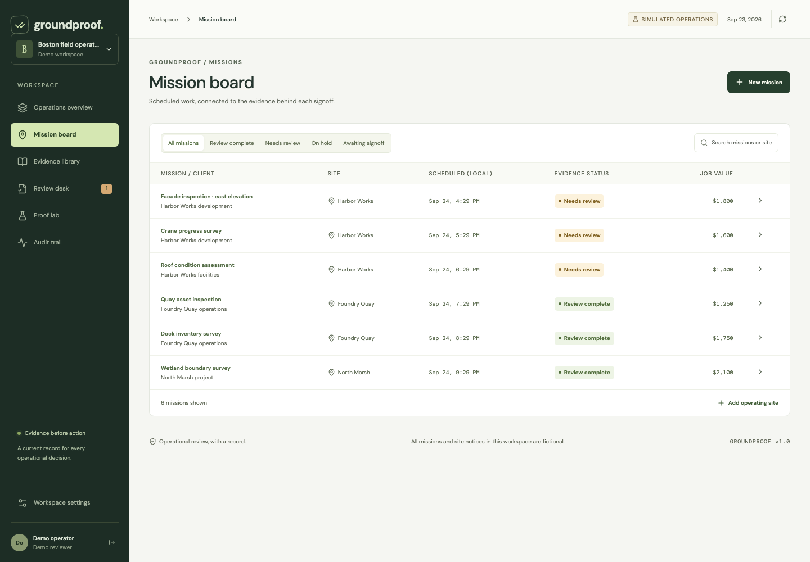
GROUNDPROOF
Every job has an evidence trail
One source can affect
several jobs.
GroundProof connects each internal approval to the source versions its reviewer accepted.
03
Notes:
Product screenshot shows the actual application with fictional demo data. It may contain illustrative planned values, which are not earned revenue or savings. Source capture, source review, and mission approval are distinct operations.

Slide 4
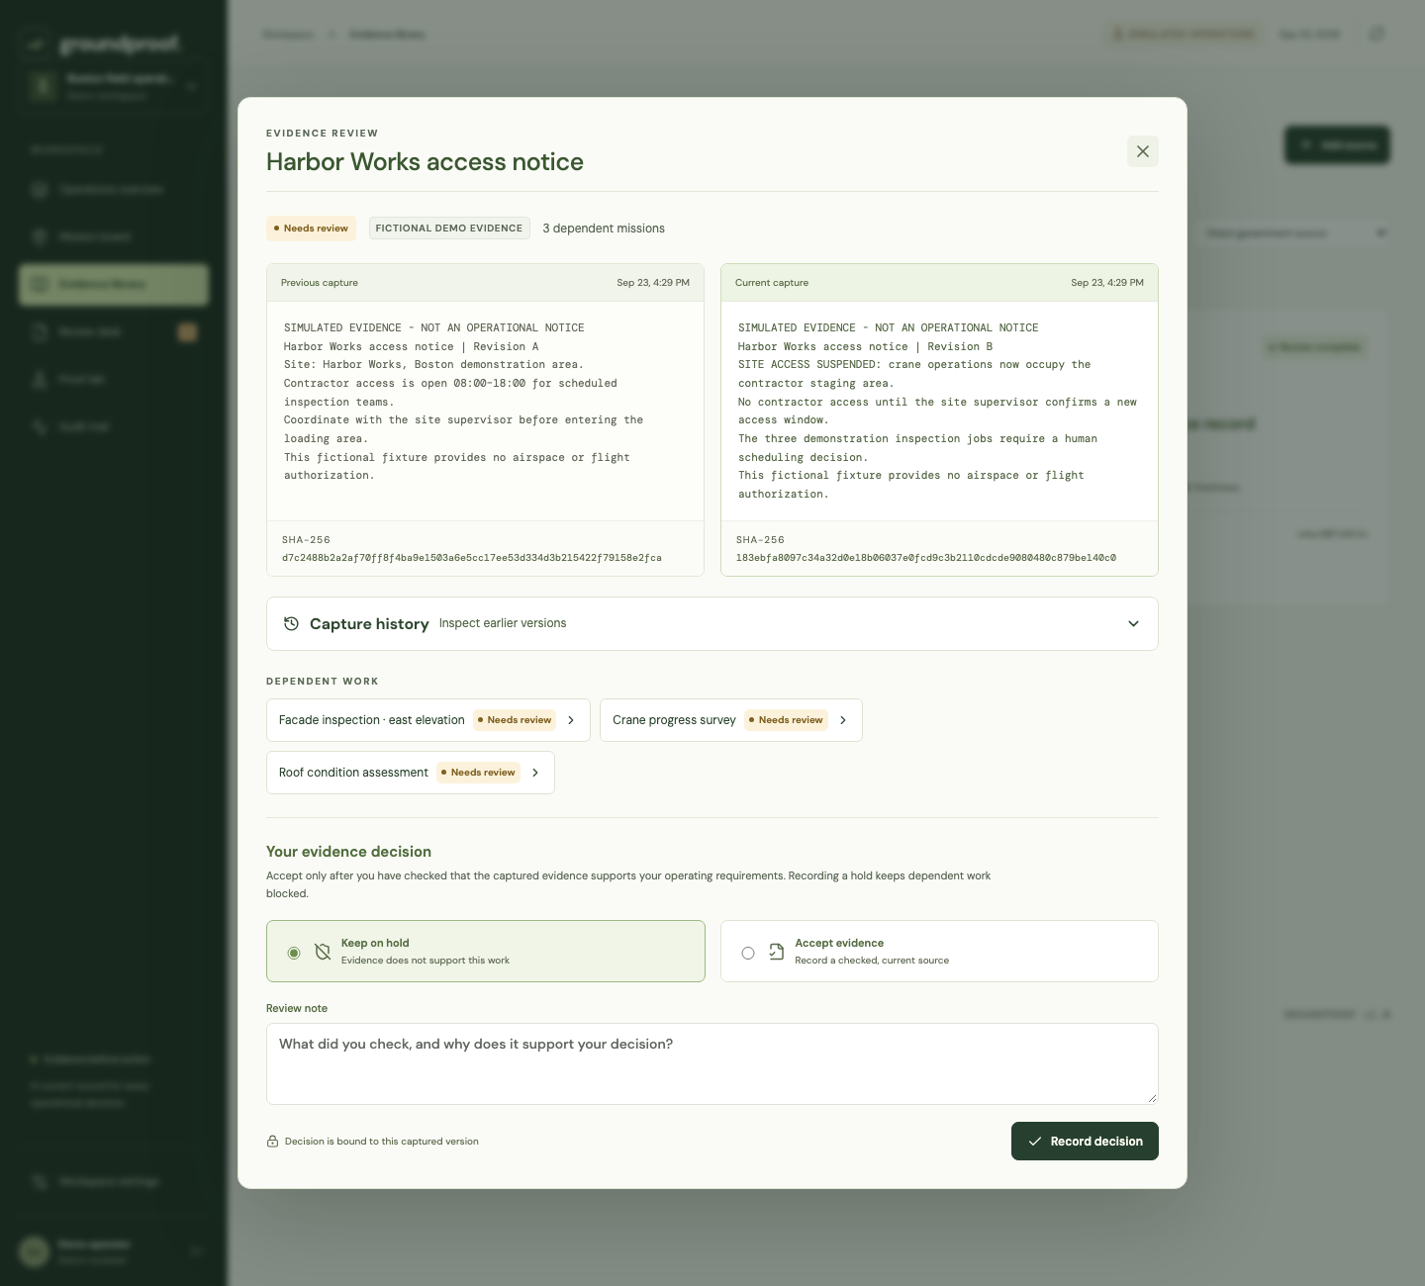
GROUNDPROOF
Changed evidence requires a fresh decision
3 jobs
depend on the simulated
Harbor Works notice
$4,800
illustrative planned value
affected, not savings
04
Notes:
The demo dataset has six jobs, three sites and five sources. The Harbor Works fixture affects the first three jobs with a combined illustrative planned value of $4,800. This is a controlled simulation. It demonstrates dependency propagation and version-bound approval, not financial loss avoided.

Slide 5
GROUNDPROOF
Approval follows the exact evidence version
Condition | Internal workflow result
New or changed source | Human evidence review required
Missing, stale, blocked, unavailable | Job on hold
Current evidence + matching approval | Review complete
Source re-reviewed after change | Fresh mission approval still required
Deterministic rules. Server checks. No LLM decides readiness.
05
Notes:
The server checks source hashes and review decisions, tenant ownership, timestamps, exact evidence coverage and the current mission revision. This is operational evidence administration, not flight authorization. The rule lab executes authored test scenarios. Exact test counts belong in the release validation report and live demonstration.

Slide 6
GROUNDPROOF
What we can prove today
Working software
Still to validate
Accounts with saved recovery keys
Authenticated Anakin capture
Scheduled source monitoring
Operator records and capture history
Version-bound signoff and export
Operator time savings
Source coverage in real workflows
Willingness to pay
Operational backup and restore
Covered tests demonstrate behavior. A pilot tests usefulness.
06
Notes:
Authenticated Anakin retrieval verified September 23, 2026 at 10:06:40 UTC: Boston public filming guidance, 5,930 characters in 2,458 ms. Evidence file docs/deliverables/anakin-integration-proof.json. This single call is not an availability or completeness benchmark. The hosted frontend uses Firebase Hosting with a Cloud Run API gateway to a Cloudflare Worker and durable SQLite database. Accounts support single-use saved recovery keys, password changes and session revocation. Retained source captures have paginated history and content-integrity checks. No customer, pilot partner, revenue, flight performance, certification, or prevented incident is claimed. Evidence packet hashes show content consistency. They do not establish source truth, a genuine permit, or legal compliance. GroundProof leaves flight decisions with the operator and remote pilot.

Slide 7
GROUNDPROOF
A focused addition to existing flight software
Existing category | Published focus
Aloft / AirHub | Fleet, compliance, approvals
Drone Harmony | Inspection capture and review
Anakin | Web capture and change monitoring
GroundProof | Evidence versions linked to job approval
The pilot must prove this narrow workflow adds enough value.
07
Notes:
Public feature descriptions inspected September 23, 2026: https://www.aloft.ai/air-control/ ; https://www.airhub.app/all-features ; https://www.droneharmony.com/asset-inspector ; https://anakin.io/products/monitoring . GroundProof does not claim those products lack version-aware capabilities. This is positioning, not a complete competitive teardown.

Slide 8
GROUNDPROOF
A subscription the pilot must earn
$199 / month
Proposed price for a coordinator workspace
Illustrative monthly time value | Result
100 jobs × 4 minutes ÷ 60 × $40/hour | $267
50 jobs × 4 minutes ÷ 60 × $40/hour | $133
Unvalidated inputs. At lower volume, time savings alone may not justify the price.
08
Notes:
All commercial numbers are hypotheses. Exact values $266.67 and $133.33 rounded to nearest dollar. Time capacity is not guaranteed payroll savings. Planning direct-cost case is $19 Anakin + $25 infrastructure + $20 support = $64 monthly cost, before other expenses. Anakin pricing inspected September 23, 2026 at https://anakin.io/pricing . 25 sites x 2 sources x 2 daily checks x 30 days = 3,000 basic captures, within the stated 5,000 Pro credits. Scheduled source monitoring and protective supplier budgets are implemented. Commercial billing and multi-user membership remain future work. The current product and initial pilot use one named coordinator account. The 25-site/five-user plan is future scope, not available team membership. A higher-volume paid deployment would require adjusting supplier budgets and verifying actual cost.

Slide 9
GROUNDPROOF
Four weeks to a paid continuation decision
Week | Operator evidence
1 | Baseline review time and source inventory
2 | Shadow workflow and discrepancy log
3 | Controlled failures and recovery drills
4 | Measured benefit, cost and continuation decision
Proposed gates: zero known invalid approvals in drills, 90% source coverage,
and 25% less median review time. Agree thresholds with the partner first.
09
Notes:
Pilot proposal only. Target 5-10 recurring sites and at least 30 job reviews if available. These are feasibility targets, not a statistically powered study. Maintain operator dispatch procedures throughout. Stop for an approval-control bypass or access-control defect. Measure total effort, including entering and maintaining private-record excerpts. Full definitions and go/no-go criteria: docs/PILOT.md.

Slide 10
GROUNDPROOF
One operator. A measurable pilot.
We need a drone inspection team
with recurring sites and a coordinator
willing to test the evidence workflow.
Shivam Gupta
Founder and product lead
groundproof-flight.web.app
10
Notes:
Ask: a commercial drone inspection operator, an experienced remote pilot or operations reviewer, and representative source records for a four-week shadow pilot. AI-assisted development and research. The application does not authorize or control aircraft. Repository: https://github.com/shi1720/HTCJ .

