Slide 1
PANTRY RELAY
Make the food
already here
go further.
Surplus coordination for a trusted pantry network
Shivam Gupta
Hack Away Hunger 2026
Notes:
Project lead: Shivam Gupta. AI-assisted development is disclosed in CREDITS.md. This presentation describes an implemented supervised-pilot release, not validated adoption. Opening: Imagine opening a pantry tomorrow with a produce gap while another pantry has approved surplus.

Slide 2
Coordination at network scale
700
partners and programs across 55 Iowa counties
Food Bank of Iowa describes a network large enough to make
coordination matter. The unanswered question is how often
one pantry’s approved surplus can fill another’s next-service gap.
Source: Food Bank of Iowa, FY2025 Impact Report. No partnership implied.
PANTRY RELAY / SHIVAM GUPTA
02
Notes:
Source: https://foodbankiowa.org/app/uploads/2025/08/FY_2025_impact_report_v8.pdf accessed2026-09-22. The scale statistic establishes context, not frequency of mismatch or market demand. We have not conducted operator interviews.

Slide 3
A shortfall before tomorrow’s service
Cedar Grove
Eastside
Produce above its own protected reserve
An upcoming service needs
120 lb of produce
A useful transfer needs more than a match.
The receiving pantry must agree. Transport must fit.
Someone must record the pounds actually accepted.
Illustrative scenario. All pantry names and operating data are fictitious.
PANTRY RELAY / SHIVAM GUPTA
03
Notes:
Tell the fictional scenario clearly. Source pantry protected reserve ensures its visitors are not deprioritized. This product does not decide assistance eligibility or collect household identities.

Slide 4
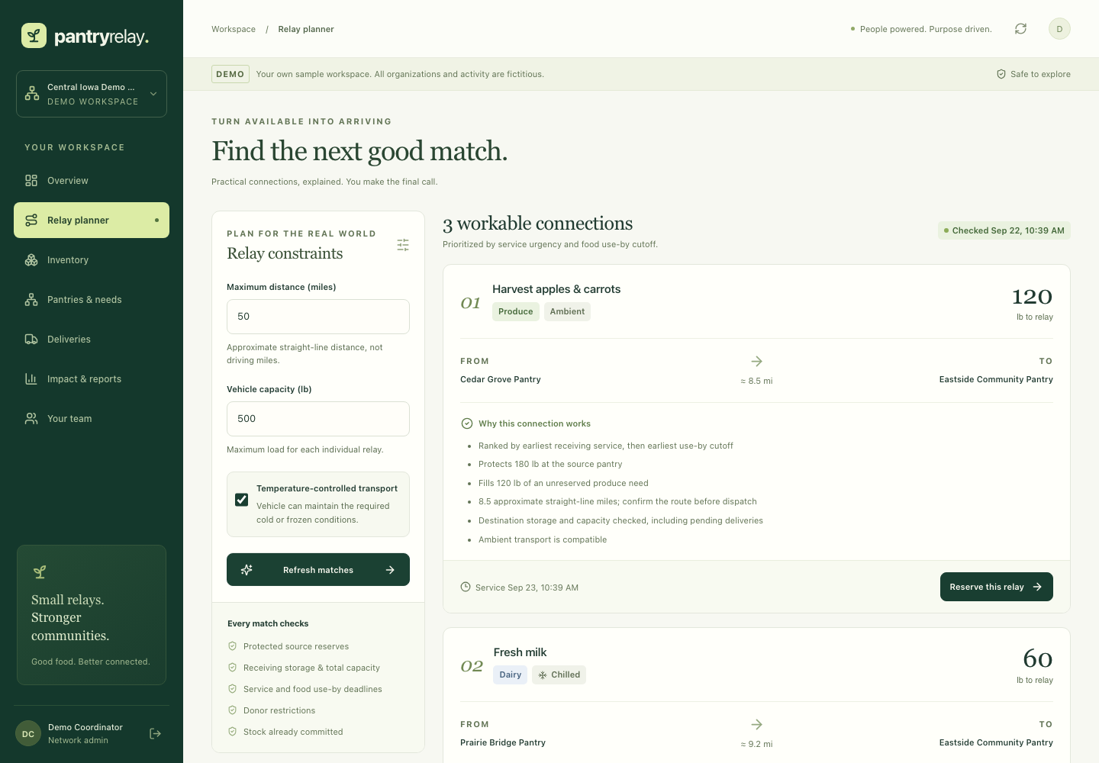
An explainable transfer proposal
Review the food, quantities and constraints before reserving stock.
PANTRY RELAY / SHIVAM GUPTA
04
Notes:
This is a screenshot of the running application with fictitious data. Live demo: generate plan, inspect reasons, reserve produce transfer. Matching is deterministic greedy allocation, not globally optimized road routing. Great-circle distance is a rough screening measure.

Slide 5
The receipt is the outcome
120 lb
112 lb
dispatched
accepted at the destination
8 lb damaged. The missing quantity reopens the need.
Illustrative partial receipt. Accepted weight is not a count of meals or people fed.
PANTRY RELAY / SHIVAM GUPTA
05
Notes:
Demo values120 dispatched,112 accepted,8 rejected. Only accepted weight enters throughput; late delivery does not fulfill a missed service. Received inventory is protected by default. Full rejection records0 and a reason. These values are sample outcomes, not real impact.

Slide 6
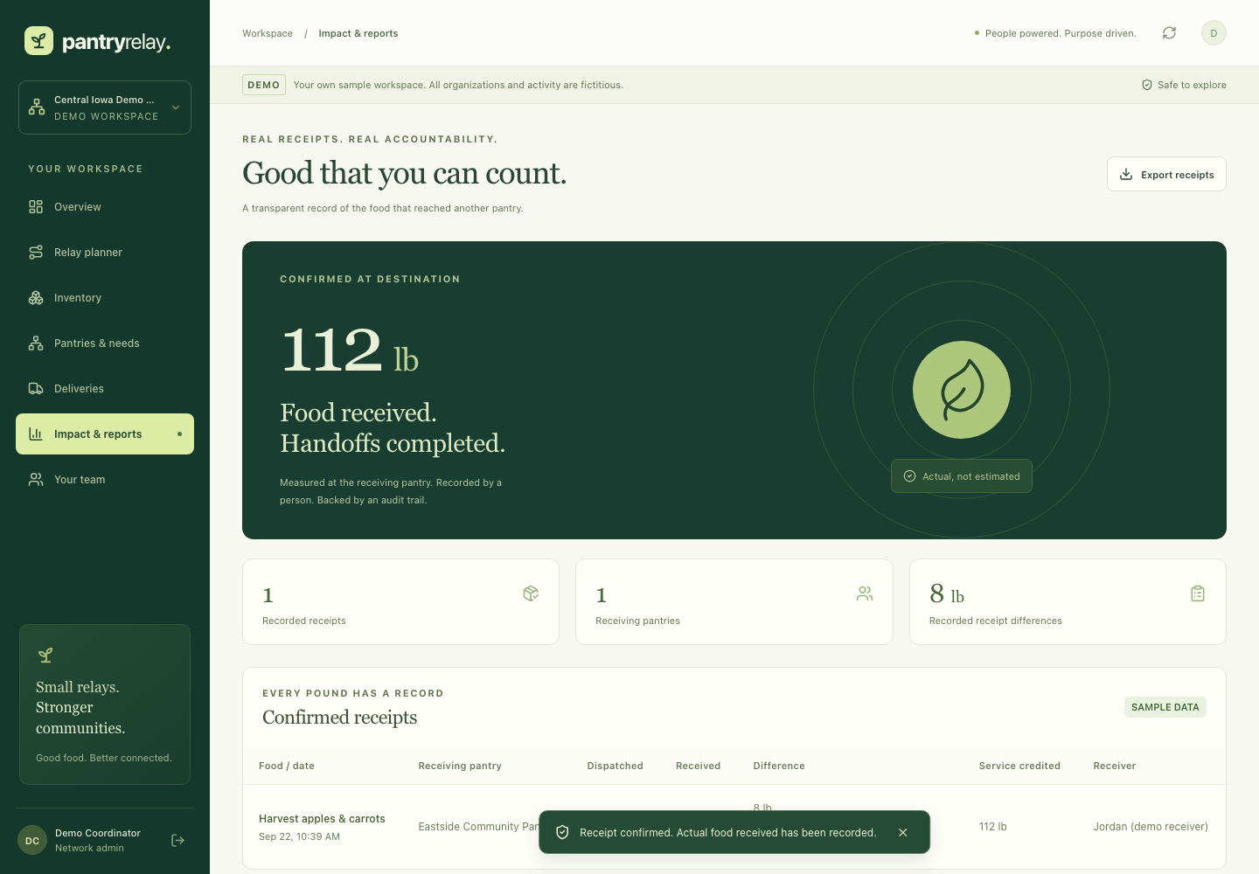
A complete handoff record
Authenticated actions, stock reservations, receipt differences and an exportable audit trail.
PANTRY RELAY / SHIVAM GUPTA
06
Notes:
Running product screenshot. Controls include network isolation, coordinator/driver roles, CSRF, opaque cookie sessions, integer weight arithmetic and atomic writes. Audit is API append-only but not tamperproof against a database admin. Operator records confirmations; no independently verified nonprofit identity or signature claim.

Slide 7
A proposed business model
$149
per network / month
Up to 10 pantry sites. Free self-hosting.
A six-week supervised pilot comes first.
At a hypothetical $25/hour staff cost, the price requires
about 6 hours saved per month to justify itself on time alone.
PANTRY RELAY / SHIVAM GUPTA
07
Notes:
Pricing is an unvalidated hypothesis, no customers or revenue claimed. Buyer: regional pantry-network coordinator, not people receiving food. Illustrative monthly economics149 revenue,15 allocated hosting/backup,30 support labor,104 contribution before overhead. No payment collection implemented.

Slide 8
Six weeks to test the real value
01
Baseline
Observe existing transfers, entry effort and service gaps.
02
Three pantries, one coordinator
Run approved transfers with existing transport and clear safety ownership.
03
A continuation decision
Compare category gaps, staff time, transport effort and accepted weight.
PANTRY RELAY / SHIVAM GUPTA
08
Notes:
Proposed pilot, not recruited. Six weeks: baseline week1; supervised weeks2-5; evaluation week6. Targets must be agreed before start. Suggested25% lower coordination time,20% lower category gap,95% receipts complete. Small uncontrolled pilot cannot establish causal household food insecurity reduction.

Slide 9
THE NEXT STEP
One network.
A real operating test.
We’re looking for a coordinator and three pantries
to test whether the next service can be better supplied.
Pantry Relay / Shivam Gupta
github.com/shi1720/Hack-Away-Hunger
Notes:
Close with a modest concrete ask. Do not claim a signed pilot or partners. Eligibility and attendance are participant responsibilities outlined in submission/START-HERE.md.

