Slide 1
HACK THE WEATHER 2026
kavu.
Every dry hour counts.
A drying operations desk for maize cooperatives
Shivam Gupta
Founder and product lead
kavu-drying.web.app
Notes:
Kavu project presentation for Hack The Weather 2026. Shivam Gupta supplied product direction, commercial focus and quality constraints. OpenAI Codex assisted research, engineering, tests and documentation. No fictional teammate or field contribution is claimed. Project source: https://github.com/shi1720/Hack-The-Weather

Slide 2
The work after the weather report
Which lot
needs action
next?
Spread and turn
Use the available yard and operator time.
Cover or seek a dryer
Respond when the weather changes.
Measure again
A new reading decides the next step.
Kavu 02
Notes:
Problem framing is a product hypothesis, not a claim from interviews. KALRO 2021 Training of Trainers Manual, Module 10, printed pp60-64 (PDF pp72-76), covers drying, moisture for storage and practical use of moisture meters. https://keep.kalro.org/appfiles/media/vc_files/maize-tot.pdf . NCPB provides paid mechanical grain drying: https://ncpb.co.ke/drying/ . Kavu has no validated customer adoption or loss reduction at submission.

Slide 3
Conduit changes the work plan
18,364
unique observations with traceable sources
2,700 kg
0 kg
12 September: outdoor allocation
Humid day or missing evidence
Same example lots, deadlines and capacity. Retrospective comparison.
Kavu 03
Notes:
Derived source: data/processed/quality-report.json and docs/evaluation.md. Input21,189 rows,18,364 unique,2,825 overlapping rows removed. Observations span28August to15September2026UTC. Longestgap144.029hours. The controlled evaluation holds inventory, deadline, capacity and September12 planning date fixed and maps comparison weather timestamps to the same hour on that date. September12 allocates2700kg; September15 humid and September8 gap allocate0. This demonstrates functional data dependence and does not estimate forecast accuracy or field outcomes. Original source folder https://drive.google.com/drive/folders/1KDoCh8vss7nv_B6SuVBlQQssjSh1yaBg . Attribution https://3d-fewsnet.icdp.ucar.edu/instruments/61 . Data redistribution and commercial terms need owner confirmation.

Slide 4
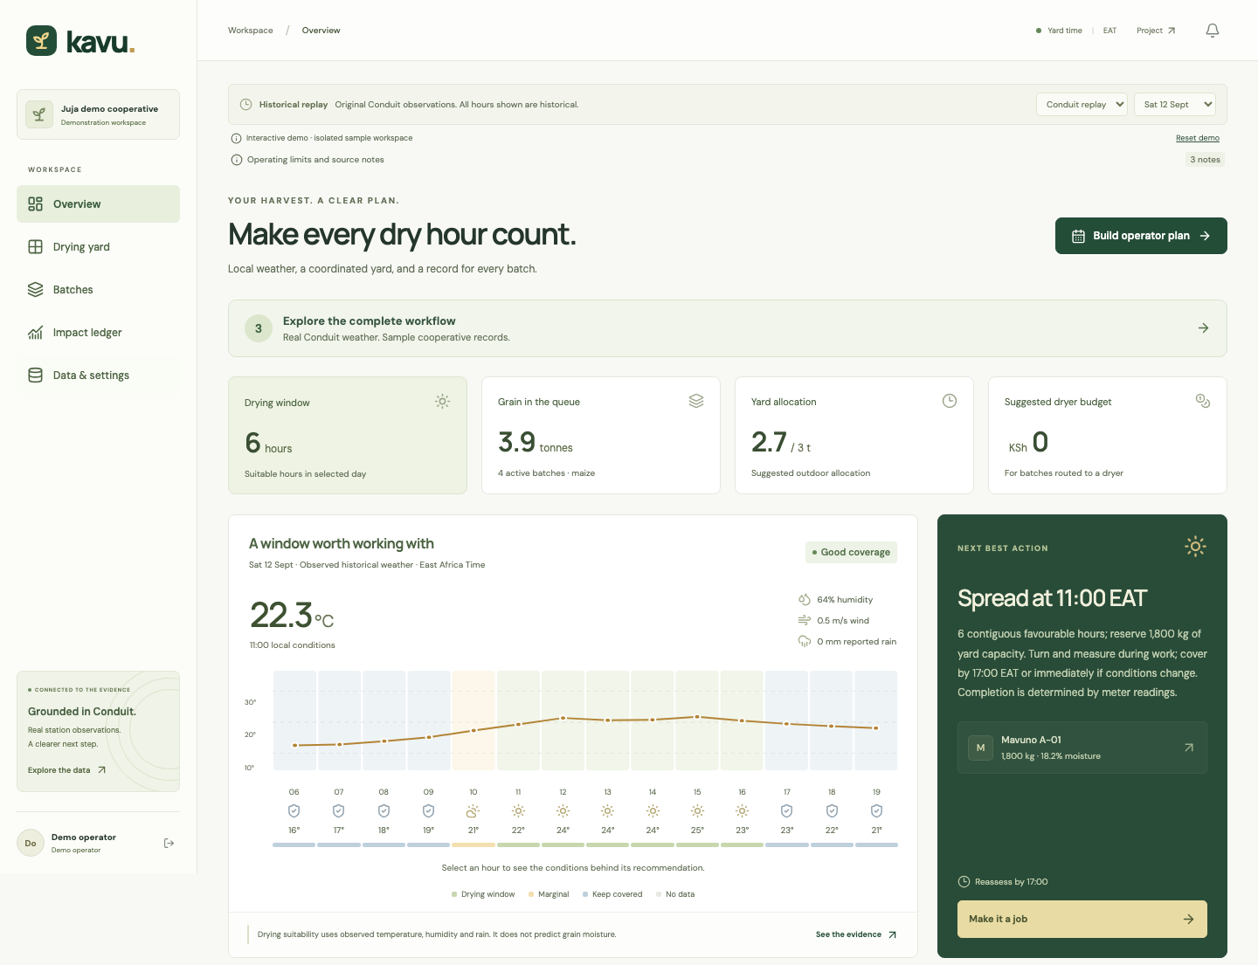
One workspace for the next job
A plan the
operator can
carry out
Capacity-aware allocation
Recorded task completion
Measured moisture history
Kavu 04
Notes:
Screenshot of the actual local Kavu application provided by the implementation owner. Historical replay for 12 September 2026 and example batches. It shows software functionality, not a photograph of a customer installation or evidence of outcomes. Overview, Drying yard, Batches, Impact ledger and Data & settings are the implemented view structure. No external imagery used.

Slide 5
Private accounts and cloud records
Hosted application
Self-hosting
Firebase Hosting
Express and SQLite
Docker deployment
Shared decision rules
React and TypeScript interface
Cloud Run API with Firestore
Private accounts and persistent lot records
kavu-drying.web.app
Kavu 05
Notes:
Architecture source: project implementation and deployment configuration. Firebase Hosting serves the React client, Cloud Run runs the Express API and a dedicated Firestore database persists cloud accounts, sessions and workspaces. SQLite remains the local self-hosting backend. Deployment verification status: implementation owner confirmed hosted checks. The current workspace has one account owner, not multi-operator role assignments. Demo workspaces are separate. Optional MET Norway forecast is separately attributed; historic Conduit observations do not calibrate it. Product direction Shivam Gupta; Codex-assisted engineering.

Slide 6
The economics of one example
KSh 2,176
Drying-tariff equivalent
1.8 tonnes × 3.2 percentage points × KSh 377.80
Mavuno A-01 example: 18.2% to 15.0%
Actual savings need labour, transport and alternative cost records.
Kavu 06
Notes:
NCPB published reference tariff: KSh377.80 per tonne per moisture percentage point, https://ncpb.co.ke/drying/ . Mavuno A-01 uses example intake mass1800kg, intake18.2%, follow-up15.0%. Calculation1.8x3.2x377.8=2176.128, displayed rounded KSh2176. Inputs are demonstration records, not field observations. This reference equivalent excludes actual labour, transport and handling, can differ from depot charges, and does not establish verified savings or causal impact. The ledger uses intake and latest moisture gap relative to target, rather than summing every downward reading.

Slide 7
A co-op buyer, a price to test
One supervisor.
Many farmers’ lots.
KSh 2,500
per active month per site
The daily alternative is a weather
report and a notebook. Renewal
depends on easier handovers.
Price to test in a pilot
Track support effort and renewal
Start with yards that already use moisture meters. Grow through useful lot and cost histories.
Kavu 07
Notes:
All buyer, price and moat statements are hypotheses, not customer discovery results. Proposed price KSh2500/active month/site from docs/research/market-and-evidence.md. Costs include infrastructure, support, onboarding, sales and seasonality. Competitor/complement sources: NCPB https://ncpb.co.ke/drying/ and Sesi GrainMate https://sesitechnologies.com/grainmate-grain-moisture-meter/ . No claim that these products lack unexamined features. The initial customer is a maize cooperative or aggregator near the station-relevant area, not all Kenyan farmers.

Slide 8
The next test is in the yard
A supervised pilot
with up to three yards
Observe the operator, then run in shadow mode.
Measure handovers, moisture checks and actual costs.
Test continued use and willingness to renew.
Seeking operator feedback and pilot introductions
Kavu 08
Notes:
Proposed pilot only. No committed yard, partner, customer or field result. Target3 yards and initially30 lot histories would test feasibility and usability, not power a causal impact study. Operators retain existing protective practices. Measure task completion, recordkeeping time, moisture-recheck process, rewetting episodes and receipts. Consider expansion after validated use, maintained station coverage and confirmed data rights. GitHub https://github.com/shi1720/Hack-The-Weather . Shivam Gupta founder/product lead; Codex-assisted research, engineering and documents.

