Slide 1
OffHire
The job is finished.
Is the rental?
Rental closeout through CALL-E
Shivam Gupta
Notes:
OffHire is a project owned by Shivam Gupta for the CALL-E hackathon. The deck makes no claim of live supplier execution, customers, revenue or measured savings. Product source: https://github.com/shi1720/call-e.

Slide 2
Equipment rental closeout
A site finishing with a machine leaves an office task behind
The contractor needs
a supplier answer
Industry guidance
IPAF recommends a unique off-hire reference communicated in writing. Collection remains a separate process.
Which asset?
When does the supplier say billing ends?
When will collection happen?
OffHire serves calls and exceptions across suppliers. Existing portal confirmations can stay in the workflow.
Source: IPAF Rental Standard, sections 9.11–9.13. Supplier terms still govern.
02
Notes:
Primary source: IPAF Rental Standard RP-3-EN V3.1 (2023-12-08), sections 9.11–9.13, printed pages 50–54. https://www.ipaf.org/sites/default/files/2023-12/IPAF%20Rental%20Standard%20(Including%20Guidance%20for%20Rental%20Companies)%20RP-3-EN--V3.1-20231208.pdf. This guidance describes recording off-hire details and a unique number, communicating written confirmation, and collection as a distinct process. It is not a universal rule that a phone call ends charges. Customer segment and product approach are hypotheses from desk research.

Slide 3
Billing cutoff and pickup
One supplier conversation can establish different facts
Field | Fictional rental desk statement | OffHire record
Pickup window | “Tomorrow, nine to eleven.” | Scheduled
Billing cutoff | “The dispatcher still needs to check.” | Unconfirmed
Actual collection | No collection recorded yet | Awaiting pickup
The TH-118 closeout stays open for billing clarification.
Illustrative Northstar Rentals scenario. No real rental agreement changes.
03
Notes:
All statements, asset IDs and business names are fictional. TH-118 is a sample 6,000 lb telehandler at Riverside. The native PowerPoint table is editable. A completed CALL-E task alone does not establish billing confirmation. A reported pickup window is distinct from actual collection and a supplier-reported billing cutoff.

Slide 4
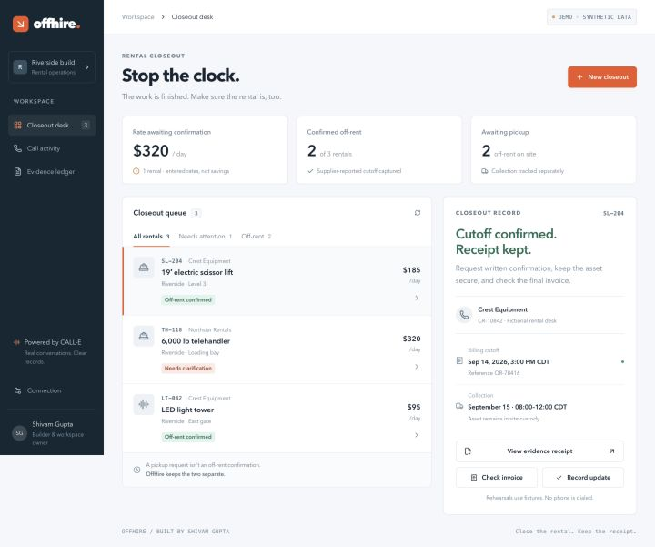
The OffHire
closeout desk
SL-204 has a supplier cutoff.
TH-118 still needs a billing answer.
Actual application
Synthetic Riverside data
04
Notes:
Source image: work/demo-assets/desk-desktop.png, supplied by the product implementation task. Screenshot depicts the actual OffHire app with a synthetic Riverside scenario. No call, customer adoption, supplier transaction or financial saving is established by this screenshot. The screenshot is an embedded raster image; surrounding slide text remains editable.

Slide 5
Reliability around the call
CALL-E gathers the answers. OffHire preserves the request and reconciles the result.
Moment | Implementation
Call creation | The server invokes the actual CALL-E SDK. Credentials stay off the browser.
Dispatch recovery | Persist the request and idempotency key before sending. Recover the same intent.
Webhook receipt | Treat unsigned callbacks as a signal. Fetch the known call with server credentials.
Business result | Keep unresolved billing separate from a completed call and scheduled pickup.
Accepted calls continue if local polling stops. Live verification remains separate.
05
Notes:
Implementation inspected in call-e/lib/server/provider.ts, store.ts, service.ts and app/api/[...path]/route.ts. Provider imports CalleClient from @call-e/calle, pins https://api.heycall-e.com, creates with idempotencyKey and reads a saved call. Durable job records retain requestJson and idempotencyKey before dispatch. Webhook route checks an event, resolves a known call and performs authenticated reconciliation instead of trusting callback business data. This slide describes code/design; it does not claim a completed live test or a test count. CALL-E references: https://docs.heycall-e.com/calls and https://docs.heycall-e.com/webhooks. CALL-E API currently does not expose a call cancellation action.

Slide 6
A measurable pilot
Contractors with frequent returns across several rental suppliers
$99
4 hours
per company per month
plus actual CALL-E usage
modeled admin time removed each month
40 events × 8 minutes × 75% removed
= 240 minutes
Pilot measures staff time, complete records and cost per closeout.
Open-source workflow
github.com/shi1720/call-e
Pricing and time benefit are hypotheses. No measured savings or paid demand claimed.
06
Notes:
All economics on this slide are assumptions for a proposed pilot, not measured results or verified willingness to pay. Calculation: 40 events/month × 8 minutes/event × 0.75 = 240 minutes/month = 4 hours/month. Proposed fee: $99/company/month plus actual provider usage. The public CALL-E pricing materials changed during research; no fixed tariff or fabricated margin is used. Product source: https://github.com/shi1720/call-e.

