Slide 1
Rill
A stream concern.
Two hours to act.
Rill helps a monitoring team choose its next useful check
and track what happens afterwards.
Shivam Gupta · Project creator
01
Notes:
OneAquaHealth IEEE Global Hackathon. Primary Track 2: Data-to-Insight. Rill is a software demonstration. No customer, field validation, or ecological impact is claimed. Creator: Shivam Gupta.

Slide 2
Rill
The work after a report
Existing tools
The Rill decision
Citizen observations
City dashboards
Rehabilitation guidance
Which check comes next?
Who owns the response?
What did the recheck find?
OneAquaHealth already offers collection and decision tools. Rill focuses on the fieldwork decision that follows.
Source: oneaquahealth.eu/project-solutions
02
Notes:
Source: OneAquaHealth, Project Solutions, accessed 23 September 2026. https://www.oneaquahealth.eu/project-solutions/ . The site lists the Citizen Science App, City Dashboards, Resilience Map, GEOSSIP, and Decision Support System. Competitive context: Cartographer already offers monitoring, QA, and confirmation workflows, https://cartographer.io/ and https://help.cartographer.io/riverfly/recording-a-sample . No worldwide novelty claim.

Slide 3
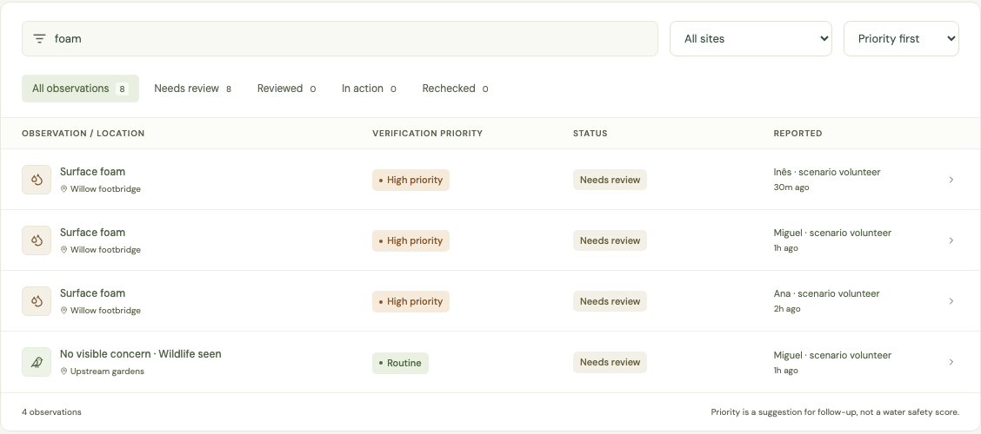
Rill
A concern with a visible next step
Observe
Describe the evidence
and uncertainty.
Review
Record a human
decision and recheck.
Synthetic demonstration scenario
03
Notes:
Screenshot shows the actual Rill application using synthetic seed data. Workflow includes structured observations, distinct evidence and priority labels, coordinator review, tasks, results, and recheck tasks. The demonstration does not constitute environmental findings or fieldwork.

Slide 4
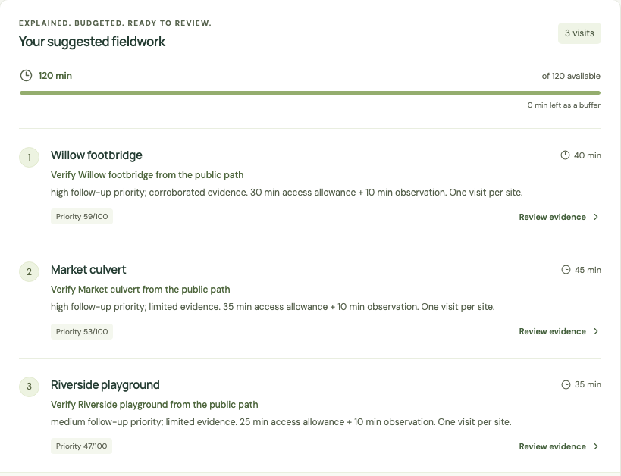
Rill
The next two hours
120
minutes available
Three visits selected
Every choice explained
Other sites deferred
Synthetic scenario. Estimates support planning, not optimal walking routes.
04
Notes:
Rill selects verification work within a requested time budget using versioned deterministic rules. Task durations are estimates. Serious signs and unsafe conditions block ordinary volunteer dispatch and require human handling. Priority is an operational heuristic, not a calibrated hazard probability. Scenario and observations are synthetic.

Slide 5
Rill
One Health, with honest uncertainty
Habitat
Animals
People
What changed
in the stream?
Where could wildlife
or pets encounter it?
How do people
use this place?
Visual signs justify investigation. Testing and qualified judgment establish what they mean.
Public-bank checks only. Follow local advice and access restrictions.
05
Source: CDC · How to Recognize a Harmful Algal Bloom
Notes:
Source: CDC, How to Recognize a Harmful Algal Bloom, https://www.cdc.gov/harmful-algal-blooms/about/how-to-recognize-a-harmful-algal-bloom.html . Visual inspection cannot establish whether a bloom is harmful. Rill does not diagnose toxins or pathogens, declare safe swimming water, or infer disease probability. The One Health questions are investigation context rather than proof of causality.

Slide 6
Rill
A working, inspectable system
Access
Authenticated workspaces and coordinator / volunteer roles
Evidence
Human review, historical decisions and a recheck gate
Deployment
Cloud Run API with PostgreSQL on Cloud SQL
Exchange
OAH directory, imports and environmental exports
Try rill-streams.web.app · No trained model or paid AI key.
06
Notes:
Implementation reference: docs/API-CONTRACT.md and the shipped Rill repository, https://github.com/shi1720/OneAquaHealth . Live directory imports provide site names and coordinates only, not water assessments or permission to access a location. CSV/JSON batch import validates records with explicit destination-site matching and preserves synthetic-data boundaries. Full JSON exports contain all retained audit events and historical review snapshots. The hosted origin https://rill-streams.web.app serves Firebase Hosting with a Cloud Run API and PostgreSQL on Cloud SQL. The hosted API lifecycle was verified. Version 1.1 local verification: SQLite and libSQL each passed 86 tests, with four PostgreSQL-only tests skipped in those runs; the dedicated PostgreSQL suite passed 53 tests. Current CI and browser evidence is recorded in docs/qa/verification.md. This is a pilot deployment, not production certification or a field-validated service. FHIR R4 Observation can reference Location: https://hl7.org/fhir/R4/observation.html . Export mapping is experimental and does not claim conformance to the evolving OAH IG. No fictional patients.

Slide 7
Rill
The coordinator is the first customer
€149
A value hypothesis
4 coordinator hours
× €40 assumed hourly cost
= €160 of monthly capacity
per programme / month
Proposed managed subscription
Volunteers contribute free
Illustrative €50 delivery cost leaves
€99 before fixed overhead.
Pilot measures: time per report, assignment delay, completed rechecks, and safe coverage.
Pricing and savings are assumptions. No customers or measured savings are claimed.
07
Notes:
Business model hypothesis, not market validation. Illustrative buyer arithmetic: 4 hours/month × €40/hour = €160/month of coordinator capacity. Proposed subscription €149/month. Illustrative monthly delivery costs: allocated infrastructure €15 + support €30 (45 minutes at €40/hour) + operations €5 = €50. Revenue less these assumed costs = €99 before development, acquisition, taxes and other fixed overhead. These are budget assumptions, not actual costs or achieved margins. Sampling and remediation are excluded. Category evidence: Cartographer offers paid environmental-monitoring subscriptions and nonprofit pricing, https://cartographer.io/pricing . Pilot target organisations are prospective, not partners.

Slide 8
Rill
A checked outcome
for every useful concern.
Seeking one monitoring programme
for a supervised pilot.
Shivam Gupta · Project creator
rill-streams.web.app · github.com/shi1720/OneAquaHealth
08
Notes:
Pilot invitation is prospective and makes no partnership claim. Hosted app: https://rill-streams.web.app . Repository: https://github.com/shi1720/OneAquaHealth . Track 2: Data-to-Insight. Project creator Shivam Gupta. AI-assisted research, design, implementation, and documentation are disclosed in submission material.

