Slide 1
LOOPLIGHT
The next step,
accounted for.
A follow-up ledger for the days after discharge.
looplight-care.web.app
Shivam Gupta
Founder & builder / Built with AI-assisted development
Notes:
Looplight is Shivam Gupta's UnivaBio project, built with AI-assisted development. This is a prototype tested with synthetic data. Demonstration records are fictional. The final Firebase deployment URL and screenshots were supplied by the build owner. Do not claim clinical validation or proven health benefit.
Release status: ready. The build owner reports 57 live Firebase checks passed on synthetic records, with owner isolation and persistence verified. Google sign-in and an edited demo surviving account save and refresh passed GUI checks. Additional UI review continues. These checks are not clinical validation or a guarantee that all defects have been found.

Slide 2
Care continues after discharge
41%
Anita is home.
Maya has the document.
A result is still pending.
had results return
after discharge
2005 study of 2,644 discharges
at two academic hospitals.
A historical finding, not a current
global prevalence estimate.
Fictional family.
A real coordination problem.
Looplight / 02
Notes:
Roy CL et al. Patient safety concerns arising from test results that return after hospital discharge. Ann Intern Med. 2005. https://pubmed.ncbi.nlm.nih.gov/16027454/ . The discharges were in 2004 at two academic hospitals. This is historical workflow context, not today's global prevalence. The 2025 SAFER Test Results Reporting and Follow-Up guide provides additional workflow context: https://healthit.gov/resources/2025-safer-guide-test-results-reporting-and-follow-up/ . Neither source endorses Looplight or establishes its benefit.
Release status: ready. The build owner reports 57 live Firebase checks passed on synthetic records, with owner isolation and persistence verified. Google sign-in and an edited demo surviving account save and refresh passed GUI checks. Additional UI review continues. These checks are not clinical validation or a guarantee that all defects have been found.

Slide 3
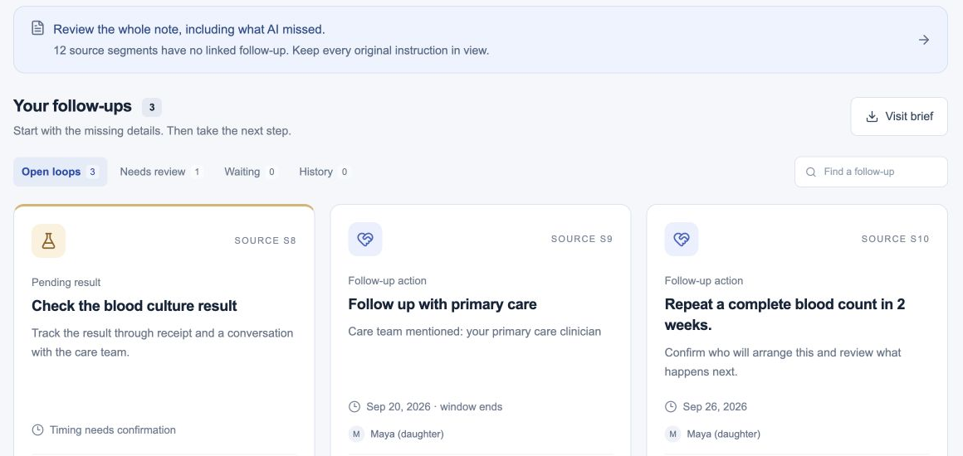
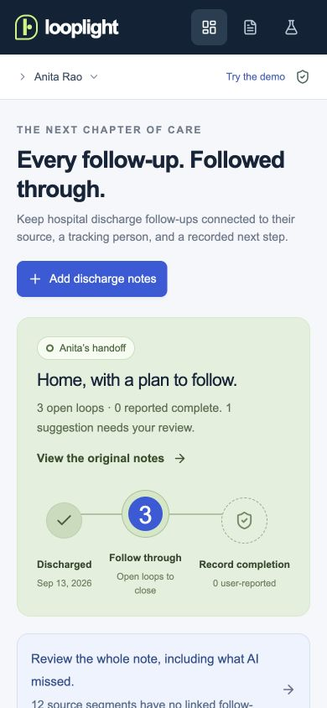
A plan with the source still attached
Inspect the original words.
On a smaller screen.
Review suggestions. Recover omissions. Name the tracker.
Looplight / 03
Notes:
The desktop and mobile captures show the real Firebase application using fictional Anita/Maya data. Original screenshot bytes are retained with editable native crops. The app accepts pasted text and text-based PDFs, exposes all source sentences, and requires task confirmation before tracking. The current demo can be saved to an account with its edits preserved. Imported PDF bytes are not retained; extracted text forms the source record. Final capture controls include Add discharge notes, Review the whole note, and the source-linked follow-up cards.
Release status: ready. The build owner reports 57 live Firebase checks passed on synthetic records, with owner isolation and persistence verified. Google sign-in and an edited demo surviving account save and refresh passed GUI checks. Additional UI review continues. These checks are not clinical validation or a guarantee that all defects have been found.

Slide 4
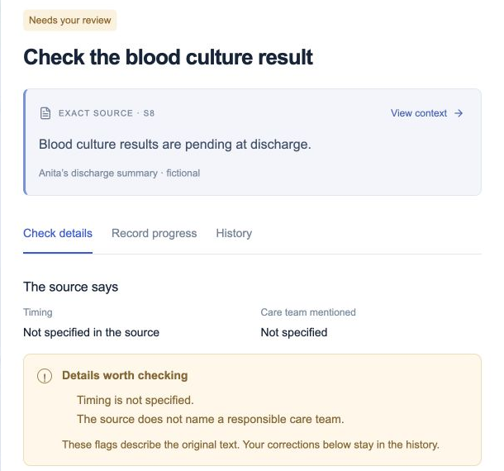
A result can arrive
before anyone reviews it
01 RESULT RECEIVED
The family has the result.
02 CLINICIAN REVIEW REPORTED
A user records who reviewed it.
03 OUTCOME RECORDED
The history keeps the reported ending.
User reports. No independent clinical verification.
Looplight / 04
Notes:
Follow-up transition logic runs in the browser. Firestore rules validate ownership, immutable source fields, versions, and quotas; they do not independently validate the full follow-up transition workflow. The user records clinician review and outcome. A clinician name is not verified identity or signed attestation. A tracker is the person following up, not an assignment of clinical responsibility. The actual Firebase result-detail capture shows source evidence and unresolved details, not clinician-verified evidence.
Release status: ready. The build owner reports 57 live Firebase checks passed on synthetic records, with owner isolation and persistence verified. Google sign-in and an edited demo surviving account save and refresh passed GUI checks. Additional UI review continues. These checks are not clinical validation or a guarantee that all defects have been found.

Slide 5
Measured on known synthetic fixtures
33/34
33/44
proposals matched
97.1% precision
expected actions found
75% recall
Historical evaluation on 20 known synthetic documents.
Reused during fixes. Not held-out or clinical validation.
The next evaluation needs independently annotated documents.
Looplight / 05
Notes:
Historical development report, not a new Firebase deployment benchmark: 20 synthetic document fixtures, 44 expected actions, 34 proposals, 33 matches. Precision 33/34 = 97.1%; recall 33/44 = 75%. The initial development result was 84.2% precision and 72.7% recall; fixes were evaluated on the same known fixtures. This is not an untouched holdout, clinician-annotated real-world evaluation, or evidence of health benefit. No model uplift over rules alone has been demonstrated. Separate classifier evidence, if judges ask: 225 original synthetic training examples, 50 separately authored synthetic challenge examples, 82% raw five-category accuracy, macro F1 about 0.816, 44/50 abstentions. Do not conflate sentence classification with document-level extraction or clinical safety. Firebase deployment checks are separate from this historical extraction evaluation.
Release status: ready. The build owner reports 57 live Firebase checks passed on synthetic records, with owner isolation and persistence verified. Google sign-in and an edited demo surviving account save and refresh passed GUI checks. Additional UI review continues. These checks are not clinical validation or a guarantee that all defects have been found.

Slide 6
A narrow first customer
A primary-care or transitions coordinator
already chasing discharge follow-up.
$149
The value to measure
Preparation time and correction burden.
Five minutes saved x 100 episodes
at $35/hour = about $292/month.
per month / 100 care episodes
Single-coordinator pricing hypothesis
Illustrative inputs, before review and implementation costs. No observed ROI.
Looplight / 06
Notes:
The price and savings inputs are hypotheses, not customer research. $149 per coordinator account/month for 100 episodes is a proposed experiment. No revenue, willingness-to-pay evidence, customer validation, or observed time saving is claimed. Five minutes x 100 / 60 x $35 = $291.67 before review and implementation costs. Inference runs in the browser without a paid model API; hosting, storage, support, security review, clinical governance, and bandwidth remain costs. Shared team workflows are future work. Related products include SeamlessMD, Memora/Commure, Eon, and care-management platforms. Source grounding alone is not a demonstrated moat.
Release status: ready. The build owner reports 57 live Firebase checks passed on synthetic records, with owner isolation and persistence verified. Google sign-in and an edited demo surviving account save and refresh passed GUI checks. Additional UI review continues. These checks are not clinical validation or a guarantee that all defects have been found.

Slide 7
Built to inspect. The next proof is a pilot.
A complete browser workflow
What the pilot must measure
Browser: model, rules, and transitions.
Firebase: hosting, sign-in, and storage.
57 live Firebase checks passed.
Owner isolation and persistence verified.
Missed actions and corrections.
Preparation time and review burden.
Reported follow-up resolution.
Prototype tested with synthetic data. No clinical validation or proven health benefit.
looplight-care.web.app
github.com/shi1720/UnivaBio
Notes:
Firebase Hosting, Firebase Authentication, and Cloud Firestore replace the previous hosting/account stack. Model inference, task extraction, and workflow transitions execute in the browser. Firestore security rules enforce ownership, immutable source fields, versions, and quotas. They do not provide independent server-side clinical transition validation. The current demo-save flow preserves edits in the account. The build owner supplied 57 passed live Firebase checks and verified owner isolation and persistence. Google sign-in and edited-demo account-save persistence were verified in the GUI. Additional UI review continues. No flawless-operation claim is made. Proposed next work is a governed retrospective review with clinician annotation, followed by a supervised pilot. A small pilot cannot prove a causal reduction in readmissions.
Release status: ready. The build owner reports 57 live Firebase checks passed on synthetic records, with owner isolation and persistence verified. Google sign-in and an edited demo surviving account save and refresh passed GUI checks. Additional UI review continues. These checks are not clinical validation or a guarantee that all defects have been found.

