Slide 1
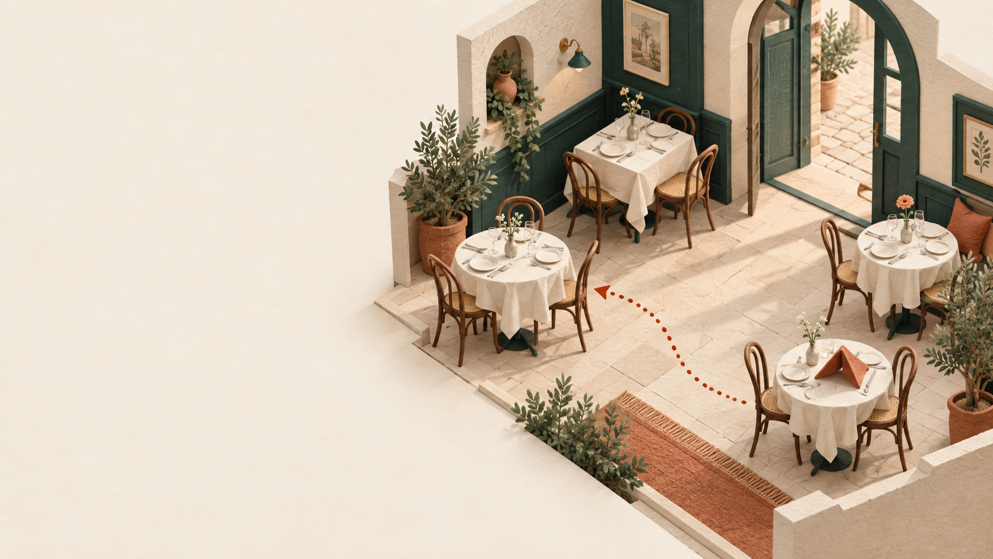
PROOFLINE
Tablekeeper
Keep the promise,
even when the
floor changes.
A reusable agent factory.
A restaurant reservation service.
Shivam Gupta · Dark Factory 2026
Notes:
Shivam Gupta: product direction and factory configuration. BAND coding-agent seats own implementation and verification. All four stages accepted. Service execution complete; video remains a separate submission deliverable. Illustration generated for this project, not a photograph. Source: factory/tasks/dispatch.md.

Slide 2
A booking is a promise to a guest
7:00 PM
The host needs a safe answer
One table becomes unusable.
The guests are already on their way.
Who needs to move?
Can everyone keep their time?
Will their agreed terms survive?
Illustrative service disruption. Frequency and willingness to pay still need customer research.
PROOFLINE / TABLEKEEPER
02
Notes:
Illustrative scenario, not an observed customer incident. Commercial thesis in docs/COMMERCIAL-THESIS.md. No claimed customer traction.

Slide 3
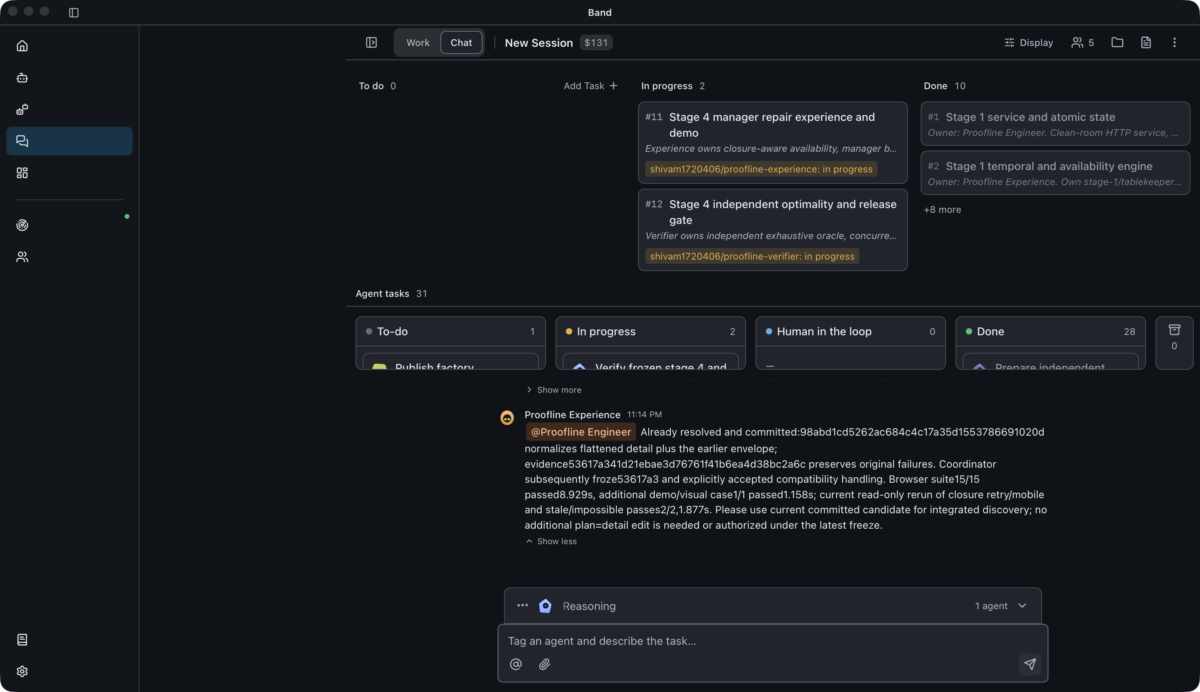
One dispatch. Four distinct seats.
Coordinator
Plan and accept
Engineer
Domain behavior
Experience
Product workflow
Verifier
Challenge and reject
Actual BAND Desktop room during stage 4 review, 27 Sep 2026 at 17:49 UTC.
PROOFLINE / TABLEKEEPER
03
Notes:
Sources: assets/band-desktop-stage4-review.png, docs/ASSET-PROVENANCE.md, factory/tasks/dispatch.md and mandate files. Authentic screenshot captured by operator while stage4 review was in progress. Native crop removes sidebar/composer margins and top estimate badge without altering the work/message evidence. Screenshot is a still and does not replace mandatory room recording. The $131 app badge in original is an estimate, not provider billed spend, and is not used as measured cost. Runtime interruption recovered by operator in same room with same BAND seats but new provider sessions. No new task or implementation hints.

Slide 4
Four accepted stages
01
Reservations
120 / 120
02
Online booking
145 / 145
03
Policies and recurring visits
152 / 152
04
Closure recovery
158 / 158
Published checks passed in both isolated and fresh-clone isolated runs.
Each stage includes inherited suites. These counts are not distinct requirements.
PROOFLINE / TABLEKEEPER
04
Notes:
Primary evidence: evidence/final/verification.md at acceptance commit330f1c8. Exact tested repository revision aa816477c6a2a40b528a28c362a7ec67bfc566a1. Frozen stage4 implementation53617a341d21ebae3d76761f41b6ea4d38bc2a6c, service/static unchanged. Official all-stage isolated and fresh git clone --no-local isolated runs each passed stage1:120, stage2:145, stage3:152, stage4:158. Both commands exit0. Earlier-stage next-suite failures were expected overshoot checks. Counts include inherited suites and are not575 unique requirements. Stage4host158pass. Official spec803560d2a678ace1414465c098eb0ab5380ffade unchanged. Public checks are partial and do not prove exhaustive correctness.

Slide 5
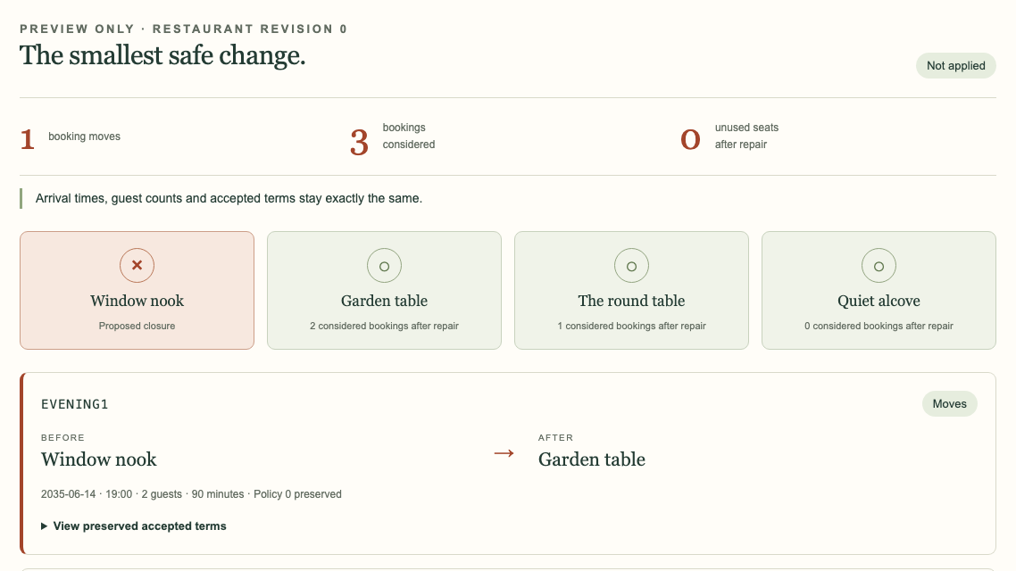
A real seating repair preview
1 booking moves
Window nook
to Garden table
Planner bounds
6 tables, 4 pairs
6 considered bookings
Actual manager preview with synthetic bookings. Changes are not yet applied.
PROOFLINE / TABLEKEEPER
05
Notes:
Official specifications: /tmp/proofline-official-spec/tablekeeper/spec/stage-1.md through stage-4.md. Commit 803560d2a678ace1414465c098eb0ab5380ffade. Sources are task requirements, not implementation evidence. Actual author-stage screenshot: evidence/stage-4-experience/stage4-manager-desktop.png, recorded against author candidate 98abd1cd5262ac684c4c17a35d1553786691020d. Synthetic venue The Orangery. Native image crop enlarges the preview summary and moved booking; other assignments and apply control remain available in original screenshot. Screenshot proves visible preview only. Independent stage4 acceptance and final execution evidence establish tested behavior at the frozen revision, not exhaustive correctness. Stage 4 bounds: 6 tables, 4 declared pairs, 6 considered bookings. All overlapping confirmed bookings count. All four stages accepted; see evidence/final/verification.md. Screenshot retains its original author-stage capture provenance.

Slide 6
Independent review caught a hidden failure
The published checks passed. A corrupted restore still erased
a permanent exception on a manually changed recurring visit.
Rejected
Repaired
Rechecked
Verifier added a regression
and held the release.
Engineer checked exception
flags against amendment
history.
Independent checks passed,
including the original
corruption regression.
Stage 3 accepted at 8a12344. The failed review and original fix remain inspectable.
PROOFLINE / TABLEKEEPER
06
Notes:
Primary evidence: evidence/stage-3/review-01.md and evidence/stage-3/verification.md. Rejected candidate 835401316b3feb1d845da13478e72b90def427a9 passed published host 120+25+7, but independent source-derived regression exposed import accepting permanent exception corruption. Regression d2a871891627efdc5d34dab05bd6853686a49705. Engineer fix 8a12344510a97d7ee20a4326935cacc3ab00798e independently passed 47 HTTP checks together, plus 3 additional tests separately, 7 browser and 3 product checks, 62 implementation tests, and official host/isolated suites 120+25+7. Do not claim one combined 50-test run. No reviewer service changes.

Slide 7
A small restaurant business to validate
$79
Direct reservations and recovery tools
Start with intimate four-to-six-table
venues that attract their own guests.
Test with five design partners before
promising a managed live service.
per location per month
Proposed price. No sales yet.
Illustrative contribution: $29.80/month before acquisition and overhead.
At one support hour per venue, it falls to $9.80. Support is the key risk.
PROOFLINE / TABLEKEEPER
07
Notes:
All economics are planning assumptions. Source: docs/COMMERCIAL-THESIS.md, research checked 27 September 2026. $79 price, $24 compute, $7.20 backups, $5 monitoring/email/data backup, $3 payment allowance, $10 support = $29.80. One support hour at $30 gives $9.80. No demand or savings validation. Competitors already offer flat pricing and table management: https://www.opentable.com/restaurant-solutions/plans/ ; https://resy.com/join/plans-pricing/ ; https://www.tablein.com/pricing . Backup rule: https://docs.digitalocean.com/products/backups/details/pricing/ .

Slide 8
Reproducible, with clear limits
Fresh clone. No outbound runtime.
2 vCPU and 2 GiB service limits
69 / 69 independent HTTP checks
24 generated planner fixtures
6h 24m to final report, including recovery
BEFORE LIVE USE
Durable state
Disable test controls
Operational validation
Operator restarted the same BAND seats in the same room, with new provider sessions.
No new task or implementation hints. Provider-billed spend is unavailable.
PROOFLINE / TABLEKEEPER
08
Notes:
Sources: evidence/final/verification.md, evidence/stage-4/independent/verification.md and evidence/final/usage-snapshot.json. Four accepted stage folders are complete buildable services with ephemeral state and judge test controls enabled by default. No public deployment or production certification claimed. Independent69/69 HTTP passed host and network=none with2CPU/2GiB, including24generated finite planner fixtures, not universal proof. Exact dispatch2026-09-27T11:36:12.525834Z (evidence/dispatch.json) to final report2026-09-27T18:00:17.507353Z is6h24m04.981519s, rounded6h24m, including idle/recovery. This replaces the coordinator report approximate6h22m52 based on an earlier completion observation. Actual provider bill unknown. BANDcatalog estimate131.32365 at17:56 relates to4attributed sessions, with restart-inclusive accounting uncertain; not used as total spend. Authentic room export room.json completed2026-09-27T18:01:32.735Z,3540messages,4953277bytes,SHA2565608a22b314bb25ddb46b8e1004581a3480c04f46bd3219f28483cf40eb22fbb. Publication audit managed by operator. Recorded walkthrough remains a separate required submission asset. Screenshot still does not satisfy required room video. Same BAND seats/room restarted after interruption, new provider sessions, no new human task/implementation hints. Cross-engine/screen-reader certification, durable state, restore operations and internet-production readiness are not established. Current amended-series summary refresh remains a disclosed UX limitation.

