Slide 1

Raksha
Every scam follows a script.
Now your phone knows the script.
The real-time scam-call shield. Script recognition in about 10 ms during a live call, powered by Moss. It interrupts before the OTP leaves your mouth, tells you what to say, and alerts someone you trust.
Shivam Gupta · with Claude · github.com/shi1720/YC-Fall-2026-x-Moss
YC Fall 2026 × Moss · Zero Latency Builder Sprint · Real-Time Voice & Conversational AI
Notes:
Open with the phone ringing. Raksha means 'protection' — the thread on Raksha Bandhan. The product is that thread for a parent's phone.

Slide 2
THE PROBLEM
Scams are conversations with a script. Nobody protects people during the conversation.
₹22,845 cr
₹1,900 cr
41%
$25.6M
reported cyber-fraud losses in India, 2024 — 10× the 2022 figure
taken by 'digital arrest' scams from 1.23 lakh people in 2024 (+465%)
of $10k+ losses by older adults in the US began with a phone call
wired by one employee to a deepfaked CFO on a video call
MHA, Lok Sabha Q.432
MHA · Supreme Court suo motu, 2025
FTC Data Spotlight, 2025
Arup, Hong Kong, 2024
Every one of these calls followed the same arc: authority → fear → secrecy → the ask.
Raksha
YC Fall 2026 × Moss · Zero Latency Builder Sprint
Notes:
The numbers are sourced in docs/research/market-facts.md. The point: the losses are enormous, growing, and concentrated on the elderly and on phone calls.

Slide 3


THE GAP
Caller-ID tells you who is calling. Nobody tells you what they are doing to you.
Truecaller · Airtel · Jio · iOS 26
Number reputation
Crews rotate numbers daily. The script never changes.
Truecaller AI Call Scanner
Synthetic-voice detection
Most scammers are humans reading a script.
Google Pixel Scam Detection
On-device content analysis
Pixel 9+ only — under 1% of Indian phones.
Hiya AI Phone
Cloud content analysis
US only, $9.99/month, cloud round-trip per fragment.
Raksha
Script-level detection + intervention
Any phone. In-process retrieval. Says what to do. Alerts family.
Raksha
YC Fall 2026 × Moss · Zero Latency Builder Sprint
Notes:
The whitespace: multi-OEM, script-level detection with an intervention step. Only two products analyse content; neither reaches the Indian mass market.

Slide 4
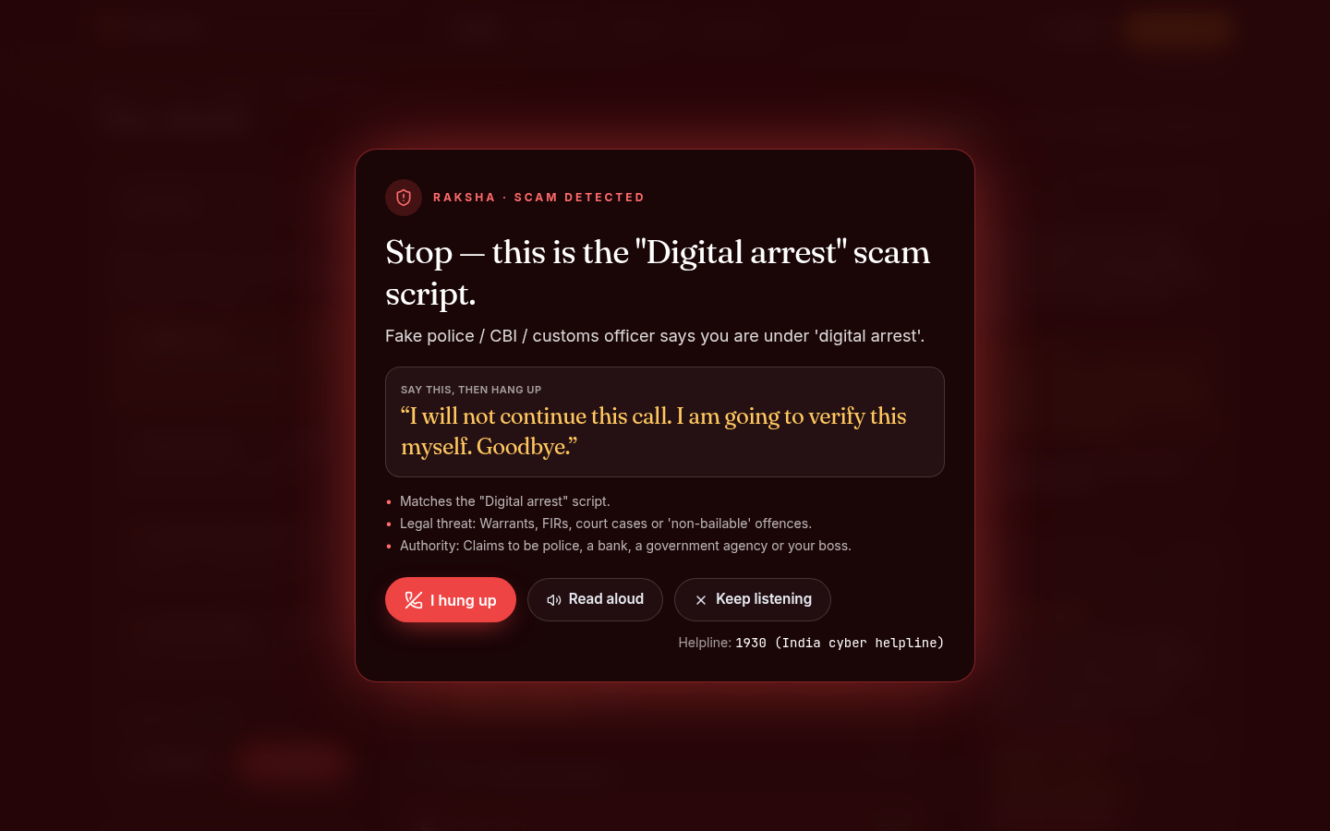



THE PRODUCT
Meet Raksha. It listens with you, recognises the script, and steps in.
Every fragment, even mid-sentence
Speech becomes text on the device; each fragment is a query.
Recognised in ≈ 10 ms
Matched against 409 real scam lines in-process with Moss, including on-device embedding. No vector DB, no round-trip.
One sentence to say
It names the script, gives the exact words to end the call, and speaks them aloud.
Raksha
YC Fall 2026 × Moss · Zero Latency Builder Sprint
Notes:
Live demo cue: /shield?scenario=digital-arrest, voices on. The overlay is the emotional peak.

Slide 5
HOW IT WORKS
A fast path that never waits for the cloud. A slow path that knows what to say.
FAST PATH · EVERY FRAGMENT · ≈ 10 MS
SLOW PATH · ASYNC · ON TRANSITIONS
Moss runtime, in-process: the playbook index is loaded at boot and queried with raw cosine scores (alpha 1.0, top-6).
Cosine → calibrated confidence. Benign look-alikes in the same index out-vote tactic lines (“we will never ask for your OTP” stays quiet).
Speaker-aware: the person's own words only ever count as compliance.
Noisy-OR over 21 persuasion tactics; evidence persists for the whole call.
Rule 1 — pressure + ask (the triad) ⇒ DANGER. Rule 2 — victim about to comply ⇒ intervene now.
A 20B model (Groq) returns a JSON contract: verdict · explanation · say this · action.
Only when risk changes, never per fragment: ≈ 300–800 ms, off the critical path.
A confident “benign” verdict can veto CAUTION. It can never override DANGER.
Template fallback: the product works with no LLM key at all.
Raksha
YC Fall 2026 × Moss · Zero Latency Builder Sprint
Notes:
Latency changes what you can build: when retrieval is free and instant you check every fragment instead of choosing which sentences to check.

Slide 6
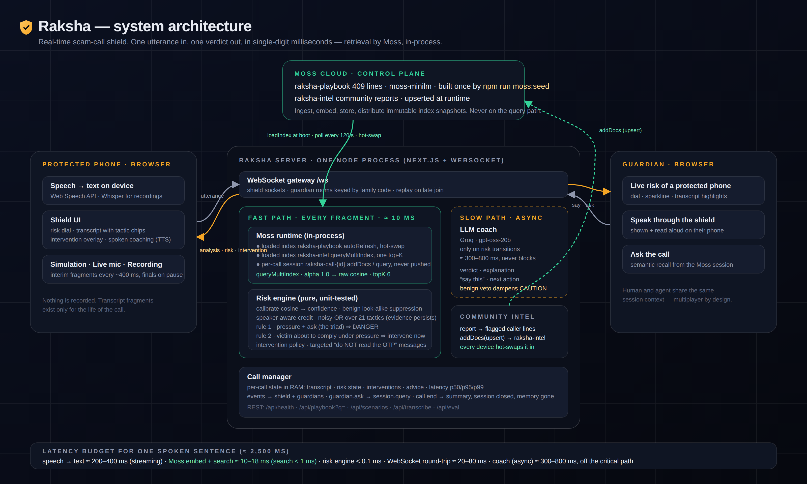
ARCHITECTURE
One Node process: Next.js, WebSockets and the Moss runtime share one memory.
Raksha
YC Fall 2026 × Moss · Zero Latency Builder Sprint
Notes:
The diagram is in the repo at docs/diagrams/architecture.png with a full write-up in docs/ARCHITECTURE.md.

Slide 7



MOSS IN THE LOOP
Four ways the retrieval layer does real work here.
Loaded index, in-process query
A session per call
raksha-playbook (409 lines) loaded at boot. Every fragment embedded and searched locally via queryMultiIndex (raw cosine, calibrated). The entire hot path ≈ 10 ms, unmetered.
client.session() opens a local index of the call's own turns. The guardian's “what did they ask for?” is a semantic query over it. Never pushed — memory dies with the call.
Auto-refresh hot-swap
Multi-index, one top-K
Reported caller lines are upserted into raksha-intel. Every running shield polls and hot-swaps the new version in with zero query downtime. No redeploy.
queryMultiIndex searches the curated playbook and community intel together. Metadata (family, tactics, severity, kind, stage) lets the engine reason over tactics, not text.
Raksha
YC Fall 2026 × Moss · Zero Latency Builder Sprint
Notes:
Deliberately not used: pushIndex (privacy) and the browser SDK on the hot path (it cannot yet use a delegated authenticator; the retriever interface is ready for it).

Slide 8
SPEED & LATENCY
A scam is won or lost inside one sentence.
“Read me the six digits, quickly” takes ~2.5 s to say. How much of that sentence is gone before the shield has an answer?
≈ 1%
of the sentence consumed by Moss retrieval (p95 ≈ 27 ms measured)
14%
consumed by a 350 ms cloud vector-DB round-trip
36%
consumed by a 900 ms LLM classifier — the OTP is already out
₹0
marginal cost per fragment: local Moss queries are unmetered
Raksha
YC Fall 2026 × Moss · Zero Latency Builder Sprint
Notes:
Reference numbers: Moss published benchmark (100k docs, p95 4.3 ms) and typical hosted vector DB p50 of 350–600 ms. Our own numbers are measured live on the Latency lab page and recorded in docs/eval/REPORT.md.

Slide 9
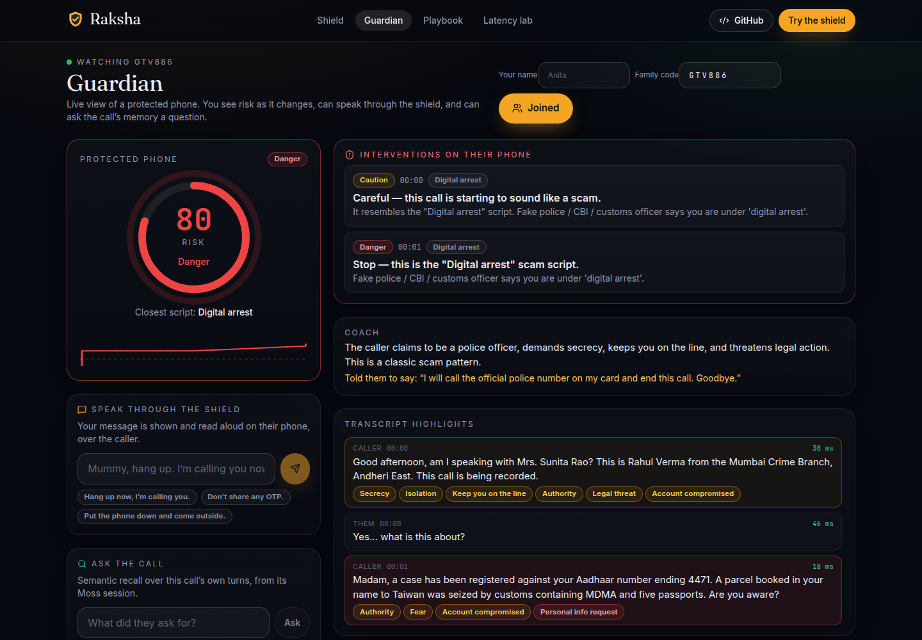



THE CIRCLE OF TRUST
Scams isolate. Raksha breaks the isolation.
A family code, no accounts
Links a parent's phone to a daughter's dashboard. Risk, transcript highlights and interventions, live.
Speak through the shield
Her words are shown and read aloud on the phone — over the scammer's voice.
Ask the call
“What money did they ask for?” — answered from the call's Moss session in milliseconds.
Human and agent, one session
Multiplayer by design: the person, the shield and the guardian share the same live context.
Raksha
YC Fall 2026 × Moss · Zero Latency Builder Sprint
Notes:
Demo cue: second window on /guardian?code=…; send 'Mummy, hang up' — it is spoken on the shield.

Slide 10
EVIDENCE
Measured, not claimed.
Nine full call transcripts replayed through the real engine — seven scams, two genuine calls — plus a live benchmark page anyone can run against the deployed instance.
100%
0%
100%
scam scenarios caught (reached DANGER)
false alarms on genuine calls
scripts named correctly
4.3
13.8 ms
26.7 ms
mean turn at which DANGER fired
retrieval p50, embed + search
retrieval p95
Full turn-by-turn report: docs/eval/REPORT.md · runtime: Moss, in-process
Raksha
YC Fall 2026 × Moss · Zero Latency Builder Sprint
Notes:
These tiles are generated from docs/eval/results.json at deck build time.

Slide 11



BUSINESS
Who pays, and why the economics work.
Banks & payment apps
UNIT COST PER PROTECTED CALL
From 1 Jan 2027 RBI makes banks compensate scam-induced losses; UK banks already reimburse £354M/yr. A per-customer licence (₹5–15/month) that stops even a fraction of transfers beats any refund — and gives the bank a real-time “transfer hold” signal.
≈ ₹0.02
Telcos & OEMs
Moss local queries: ₹0 (unmetered)
STT on device: ₹0
LLM coach, ≤ 6 calls on a 20B model: ≈ ₹0.02
One small container serves thousands of concurrent calls
A “protected line” add-on (₹49–99/month) on any Android phone, not just a Pixel. DoT's kill-switch ambitions need exactly this signal.
Families
A ₹99/month circle that protects parents — the price band where family-safety apps already convert (Life360: 2.8M paying circles).
One prevented ₹1.5-lakh digital-arrest transfer pays for ~7 million protected calls.
“Truecaller tells you who is calling. Raksha tells you what they are doing to you — and what to say back.”
Raksha
YC Fall 2026 × Moss · Zero Latency Builder Sprint
Notes:
The liability shift is the wedge: banks now have a P&L reason to buy prevention that fires before the transfer.

Slide 12
WHAT'S NEXT
Every phone, not just a Pixel.
Now
+4 weeks
+3 months
+6 months
Web reference implementation, deployed. 9 scenarios, live mic, recordings, guardian, community intel, eval.
Android app with in-call audio; Hindi / Tamil / Telugu playbooks; bank “transfer hold” webhook.
Hot path fully on-device with Moss mobile/browser SDKs; deepfake-voice liveness fused into the risk model; pilot with one bank and one senior-living network.
Federated playbook across partners; one-tap 1930 / NCRP reporting; regional script variants.
Every scam follows a script. Now the phone knows the script.
github.com/shi1720/YC-Fall-2026-x-Moss · Shivam Gupta, with Claude · retrieval by Moss
Raksha
YC Fall 2026 × Moss · Zero Latency Builder Sprint
Notes:
Close on the tagline. Thank Moss and the organisers.

