Slide 1
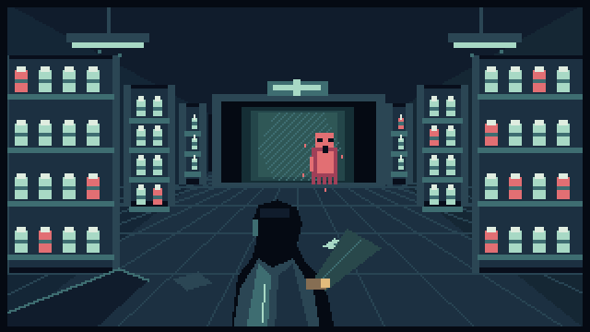
AFTERHOURS / 01
AFTER
HOURS
THE TENTH PRESCRIPTION
Ten wards.
Three records in each.
One light left on.
A pixel horror game by Shivam Gupta
Notes:
Source: README.md and docs/SUBMISSION.md. Original game title illustration. The pharmacy closed ten years ago. Tonight its lights return.

Slide 2
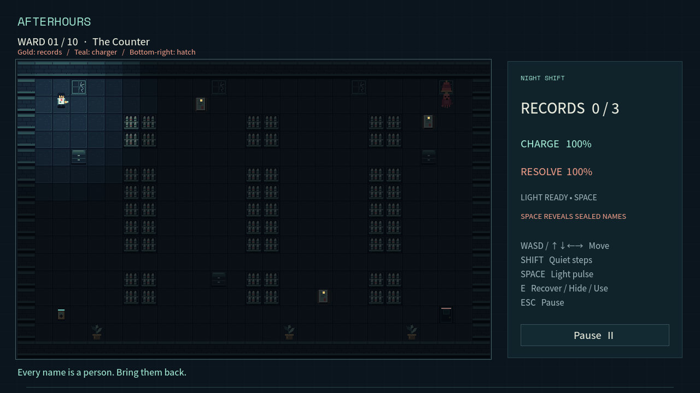
AFTERHOURS / 02
One pulse serves two purposes
SPACE
Reveal a sealed name.
Stun nearby shadows.
18 charge buys
4.5 seconds of safety.
Recover all three records.
Return to the hatch.
Notes:
Source: README.md and docs/TEST_REPORT.md. E collects revealed records. Charging restores energy and some resolve but attracts enemies. The same finite resource advances the objective and creates safety.

Slide 3
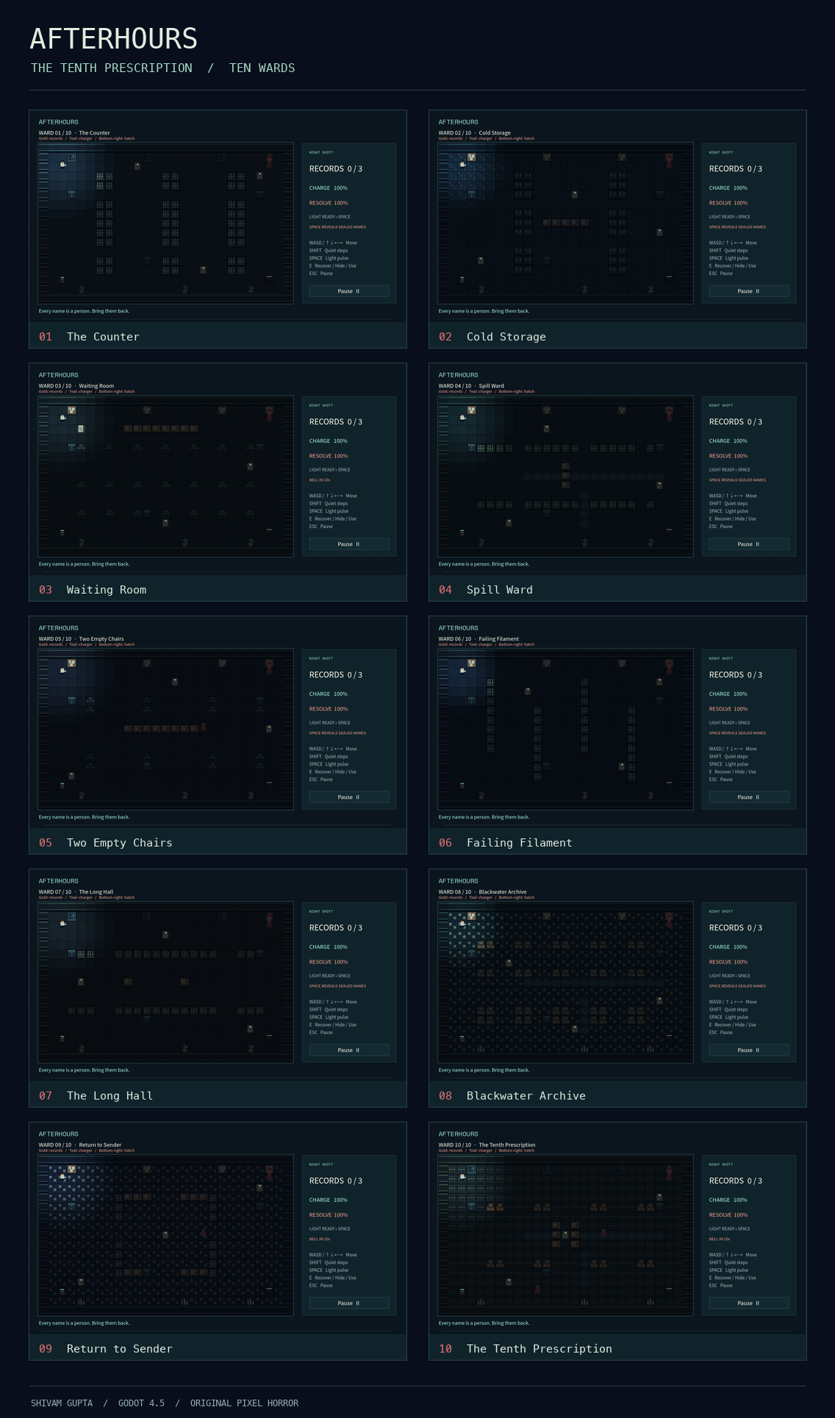
AFTERHOURS / 03
Ten wards change the route and risk
10
authored layouts
30 fictional names
2 final choices
Blackouts restrict sight. Alarms draw pursuit.
Residue blocks easy crossings. Later wards
combine hazards and multiple shadows.
Notes:
Source: scripts/levels.gd, README.md and docs/TEST_REPORT.md. All ten routes have connected geometry and completed in active-enemy simulation. The screenshot sheet shows the actual ten authored ward layouts.

Slide 4
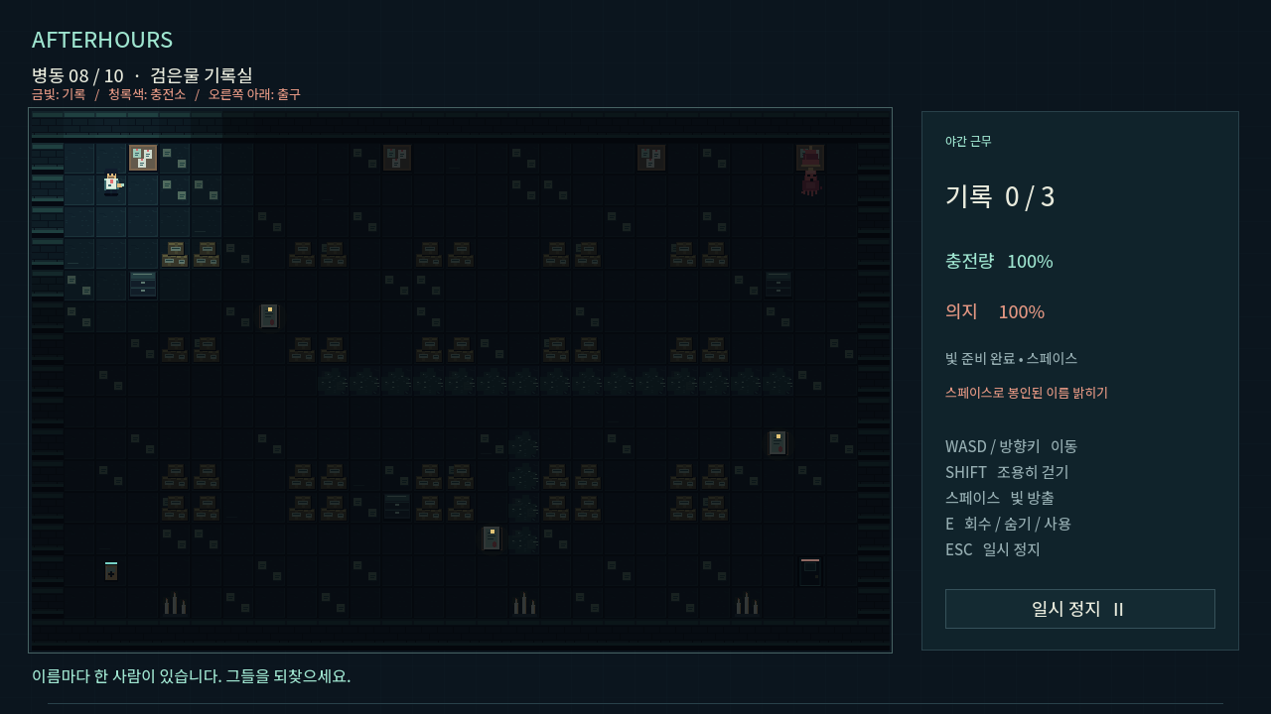
AFTERHOURS / 04
A complete experience in two languages
English and Korean
Six-page first-launch guide
Three-ward demo
Local profile and checkpoints
Gentle mode, high visibility
and animation controls
Notes:
Source: README.md and docs/TEST_REPORT.md. Profiles identify a local save. They are not online accounts. No email, password or cloud sync. Mobile and controller input are outside this release.

Slide 5
AFTERHOURS / 05
A compact premium game is the hypothesis
FREE TODAY
POSSIBLE EXPANDED EDITION
The complete jam campaign
US$4.99–7.99
All ten wards, plus a separate demo.
Static web delivery and Godot source.
No paid inference service during play.
A tentative price to test.
New chapters and richer animation.
A free browser prologue.
Next evidence: observe at least ten new players across both languages.
Measure comprehension and voluntary continuation before pricing research.
Notes:
Source: docs/COMMERCIAL_STRATEGY.md. This business model and price range are unvalidated hypotheses. No demand, retention, sales, market-size or willingness-to-pay evidence is claimed. Hosting, development, localization and marketing still have costs.

Slide 6
AFTERHOURS / 06
A playable release candidate with evidence
4,945
PLAY THE WEB BUILD
shi1720.github.io/
afterhours-tenth-prescription/
assertions passed
0 failures
SOURCE
github.com/shi1720/
afterhours-tenth-prescription
Godot 4.5 native headless QA
Ten active-enemy completion routes
Persistence and bilingual UI checks
Creator and product direction: Shivam Gupta
AI-assisted code, writing, original procedural art and synthesized audio
Notes:
Source: docs/TEST_REPORT.md and README.md. Native headless assertions do not establish browser compatibility, OS keyboard focus, audio behavior, human enjoyment or commercial demand. Live URL supplied by project creator: https://shi1720.github.io/afterhours-tenth-prescription/ . Repository: https://github.com/shi1720/afterhours-tenth-prescription . Apply the organizer’s exact AI disclosure requirements.

