Slide 1
Epilogue.
The agent that settles what's left behind.
Built on the Strands Agents SDK · Amazon Bedrock · AWS “Agents for Humans” 2026 · Shivam Gupta
Notes:
This is Epilogue — a project by Shivam Gupta, built on the Strands Agents SDK. It's an agent for the hardest week of ordinary life.

Slide 2
When someone dies, their family inherits a second job.
420 hours.
of paperwork, phone trees, forms, and follow-ups — over 12–18 months, at the worst moment of a family's life. The British have a word for it: “sadmin.”
3.4M
deaths per year in the US alone — each one starts this clock
10+
institutions to notify, each demanding its own certified documents
800K
deceased Americans have their identity misused every year — “ghosting”
1 month
of benefits clawed back — the payment for the month of death must be returned
Notes:
Researchers estimate it at more than four hundred hours over a year or more…

Slide 3
Built for Sarah.
Grieving her father — and back at work already.
Two states away from the house, the mail, the paperwork.
Executor of the estate: every institution is her job now.
Terrified of missing something — or losing his photos.
“The agent runs autonomously and only surfaces when there's a real decision to make.”
— the hackathon brief.
We took it to the place
it matters most.
Notes:
It lands on people like Sarah — grieving, back at work, two states away…

Slide 4
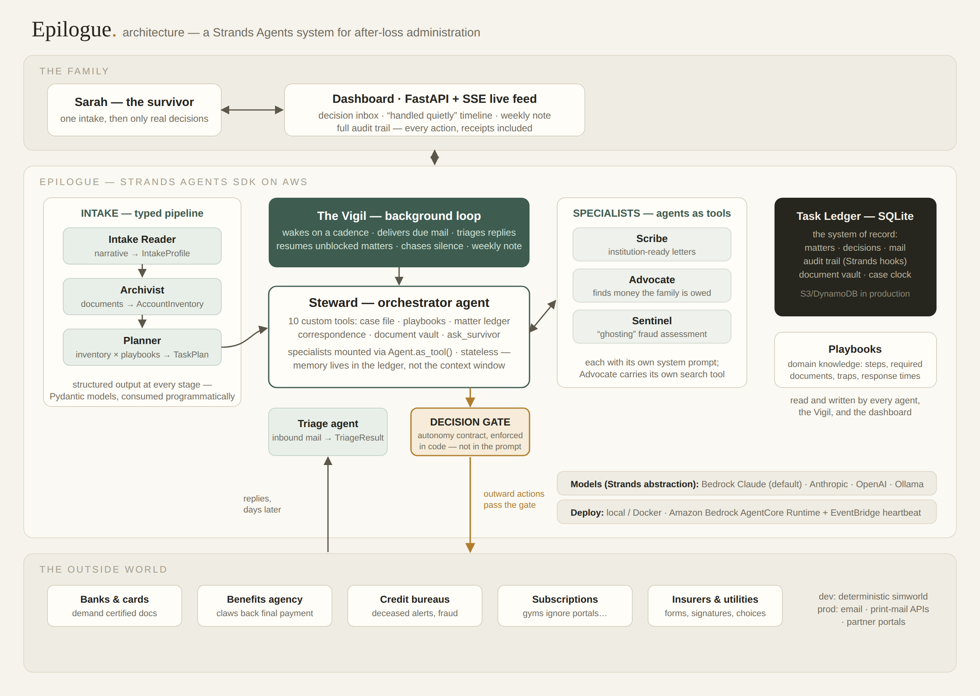
Notes:
Under the hood: six Strands agents. A Steward orchestrator with specialists mounted as tools…

Slide 5
Is this a company? It already is — twice.
VALIDATED MARKET
AGENTIC UNIT ECONOMICS
DISTRIBUTION
$90M
≈ $8
B2B2C
raised by Empathy for human-powered after-loss support — sold through insurers and employers. The demand is proven; the labor model is the constraint.
in model cost per full case on Bedrock — against 400+ hours of family time. Agents collapse the marginal cost of care.
life insurers, employers, banks, and funeral homes already pay for bereavement support. Epilogue is the benefit they hand to a family.
Notes:
Is this real? 3.4 million American families face this every year…

Slide 6
The hardest week of ordinary life
deserves an agent for humans.
Epilogue. github.com/shi1720/epilogue · MIT licensed · Strands Agents SDK · Amazon Bedrock
Notes:
The hardest week of ordinary life deserves an agent for humans. This is Epilogue. Thank you.

