Slide 1

granted.
The AI grants team
for small nonprofits.
Finds the federal grants you can actually win · tells you honestly which to skip · drafts reviewer-critiqued proposals in minutes.
Shivam Gupta · AI Builders Hackathon 2026 · Live Grants.gov data + a team of Claude agents
Notes:
Granted is the AI grants team for small nonprofits: it finds winnable federal grants on live Grants.gov data, gives an honest go/no-go on each, and drafts reviewer-critiqued proposals in minutes.

Slide 2



THE PROBLEM
The money exists. The capacity doesn't.
Small nonprofits — food pantries, youth programs, shelters — are the delivery layer of American social policy. Federal grants are written for them. Yet the application system assumes staff they don't have.
1.8M
$80–150/hr
40+ hrs
US nonprofits — the overwhelming majority with no development staff or grant writer
market rate for professional grant writers, out of reach for small budgets
of staff time per federal application — a month of an ED's spare capacity
The result: billions in grants go unclaimed or flow to whoever could afford the writer — while hundreds of opportunities sit open on Grants.gov right now (our landing page shows the live count).
Notes:
The delivery layer of social policy has no grants capacity. Writers cost $80–150/hr; a federal application takes 40+ hours. Billions go unclaimed — and the number of open opportunities on our landing page is live.

Slide 3
THE INSIGHT
Nonprofits don't lose grants because they write badly.
They lose because they apply to the wrong grants — and run out of time.
A wrong application costs a small org a month of capacity. Every competitor builds a writing tool. Granted starts where the money is actually lost:
Eligibility as a hard gate
Expected-value math, shown
An honest “skip this one”
funder's applicant-type rules, checked first
award × win odds − cost to apply
the AI that says no is the one you trust
Notes:
Core thesis: targeting, not writing, is where small orgs lose. So triage comes first — eligibility gate, EV math, and an honest 'skip'. That honesty is the trust wedge.

Slide 4
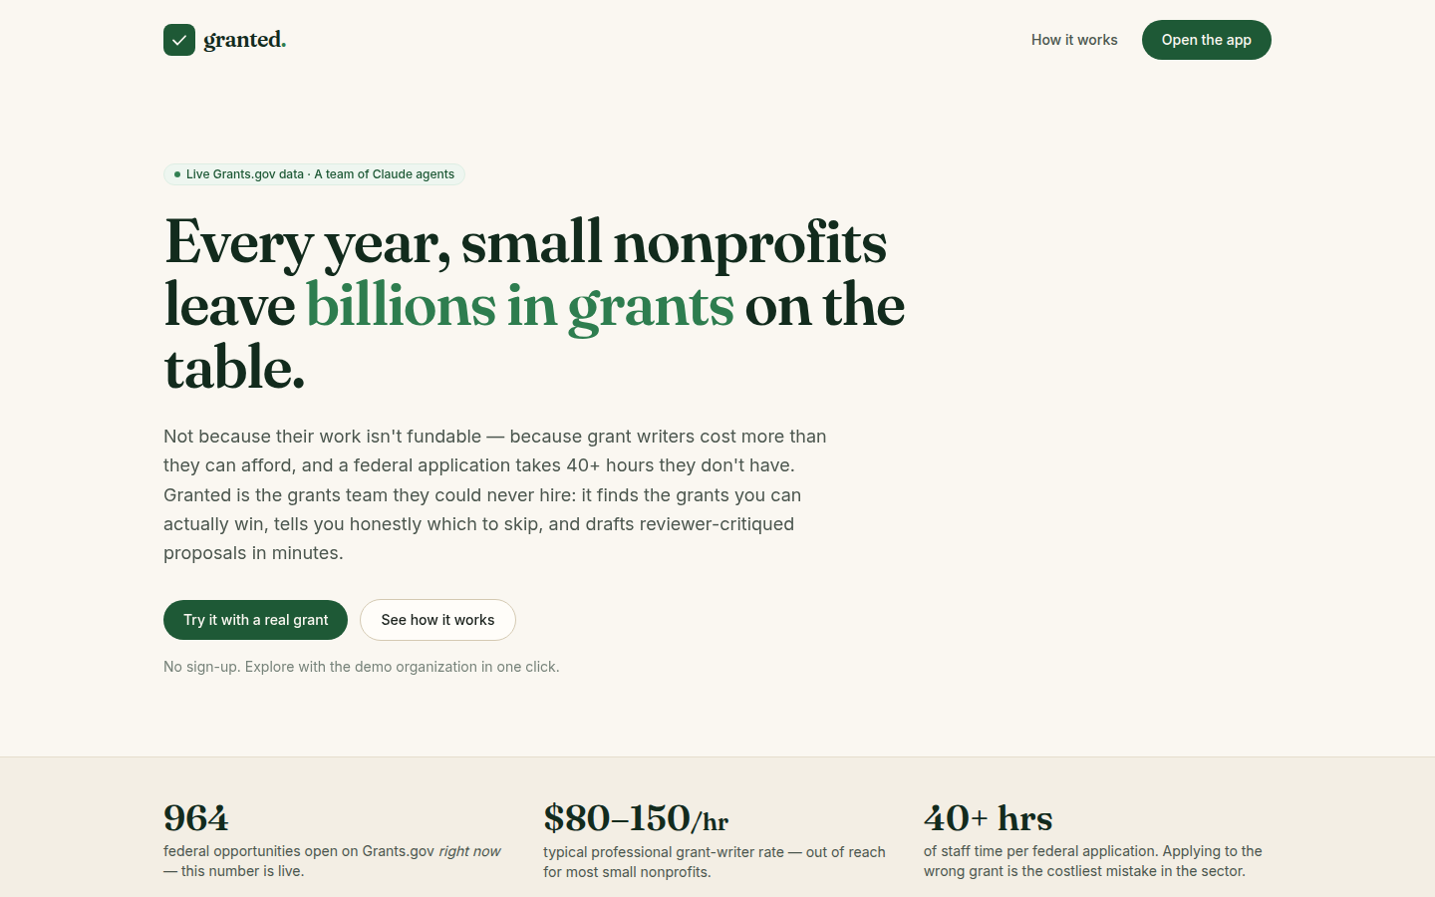



THE PRODUCT
Mission statement in. Reviewed federal draft out.
1 · Profile
Paste anything — mission, website copy. Claude extracts a structured profile of real programs and outcomes. Extraction only; it never invents your numbers.
2 · Triage
Live Grants.gov search + a go/no-go brief per grant: eligibility gate, alignment, capacity vs. award size, effort, and the EV math — including honest skips.
3 · Draft
A streaming agent team writes the proposal, scores it like the funder's panel, and revises what got flagged — before you ever see it.
Live product — the counter on the hero is the real number of open federal opportunities.
4 · Track
A deadline-sorted pipeline with the combined expected value of everything you're chasing.
Notes:
Four steps: profile extraction (never invents data), triage on live Grants.gov data with honest skips, the agent drafting team, and a pipeline tracker with combined EV.

Slide 5
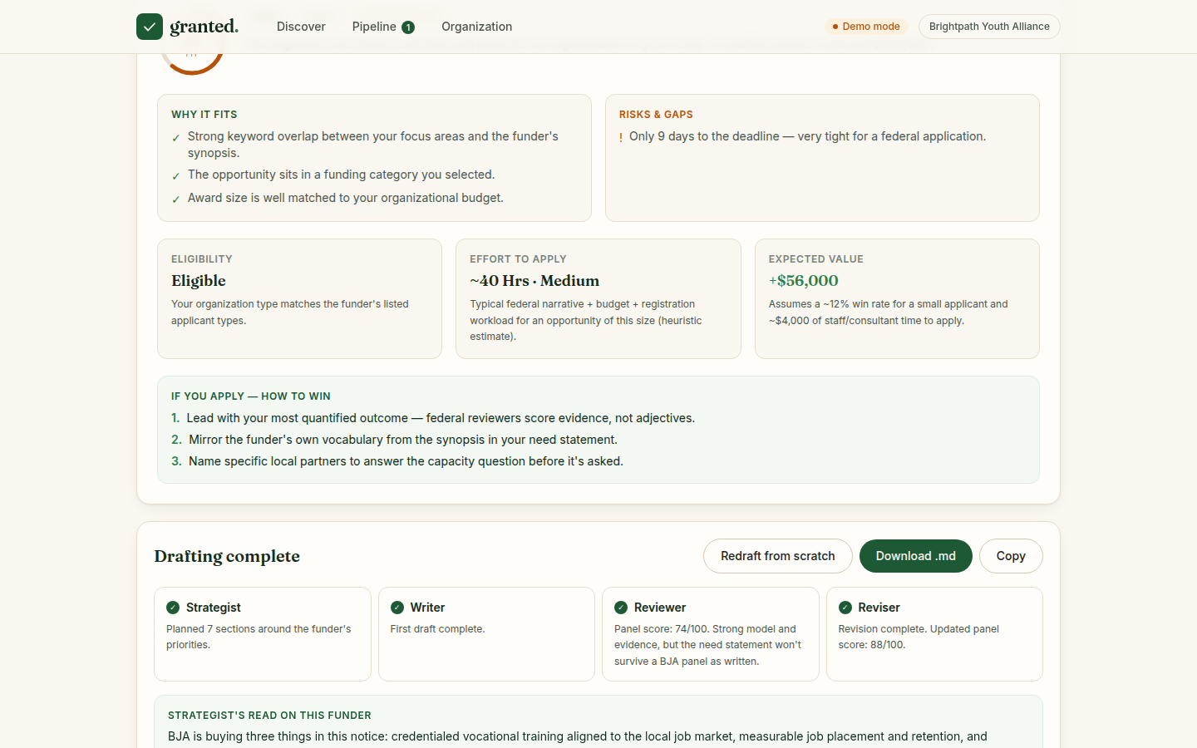
IT WORKS — LIVE
Watch a real $1M opportunity go from fit brief to reviewed draft.
74 → 88
panel score before/after the Reviser addresses the Reviewer's critical notes — with per-section diffs
“Skip.”
a perfect-sounding grant rejected because its eligibility list excludes nonprofits — one honest no saves 40 hours
≈ 3 min
from click to reviewed, exportable draft — streamed live so you watch every agent work
BJA Second Chance Act (real opportunity, up to $1M) — fit brief with EV, then the four-agent run.
Notes:
Demo proof points: the self-correcting score (74→88 with visible diffs), the honest skip on an ineligible grant, and ~3 minutes to a reviewed draft.

Slide 6


THE AI — A TEAM, NOT A PROMPT
Judgment and generation are separate agents.
Analyst
→
Strategist
→
Writer
→
Reviewer
→
Reviser
go/no-go brief — eligibility gate, fit score, EV math
reads what the funder is buying; plans the narrative
streams every section, grounded in your real outcomes
scores the draft like the funder's panel — 0–100 + typed notes
rewrites only what got flagged; the panel rescores
Claude Opus 5 end to end (model-swappable via one env var)
Structured outputs (Zod schemas) for every judgment — the UI never parses prose
One streaming call writes all sections; a chunk-safe marker parser routes them live (unit-tested to 1-char chunks)
Deterministic code owns the arithmetic — EV, capacity ratios, eligibility codes. The model owns judgment.
Notes:
Five agents with separated concerns. Tech: Opus 5, structured outputs everywhere, one streamed call per draft with a chunk-safe parser, and deterministic code for all arithmetic.

Slide 7



BUILT FOR TRUST
AI a grant reviewer — and your board — can trust.
It says no.
[ADD: your data]
It shows the math.
Wrong applications are the enemy, not the revenue. Ineligible or bad-EV grants get a reasoned “skip” — before you spend a minute.
The Writer never invents statistics, partners, or outcomes. Missing facts become visible placeholders — in federal grants, a fabricated number is disqualifying.
Every recommendation carries its reasoning and economics: realistic award × conservative win odds − true cost to apply. The decision stays yours.
Every fallback is labeled in the UI: heuristic engine without a key, snapshot data if Grants.gov is down, typed errors from Claude — the product never pretends.
Notes:
Trust is the product: honest skips, visible ADD placeholders instead of hallucinated data, EV math shown, and every fallback labeled.

Slide 8
WHY THIS IS A BUSINESS
Software margins on a $3,000 pain.
What one reviewed federal proposal costs
TARGET USERS
Professional grant writer
Small/mid nonprofits ($100K–$5M budgets) + grant consultants who serve many orgs at once
$3,000–5,000
PRICING
Staff DIY (40+ hrs of an ED's time)
Starter $49/mo · Team $149/mo — vs. $1.5–3K/yr discovery-only databases and $3–5K/proposal writers
≈ $1,600
WEDGE → MOAT
Granted (Claude Opus 5 compute)
Free eligibility triage on live data → the org's outcome profile + win/loss history compounds
≈ $0.40
EXPANSION
Fit brief: ≈ $0.05–0.08 · a heavy user drafting 10 proposals/mo costs ≈ $4.50 to serve
Foundation & state sources, compliance reporting, consultant multi-org seats
Notes:
Unit economics: ~$0.40 per reviewed draft vs $3–5K human alternative; $49–149/mo pricing with >90% gross margin. Wedge is free triage; moat is the compounding org/outcome dataset. 1.8M orgs, consultants as first paying segment.

Slide 9
TECHNICAL ARCHITECTURE
Boring where it should be. Tested where it hurts.
Next.js 16 UI
Stateless API routes
Grants.gov public API
Claude Opus 5
profile · discover ·
workspace · pipeline
⇄
validation (Zod) ·
SSE streaming
⇄
live search + detail
(no key required)
⇄
5 agents · structured
outputs · streaming
Every dependency has a tested fallback
No API key
transparent heuristic fit engine + replayed pipeline demo — labeled, never a wall
26
Grants.gov down
bundled snapshot of real opportunities, labeled “offline”
unit tests + a Playwright E2E that drives the whole journey — it caught a real state-loss bug before any human did
Claude errors / refusal / token cap
typed errors → friendly retry; SSE emits a terminal error event
Malformed stream frames
skipped, never crash the draft; parser tested to 1-char chunks
Notes:
Architecture is deliberately boring: one Next.js app, stateless routes, two external surfaces. The interesting part is the failure matrix — everything degrades gracefully and it's tested end to end.

Slide 10
WHAT'S NEXT
From federal MVP to the grants OS for small nonprofits.
Now
Federal grants, live · agent pipeline · honest triage (this demo)
Next 3 mo
Foundation & state sources (990-PF) · teams (Postgres + auth) · DOCX/JustGrants export
6–12 mo
Win/loss feedback → calibrated EV priors · funder-specific Reviewer rubrics (BJA, DOL, HHS)
The moat
The compounding dataset of org outcomes × funder decisions — every proposal makes the next one smarter
The grant your community needs is open right now.
github.com/shi1720/ai-b-h · works with zero keys · Shivam Gupta — AI Builders Hackathon 2026
Notes:
Roadmap: more sources, teams, then the feedback-loop moat. Close: the grant your community needs is open right now — Granted makes sure you don't miss it.

