Slide 1
UndoProof
Prove the way back
PostgreSQL rollback rehearsal
Shivam Gupta
IBM Bob 2.0 Hackathon / September 2026
Notes:
Created by Shivam Gupta for IBM Bob 2.0 Hackathon. Product description and scope: docs/BUILD-BRIEF.md. No claims of production certification.

Slide 2
The order that disappears
The release succeeds.
A customer places an order.
The rollback erases it.
SQL success does not establish data preservation.
UndoProof / 02
Notes:
Illustrative synthetic scenario implemented in the sample release contracts, not a report of an actual customer incident. The snapshot restoration path can execute successfully while discarding rows inserted after the snapshot.

Slide 3
A release contract, executed
Input | Execution | Evidence
Seed + migration SQL | Fresh PGlite databases | Exact statements and errors
Old + new query contracts | Compatibility checks | A result for each release state
New writes + invariant | Rollback, compare, reapply | Before-and-after rows
New writes happen before rollback.
UndoProof / 03
Notes:
Method and scope follow docs/BUILD-BRIEF.md. PGlite runs PostgreSQL in WebAssembly: https://pglite.dev/docs/about. These are SQL query contracts, not a full application process. Independent branches isolate expected failures.

Slide 4
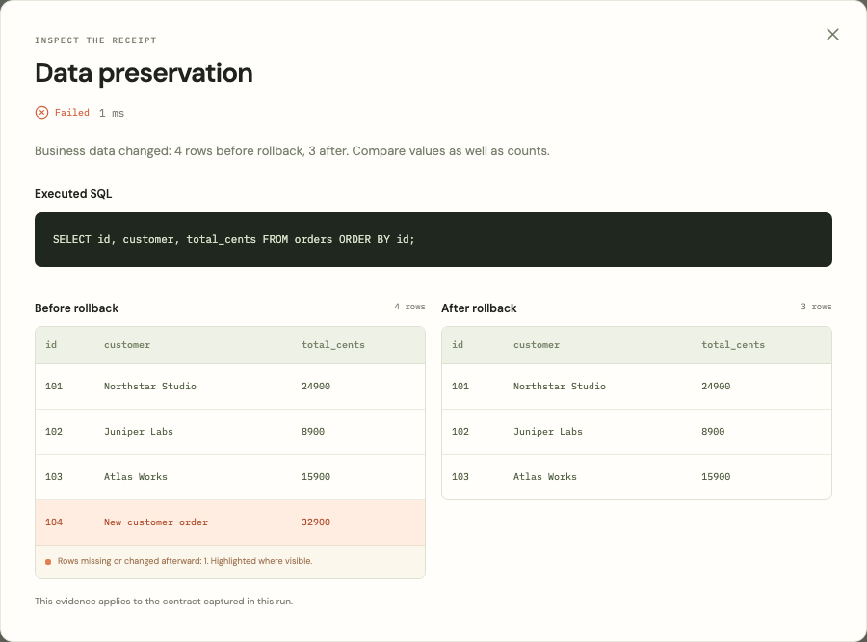
The rollback loses order 104
4 rows before
3 rows after
The rollback SQL succeeds.
The invariant fails.
UndoProof / 04
Notes:
Actual running-product screenshot: submission/media/data-loss-modal.png. Original synthetic checkout scenario. Genuine element screenshot of the evidence modal. Result: four rows before rollback, three afterward. The invariant selects id, customer and total_cents. This screenshot is separate from the CLI measurements on the following slide.

Slide 5
One reproducible rehearsal per plan
Plan | Passed checks | Rows after rollback | Engine duration
Unsafe snapshot | 9 of 10 | 3 of 4 | 2,810.96 ms
Supplied repair | 10 of 10 | 4 of 4 | 2,808.79 ms
Same invariant. The repair preserves the new order.
Single synthetic CLI run per plan. Engine duration excludes setup and review.
This measures execution, not a percentage productivity improvement.
UndoProof / 05
Notes:
Source: submission/cli-blocked-report.json and submission/cli-repaired-report.json, generated September 27, 2026. One measured engine invocation per condition, Darwin arm64, Node.js 22.16.0, PGlite 0.3.16. Duration excludes installation, CLI startup, contract authoring, review and repair preparation. Exact synthetic invariant projection; no general productivity claim. Reproduction: npm run rehearse -- demo:snapshot --out=blocked.json ; npm run rehearse -- demo:snapshot --repair --out=repaired.json.

Slide 6
IBM Bob repository validation
1 Source-derived regression tests
41 checks cover the checkout contract, silent data loss,
and the unchanged repair invariant.
2 Real PostgreSQL validation
Bob ran the new suite in the repository using PGlite.
Scoped Bob testing contribution. Sample repairs remain authored examples.
UndoProof / 06
Notes:
Bob IDE authored tests/bob-workflow.test.ts and ran all 41 tests successfully using real PGlite. The tests inspect source-derived checkout contracts, lost post-deployment order 204, the safe candidate and invariant identity. This is a scoped testing contribution, not a claim that Bob built the entire product. A genuine Bob work capture is retained in submission/media/bob-verification-work.png. The required task consumption summary is a separate deliverable. New custom repair investigations use the manual exported evidence handoff.

Slide 7
A focused commercial starting point
The first buyer
Free
Platform leads at SaaS teams
shipping database changes
MIT local runner + CI
The adoption trigger
$99 / team / month
The next migration
pull request
Proposed shared policies
and retained evidence
Pricing hypothesis
UndoProof / 07
Notes:
Commercial hypotheses, not customers, revenue, or validated pricing. Details and validation plan: submission/COMMERCIAL.md. Proposed paid features may exceed the current prototype.

Slide 8
A complement to migration tools
Atlas, Liquibase and Flyway already manage migrations
and support recovery workflows.
UndoProof focuses the review on old/new query
compatibility and data written after deployment.
Tested SQL and fixtures only. Full application behavior, concurrency
and production locks remain outside this prototype.
UndoProof / 08
Notes:
Sources checked September 27, 2026: https://www.atlasgo.io/versioned/down ; https://docs.liquibase.com/secure/reference-guide-5-1-1/init-update-and-rollback-commands/update-testing-rollback ; https://www.red-gate.com/products/flyway/ ; https://github.com/ankane/strong_migrations . PGlite limits: https://pglite.dev/docs/pglite-socket . No claim of exclusive capability or production safety.

Slide 9
The way back belongs
in the release review.
UndoProof
undoproof.web.app
github.com/shi1720/ibm-bob
Shivam Gupta
UndoProof / 09
Notes:
Verified hosted application: https://undoproof.web.app . Public repository: https://github.com/shi1720/ibm-bob . Created by Shivam Gupta with AI-assisted development. Firebase Authentication and Firestore support private account history. Guest SQL runs locally in the browser.

