Slide 1
SHADE SHIFT / THE PROBLEM
ShadeShift
The ticket gets you a seat.
It does not get you shade.
A budget and deployment planner for the outdoor
walks and queues around major events.
01 / RICE URBAN SUSTAINABILITY HACKATHON · TRACK 3
Notes:
Opening: imagine leaving a train for a stadium. The arrival and queue remain outdoors. The operator must choose where limited preparation money goes. ShadeShift supports that decision. This is a scenario-planning product, not a medical prediction. Track 3 uses FIFA World Cup 2026 as a case for repeat events.

Slide 2
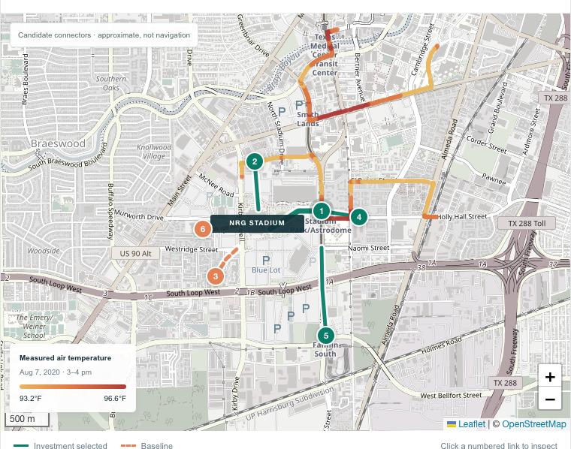
SHADE SHIFT / THE BUYER
Venue operations has a recurring decision
Where should the next
$70,000 go?
Allocate shade, queue changes
and refill access before each event.
Compare allocations. Save privately.
Export a plan for operator review.
02 / RICE URBAN SUSTAINABILITY HACKATHON · TRACK 3
Notes:
Actual application screenshot. First buyer hypothesis: a venue or event operator. The $70,000 is selected intervention spend in the demonstration, with a $75,000 cap. This is separate from software pricing. Approximate candidate connectors are not navigation instructions. Colored historical temperature points date to August 7 2020, not the event date. OpenStreetMap basemap attribution remains visible. Sources: https://www.openstreetmap.org/copyright and https://www.arcgis.com/home/item.html?id=d8dd6004e1ab4dccbfb36a5992f480bc . Users can explore without signing in, then use Firebase Authentication with email and password for private plans stored in Cloud Firestore with owner-scoped security rules.

Slide 3
SHADE SHIFT / THE EVIDENCE
Measured context. Visible assumptions.
654
11
Houston temperature observations
U.S. host-location weather benchmarks
7 August 2020, 3–4 pm
H3AT / CAPA / HARC mobile sensors
Coverage is partial around the venue.
49 afternoons per venue in summer 2025
Consistent ERA5 modeled weather
Seasonal context, not a 2026 forecast.
Visitor counts, dwell time, shade coverage, costs and intervention effects remain editable planning assumptions.
03 / RICE URBAN SUSTAINABILITY HACKATHON · TRACK 3
Notes:
Houston measured data: 654 exact point observations from August 7 2020 afternoon, cleaned within the NRG-area bounding box. Do not extrapolate into unsampled areas. Source https://www.arcgis.com/home/item.html?id=d8dd6004e1ab4dccbfb36a5992f480bc and https://www.h3at.org/2024-campaign/2024-campaign-results . METRO GTFS anchors from official feed August2026IVOMS_20260828 https://api-portal.ridemetro.org/ . The 11-location atlas samples 15:00 local June 1–July 19 2025 and derives NWS shade heat index from temperature and relative humidity using ERA5 0.25 degree grids via Open-Meteo. Source https://open-meteo.com/en/docs/historical-weather-api and https://www.weather.gov/safety/heat-index . Neither weather layer drives the optimizer objective. Approximate connectors require site validation.

Slide 4
SHADE SHIFT / THE VERIFIED SCENARIO
Same $70,000. Different allocation.
31.25%
modeled direct-sun time reduction
with the exposure-maximizing plan
127,902 person-minutes avoided
per modeled event
Arithmetic verified against the model.
Physical impact has not been measured.
Remaining direct-sun person-minutes per event
04 / RICE URBAN SUSTAINABILITY HACKATHON · TRACK 3
Notes:
Verified deterministic model run: baseline 409,260 direct-sun person-minutes. Starting plan cost $70,000, remaining 311,811.6, reduction 23.810878%. Optimized same cost $70,000, remaining 281,358, avoided 127,902, reduction 31.252016%. Optimizer chose shade at Stadium station, north arrival and Yellow Lot, queue changes at Holly Hall and Kirby, no intervention at Fannin. Feasible search evaluated 2,505 complete candidates in this constrained run. Do not interpret “verified” as field validation. Inputs are planning assumptions. The percentage describes six modeled connectors, not all people or all of Houston. Source: reproducible application model export shadeshift-model-results.json.

Slide 5
SHADE SHIFT / THE TRADEOFF
More exposure reduction can mean less service
Water access
1,200 refills to 0
Community-weighted investment
53.29% to 27.43%
Starting plan to optimized plan.
The operator still decides what to fund.
Fixed optimized portfolio: intervention effectiveness
changes the estimated reduction from 18.75% to 31.25%.
05 / RICE URBAN SUSTAINABILITY HACKATHON · TRACK 3
Notes:
Sensitivity holds the optimized portfolio and costs fixed. Effectiveness multiplier applies to added shade and queue-duration reduction: 60% gives 76,741.2 avoided person-minutes or 18.7512%; 80% gives 102,321.6 or 25.0016%; 100% gives 127,902 or 31.2520%. These are deterministic assumption scenarios, not confidence intervals. Water access is separate from direct-sun exposure. Starting plan has capacity for 1,200 refills in the arrival window and community-weighted investment $37,300/$70,000 = 53.2857%. Optimized plan has zero refills and $19,200/$70,000 = 27.4286%. Community weighting uses assumed resident-share weights. It does not measure verified demographics or represent dollars paid directly to residents.

Slide 6
SHADE SHIFT / THE BUSINESS
A paid pilot before a subscription
$5,000
$6,000 / year
Two-event assisted pilot
One venue, repeat events
Field audit, scenario workshops,
plan exports and a measured review.
Test renewal after the pilot.
Hardware and installation are separate.
Prices are hypotheses. Measure planning hours, accepted plans and repeat use before claiming commercial traction.
06 / RICE URBAN SUSTAINABILITY HACKATHON · TRACK 3
Notes:
These are unvalidated price hypotheses, not revenue or contracts. Buyer is venue operations. Pilot scope is one venue and two events. The annual $6,000 license targets repeated planning use; hardware, installation, on-site staff and custom integrations are excluded. We do not claim insurance savings or willingness to pay. Existing tools include ShadeMap for shadow/event planning https://shademap.app/help/ and UrbanFootprint for spatial climate analysis https://urbanfootprint.com/platform/explorer/ . Differentiation hypothesis is an auditable intervention budget-to-plan workflow. Future advantage would come from verified site constraints, actual costs and observed deployment performance, not exclusive ownership of public data. Open-Meteo free service is noncommercial; a commercial launch requires appropriate licensing or self-hosting.

Slide 7
SHADE SHIFT / THE LEGACY
One venue. Two events. A reuse plan.
Days 1–30
Days 31–60
Days 61–90
Walk the sites
Run event one
Reuse and review
Verify access and shade.
Measure counts and
queue times.
Obtain supplier quotes.
Obtain operator approval.
Compare the plan with
observed exposed time
and planning hours.
Run the second event.
Assign asset ownership.
Test community reuse
and renewal.
Legacy estimates use separate resident demand and reuse days. No automatic annualization of event attendance.
07 / RICE URBAN SUSTAINABILITY HACKATHON · TRACK 3
Notes:
This is the proposed pilot, not a completed deployment or committed partnership. Record a named physical asset owner, storage and maintenance responsibilities, reuse destination and operating schedule. Legacy model uses independent resident demand and selected reuse days, not event attendance multiplied throughout the year. Validate accessibility, egress, installation permission and supplier quotes before deployment. The current app supports analysis and export, but commercial operations still require security, tenant-isolation, deletion/retention, backup and incident-response verification.

Slide 8
SHADE SHIFT / THE ASK
One venue partner.
Two events.
A plan we can verify on the ground.
Provide site access and operator counts.
We test the inputs, planning value and repeat use.
shadeshift-city.web.app
08 / RICE URBAN SUSTAINABILITY HACKATHON · TRACK 3
Notes:
Close with a concrete ask: one venue partner for two events, with site access, operator counts, a venue operations contact and an accessibility review. No outreach or partner commitment is implied. The product turns a heat map into a reviewable funded shade plan. Live demonstration: https://shadeshift-city.web.app . Source repository: https://github.com/shi1720/shadeshift . Built with Vite, React, TypeScript, Leaflet and Recharts, hosted on Firebase Hosting with Firebase Authentication and Cloud Firestore. Anonymous judging copy.

