Slide 1
thesis.
Conviction, with a
counterargument
A research committee for the decisions that deserve a second opinion
Shivam Gupta
Open Agent Hackathon 2026
Track 3: Reasoning Architecture
Notes:
Built by Shivam Gupta with AI-assisted engineering. Primary track: Reasoning Architecture, Track 3. Thesis combines deterministic numerical gates, adaptive critique, account-scoped state and Meterless H-MEM context, bounded model repair and explicit abstention. Sponsor execution over synthetic inputs is infrastructure evidence, not verified financial observations.

Slide 2
A compelling stock is easy to find.
A defensible decision is harder.
For a self-directed investor researching across markets
01
02
03
Find a candidate
Challenge the case
Remember the decision
Screeners surface companies.
The shortlist keeps growing.
A persuasive explanation can
leave its weak assumptions hidden.
Risk limits, rejected alternatives
and invalidation triggers get lost.
“What fits my limits, and what would change my mind?”
02
Notes:
User problem is a product hypothesis, not a survey result. Initial target: self-directed investors with existing brokerage accounts, comparing companies across the US, India, China and UAE. Risk/horizon framing follows Investor.gov: https://www.investor.gov/introduction-investing/getting-started/asset-allocation (accessed 27 October 2026). Local source: docs/product-strategy.md. No promised investment return or claimed customer traction.

Slide 3
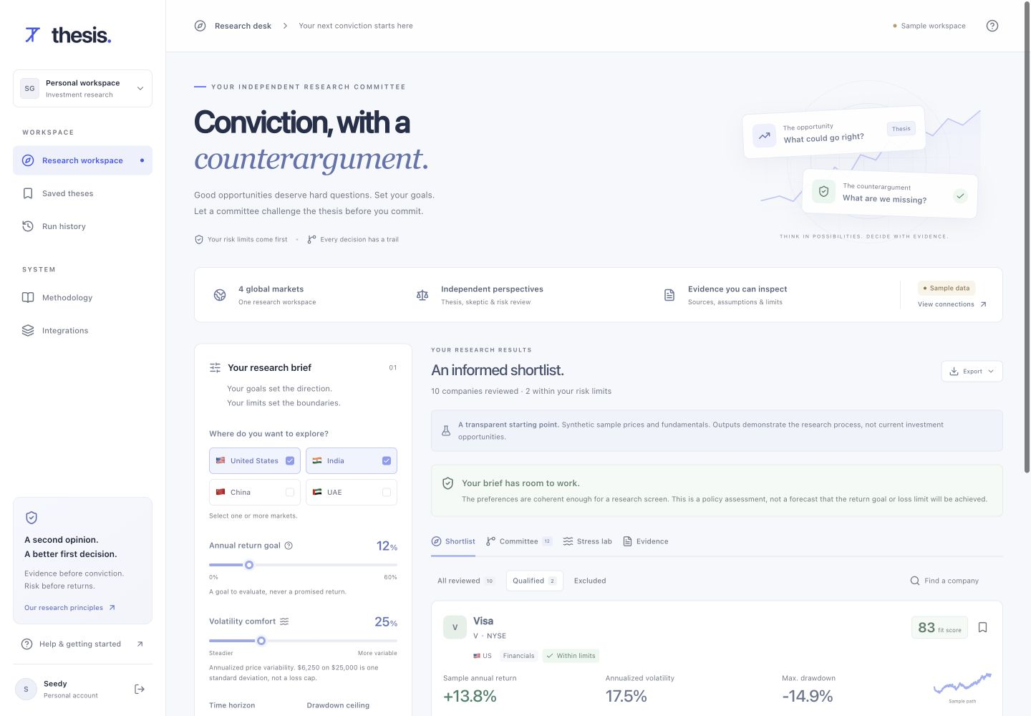
A brief becomes a reviewable decision.
Four markets. Explicit risk limits. A thesis and a counterargument.
Product workflow shown with clearly labeled synthetic sample data
03
Notes:
Product screenshot to be embedded from evidence/ui-workspace.png, a captured running Thesis application. The image is actual product UI, not a rendered concept. Included 20-company data is synthetic. Run execution is on the server and UI progress does not invent completed agent actions. Native authenticated access, saved dossiers, history and exports are implemented.

Slide 4
Adaptive critique. Deterministic guarantees.
Planner
Mandate and memory
Quant + fundamentals
Recomputed risk
Skeptic
Countercase
Risk guardian
Immutable limits
Revise priorities
Research
shortlist
Abstain
State carries context. Models never override hard risk limits.
04
Notes:
Primary track: Reasoning Architecture. Native editable diagram shows planner, computational analysts, skeptic feedback, planner revision and immutable risk gating, with a branch to abstention. Account-scoped H-MEM carries relevant prior decisions without replacing fresh evidence. In connected mode, a source-constrained Qwen critique enters a schema/source-ID evaluator with one bounded repair. An optional NVIDIA Nemotron exclusion auditor can request a planner recheck, which recomputes the failed gates and retains the deterministic veto. Code: lib/server/service.ts, lib/research/engine.ts, lib/providers/nightshift.ts. The evaluator does not verify prose entailment or financial truth.

Slide 5
The most useful answer can be “no”.
A return goal is an aspiration. A risk constraint is a boundary.
ILLUSTRATIVE RESEARCH MANDATE
Committee abstains
40% return goal
5% volatility comfort
6-month horizon
It explains the conflict, preserves
the rejected cases and makes
zero model calls for this mandate.
Historical risk measures do not cap future losses.
05
Notes:
This mandate is a deliberately contradictory synthetic test case, not investment advice. Confirm in current engine tests and demo before recording: targetReturn40, maxVolatility5, maxDrawdown5, horizonMonths6. Global infeasibility/short-horizon policy should abstain and skip Nightshift requests. No claim that a 5% measured volatility guarantees a 5% loss cap. Source: lib/research/engine.ts and tests/research.test.ts. Investor.gov explains time horizon and risk tolerance: https://www.investor.gov/introduction-investing/getting-started/asset-allocation.

Slide 6
Every sponsor component has a specific job.
Meterless H-MEM
Retains decisions and recalls relevant context
Verified reference engine; 13/13 conformance checks
Meterless Nightshift
Runs the bounded skeptical model review
Real Qwen runtime receipt retained
Zetaris
Federates the research universe and provenance
Adapter implemented; live verification pending
NVIDIA Nemotron
Audits exclusions and requests a planner recheck
Nemotron Mini 4B
Two real receipts retained
A real infrastructure call over synthetic inputs remains a sample-data demonstration.
06
Notes:
Verified infrastructure features over synthetic data. Meterless H-MEM official reference commit1742dec56a66e58eef9dda2d2b865823758ca8cd passes13/13conformance checks. Fresh Qwen skeptical review proof in work/evidence/nightshift-live.json, started2026-10-27T05:34:30.796Z, model local-runtime/qwen2-5-7b-instruct-q4-k-m, receipt rcpt_req_hx5lp5c2, latency29645ms. NVIDIA exclusion audit proof: evidence/nemotron-live.json, finished2026-10-27T05:32:03.139Z, model local-runtime/nemotron-mini-4b-instruct-q4-k-m. First receipt rcpt_req_vl5i98jj latency3297ms, second bounded-repair receipt rcpt_req_lz7ros6b latency3740ms. Final validated classification requested review because inputs are synthetic. Service wiring sends a requested review back to the planner and retains the numeric exclusion. This proves the optional audit feature, not complete connected mode, live financial evidence or financial correctness. Zetaris remains pending live verification. Official APIs: https://github.com/Meterless/Meterless/blob/main/docs/agent-ready/add-meterless-provider.md and https://github.com/zetaris/getting-started/blob/main/scripts/query_zetaris.ts.

Slide 7
Trust comes from constraints you can inspect.
Risk stays deterministic
Evidence remains scoped
Models cannot rewrite volatility, drawdown or the user’s limits.
Unknown candidates and foreign evidence IDs trigger rejection.
Recovery stays bounded
Personal records stay scoped
One repair, explicit deadlines and a visible failure state.
Server-side identity checks protect research, notes and memory.
50 tests and 14 API checks passed from a clean checkout.
07
Notes:
work/clean-repro-result.json records a clean isolated copy without credentials, npm ci, npm run setup, typecheck,50passing tests, repeat-setup migration stability, and14API checks against a local production Worker. The API checks use synthetic trusted platform identity headers and cover cross-user authorization. They do not establish the hosted identity boundary or sponsor availability. No market data or investment-performance validation is claimed. Safeguards are implementation controls, not external security certification. Candidate/source-ID/schema validation cannot prove narrative entailment.

Slide 8
A research habit is the business hypothesis.
$19
Bounded research allowance
Saved evidence dossiers
Revisit and revise a thesis
per month, proposed individual plan
Provisional variable-cost ceiling: $3.80 per active subscriber.
Pricing and demand are unvalidated. Licensed data may dominate inference cost.
08
Notes:
Commercial assumptions, not offers, traction or financial forecasts. $19/month individual and $79/month team are hypotheses in docs/product-strategy.md. $3.80 equals20%×$19, a provisional cost ceiling for80% contribution margin before fixed costs, support, fees and salaries. There is no billing implementation. No return/outperformance claim. First validation:5 observed investor sessions, willingness-to-pay interviews and data licensing assessment. Local inference receipts of$0 exclude hardware and operation.

Slide 9
Research decisions retain their context.
Market tools
Thesis today
Thesis over time
Deep data, screeners,
filings and watchlists.
Risk vetoes, countercases,
source registers and
explicit invalidation.
Revisit why a decision changed
as evidence and investor
preferences evolve.
Established category
Implemented workflow
Product validation goal
09
Notes:
This is product positioning, not a claim that competitors lack every listed feature. Koyfin publicly offers company research, screeners, charts, filings and watchlists: https://www.koyfin.com/Pricing/ (accessed27October2026). Stock Analysis describes global coverage with multiple financial-data providers: https://stockanalysis.com/help/data-and-downloads/about-our-data/ (updated31July2026, accessed27October2026). These products establish that data breadth is a mature competitive dimension. Thesis differentiation remains a hypothesis. H-MEM is open source and not a proprietary moat. Source: docs/product-strategy.md.

Slide 10
From a working committee to a trusted product.
01
Verify the financial evidence
Licensed data, source freshness and complete Zetaris execution.
02
Validate the research habit
Five observed users, countercase comprehension and paid-pilot interest.
03
Earn launch readiness
Security review, monitoring, backups and jurisdiction-specific review.
Built by Shivam Gupta with AI-assisted engineering
10
Notes:
Primary track: Reasoning Architecture, Track3. Built by Shivam Gupta with AI-assisted engineering. A production-oriented hackathon system with explicit launch gates. Retained proofs verify H-MEM, Qwen through Nightshift and an optional NVIDIA Nemotron Mini exclusion audit through Nightshift over synthetic examples. Live Zetaris verification remains pending. Commercial readiness, financial evidence coverage and investment effectiveness are unvalidated. Licensed data, independent security review, monitoring, backups and jurisdiction-specific review remain launch gates.

