Slide 1
thesis.
A second look at
your investments
Personal investment research, goal planning and portfolio review
Shivam Gupta · October 2026
thesis-investing.web.app
Notes:
Thesis is a personal research project, not a commercial launch or trade-execution service. The deck covers the actual implemented workflow and explicitly distinguishes dated public financial snapshots, user-entered examples, observed source data and future monitoring work. Product: https://thesis-investing.web.app. Source: https://github.com/shi1720/thesis-investment-committee.

Slide 2
An investing decision outlives the first stock tip
01
The goal
A home deposit in two years has different needs from a long-term investment.
02
The evidence
Prices, filings and headlines arrive separately, often with different dates.
03
The follow-through
The original investment case needs another look when the facts change.
Built for my own investing research and ongoing portfolio review.
02
Notes:
Personal problem and intended user, not a market-size or adoption claim. Thesis supports research and human decisions. Current reviews are initiated by the user. Automatic notifications are future work.

Slide 3
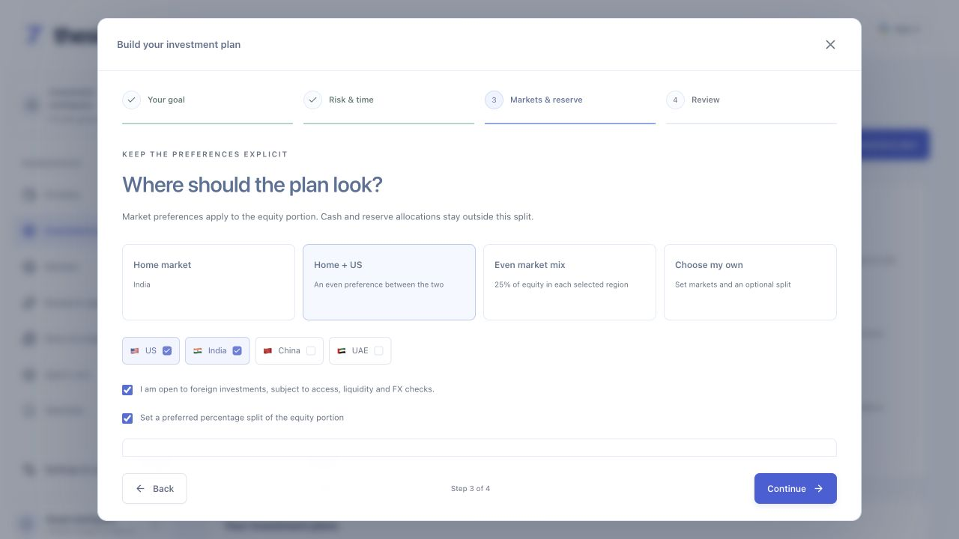
The plan starts with a few simple choices
$10,000
A home in two years
Investing from India
India and US access
20% volatility comfort
10% loss tolerance
A firm deadline
Illustrative inputs entered in the hosted application.
03
Notes:
Illustrative user inputs entered into the actual hosted application: USD10,000 lump sum, India residence, home goal,24-month firm deadline, balanced comfort,20% volatility and10% loss tolerance. The optional50/50India/US preference governs only any equity portion, not the entire budget. No emergency reserve amount supplied. Tolerances do not guarantee losses or future risk. Source: actual browser capture and retained job input.

Slide 4
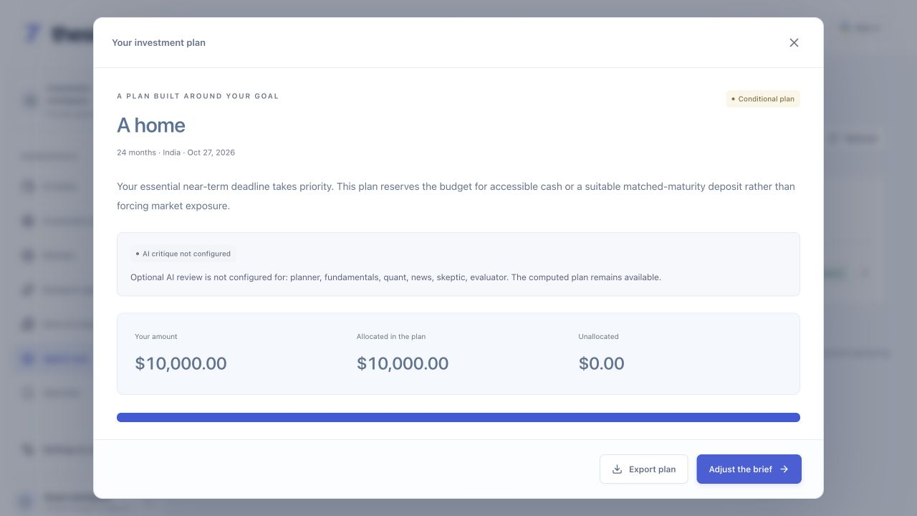
A firm deadline can make the answer cash first
$10,000 budget
100% reserved
Accessible cash or a suitable
matched-maturity deposit.
No bank, rate or future return is assumed.
Product, currency and liquidity checks
remain necessary.
Actual conditional result for the illustrative two-year home goal.
04
Notes:
Actual deterministic planner result for the example, not a stock recommendation or an investment guarantee. Exact conservation:0USD risk assets +10,000USD reserve =10,000USD total. A conditional plan does not claim that every deposit is accessible, insured or appropriate. The optional six-role AI critique is not configured in this captured workspace. The separate connected source audit is shown later. Sources: server/platform/planning.ts,lib/finance/allocation.ts and hosted result.

Slide 5
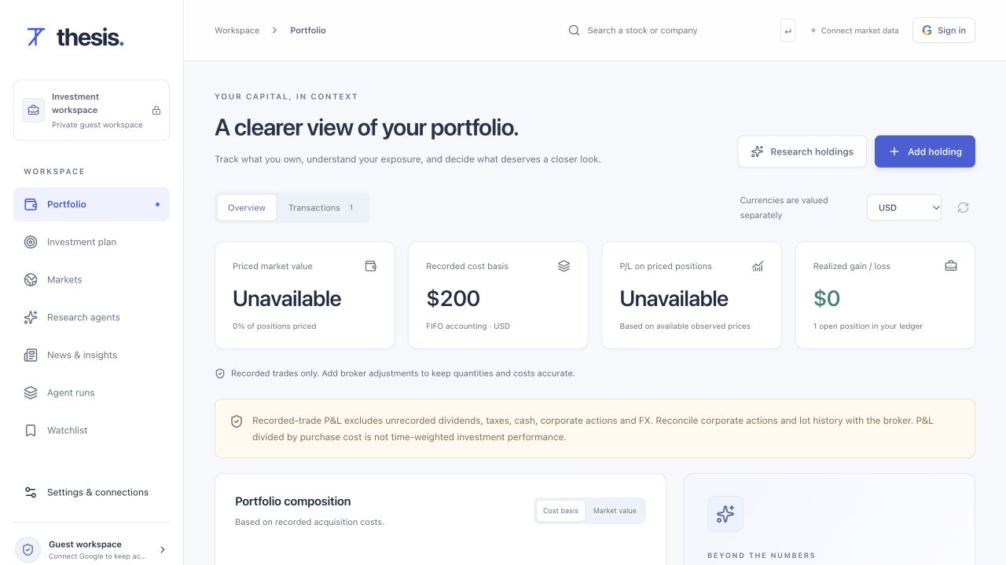
The portfolio keeps inputs and observations visible
Illustrative manual input
2 AAPL shares
$100 entered per share
$200 recorded cost basis
The live valuation stays unavailable until an entitled quote source supplies it.
An attributed TradingView chart provides a separate market view.
05
Notes:
The ledger example is illustrative user input, not a real holding, broker order or current share price. Zero fee and exact200USD cost basis were verified on the hosted application. Live valuation and P&L were unavailable without a separate entitled quote API. TradingView chart was actually rendered and verified; widget data does not feed AI, risk calculations or P&L. Sources: hosted captures08b and09,server/platform/portfolio.ts,quote-observations.ts.

Slide 6
Source review combines a model, code and memory
Goal and selected
instrument
Dated source facts
through Zetaris
Code plans source
coverage and gaps
H-MEM recalls
earlier decisions
Validated report
and source gaps
Nightshift NVIDIA
countercheck
Historical memory adds context. Current source checks still run again.
06
Notes:
Connected source-review workflow. Dated actual source envelopes are owner-scoped, hashed, staged and queried through Zetaris before consumption. Code plans available source coverage and missing inputs. Nightshift serves the actual NVIDIA Nemotron Mini model for one bounded source-risk countercheck. Deterministic validation retains control of listing identity, source dates, missing quotes/history and the final readiness decision. H-MEM recalls short historical user decision context, explicitly separate from current evidence. No independent model diversity or investment approval is claimed. Sources: server/platform/source-review.ts,zetaris-layer.ts,memory.ts and retained execution receipts.

Slide 7
Every required component has a working responsibility
Zetaris
Owner-scoped financial observations
Actual SQL readback with matching payload hash
Nightshift
Primary model gateway for source review
Concrete model and usage receipts in each report
NVIDIA Nemotron Mini
One source-risk countercheck
Bounded output with binding code validation
Meterless H-MEM
Recall prior review decisions
Historical context remains separate from sources
React and TypeScript UI. Firebase Auth and Hosting. Firestore, Cloud Run and Cloud Tasks.
07
Notes:
Implementation map. NVIDIA concrete model: local-runtime/nemotron-mini-4b-instruct-q4-k-m, through the Nightshift gateway. One source-risk countercheck per review, with at most one bounded repair. Zetaris API512m and Spark driver1g run with the normally admitted model, Postgres and no UI container. No memory-admission override. The operator machine and temporary authenticated tunnel must remain available; no uptime guarantee. Native personal model routes are optional and require user keys/credits. Firestore stores app state; Zetaris supplies the financial observation layer.

Slide 8
The next step is attention between reviews
Working today
Next for personal use
Goal-based conditional plans
Manual portfolio accounting
Attributed market charts
Source audits and saved review history
Scheduled filing and news checks
Alerts when the original case changes
Broader entitled market coverage
User feedback on plan explanations
thesis-investing.web.app
github.com/shi1720/thesis-investment-committee
08
Notes:
A personal project, with no commercial launch planned. Current user-triggered source reviews do not provide scheduled monitoring, trade execution or guaranteed investment outcomes. GDELT news source was unavailable during current hosted capture and no generated headlines replaced it. Actual SEC financial snapshots are dated, not fresh live quotes. Some model providers require user keys and funded accounts. Repository declares preexisting components, AI assistance, setup and testing limits.

