Slide 1



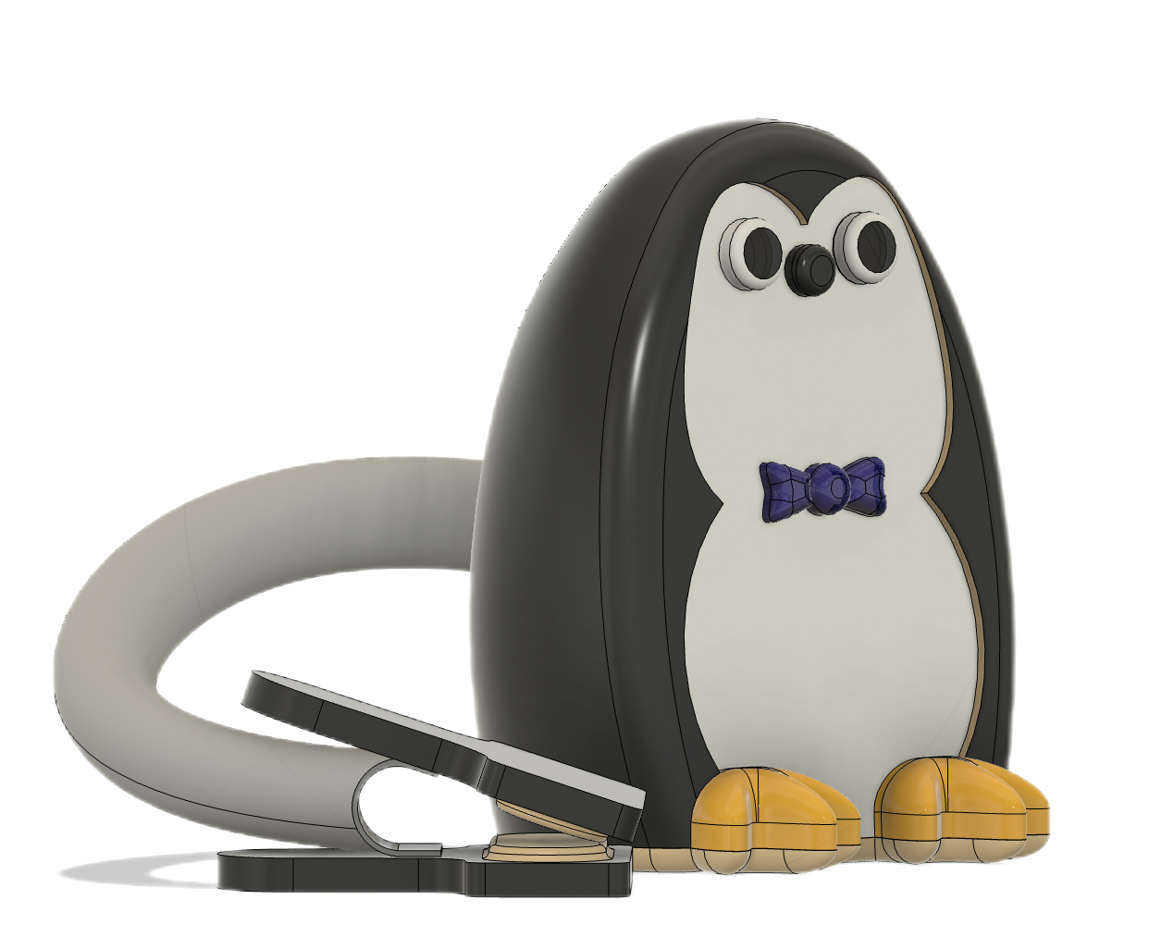





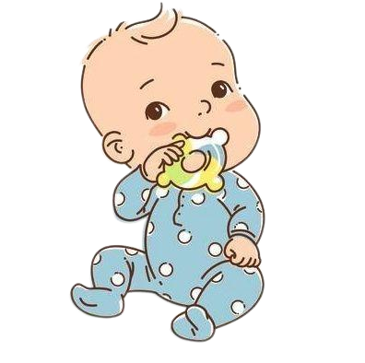
Baby Monitor
DOUBLE CARE FOR FRESHMEN
Mask Alert
Cry Alert
Temperature Alert
Human Track
Live Video

