Slide 1



Sprint 2
LINGUISTIC MISINFORMATION MARKERS
Stakeholder Meeting: Friday, February 27, 2026
NAME OF PROJECT:
PRESENTED BY:
PRESENTED TO:
COLX_523: Misinformation
Jennifer, Shiao-li, Nicole, Rachelle
Changbing Yang

Slide 2

Agenda
03 | Project Proposal
04 | Data Storage
05 | Corpus Collection & Basic Information
06 | Annotation Plan & Schema
07 | Next Steps

Slide 3
RESEARCH QUESTION:
What linguistic markers distinguish misinformation from factual/verified information in news articles, news headlines and social media posts?
Is there a way to distinguish a third category of information?
Project Proposal
HYPOTHESIS:
News and social media texts will have measurable differences in linguistic features
ANNOTATION TASK:
operates at both the token span and document level: annotators will tag specific linguistic features within the text (token), as well as classify the overall category of the document (document-level sentiment)

Slide 4
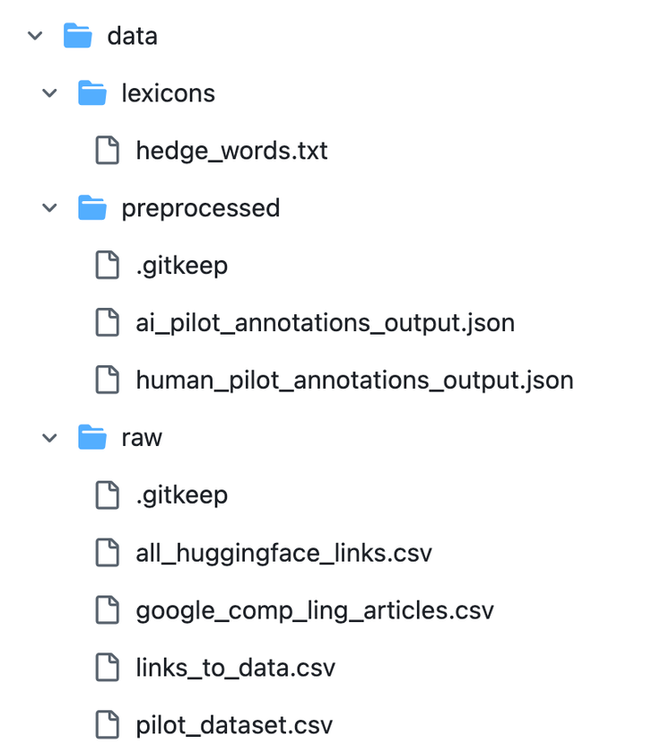
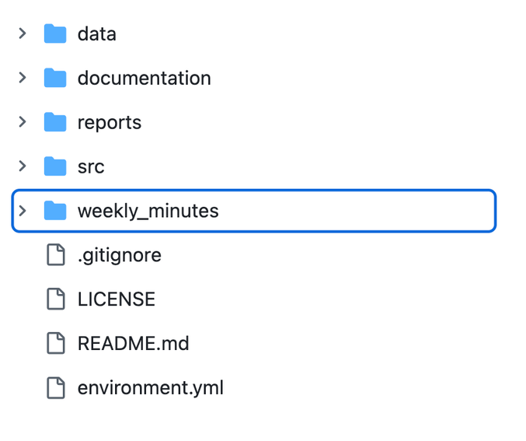
Data Storage
Link to repo

Slide 5
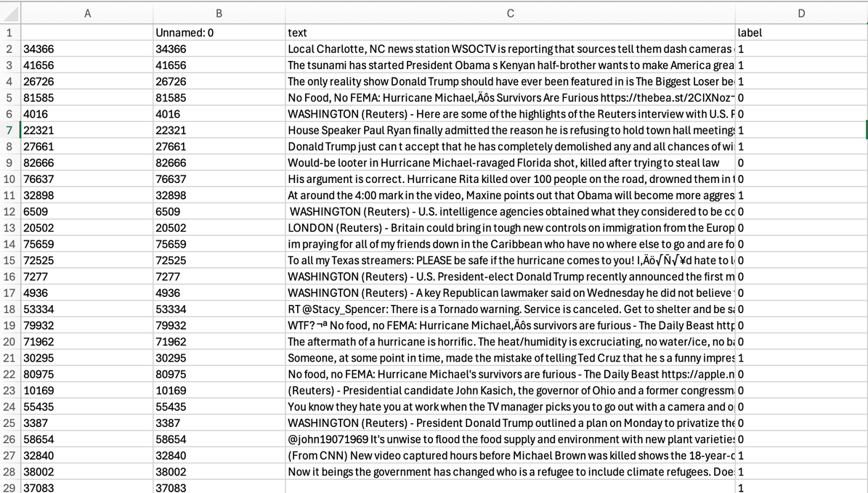
SOURCES:
RAW DATA: Hugging Face Roupeminassian Twitter Misinformation
WEB SCRAPING: Google News & News_Scraper.py
Corpus Collection & Basic Corpus Information
COMPILATION CODE:
Dataset_Builder.py
CORPUS README:
Basic Stats

Slide 6
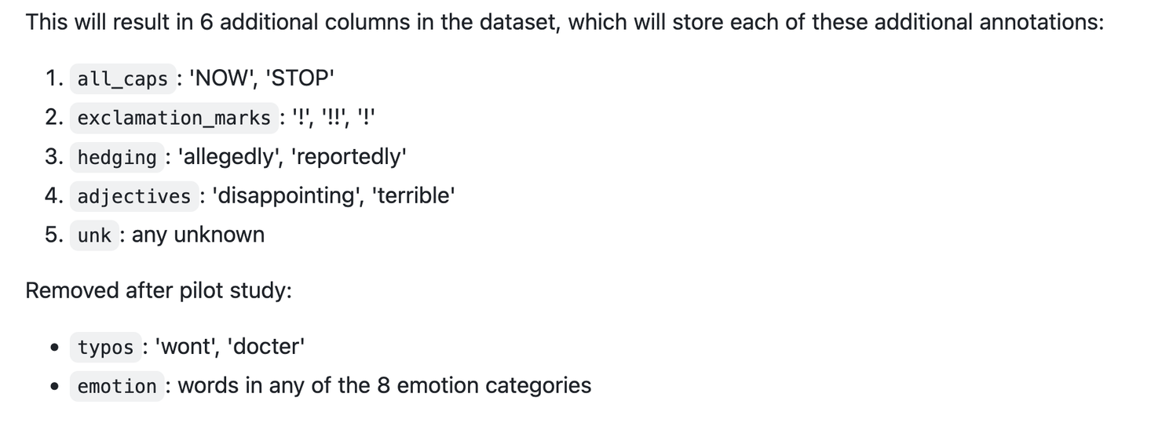
Annotation Plan & Schema
Proposal listed many potential linguistic markers
Refined through Pilot Study

Slide 7
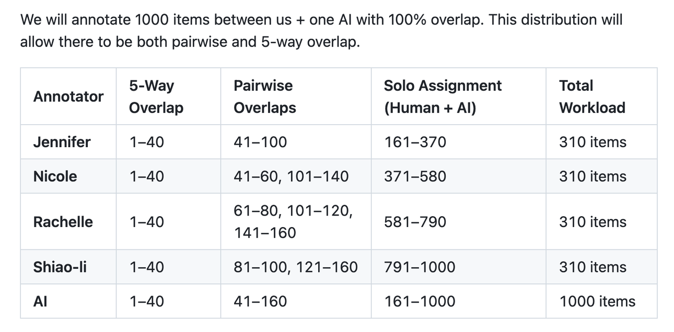
Next Steps & Questions
Annotation!

