Slide 1
Concurrent Quantum Separation Logic for Fine-Grained Parallelism
Yusuke Matushita (Kyoto University)
Kengo Hirata (The University of Edinburgh)
〇Ryo Wakizaka (Kyoto University)
25th January, 2025 @ PLanQC2025
Notes:
Hello everyone. I am Yusuke Matsushita from Kyoto University.

Slide 2
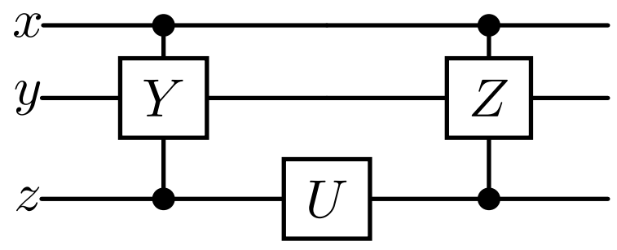
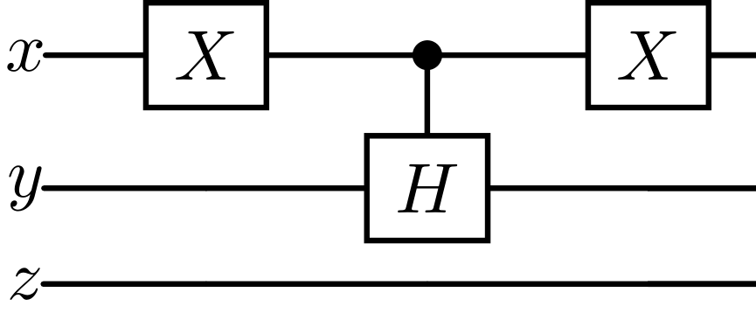
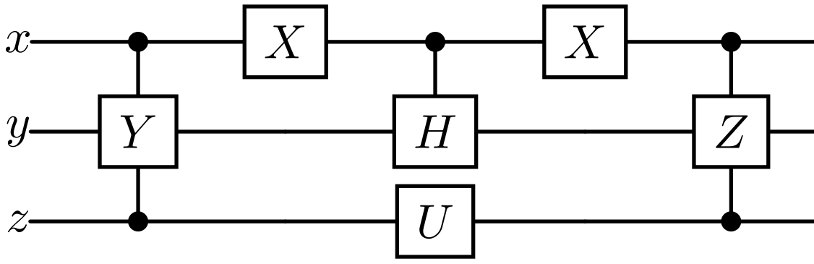



Overview of Our Work
We propose concurrent quantum separation logic for modularly verifying quantum programs with fine-grained parallelism
Compared to existing quantum SLs [Zhou+ LICS’21] [Le+ POPL’22], our logic is the first to support concurrency and the sharing of quantum resources, and can verify non-trivial programs
Shared variables ($x,y$)
Embedding via atomicity
$$∣∣$$
$$≡$$
Notes:
In this work, we propose concurrent quantum separation logic for modularly verifying quantum programs with fine-grained parallelism.
Compared to existing quantum separation logics, our logic is the first logic that supports concurrency and the sharing of quantum resources, circuit embedding by atomic expressions.
This study is a kind of theoretical one, but the our ultimate goal is developing automatic and safe parallelization algorithm based on our logic.

Slide 3
Outline
Motivation: Parallelizing Quantum Programs
Our Work: Concurrent QSL for Fine-Grained Parallelism
Extension to Probabilistic Reasoning & Conclusion
Notes:
Now we are ready to discuss the motivation of our work.
なんでこんな論理を作るのか？→正しい量子計算・コンパイラを作りたい
古典計算の世界だと simlIris というのがある→並列コンパイラの基礎付けを与える分離論理
これにたいして量子の世界のめんどくさい事項を考えた分離論理を通して

Slide 4

Parallelizing Quantum Programs
Parallelizing quantum programs can reduce execution costs
$$||$$
Parallel execution

Slide 5


Parallelizing Quantum Programs
Parallelizing quantum programs can reduce execution costs
Other candidates
$$||$$
Clever scheduling
Patterns of parallelization results = Possible execution traces
$$;$$
$$;$$
Notes:
並列化の一例としてはこのように二つ目の回路を埋め込むようなものがある。もし Uゲートのコストが大きいなら、回路の depth を下げることができる。
Here we can consider the patterns of … as possible execution traces of concurrent program.

Slide 6
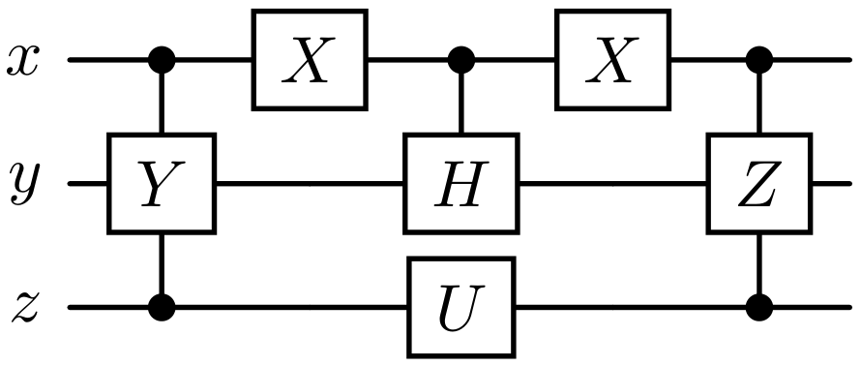
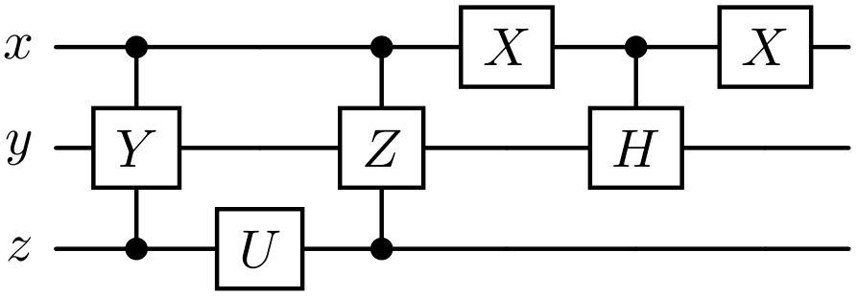
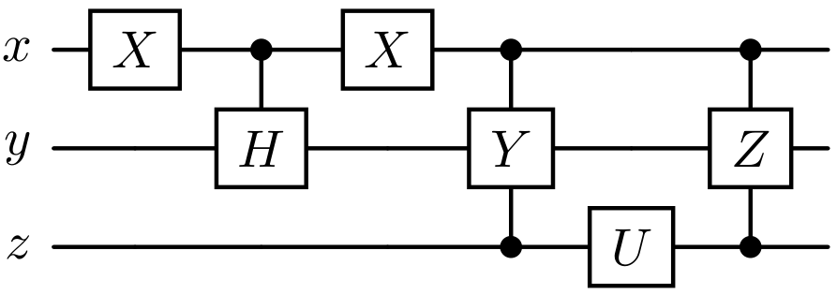



Verifying the Correctness of Parallelization
Parallelization is correct? = Concurrent program is correct?
Correctness of a parallel program ≈ Uniqueness of the output
$$||$$
?
?
$$=$$
$$=$$
Notes:
What we want to do here is checking whether the parallelization is safe, that is, whether the parallel quantum program is correct.
Here, we say a concurrent quantum program is correct if the execution result of the program unique. (no data race)
So the goal of our study is verifying the uniqueness of the output of concurrent quantum programs.

Slide 7

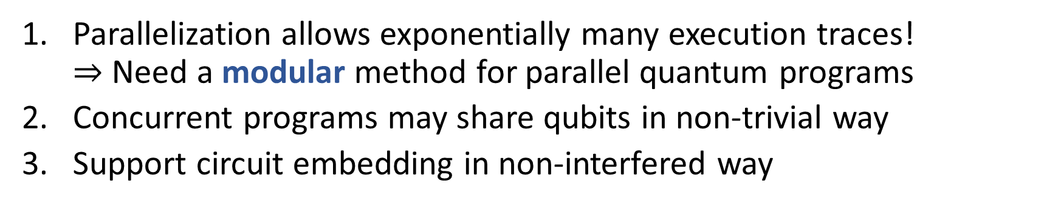



What is Challenge?
Parallelization allows exponentially many execution traces! $⇒$ Need a modular method for parallel quantum programs
Concurrent programs may share qubits in non-trivial way
Support circuit embedding in non-interfered way
3. Circuit Embedding
2. Shared variables ($x,y$)
$$||$$
$$⋮$$
$$⋮$$
Notes:
Here, we have to tackle three major challenges to achieve our goal.
First, parallelization allows exponentially many execution traces, so we need a modular method for parallel quantum programs.
Second, concurrent programs may share qubits in non-trivial way.
Third, sometimes we need support circuit embedding in non-interfered way like this.

Slide 8



Concurrent Quantum Separation Logic for Fine-Grained Parallelism
Our Work:
Support parallel execution of quantum processes
Support shared quantum variables
Even when there are apparent write-write races
Support atomic expressions
For non-interfered embedding of quantum circuits
2. Shared variables ($x,y$)
3. Embedding via atomicity
1.
$$∣∣$$
$$≡$$
Notes:
To address these challenges, we propose concurrent quantum separation logic having the following notable features.
First, our logic supports parallel execution of quantum processes.
Second, it supports shared quantum variables, even when there are apparent write-write races.
Third, our logic supports atomic expressions, for non-interfered embedding of quantum circuits in parallelization.

Slide 9
Outline
Motivation: Parallelizing Quantum Programs
Our Work: Concurrent QSL for Fine-Grained Parallelism
Extension to Probabilistic Reasoning & Conclusion
Notes:
From now on, I will explain our work in more detail.

Slide 10
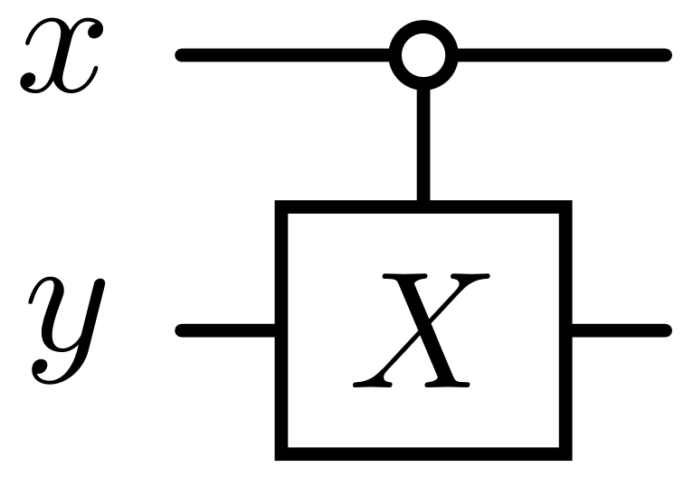
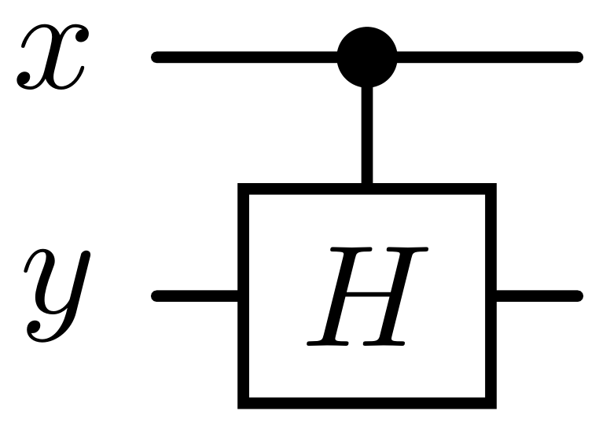
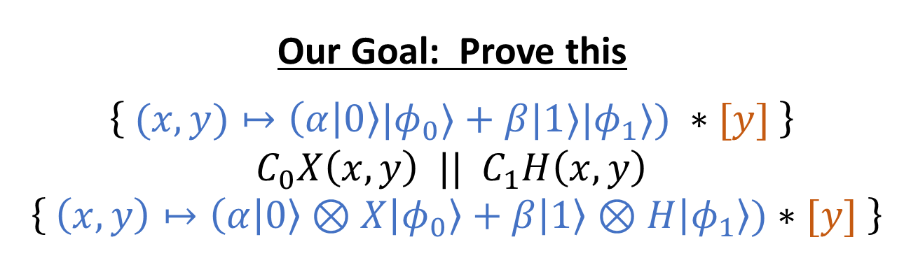


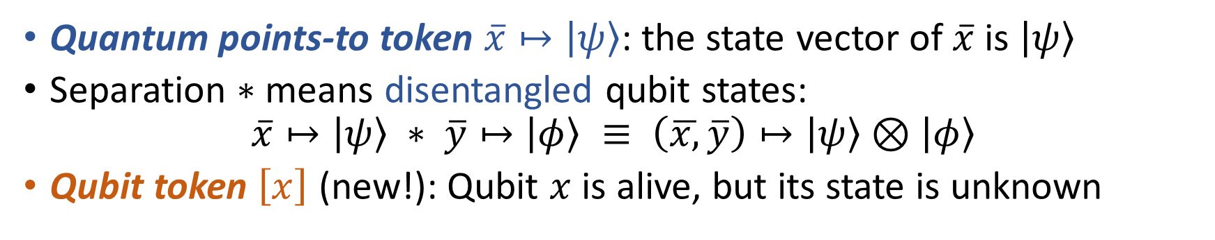
A Simple Example
$$||$$
$$C_{0}X\left(x,y\right) || C_{1}H\left(x,y\right)$$
Our Goal: Prove this
$\left\{ (x,y)↦\left(α | 0\right\rangle |φ_{0}⟩+β|1⟩|φ_{1}⟩) ∗[y] \right\}$
$C_{0}X\left(x,y\right) || C_{1}H\left(x,y\right)$
$\left\{ \left(x,y\right)↦\left(α | 0\right\rangle ⊗X\left|φ_{0}\right\rangle +β\left|1\right\rangle ⊗H\left|φ_{1}\right\rangle )∗[y] \right\}$
Precondition
Postcondition
Quantum points-to token $\overline{x}↦\left|ψ\right\rangle$: the state vector of$\overline{x}$ is $\left|ψ\right\rangle$
Separation $∗$means disentangled qubit states: $\overline{x}↦\left|ψ\right\rangle ∗ \overline{y}↦\left|φ\right\rangle ≡ \left(\overline{x,}\overline{y}\right)↦\left|ψ\right\rangle ⊗\left|φ\right\rangle$
Qubit token $\left[x\right]$ (new!): Qubit $x$ is alive, but its state is unknown
Notes:
In this talk, I use this simple example to show the expressiveness of our logic.
This examples consists of two concurrent processes. Negative-controlled X and positive controlled H gate
Points-to token は ownership to update the state と見ることもできる
… unknown.
Basically we cannot manipudate the state of qubit token, but as explained later we can do that in some case.

Slide 11


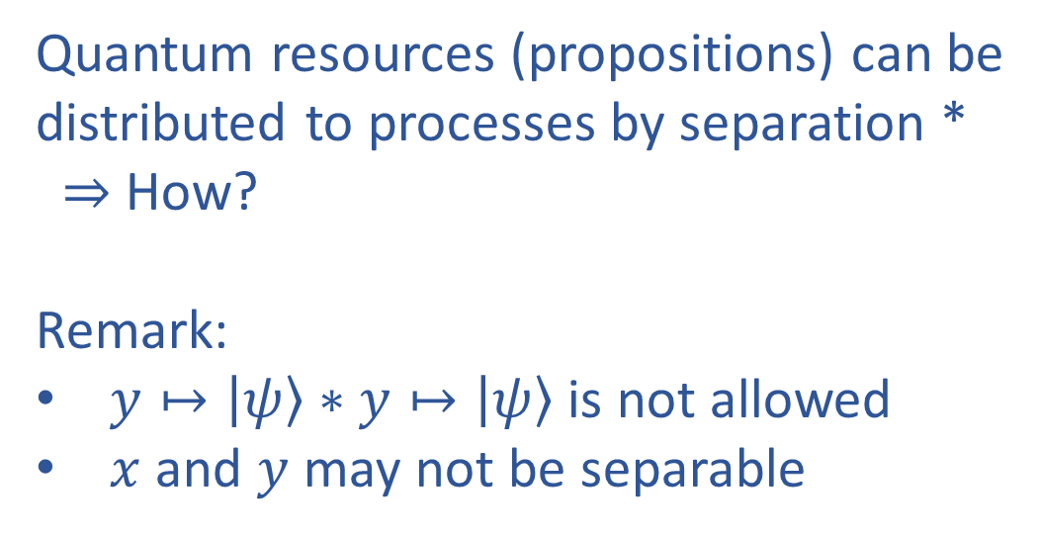

Proof for $C_{0}X\left(x,y\right) ||$ $C_{1}H\left(x,y\right)$
$\left\{ \left(x,y\right)↦\left(α\left|0\right\rangle \left|φ_{0}\right\rangle +β\left|1\right\rangle \left|φ_{1}\right\rangle \right)∗\left[y\right] \right\}$
$\left\{ x↦\left|0\right\rangle ∗y↦\left|φ_{0}\right\rangle ∗\left[y\right] \right\}$
$\left\{ x↦\left|1\right\rangle ∗y↦\left|φ_{1}\right\rangle ∗\left[y\right] \right\}$
${\left\{ y↦\left|φ_{0}\right\rangle ∗\left[y\right] \right\}}^{ x↦|0⟩}$
${\left\{ y↦\left|φ_{1}\right\rangle ∗\left[y\right] \right\}}^{ x↦|1⟩}$
$C_{0}X\left(x,y\right) || C_{1}H\left(x,y\right)$
${\left\{ y↦X\left|φ_{0}\right\rangle ∗\left[y\right] \right\}}^{ x↦|0⟩}$
${\left\{ y↦H\left|φ_{1}\right\rangle ∗\left[y\right] \right\}}^{ x↦|1⟩}$
$\left\{ x↦\left|0\right\rangle ∗y↦X\left|φ_{0}\right\rangle ∗\left[y\right] \right\}$
$\left\{ x↦\left|1\right\rangle ∗y↦H\left|φ_{1}\right\rangle ∗\left[y\right] \right\}$
$\left\{ \left(x,y\right)↦\left(α\left|0\right\rangle ⊗X\left|φ_{0}\right\rangle +β\left|1\right\rangle ⊗H\left|φ_{1}\right\rangle \right)∗\left[y\right] \right\}$
Quantum resources (propositions) can be distributed to processes by separation * $⇒$ How? Remark:
$y↦\left|ψ\right\rangle ∗y↦\left|ψ\right\rangle$ is not allowed
$x$ and $y$ may not be separable
$$∗$$
Notes:
Anyway, let’s start prove this Hoare assertion.
First, we need to distribute quantum resources like quantum points-to tokens to each process for the verification.
In concurrent separation logic we use separating conjunction * to distribute such resources and verify the concurrent program in modular way.

Slide 12

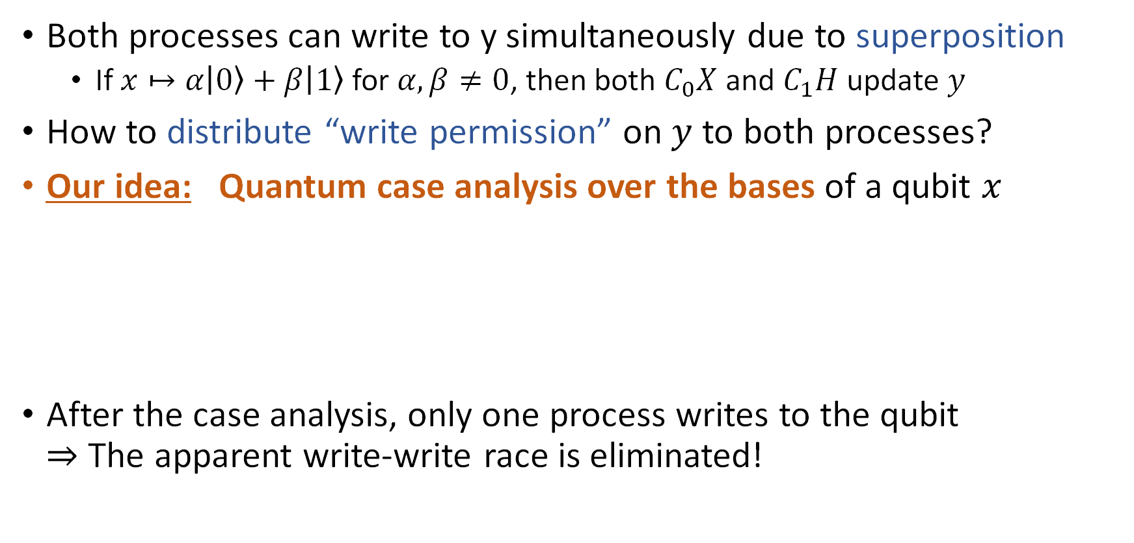




Our Key Observation
$$C_{0}X\left(x,y\right) || C_{1}H\left(x,y\right)$$
Both processes can write to y simultaneously due to superposition
If $x↦α\left|0\right\rangle +β\left|1\right\rangle$for $α,β≠0$, then both $C_{0}X$ and $C_{1}H$ update $y$
How to distribute “write permission” on $y$ to both processes?
Our idea: Quantum case analysis over the bases of a qubit $x$
After the case analysis, only one process writes to the qubit $⇒$ The apparent write-write race is eliminated!
$$x↦\left|0\right\rangle$$
Write permission is not required
$$x↦\left|1\right\rangle$$
$$C_{0}X\left(x,y\right) || C_{1}H\left(x,y\right)$$
$$C_{0}X\left(x,y\right) || C_{1}H\left(x,y\right)$$
Notes:
The challenge in this example is that both processes can write to y simultaneously, because x can be a superposition of 0 and 1 in the quantum setting.
So we need to distribute the write permission on y to both processes. How can we do that in a sound way?
Our idea is to support a quantum version of a case analysis over the basis of a qubit.
In this example, we split into two worlds where the vector of x is 0 and 1, respectively.
In each simplified world, only one process writes to y. For example, if x is 0, then the one-controlled Hadamard gate does not change the state of y.
This successfully eliminates the apparent write-write race, and enables the standard separation logic reasoning.

Slide 13
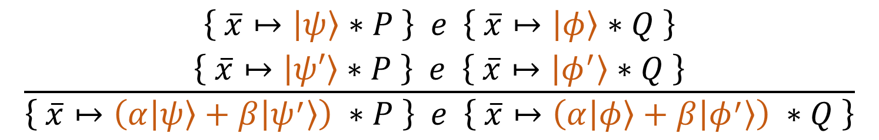
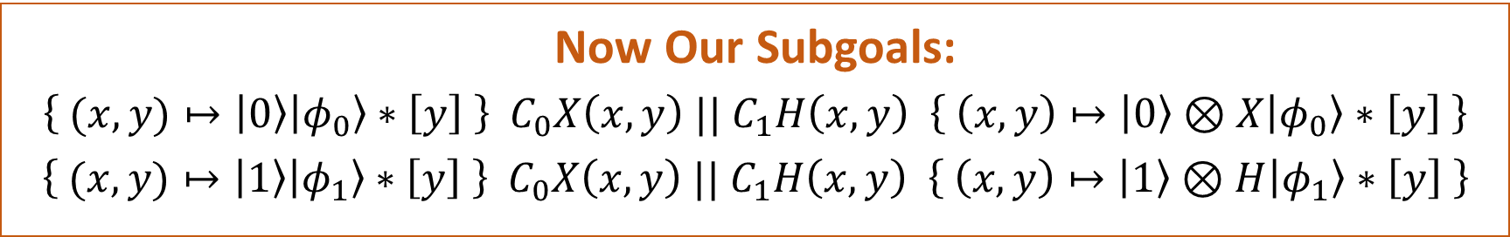
Linear Combination Rule
This idea can be formalized as linear combination of Hoare triples
$$\frac{\begin{aligned}\left\{ \overline{x}↦\left|ψ\right\rangle ∗P \right\} e \left\{ \overline{x}↦\left|φ\right\rangle ∗Q \right\} \\ \left\{ \overline{x}↦\left|ψ′\right\rangle ∗P \right\} e \left\{ \overline{x}↦\left|φ^{′}\right\rangle ∗Q \right\}\end{aligned}}{\left\{ \overline{x}↦\left(α\left|ψ\right\rangle +β\left|ψ^{′}\right\rangle \right) ∗P \right\} e \left\{ \overline{x}↦\left(α\left|φ\right\rangle +β\left|φ^{′}\right\rangle \right) ∗Q \right\}}$$
Now Our Subgoals:
$\left\{ (x,y)↦\left|0\right\rangle \left|φ_{0}\right\rangle ∗\left[y\right] \right\} C_{0}X\left(x,y\right) || C_{1}H\left(x,y\right) \left\{ \left(x,y\right)↦\left|0\right\rangle ⊗X\left|φ_{0}\right\rangle ∗\left[y\right] \right\}$
$\left\{ (x,y)↦\left|1\right\rangle \left|φ_{1}\right\rangle ∗\left[y\right] \right\} C_{0}X\left(x,y\right) || C_{1}H\left(x,y\right) \left\{ \left(x,y\right)↦\left|1\right\rangle ⊗H\left|φ_{1}\right\rangle ∗\left[y\right] \right\}$
Notes:
X を何らかの基底によって分解し、それぞれのケースについて reasoning を行った後、それらの線形結合をとる。
This rule enables us to continue the verification in the world where there is no write-write races.

Slide 14



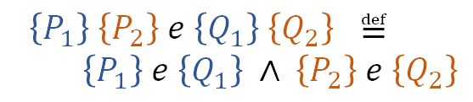
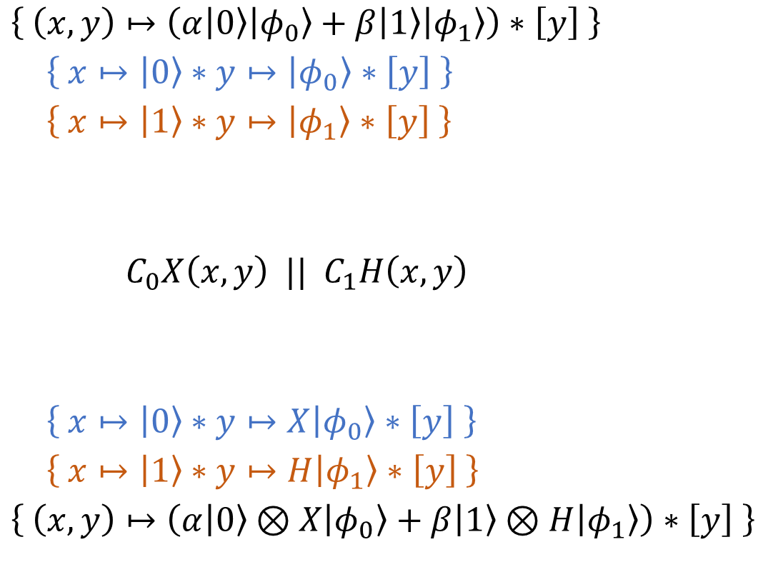

Proof for $C_{0}X\left(x,y\right) ||$ $C_{1}H\left(x,y\right)$
$\left\{ \left(x,y\right)↦\left(α\left|0\right\rangle \left|φ_{0}\right\rangle +β\left|1\right\rangle \left|φ_{1}\right\rangle \right)∗\left[y\right] \right\}$
$\left\{ x↦\left|0\right\rangle ∗y↦\left|φ_{0}\right\rangle ∗\left[y\right] \right\}$
$\left\{ x↦\left|1\right\rangle ∗y↦\left|φ_{1}\right\rangle ∗\left[y\right] \right\}$
${\left\{ y↦\left|φ_{0}\right\rangle ∗\left[y\right] \right\}}^{ x↦|0⟩}$
${\left\{ y↦\left|φ_{1}\right\rangle ∗\left[y\right] \right\}}^{ x↦|1⟩}$
$C_{0}X\left(x,y\right) || C_{1}H\left(x,y\right)$
${\left\{ y↦X\left|φ_{0}\right\rangle ∗\left[y\right] \right\}}^{ x↦|0⟩}$
${\left\{ y↦H\left|φ_{1}\right\rangle ∗\left[y\right] \right\}}^{ x↦|1⟩}$
$\left\{ x↦\left|0\right\rangle ∗y↦X\left|φ_{0}\right\rangle ∗\left[y\right] \right\}$
$\left\{ x↦\left|1\right\rangle ∗y↦H\left|φ_{1}\right\rangle ∗\left[y\right] \right\}$
$\left\{ \left(x,y\right)↦\left(α\left|0\right\rangle ⊗X\left|φ_{0}\right\rangle +β\left|1\right\rangle ⊗H\left|φ_{1}\right\rangle \right)∗\left[y\right] \right\}$
Give $y↦\left|φ_{i}\right\rangle$ to $i$-th process
$x$ is required by both processes as “read-only” qubits
Remark:
$x↦\left|ψ\right\rangle ∗x↦\left|ψ\right\rangle$ is not allowed
$$y↦\left|φ_{0}\right\rangle$$
$$∗$$
$$[y]$$
$\left\{P_{1}\right\} \left\{P_{2}\right\} e \left\{Q_{1}\right\} \left\{Q_{2}\right\} ≝$
$\left\{P_{1}\right\} e \left\{Q_{1}\right\} ∧ \left\{P_{2}\right\} e \left\{Q_{2}\right\}$
Notes:
As a summary, we illustrate the complete proof of the Hoare assertion for the simple example.

Slide 15

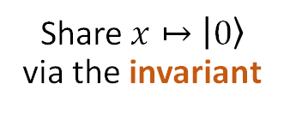

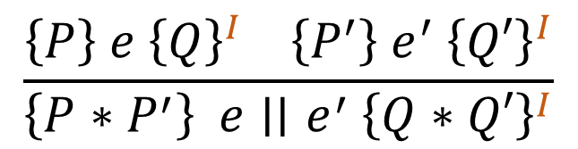
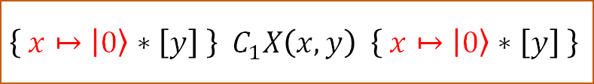
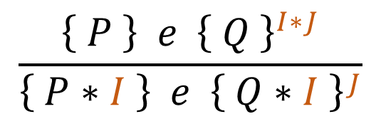
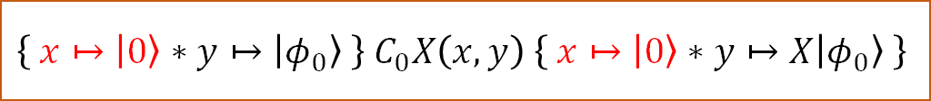
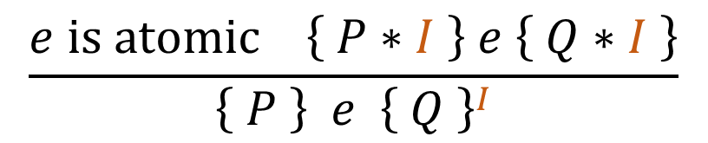
Resource Sharing via Invariants
$$\left\{ (x,y)↦\left|0\right\rangle \left|φ_{0}\right\rangle ∗\left[y\right] \right\} C_{0}X\left(x,y\right) || C_{1}H\left(x,y\right) \left\{ (x,y)↦\left|0\right\rangle ⊗X\left|φ_{0}\right\rangle ∗\left[y\right] \right\}$$
$$\left\{ y↦\left|φ_{0}\right\rangle ∗\left[y\right] \right\} C_{0}X\left(x,y\right) || C_{1}H\left(x,y\right) { \left\{ y↦X\left|φ_{0}\right\rangle ∗\left[y\right] \right\}}^{ x↦\left|0\right\rangle }$$
Share $x↦\left|0\right\rangle$ via the invariant
$$\left\{ y↦\left|φ_{0}\right\rangle \right\} C_{0}X\left(x,y\right) {\left\{ y↦X\left|φ_{0}\right\rangle \right\}}^{ x↦\left|0\right\rangle }$$
$$\left\{ \left[y\right] \right\} C_{1}X\left(x,y\right) {\left\{ \left[y\right] \right\}}^{ x↦\left|0\right\rangle }$$
$$\left\{ x↦\left|0\right\rangle ∗y↦\left|φ_{0}\right\rangle \right\} C_{0}X\left(x,y\right) \left\{ x↦\left|0\right\rangle ∗y↦X\left|φ_{0}\right\rangle \right\}$$
$$\left\{ x↦\left|0\right\rangle ∗\left[y\right] \right\} { C}_{1}X\left(x,y\right) \left\{ x↦\left|0\right\rangle ∗\left[y\right] \right\}$$
$$\frac{e is atomic \left\{ P∗I \right\} e \left\{ Q∗I \right\}}{\left\{ P \right\} e {\left\{ Q \right\}}^{I}}$$
$$\frac{\left\{ P \right\} e {\left\{ Q \right\}}^{I∗J}}{\left\{ P∗I \right\} e {\left\{ Q∗I \right\}}^{J}}$$
$$\frac{\left\{P\right\} e {\left\{Q\right\}}^{I} \left\{P^{′}\right\} e^{′} {\left\{Q′\right\}}^{I}}{\left\{P∗P^{′}\right\} e∣∣e^{′} {\left\{Q∗Q′\right\}}^{I}}$$
Notes:
We can prove the subgoals by resource sharing via invariants, a standard technique in concurrent separation logic.
Here we show how the first subgoal is proved. The second one is proved in the same way.
→ We want to reduce this subgoal to the two Hoare assertions shown at the bottom.
→ For that, we can simply move the points-to token of x into the invariant, which can be accessed by all processes at every atomic step.
The proof rules for invariants are shown below.
Now our proof is almost done. The Hoare assertion on the left-hand side can be proved easily.
→ But how can we prove the Hoare assertion on the right-hand side?

Slide 16
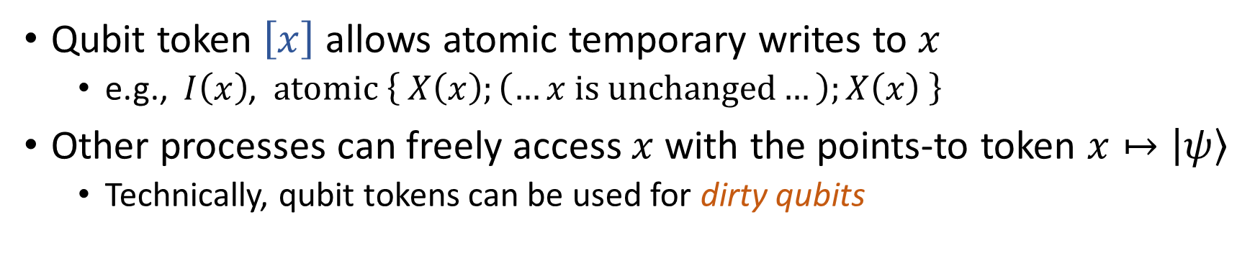
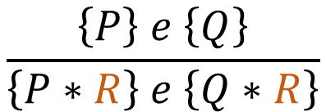

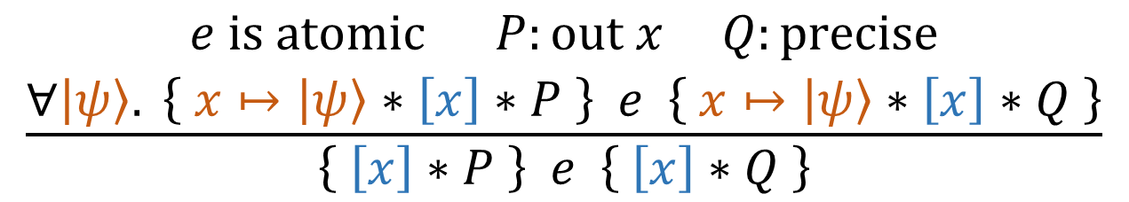
Anti-Frame Rule by Atomicity
$$\left\{ x↦\left|0\right\rangle ∗\left[y\right] \right\} C_{1}X\left(x,y\right) \left\{ x↦\left|0\right\rangle ∗\left[y\right] \right\}$$
$$\frac{\begin{aligned}e is atomic P:out x Q:precise \\ ∀\left|ψ\right\rangle . \left\{ x↦\left|ψ\right\rangle ∗\left[x\right]∗P \right\} e \left\{ x↦\left|ψ\right\rangle ∗\left[x\right]∗Q \right\}\end{aligned}}{\left\{ \left[x\right]∗P \right\} e \left\{ \left[x\right]∗Q \right\}}$$
Cf. Frame rule
$$\frac{\left\{P\right\} e \left\{Q\right\}}{\left\{P∗R\right\} e \left\{Q∗R\right\}}$$
Qubit token $\left[x\right]$ allows atomic temporary writes to $x$
e.g., $I\left(x\right)$, $atomic \left\{ X\left(x\right);\left(…x is unchanged…\right);X\left(x\right) \right\}$
Other processes can freely access $x$with the points-to token $x↦\left|ψ\right\rangle$
Technically, qubit tokens can be used for dirty qubits
Notes:
To solve such situations, we introduce the following novel proof rule for the qubit token.
By this rule, we can get access to the points-to token for the qubit at each atomic step.
We call this the anti-frame rule by atomicity for the qubit token, because it adds a frame to the hypothesis, instead of removing it.
This rule allows atomic writes to the qubit that is temporary, or restores the qubit state after the execution is finished, which does not interfere with other processes freely accessing the qubit.
In our example, the one-controlled X gate does not update y when x is 0, so we can use this rule to complete the whole proof.
(For PLanQC 2025) In this sense, our logic can express dirty qubits via qubit tokens.

Slide 17



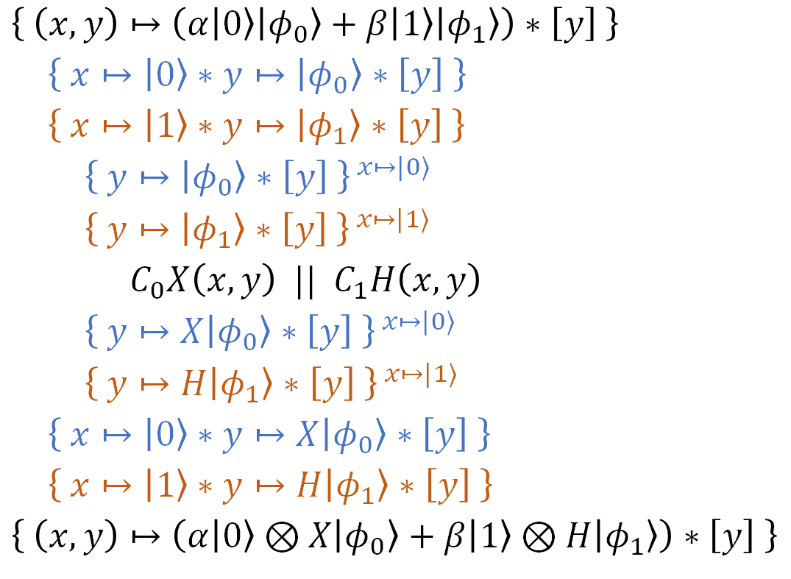
Complete Proof for $C_{0}X\left(x,y\right) ||$ $C_{1}H\left(x,y\right)$
$\left\{ \left(x,y\right)↦\left(α\left|0\right\rangle \left|φ_{0}\right\rangle +β\left|1\right\rangle \left|φ_{1}\right\rangle \right)∗\left[y\right] \right\}$
$\left\{ x↦\left|0\right\rangle ∗y↦\left|φ_{0}\right\rangle ∗\left[y\right] \right\}$
$\left\{ x↦\left|1\right\rangle ∗y↦\left|φ_{1}\right\rangle ∗\left[y\right] \right\}$
${\left\{ y↦\left|φ_{0}\right\rangle ∗\left[y\right] \right\}}^{ x↦|0⟩}$
${\left\{ y↦\left|φ_{1}\right\rangle ∗\left[y\right] \right\}}^{ x↦|1⟩}$
$C_{0}X\left(x,y\right) || C_{1}H\left(x,y\right)$
${\left\{ y↦X\left|φ_{0}\right\rangle ∗\left[y\right] \right\}}^{ x↦|0⟩}$
${\left\{ y↦H\left|φ_{1}\right\rangle ∗\left[y\right] \right\}}^{ x↦|1⟩}$
$\left\{ x↦\left|0\right\rangle ∗y↦X\left|φ_{0}\right\rangle ∗\left[y\right] \right\}$
$\left\{ x↦\left|1\right\rangle ∗y↦H\left|φ_{1}\right\rangle ∗\left[y\right] \right\}$
$\left\{ \left(x,y\right)↦\left(α\left|0\right\rangle ⊗X\left|φ_{0}\right\rangle +β\left|1\right\rangle ⊗H\left|φ_{1}\right\rangle \right)∗\left[y\right] \right\}$
${\left\{ y↦\left|φ_{0}\right\rangle \right\}}^{ x↦\left|0\right\rangle } {\left\{ \left[y\right] \right\}}^{ x↦\left|1\right\rangle }$
$\left\{ y↦ | φ_{0}\right\rangle ∗x↦\left|0\right\rangle \} \{ \left[y\right]∗x↦\left|1\right\rangle \}$
$C_{0}X\left(x,y\right)$
$\left\{ y↦X\left|φ_{0}\right\rangle ∗x↦\left|0\right\rangle \right\} \left\{ \left[y\right]∗x↦\left|1\right\rangle \right\}$
${\left\{ y↦X\left|φ_{0}\right\rangle \right\}}^{ x↦\left|0\right\rangle } { \left\{ \left[y\right] \right\}}^{ x↦\left|1\right\rangle }$
${\left\{ \left[y\right] \right\}}^{ x↦\left|0\right\rangle } {\left\{ y↦\left|φ_{1}\right\rangle \right\}}^{ x↦\left|1\right\rangle }$
$\left\{ \left[y\right] \right\} \left\{ y↦\left|φ_{1}\right\rangle ∗x↦\left|1\right\rangle \right\}$
$C_{1}H\left(x,y\right)$
$\left\{ \left[y\right]∗x↦\left|0\right\rangle \right\} \left\{ y↦H\left|φ_{1}\right\rangle ∗x↦\left|1\right\rangle \right\}$
${\left\{ \left[y\right] \right\}}^{ x↦\left|0\right\rangle } {\left\{ y↦H\left|φ_{1}\right\rangle \right\}}^{ x↦\left|1\right\rangle }$
$\left\{P_{1}\right\} \left\{P_{2}\right\} e \left\{Q_{1}\right\} \left\{Q_{2}\right\} ≝$
$\left\{P_{1}\right\} e \left\{Q_{1}\right\} ∧ \left\{P_{2}\right\} e \left\{Q_{2}\right\}$
Notes:
As a summary, we illustrate the complete proof of the Hoare assertion for the simple example.

Slide 18

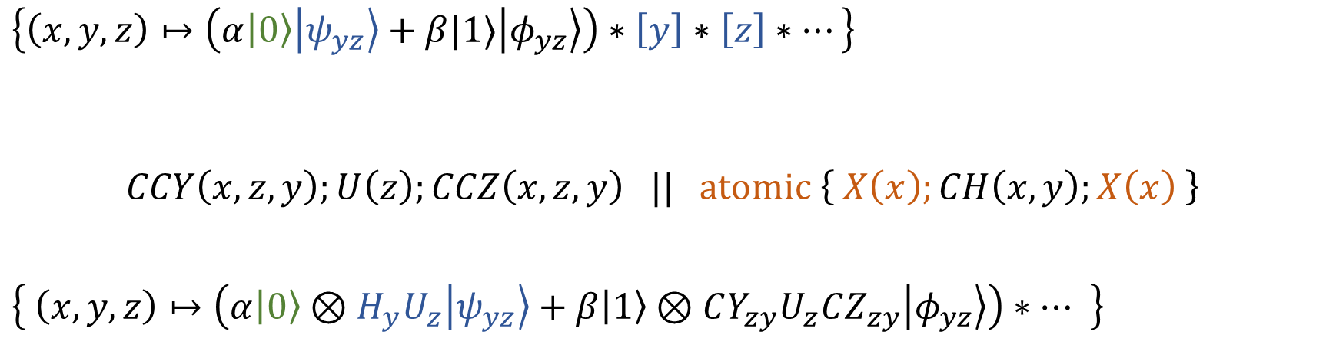





More Complex Example
$$∣∣$$
$$≡$$
$\left\{\left(x,y,z\right)↦\left(α\left|0\right\rangle \left|ψ_{yz}\right\rangle +β|1⟩\left|φ_{yz}\right\rangle \right)∗\left[y\right]∗\left[z\right]∗…\right\}$
$$CCY\left(x,z,y\right);U\left(z\right);CCZ\left(x,z,y\right) || atomic \left\{ X\left(x\right);CH\left(x,y\right);X\left(x\right) \right\}$$
$\left\{ \left(x,y,z\right)↦\left(α\left|0\right\rangle ⊗H_{y}U_{z}\left|ψ_{yz}\right\rangle +β\left|1\right\rangle ⊗CY_{zy}U_{z}CZ_{zy}\left|φ_{yz}\right\rangle \right)∗… \right\}$
Invariant
Invariant
$$x↦\left|0\right\rangle ∗\left[y\right]∗\left[z\right]$$
$$||$$
$$x↦\left|0\right\rangle ∗\left(y,z\right)↦\left|ψ_{yz}\right\rangle$$
$x$ is updated only temporarily
Notes:
Of course, our logic can support much more complex examples, including one we showed when motivating parallelized quantum programs.

Slide 19

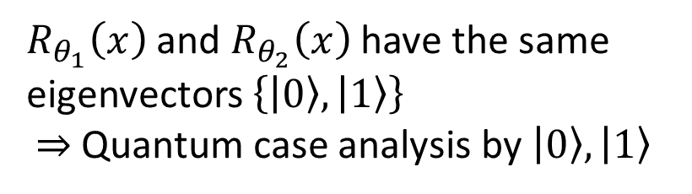
Another Fun Thing: Commuting Matrices
We can verify parallelization of arbitrary commuting matrices
Since commutative matrices are simultaneously diagonalizable
$\left\{ x↦\left(α\left|0\right\rangle +β\left|1\right\rangle \right) \right\}$
$\left\{ x↦\left|0\right\rangle \right\}$ $\left\{ x↦\left|1\right\rangle \right\}$
${\left\{ ()↦1 \right\}}^{ x↦|0⟩} {\left\{ ()↦1 \right\}}^{ x↦|1⟩}$
$R_{θ_{1}}\left(x\right) ||$ $R_{θ_{2}}\left(x\right)$
${\left\{ ()↦1 \right\}}^{ x↦|0⟩} {\left\{ () ↦e^{i\left(θ_{1}+θ_{2}\right)} \right\}}^{ x↦|1⟩}$
$\left\{ x↦\left|0\right\rangle \right\}$ $\left\{ x↦e^{i\left(θ_{1}+θ_{2}\right)}\left|1\right\rangle \right\}$
$\left\{ x↦\left(α\left|0\right\rangle +βe^{i\left(θ_{1}+θ_{2}\right)}\left|1\right\rangle \right) \right\}$
$R_{θ_{1}}\left(x\right)$ and $R_{θ_{2}}\left(x\right)$ have the same eigenvectors $\left\{\left|0\right\rangle ,\left|1\right\rangle \right\}$ $⇒$ Quantum case analysis by $\left|0\right\rangle ,\left|1\right\rangle$
Global phases can be tracked with empty-qubit points-to tokens

Slide 20
Outline
Motivation: Parallelizing Quantum Programs
Our Work: Concurrent QSL for Fine-Grained Parallelism
Extension to Probabilistic Reasoning & Conclusion
Notes:
Great. Finally, I will discuss our ongoing extension to probabilistic reasoning.
But this may be too technical to talk, so I do not give the details today. If you have interests, let’s discuss later.

Slide 21
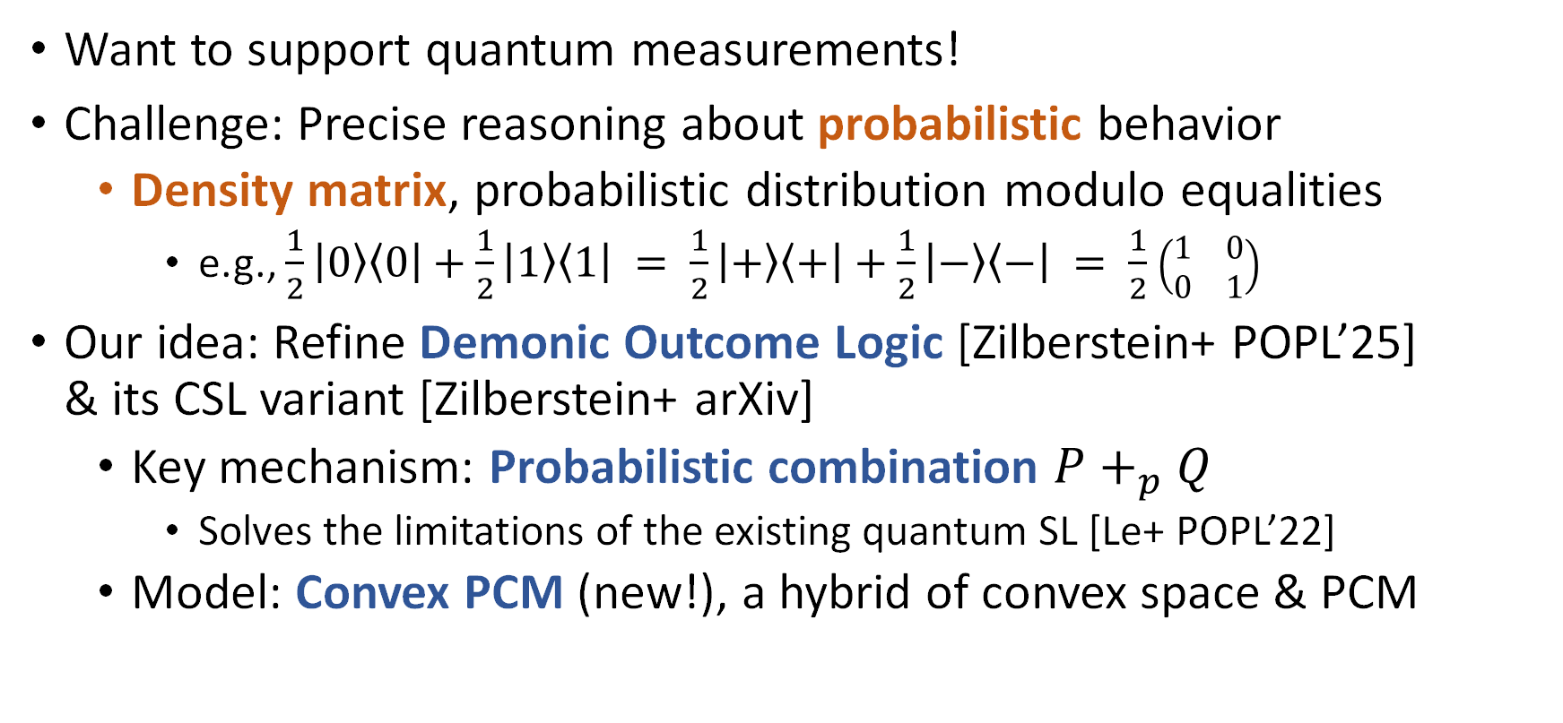
Extension to Probabilistic Reasoning
Want to support quantum measurements!
Challenge: Precise reasoning about probabilistic behavior
Density matrix, probabilistic distribution modulo equalities
e.g., $\frac{1}{2}\left|0\right\rangle \left\langle 0\right|+\frac{1}{2}\left|1\right\rangle \left\langle 1\right| = \frac{1}{2}\left|+\right\rangle \left\langle +\right|+\frac{1}{2}\left|−\right\rangle \left\langle −\right| = \frac{1}{2}$ $\left(\begin{matrix}1 & 0 \\ 0 & 1\end{matrix}\right)$
Our idea: Refine Demonic Outcome Logic [Zilberstein+ POPL’25] & its CSL variant [Zilberstein+ arXiv]
Key mechanism: Probabilistic combination $P+_{p}Q$
Solves the limitations of the existing quantum SL [Le+ POPL’22]
Model: Convex PCM (new!), a hybrid of convex space & PCM
Notes:
We want to support quantum measurements. The primary challenge for that is to precisely reason about probabilistic behavior.
In quantum computing, the standard model for that is a density matrix, which is roughly a probabilistic distribution of state vectors modulo some equalities.
Our idea is to refine the approach of Demonic Outcome Logic.
We are also based on a concurrent separation logic variant of that work.
A key mechanism is the probabilistic combination of logic assertions, which solves the limitations of the existing quantum separation logic.
For the model, we also introduce a new mathematic structure called convex PCM, a hybrid of convex space and partial commutative monoid.

Slide 22
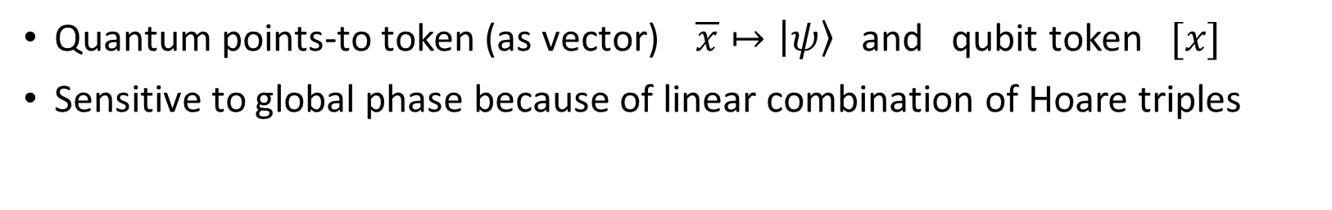
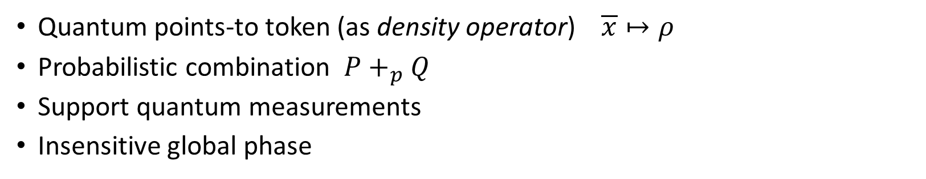
Two-Layer Logic
Layer1: Vector-based Quantum Separation Logic (I talked today)
Quantum points-to token (as vector) $\overline{x}↦\left|ψ\right\rangle$ and qubit token $[x]$
Sensitive to global phase because of linear combination of Hoare triples
“densify”
Layer2: Probabilistic Quantum Separation Logic (New)
Quantum points-to token (as density operator) $\overline{x}↦ρ$
Probabilistic combination $P+_{p}Q$
Support quantum measurements
Insensitive global phase
Notes:
This is the brief overview of our new logic.
Our logic consist of two layer separation logic. The first one is the logic I talked today, and the second one is introduces in previous slide.
The reason why our framework has two layers is that the property we can verify in each logic is different.

Slide 23
Conclusion
We proposed a concurrent quantum separation logic for modular verification of fine-grained parallelism
Our logic supports shared quantum resources via invariants, the linear combination rule, and the anti-frame rule by atomicity
Future work
More powerful concurrency reasoning
Automated optimization of quantum programs & its verification
Notes:
Vlogic -> sound
Plogic -> sound, relative complete for non-concurrent fragment

Slide 24
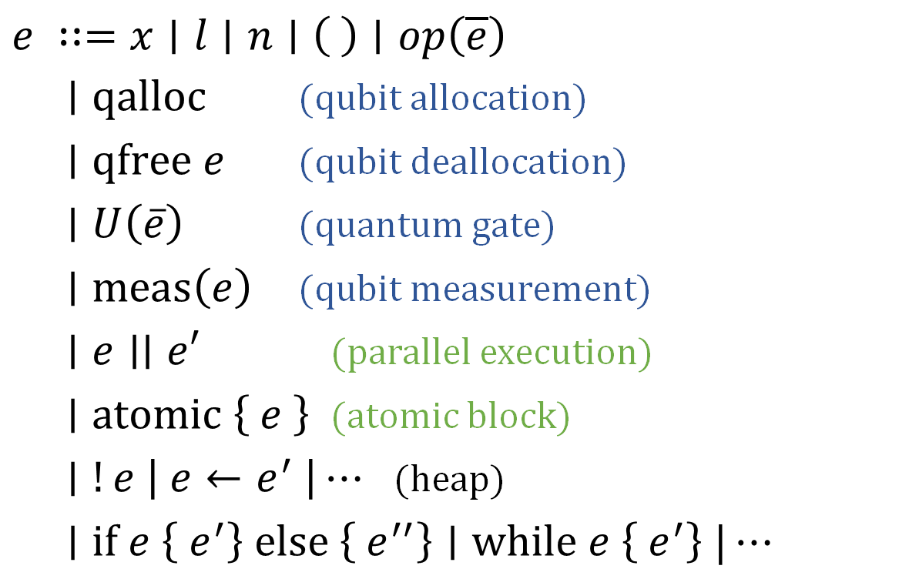
Our Target Language
$e ∷=x∣l∣n∣\left( \right)∣op\left(\overline{e}\right)$
$∣qalloc$ (qubit allocation)
$∣qfree e$ (qubit deallocation)
$∣U\left(\overline{e}\right)$ (quantum gate)
$∣meas\left(e\right)$ (qubit measurement)
$∣e∣∣e′$ (parallel execution)
$∣atomic \left\{ e \right\}$ (atomic block)
$∣!e \left| e←e^{′} \right|⋯$ (heap)
$∣if e \left\{ e^{′}\right\} else \left\{ e^{′′}\right\}∣while e \left\{ e^{′}\right\} |⋯$
Quantum
Concurrency
Notes:
Our target language looks like this.
It has primitives for quantum operations, parallel execution and an atomic block for concurrency, and classical heap operations and control flows.

Slide 25
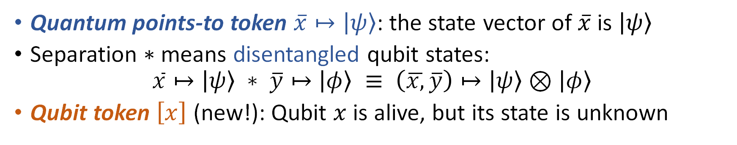
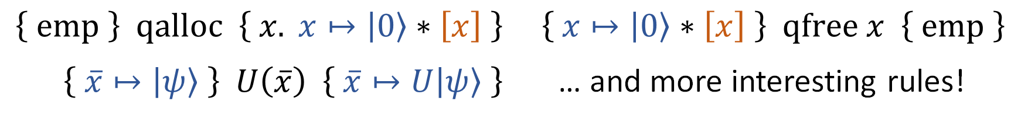

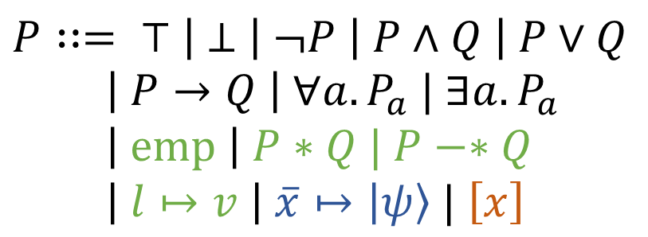
Overview of Our Logic
Invariant
$$P∷= ⊤ \left| ⊥ \right| ¬P \left| P∧Q \right| P∨Q$$
$\left| P→Q \right| ∀a. P_{a} | ∃a. P_{a}$ $\left| emp \right| P∗Q | P−∗Q$
$\left| l↦v \right| \overline{x}↦\left|ψ\right\rangle | \left[x\right]$
$$\left\{P\right\} e {\left\{v. Q_{v}\right\}}^{I}$$
$$\left\{P\right\} e \left\{v.Q_{v}\right\} ≜ \left\{P\right\} e {\left\{v.Q_{v}\right\}}^{emp}$$
(SL connectives)
$\left\{ emp \right\} qalloc \left\{ x. x↦\left|0\right\rangle ∗\left[x\right] \right\} \left\{ x↦\left|0\right\rangle ∗\left[x\right] \right\} qfree x \left\{ emp \right\}$
$\left\{ \overline{x}↦\left|ψ\right\rangle \right\} U\left(\overline{x}\right) \left\{ \overline{x}↦U\left|ψ\right\rangle \right\}$ … and more interesting rules!
Quantum points-to token $\overline{x}↦\left|ψ\right\rangle$: the state vector of$\overline{x}$ is $\left|ψ\right\rangle$
Separation $∗$means disentangled qubit states: $\overline{x}↦\left|ψ\right\rangle ∗ \overline{y}↦\left|φ\right\rangle ≡ \left(\overline{x,}\overline{y}\right)↦\left|ψ\right\rangle ⊗\left|φ\right\rangle$
Qubit token $\left[x\right]$ (new!): Qubit $x$ is alive, but its state is unknown
Notes:
Here is an overview of our logic.
First, as concurrent separation logic, the Hoare triple is equipped with the invariant, accessible at each atomic step.
The syntax of the assertions is shown on the right-hand side.
We have standard separation logic connectives with standard proof rules.
Like the classical heap points-to token, we introduce the quantum points-to token, which owns and asserts the state vector psi of qubits x. We can freely apply a quantum gate if we update the vector of the points-to token.
Separation of points-to tokens means not only disjoint ownership but also disentangled qubit states.
We also newly introduce the qubit token, which asserts that the qubit x is alive or allocated but its state vector is unknown.
We have more interesting proof rules, which I will explain soon.

Slide 26

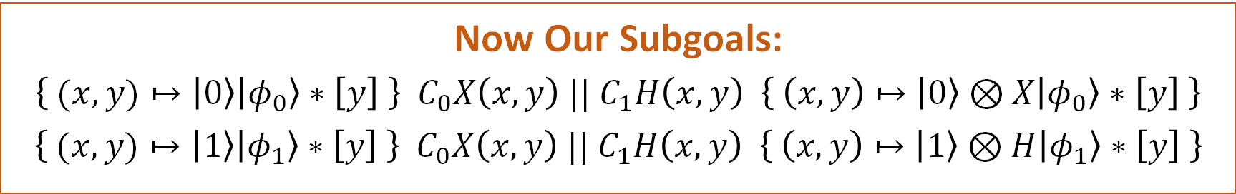
Linear Combination Rule
This idea can be formalized as linear combination of Hoare triples
With the side condition $Q,I:precise$
Precise assertions represent a unique (or no) resource
e.g., $emp, ⊥,l↦v, x↦\left|ψ\right\rangle ,l↦v∗x↦\left|ψ\right\rangle$, …
If not $I:precise$, the angelic branching on $I$ makes the rule unsound
$$\frac{\left\{ \overline{x}↦\left|ψ\right\rangle ∗P \right\} e {\left\{ \overline{x}↦\left|φ\right\rangle ∗Q \right\}}^{I} \left\{ \overline{x}↦\left|ψ′\right\rangle ∗P \right\} e {\left\{ \overline{x}↦\left|φ^{′}\right\rangle ∗Q \right\}}^{I}}{\left\{ \overline{x}↦\left(α\left|ψ\right\rangle +β\left|ψ^{′}\right\rangle \right) ∗P \right\} e {\left\{ \overline{x}↦\left(α\left|φ\right\rangle +β\left|φ^{′}\right\rangle \right) ∗Q \right\}}^{I}}$$
Now Our Subgoals:
$\left\{ (x,y)↦\left|0\right\rangle \left|φ_{0}\right\rangle ∗\left[y\right] \right\} C_{0}X\left(x,y\right) || C_{1}H\left(x,y\right) \left\{ \left(x,y\right)↦\left|0\right\rangle ⊗X\left|φ_{0}\right\rangle ∗\left[y\right] \right\}$
$\left\{ (x,y)↦\left|1\right\rangle \left|φ_{1}\right\rangle ∗\left[y\right] \right\} C_{0}X\left(x,y\right) || C_{1}H\left(x,y\right) \left\{ \left(x,y\right)↦\left|1\right\rangle ⊗H\left|φ_{1}\right\rangle ∗\left[y\right] \right\}$
Notes:
This idea can be formalized as the following rule for taking the linear combination of Hoare triples.
It decomposes the target state vector in some basis psi and psi prime, and then combines the outputs respecting the coefficients.
Technically, we have the side condition that Q and I are precise, or represent a unique or no resource.
Now using this rule, our goal boils down to the two subgoals shown below.

Slide 27
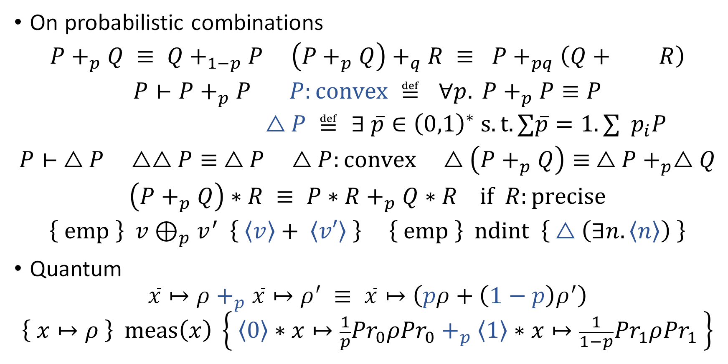
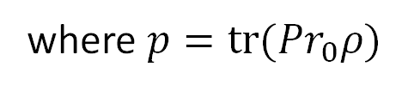



Teaser of Our Probabilistic Quantum SL
On probabilistic combinations
$$P+_{p}Q ≡ Q+_{1−p}P \left(P+_{p}Q\right)+_{q}R ≡ P+_{pq}\left(Q+ R\right)$$
$$P⊢P+_{p}P P:convex ≝ ∀p. P+_{p}P≡P$$
$$△P ≝ ∃ \overline{p}∈{\left(0,1\right)}^{∗} s.t. ∑\overline{p}=1. ∑{ p}_{i}P$$
$$P⊢ △P △△P≡ △P △P:convex △\left(P+_{p}Q\right)≡ △P+_{p}△Q$$
$$\left(P+_{p}Q\right)∗R ≡ P∗R+_{p}Q∗R if R:precise$$
$$\left\{ emp \right\} v⊕_{p}v^{′} \left\{ \left\langle v\right\rangle + \left\langle v′\right\rangle \right\} \left\{ emp \right\} ndint \left\{ △\left(∃n.\left\langle n\right\rangle \right) \right\}$$
Quantum
$$\overline{x}↦ρ+_{p}\overline{x}↦ρ^{′} ≡ \overline{x}↦\left(pρ+\left(1−p\right)ρ^{′}\right)$$
$$\left\{ x↦ρ \right\} meas\left(x\right) \left\{ \left\langle 0\right\rangle ∗x↦\frac{1}{p}{Pr}_{0}ρ{Pr}_{0}+_{p}\left\langle 1\right\rangle ∗x↦\frac{1}{1−p}{Pr}_{1}ρ{Pr}_{1} \right\}$$
$$\frac{\left(1−p\right)q}{1−pq}$$
Convex hull modality
$$i$$
$$p$$
where $p=tr({Pr}_{0}ρ)$
Notes:
Here is the teaser of our probabilistic quantum separation logic.
Unlike demonic outcome logic, we introduce the concept of convex assertions with the convex hull modality, related to the idempotence of the probabilistic combination.
Also, we manage return values as resources in separation logic to model probabilistically varying return values.
On the quantum side, we make the points-to token assert a density matrix instead of a vector, following the probabilistic combination, and naturally support measurement.

Slide 28
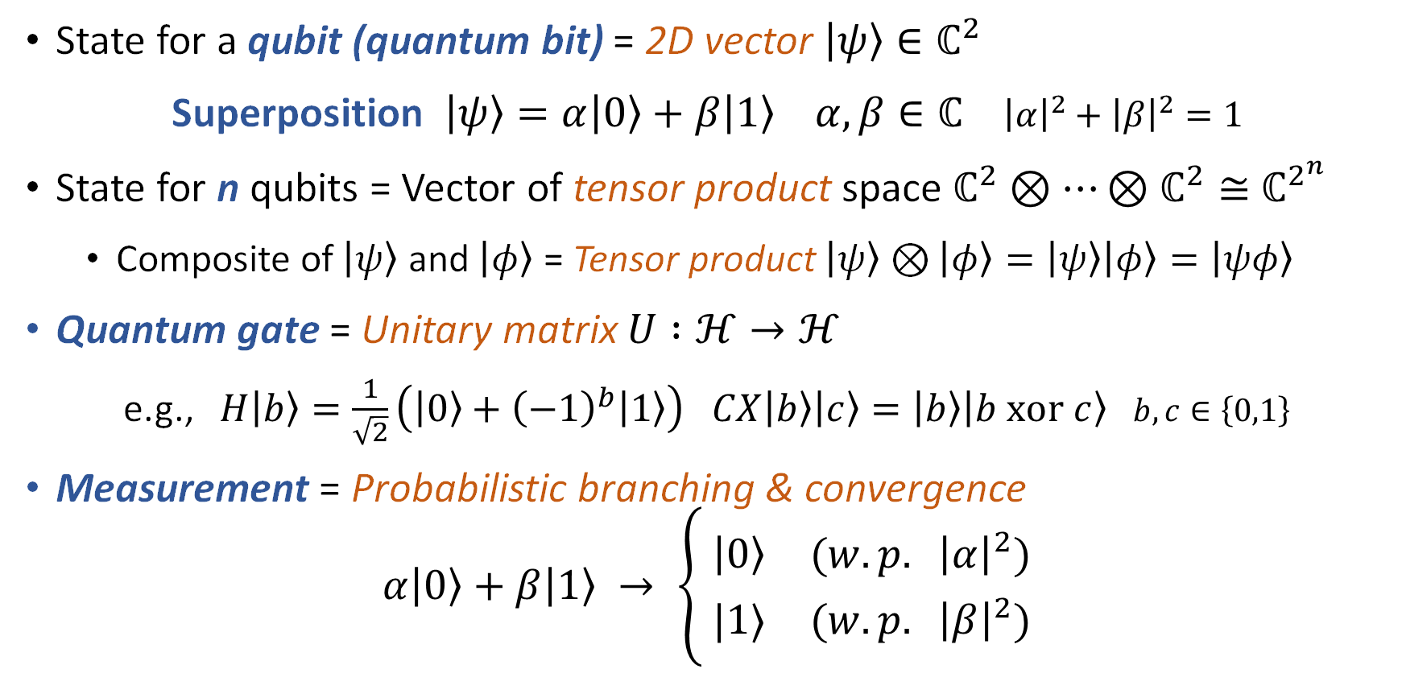
Basics of Quantum Computing
State for a qubit (quantum bit) = 2D vector $\left|ψ\right\rangle ∈ℂ^{2}$
Superposition $\left|ψ\right\rangle =α\left|0\right\rangle +β\left|1\right\rangle α,β∈ℂ$ ${\left|α\right|}^{2}+{\left|β\right|}^{2}=1$
State for n qubits = Vector of tensor product space $ℂ^{2}⊗⋯⊗ℂ^{2}≅{ ℂ}^{2^{n}}$
Composite of $\left|ψ\right\rangle$ and $\left|φ\right\rangle$ = Tensor product $\left|ψ\right\rangle ⊗\left|φ\right\rangle =\left|ψ\right\rangle \left|φ\right\rangle =\left|ψφ\right\rangle$
Quantum gate = Unitary matrix $U :ℋ→ℋ$
e.g., $H\left|b\right\rangle =\frac{1}{\sqrt{2}}\left(\left|0\right\rangle +{\left(−1\right)}^{b}\left|1\right\rangle \right)$ $CX\left|b\right\rangle \left|c\right\rangle =\left|b\right\rangle \left|b xor c\right\rangle$ $b,c∈\left\{0,1\right\}$
Measurement = Probabilistic branching & convergence
$$α\left|0\right\rangle +β\left|1\right\rangle → \left\{\begin{aligned} \left|0\right\rangle (w.p. {\left|α\right|}^{2}) \\ |1⟩ (w.p. {\left|β\right|}^{2})\end{aligned}\right.$$
Hadamard
Controlled X
Notes:
The basic building block of quantum computing is a qubit, or a quantum bit.
While a classical bit can only be either 0 or 1, a qubit can be an arbitrary superposition of them, which is technically a linear combination.
For multiple qubits, we technically consider the tensor product, which accommodates superposition of exponentially many classical states.
Please keep in mind the notation for the tensor product, or composite state, with some shorthand.
The gates applied to qubits are restricted to unitary matrices.
For example, the Hadamard gate generates a superposition like this. Also, the controlled X gate operates on multiple qubits.
The result of quantum computing can be obtained by measurement, which lets a quantum superposition converge to a classical state with a probability determined by coefficients.

Slide 29
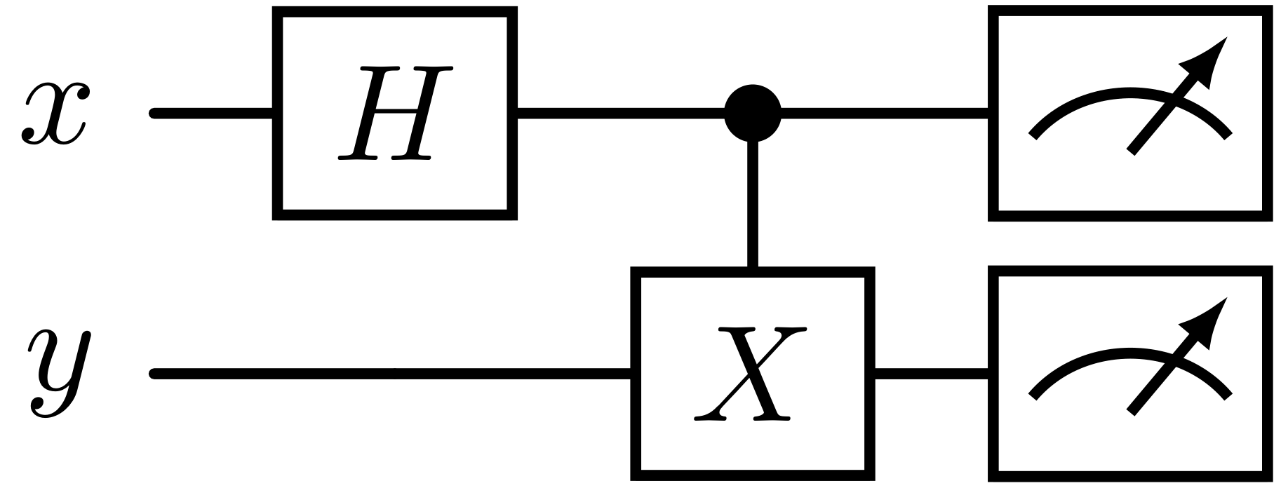

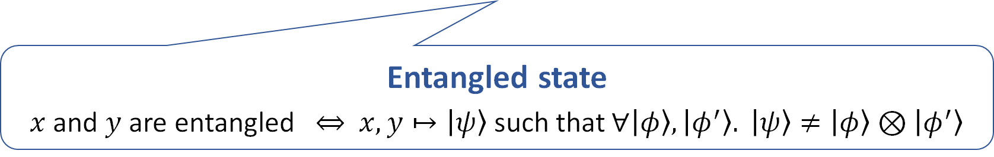
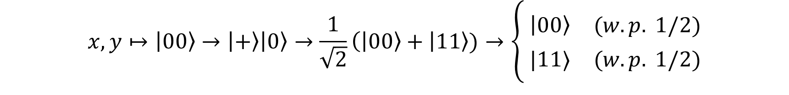
Quantum Program (Circuit)
Gate applications
Measurements
qubits
Stochastic dependence
$$x,y↦\left|00\right\rangle →\left|+\right\rangle \left|0\right\rangle →\frac{1}{\sqrt{2}}\left(\left|00\right\rangle + | 11\right\rangle )→\left\{\begin{aligned} \left|00\right\rangle (w.p. 1/2) \\ |11⟩ (w.p. 1/2)\end{aligned}\right.$$
$$\left|±\right\rangle ≝\frac{1}{\sqrt{2}}\left(\left|0\right\rangle ±\left|1\right\rangle \right)$$
Entangled state
$x$ and $y$ are entangled $⇔$ $x,y↦\left|ψ\right\rangle$ such that $∀\left|φ\right\rangle ,\left|φ^{′}\right\rangle . \left|ψ\right\rangle ≠\left|φ\right\rangle ⊗\left|φ^{′}\right\rangle$
Notes:
Here is an example of a quantum program, or circuit.
It applies the Hadamard gate to x, followed by the X gate on y controlled by x, and finally measures both qubits.
Starting with 00, after applying the two gates, we get a superposition of 00 and 11. By measuring it, we probabilistically get either 00 or 11, which makes the outputs of x and y stochastically dependent.
This is a typical example of an interesting phenomenon called quantum entanglement. Mathematically, an entangled state cannot be simply expressed as a tensor product.
(~2min)

Slide 30
References
Zhou, Li, Gilles Barthe, Justin Hsu, Mingsheng Ying, and Nengkun Yu. “A Quantum Interpretation of Bunched Logic for Quantum Separation Logic.” arXiv:2102.00329 [Quant-Ph], January 30, 2021. http://arxiv.org/abs/2102.00329.
Le, Xuan-Bach, Shang-Wei Lin, Jun Sun, and David Sanan. “A Quantum Interpretation of Separating Conjunction for Local Reasoning of Quantum Programs Based on Separation Logic.” Proceedings of the ACM on Programming Languages 6, no. POPL (11 2022): 36:1-36:27. https://doi.org/10.1145/3498697.
Su, Bonan, Li Zhou, Yuan Feng, and Mingsheng Ying. “BI-Based Reasoning about Quantum Programs with Heap Manipulations.” arXiv, September 16, 2024. https://doi.org/10.48550/arXiv.2409.10153.
Zilberstein, Noam, Angelina Saliling, and Alexandra Silva. “Outcome Separation Logic: Local Reasoning for Correctness and Incorrectness with Computational Effects.” Proc. ACM Program. Lang. 8, no. OOPSLA1 (29 2024): 104:276-104:304. https://doi.org/10.1145/3649821.
Svyatlovskiy, Mikhail, Shai Mermelstein, and Ori Lahav. “Compositional Semantics for Shared-Variable Concurrency.” Coq Mechanization for “Compositional Semantics for Shared-Variable Concurrency” (PLDI 2024) 8, no. PLDI (20 2024): 169:543-169:566. https://doi.org/10.1145/3656399.
Brookes, Stephen. “Full Abstraction for a Shared-Variable Parallel Language.” Information and Computation 127, no. 2 (June 15, 1996): 145–63. https://doi.org/10.1006/inco.1996.0056.
Ying, Mingsheng, Li Zhou, Yangjia Li, and Yuan Feng. “A Proof System for Disjoint Parallel Quantum Programs.” Theoretical Computer Science 897 (January 2, 2022): 164–84. https://doi.org/10.1016/j.tcs.2021.10.025.

