Slide 1
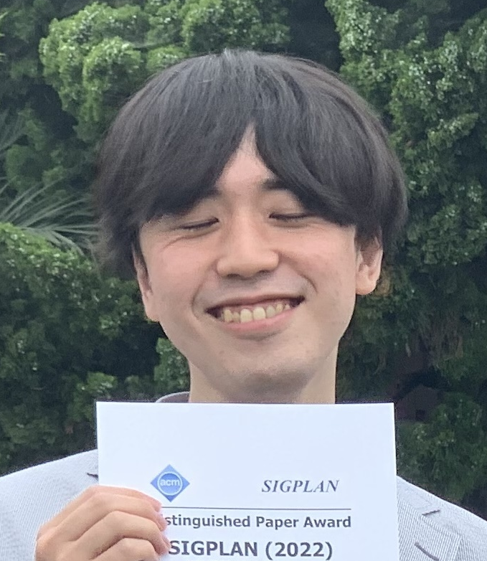
Pure Borrow: Linear Haskell Meets Rust-Style Borrowing
15th
Yusuke Matsushita (Kyoto University) Hiromi Ishii (JIJ Inc.)
Published at ACM PLDI 2026
Big picture
Humans
Computer
Functional languages
Ideal
Imperative languages
Same results regardless of
when & where computed
Purity
Mutation
Crucial for
performance
λ-calculus Church 1936
Haskell ’90
Pure Borrow
Rust 2015
C ’72
Linear Haskell Spiwack+ ’18
Ownership & borrowing
controls mutation
Our work
Rust-style borrowing in
Linear Haskell with purity!
Rust-style
borrowing
Lender
Lifetime
Owner
Borrow
Borrower
No direct
communication of ownership
Mutation
Mutation
Our Pure Borrow API
Monad = Computation
possible only during lifetime
cf. ST monad Launchbury+ ’94
cf. traditionally
Direct ownership threading
Case study
Parallel in-place quicksort
Performance
improved!
+ Advanced parallelism by work stealing
Metatheory
Design denotational operational semantics, which is pure
Conjecture (WIP): It matches standard operational semantics under well-typedness
Standard
Denotational
History of mutations is recorded
to locally model lender reclaim

