Slide 1
NST DVA · CAPSTONE 2 · SECTION-A · TEAM G12
DeliverIQ
Severity Reality Check
Disentangling true accident severity from congestion,
time-of-day, and location bias
ANALYZING 95K US ROAD ACCIDENTS · 2016–2023
Newton School of Technology
GitHub: github.com/shiavm006/Section-A_G12_DeliverIQ
Team: Shivam · Satyam · Keshav · Mohit · Prachee · Rishita
Tableau: public.tableau.com/.../RoadAccidentDataofUSA
Mentor: <fill> · Submission: April 29, 2026
Project Lead: Shivam Mittal

Slide 2
02 · CONTEXT
Public severity data is widely used —
but it measures the wrong thing.
WHAT'S WRONG
OUR CORE BUSINESS QUESTION
■ The most common severity field measures traffic-flow impact (short delay → long delay), not crash physical severity.
■ A fender-bender at rush hour can register Severity 4. A fatal crash on a quiet road can register Severity 1.
■ Insurers, DOTs, and logistics planners use this field directly in pricing models, capital plans, and routing — silently absorbing the bias.
How much of what is labeled "severe" in public US accident data is genuinely severe — and how should insurers, DOTs, and logistics planners adjust their decisions to use a bias-corrected signal?
→ Decision: down-weight raw severity in pricing,
capital allocation, and corridor routing.
DeliverIQ · Severity Reality Check · NST DVA Capstone 2 · Section-A · G12
2 / 11

Slide 3
03 · DATA ENGINEERING
From 7.7M raw rows to a 95K balanced sample
ORIGINAL ROWS
WORKING SAMPLE
COLUMNS
STATES COVERED
7.7M
95,607
49
49
raw Kaggle dataset
balanced across Sev 1–4
incl. 13 derived features
5,558 cities
CLEANING PIPELINE (notebooks/02_cleaning.ipynb)
KEY DERIVED FEATURES
■ Drop high-null + zero-variance columns (End_Lat/Lng, Country, Turning_Loop)
■ Validate geographic bounds (lat 24–50, lng −125 to −66)
■ Cap Distance_mi outliers at 99th percentile
■ Context-aware imputation (median by State + Month + Hour)
■ Cast booleans to int for Tableau
■ Severity_Label · Weather_Category · State_Region
■ Time_of_Day · Season · Is_Rush_Hour · Is_Weekend
■ Duration_min · Road_Feature_Count
■ Is True Severe = Sev=4 AND Distance ≥ 0.5 mi
DeliverIQ · Severity Reality Check · NST DVA Capstone 2 · Section-A · G12
3 / 11

Slide 4
04 · KPI FRAMEWORK
15 decision-relevant KPIs across 3 dashboards
D1 — Severity Reality Check
D2 — When Risk Strikes
D3 — Where & Why
the hook
the diagnosis
the cause
■ Total Incidents (95,607)
■ Critical Accidents (18,023)
■ True Severe Accidents (9,155)
■ Avg Duration Severe (1,829 m)
■ Severe Distance (24,415 mi)
■ Worst Season (Winter)
■ Peak Risk Hour (12 AM)
■ Weekend vs Weekday Δ (+0.34)
■ Night Sev 3+ Share (8.42%)
■ Riskiest Weather (Drifting Snow)
■ Top State by Volume (CA · 8,780)
■ Top State by Severity (WV)
■ Junction Severity (+28.8%)
■ Signal Drop (−62.1%)
■ Cities Tracked (5,558)
DeliverIQ · Severity Reality Check · NST DVA Capstone 2 · Section-A · G12
4 / 11

Slide 5
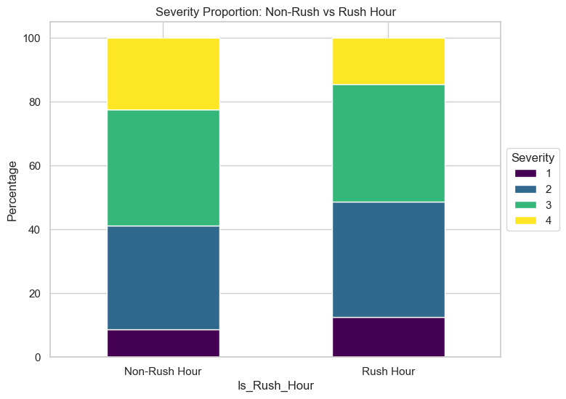
05 · KEY EDA INSIGHTS
Five observations that reframe the data
■ Severity-2 dominance dropped after balanced sampling — every tier now has enough N for cross-tier comparison.
■ Volume peaks at 5 PM rush hour — but per-accident severity is barely different between rush and non-rush.
■ Weekday volume rises Tue–Wed, falls weekend. Severity does not follow the same curve.
■ Top-volume state: CA (8,780). Top-severity state: WV — geography differs once bias is corrected.
■ Most accidents happen in fair weather. Severe accidents are no exception.
Severity proportions: Rush Hour vs Non-Rush — barely shift
DeliverIQ · Severity Reality Check · NST DVA Capstone 2 · Section-A · G12
5 / 11

Slide 6
06 · ADVANCED ANALYSIS
Statistical tests aligned with the bias hypothesis
Test 1 — Congestion Bias
Test 2 — Duration × Severity
Method: Chi-square (Rush Hour × Severity)
Method: Kruskal-Wallis H (non-parametric)
Significant by N, but proportions barely shift. Rush-hour volume is NOT the dominant severity driver.
Median duration rises monotonically: Sev 1 ≈ 30 min → Sev 4 ≈ 210 min. Validates True-Severe definition.
Test 3 — Weather × Severity
Test 4 — Location Bias
Method: Chi-square (top 5 weather × Sev)
Method: State × Severity cross-tab
Statistically significant but small effect size. Weather is NOT the primary driver of severity.
WV, PA, MD, NC over-represented in Sev 3+4. Reporting bias is real and must be corrected.
Net finding: Severity in this dataset is partly real, partly noise. The True-Severe filter (Sev 4 + Dist ≥ 0.5 mi) cleanly separates them.
DeliverIQ · Severity Reality Check · NST DVA Capstone 2 · Section-A · G12
6 / 11

Slide 7
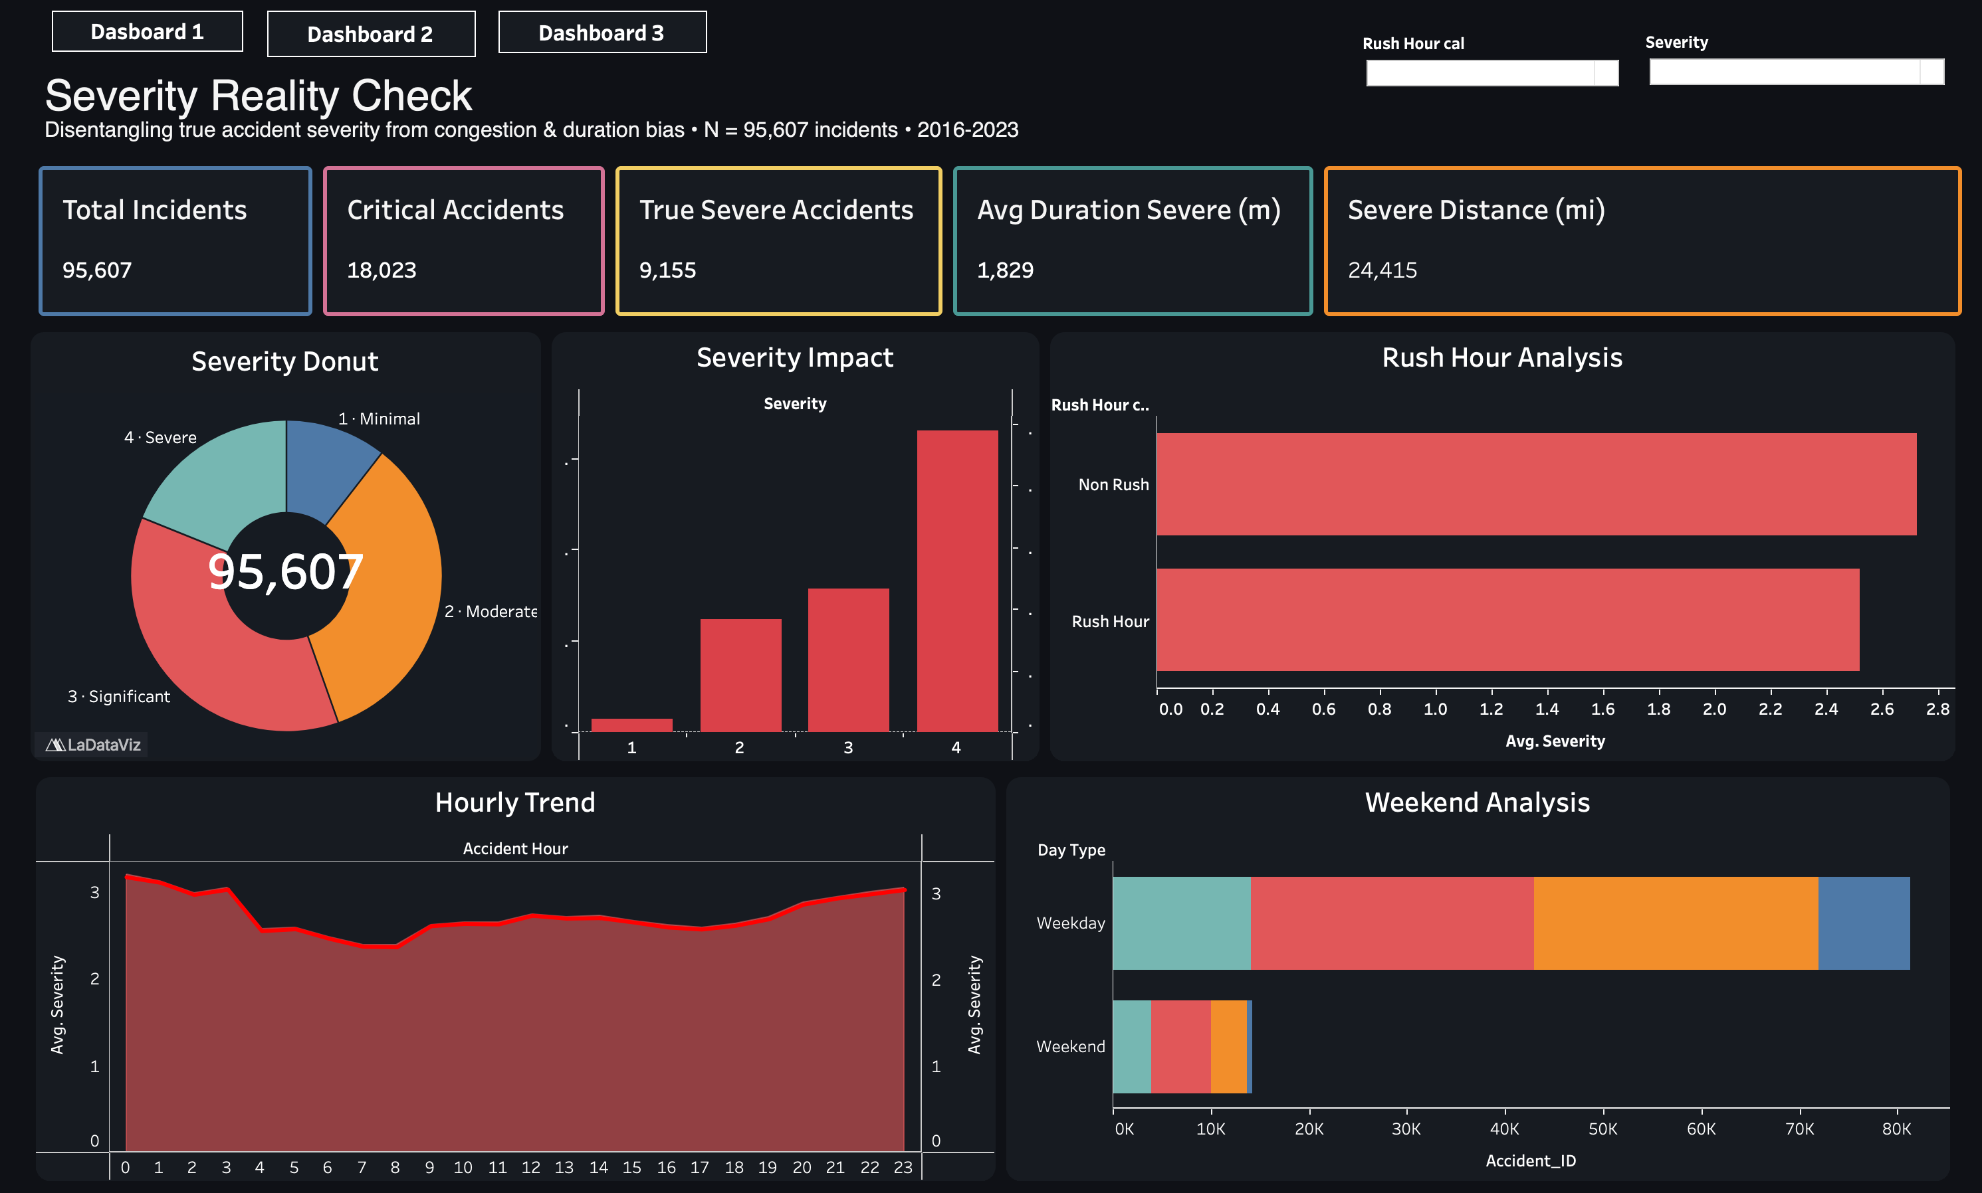
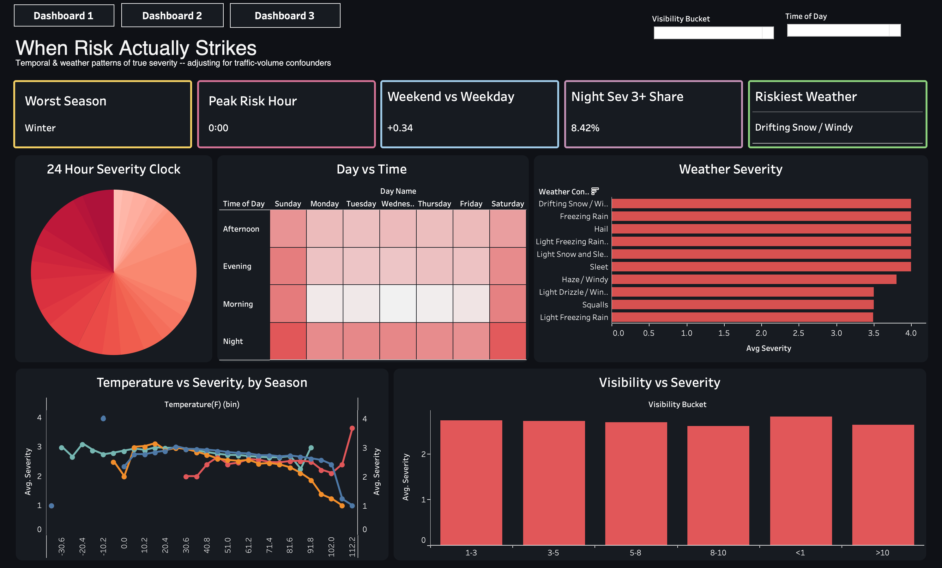
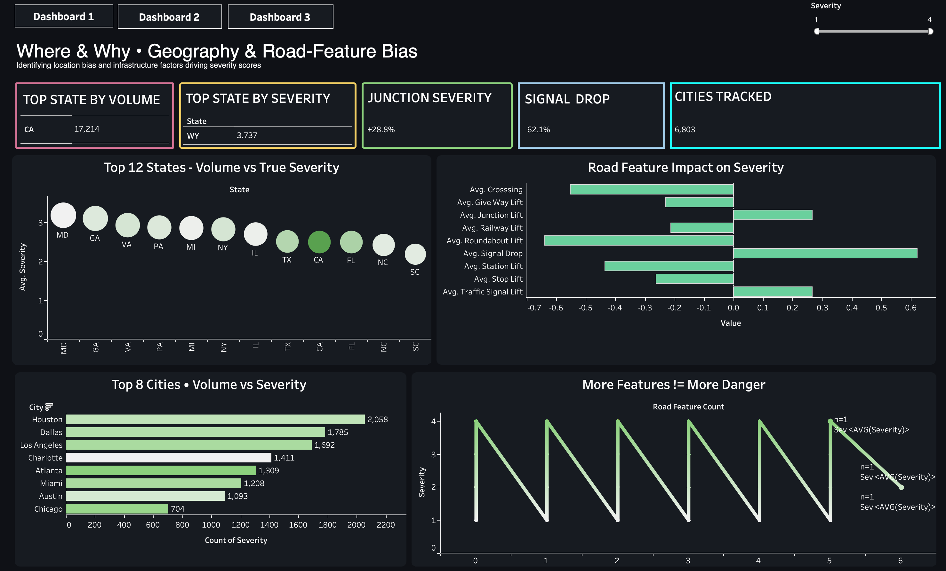
07 · TABLEAU DASHBOARDS
Three dashboards: What → When → Where & Why
D1
Severity Reality Check
D2
When Risk Strikes
D3
Where & Why
True Severe = 9,155 of 18,023 (~51%)
Peak Risk Hour: 12 AM · Worst Season: Winter
Junction +28.8% · Signal −62.1% · Top: WV
Half of "severe" is congestion noise.
Risk peaks at midnight, not rush hour.
Infrastructure has measurable lifts.
THE HOOK
THE DIAGNOSIS
THE CAUSE
Interactive filters: Rush Hour · Severity · Visibility Bucket · Time of Day (across 30+ worksheets)
DeliverIQ · Severity Reality Check · NST DVA Capstone 2 · Section-A · G12
7 / 11

Slide 8
08 · RECOMMENDATIONS
Five actions, each tied to an insight
#
STAKEHOLDER
RECOMMENDATION
EXPECTED IMPACT
1
Insurer
Discount publicly-reported Severity 4 by ~50%; switch to True-Severe-based pricing.
Mis-priced urban-policy margin recovered.
2
State DOT
Prioritize signal installations at top junction hotspots (D3).
~62% severity reduction at signal-equipped sites; per-installation ROI.
3
Logistics fleet
Re-rank corridors by True-Severe Index; shift dispatch off PA/WV winter night windows.
Lower expected claim frequency / severity per million miles.
4
Federal grants
Reweight per-state safety allocation using True-Severe counts, not raw volume.
Capital tracks real severity, not reporting frequency.
5
Ride-share / Fleet
Adjust state-level driver pay & rest-cycle by True-Severe density.
Driver-safety alignment with actual risk; lower carrier liability.
DeliverIQ · Severity Reality Check · NST DVA Capstone 2 · Section-A · G12
8 / 11

Slide 9
09 · IMPACT & VALUE
Why this work pays off — directional estimates
INSURER · REC #1
STATE DOT · REC #2
FLEETS · REC #3
~50%
−62%
5–10%
of Severity-4 in pricing models is over-weighted; bias-correction unlocks ~$100M risk-adj premium reallocation per $10B book.
severity drop at locations with traffic signals vs. without — quantifies per-installation infrastructure ROI.
expected reduction in severe-corridor exposure when routing on True-Severe Index instead of raw volume.
WHY ACT NOW
■ Real-time accident APIs increasingly feed pricing engines — bias compounds quickly.
■ Post-COVID vehicle-miles-traveled have rebounded; more decisions flow through the same biased input.
■ Signal Drop is one of the most cost-effective infrastructure levers — and the data quantifies it.
DeliverIQ · Severity Reality Check · NST DVA Capstone 2 · Section-A · G12
9 / 11

Slide 10
10 · LIMITATIONS & NEXT STEPS
Honesty about what this analysis can and cannot say
LIMITATIONS
NEXT STEPS
■ Severity is a flow-impact label, not a crash-injury label — True Severe is a proxy.
■ 0.5-mi threshold is defensible but not absolute; sensitivity tested at 0.25 and 1.0 mi.
■ All findings are correlational, not causal.
■ API coverage varies by state; 2020+ volume spike is partly artefact.
■ No injury / fatality outcomes available in this dataset.
■ Balanced sample changes base rates — most KPIs use ratios to control.
■ Join FARS / state crash records to validate True-Severe against real injury data.
■ Add quasi-experimental causal layer for Signal Drop estimate.
■ Wrap corrected severity index as a real-time API for fleets and insurers.
■ Train a gradient-boosted classifier on incoming reports (predict True Severe).
■ Geospatial drill-down map (Mapbox / Leaflet) for DOT use.
■ Attach cost-benefit modelling using FHWA retrofit cost data.
DeliverIQ · Severity Reality Check · NST DVA Capstone 2 · Section-A · G12
10 / 11

Slide 11
11 · TEAM & ARTEFACTS
Team G12 · Section A · DeliverIQ
TEAM ROLES
Project Lead
Data Lead
ETL Lead
Shivam Mittal
Satyam Kumar
Keshav
Analysis Lead
Visualization Lead
Strategy + PPT Lead
Mohit Singh
Prachee Dhar
Rishita Boisnobi
ARTEFACTS · GitHub + Tableau + Reports
▸ GitHub Repo:
github.com/shiavm006/Section-A_G12_DeliverIQ
▸ Tableau Public:
public.tableau.com/views/RoadAccidentDataofUSA_17773613139680/Dashboard1
▸ Project Report:
reports/project_report.pdf (18 sections, ~22 pages)
▸ This Deck:
reports/presentation.pdf (11 slides)
Submitted Apr 29, 2026 · Newton School of Technology · DVA Capstone 2

