Slide 1
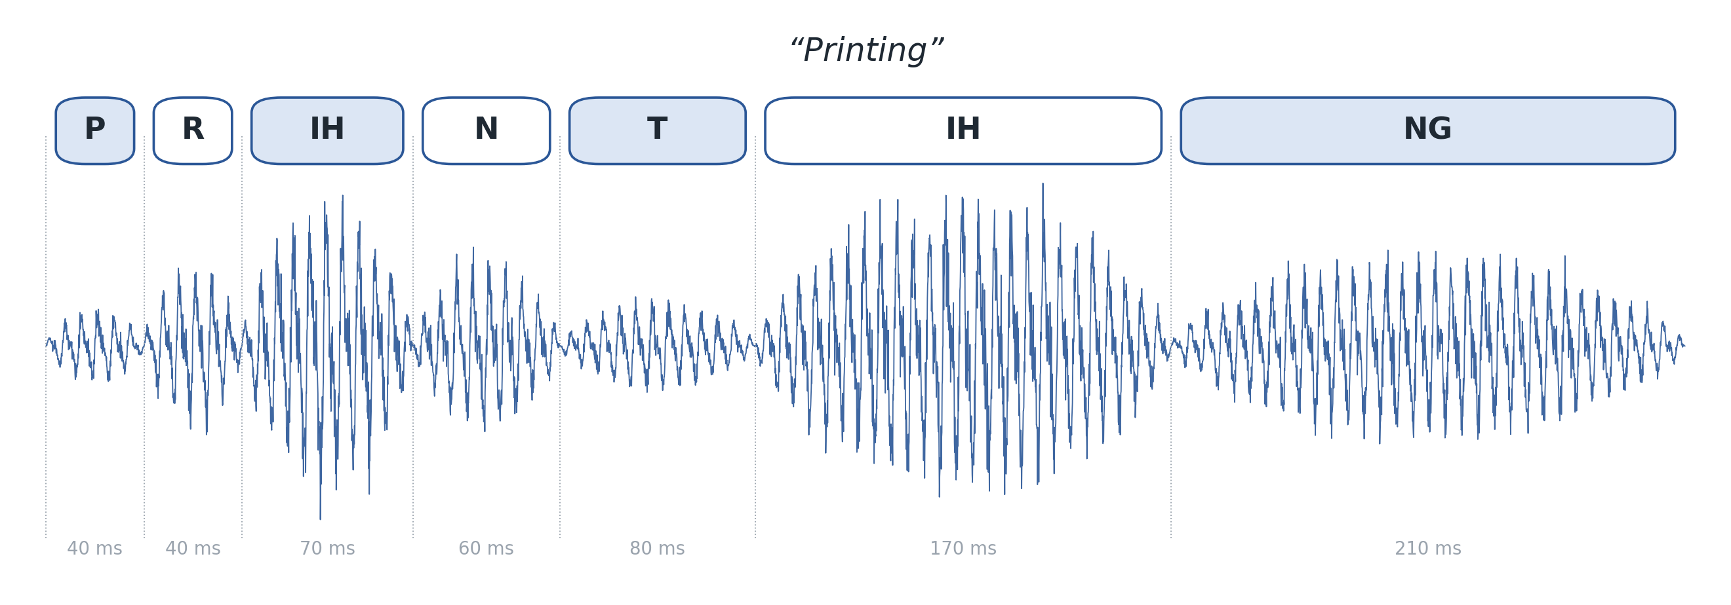
ADVANCED MACHINE LEARNING & DEEP LEARNING
Phonetic Guided Speech Generation
Explicit phoneme alignment and learned acoustic generation for text-to-speech
Shivam Mittal · Khushi Batra · Divya Singh · Sanath Waraikar · Aryan
Newton School of Technology, Rishihood University · github.com/shiavm006/phonetic-guided-tts
Notes:
Presenter: Shivam Mittal
Our project asks how much of good synthetic speech comes from knowing the timing of each sound, and how much needs a learned model of the sound itself. The image is real forced-alignment output for the word 'Printing': every phoneme with its exact duration.

Slide 2
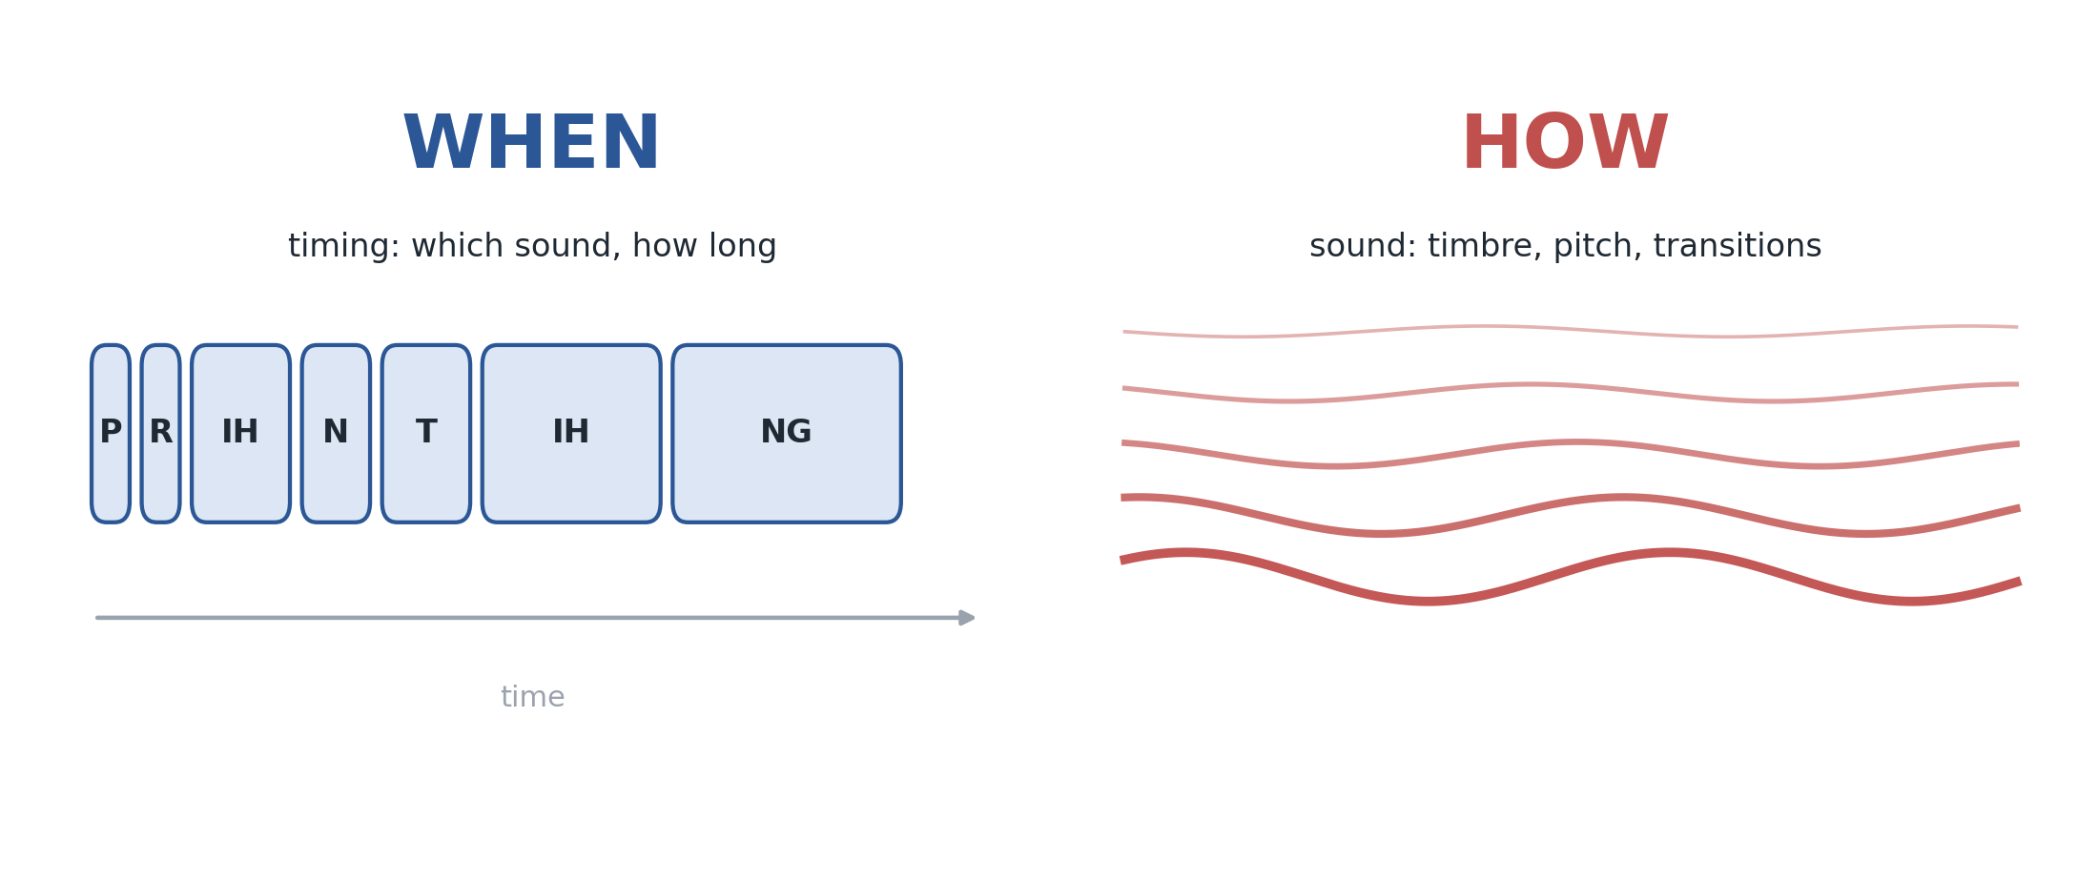
Speech has two parts: when, and how
01 MOTIVATION & HYPOTHESES
H1
Explicit timing alone cannot give intelligible speech; a learned acoustic model is needed.
H2
Explicit duration and pause models improve a neural decoder over its own timing.
If the timing is known exactly, how much of speech comes for free?
H3
Fine-tuning the decoder on our alignments helps it render raw alignment timing.
Scope: diffusion, optional in the brief, is left as a motivated extension (see slide 12).
Notes:
Presenter: Shivam Mittal
Speech synthesis has two parts: deciding when each sound happens and how long it lasts, and deciding what it sounds like. We separate them and test three hypotheses. H1 is the gap described in the brief. H2 asks whether classical explicit timing still adds value to a neural model. H3 we formed during the project after raw alignment timing hurt the decoder.

Slide 3
Where this work sits
02 RELATED WORK
Forced alignment
Neural TTS
Generation
Evaluation
HMM-GMM aligners place phoneme boundaries: Montreal Forced Aligner [1]; statistical parametric TTS [2]
Implicit alignment by attention: Tacotron 2 [3]. Explicit durations: FastSpeech 2 [4]
Neural vocoder HiFi-GAN [5]; diffusion decoder Grad-TTS [6] against over-smoothing
Held-out ASR for intelligibility: Whisper [7]; learned MOS predictor: UTMOS [8]
Our angle: hold one part fixed, change the other, on a leak-free test set.
[1] McAuliffe 2017 · [2] Zen 2009 · [3] Shen 2018 · [4] Ren 2021 · [5] Kong 2020 · [6] Popov 2021 · [7] Radford 2023 · [8] Saeki 2022. Full references in the report.
Notes:
Presenter: Khushi Batra
Forced alignment comes from the HMM tradition, which modelled duration explicitly. Neural TTS either learns alignment implicitly, like Tacotron 2, or predicts durations inside the network, like FastSpeech 2. Grad-TTS uses diffusion to fight over-smoothing, which becomes relevant later. Our contribution is a controlled comparison: change exactly one part at a time.

Slide 4
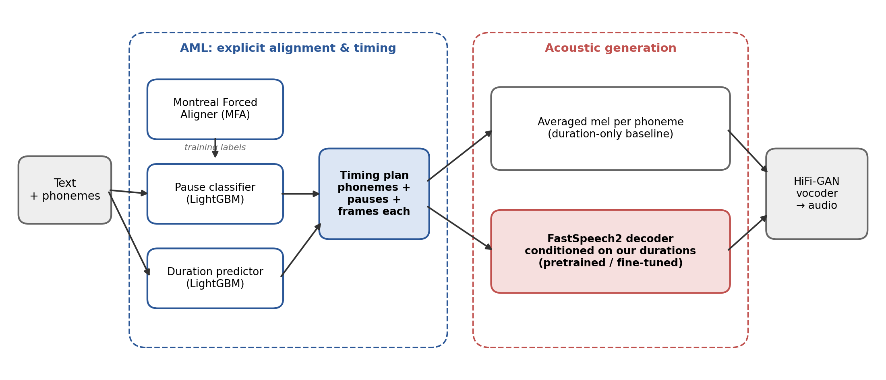
Classical timing, neural sound
03 APPROACH & DATA
LJSpeech 1.1 · 13,100 clips, 23.9 h, one speaker · MFA alignment, 0 failures · 80-band mels · 11,790 / 1,310 split by sentence
Notes:
Presenter: Divya Singh
Two classical models predict a timing plan: where pauses go and how long each phoneme lasts; the aligner only provides training labels. The plan is rendered either by averaged sounds or by a pretrained FastSpeech2 decoder driven by our own durations, with the same vocoder for all. Data: LJSpeech, one speaker, about 24 hours; every clip aligned, split by sentence.

Slide 5
Two classical models predict the timing
04 AML MODELS
DURATION
PAUSES
18.3 ms
64.2%
mean error per speech sound
F1 for pause placement
MAE | SPEECH | PAUSES
Per-phoneme mean | 28.8 ms | 145.6 ms
LightGBM | 18.3 ms | 112.9 ms
PAUSES | RECALL | F1
Punctuation rule | 51.5% | 58.7%
LightGBM | 60.6% | 64.2%
Only 56% of pauses longer than 200 ms follow punctuation: readers also pause mid-phrase.
Notes:
Presenter: Divya Singh
Duration: each phoneme is one example; LightGBM uses the phoneme, its neighbours, stress, position and whether a pause follows, and cuts error by a third versus a per-phoneme average. Pauses: for every word gap we predict pause or no pause from text only; the classifier finds nine points more real pauses than the punctuation rule at the same 68% precision.

Slide 6
Two ways to turn timing into sound
05 RENDERING
Averaged sounds
Neural decoder
BASELINE (AML ONLY)
HYBRID (AML + DL)
Each phoneme becomes its mean spectrogram frame over the training set, repeated for its predicted duration.
Pretrained FastSpeech2: phonemes are encoded, expanded by our durations, then decoded. Output length equals the sum of our durations exactly.
Input format matters: pauses use the model's spn token and there is no word separator. A space token silently became <unk> and inflated WER from 6.9% to 20.8% on our initial test set.
Notes:
Presenter: Sanath Waraikar
The baseline is deliberately simple: one averaged frame per phoneme. The hybrid bypasses FastSpeech2's own duration predictor and expands the encoded phonemes by our durations. One lesson: the model's vocabulary has no space token; we initially followed its documentation and fed spaces, which silently became unknown tokens and badly degraded output. Our code now rejects unknown tokens.

Slide 7
A controlled, leak-free comparison
06 EVALUATION
1,327
1,310
100
∩
→
held out by SpeechBrain
in our test split
evaluation sentences
SYSTEM | PAUSES | DURATIONS | SOUND
Baseline | MFA / MFA / predicted | MFA / LightGBM / LightGBM | averaged sounds
Hybrid (ours) | MFA / MFA / predicted | MFA / LightGBM / LightGBM | FastSpeech2 decoder
FastSpeech2 | predicted | its own | FastSpeech2 decoder
Ceiling | real | real | real mel → vocoder
Metrics: WER (Whisper), UTMOS naturalness, duration MAE, 95% paired bootstrap CIs, blind A/B test. Fine-tuned variants of every neural system.
Notes:
Presenter: Aryan
The pretrained models were trained on SpeechBrain's own split; we re-ran their split script with the same seed and tested only on sentences held out from their training and ours. Each system changes one thing: baseline and hybrid share timing, hybrid and FastSpeech2 share the decoder and pauses. Text-only variants use no information from the test recording.

Slide 8
Same timing. Different sound.
07 MAIN RESULT
H1 · SUPPORTED
Word error rate, lower is better. Ours and the baseline share identical text-only timing; paired difference −37.9 to −29.4 points.
Notes:
Presenter: Aryan
With identical text-only timing, the averaged-sound baseline gets more than a third of words wrong; the neural decoder driven by our timing gets 3.1 percent, close to real recordings at 2.0. The confidence interval of the difference is nowhere near zero. H1 is supported: learned acoustics are essential.

Slide 9
Intelligibility, naturalness and listeners
08 RESULTS
TEXT-ONLY TIMING | WER [95% CI] | UTMOS
Recording | 2.0% [1.2, 3.0] | 4.37
Ceiling: real mel | 2.2% [1.4, 3.0] | 4.08
Hybrid (ours) | 3.1% [2.0, 4.3] | 3.70
FastSpeech2, own durations | 5.3% [3.8, 7.1] | 3.74
Hybrid, fine-tuned | 3.6% [2.5, 5.0] | 3.27
FastSpeech2, fine-tuned | 5.5% [4.0, 7.4] | 3.28
Baseline | 36.6% [32.3, 41.1] | 1.24
BLIND A/B TEST
67 / 70
judgements preferred the neural system; baseline never
Clarity 4.1 vs 1.7 out of 5, 7 listeners
Hybrid vs FastSpeech2 naturalness: −0.03 [−0.09, +0.03], not significant. A/B test ran on an earlier neural version: a conservative estimate.
Notes:
Presenter: Aryan
Our hybrid is the most intelligible synthetic system and statistically as natural as FastSpeech2. The vocoder costs naturalness but not intelligibility. In the blind listening test the baseline was never preferred; that test used an earlier, weaker neural system, so it is conservative. Main failure cases are rare proper nouns such as 'Walsall in Staffordshire'.

Slide 10
Explicit timing improves the neural model
09 KEY FINDING
H2 · SUPPORTED
5.3%
3.1%
WER, model's own durations
WER, our durations
SAME PHONEMES, PAUSES AND DECODER | OURS | FASTSPEECH2 | PAIRED DIFFERENCE
WER | 3.1% | 5.3% | −3.6 to −0.9 pts
UTMOS | 3.70 | 3.74 | n.s.
Duration MAE | 17.8 ms | 23.2 ms | –
Notes:
Presenter: Divya Singh
Here the decoder, the phonemes and the pause positions are identical; only the source of the durations changes. Our explicit duration model lowers word error from 5.3 to 3.1 percent, a significant gain, with no loss of naturalness. Our predictor is also more accurate, partly because it is trained on the same kind of alignments it is measured against.

Slide 11
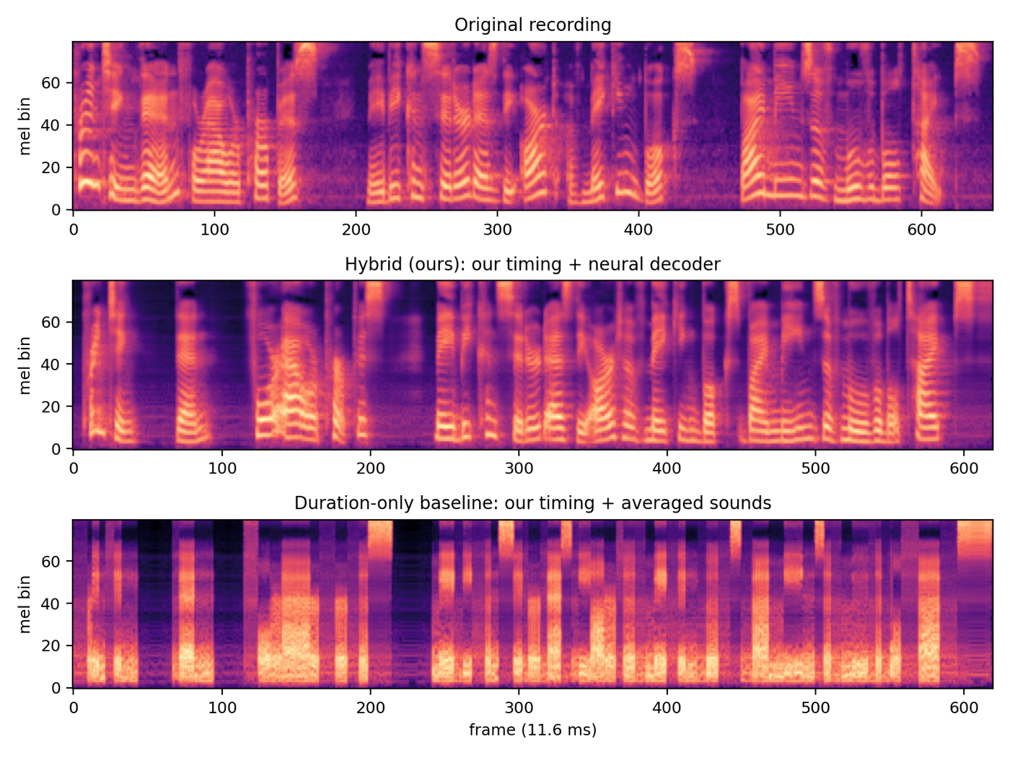
Timing without timbre
10 ANALYSIS
The recording and our system show curved stripes: pitch harmonics and smooth transitions.
The baseline is flat blocks. Averaging a sound across many pitches erases its harmonics.
Rhythm survives. Voice does not.
Notes:
Presenter: Sanath Waraikar
The recording and our system show harmonics of a moving pitch and smooth transitions. The baseline has the same rhythm but consists of flat blocks: averaging one vowel across thousands of recordings at different pitches cancels the harmonics. This is the brief's gap made visible: timing without timbre, coarticulation or prosody.

Slide 12
Lower loss, less natural speech
11 FINE-TUNING
H3 · SUPPORTED, WITH A COST
METRIC | PRETRAINED | FINE-TUNED | CHANGE
Dev mel L1 | 0.754 | 0.617 | −18%
WER, raw MFA timing | 4.2% | 2.8% | −2.5 to −0.6 pts
WER, text-only hybrid | 3.1% | 3.6% | +0.1 to +1.2 pts
UTMOS, text-only hybrid | 3.70 | 3.27 | −0.48 to −0.38
Minimising average error pulls output towards an average spectrogram: over-smoothing.
Setup: decoder, output layer and postnet trained (22.5M of 43.3M params) on our split with our MFA durations; L1 loss, AdamW 5e-5, 6 epochs on a T4. Raw MFA timing has 15× more ultra-short phonemes.
Notes:
Presenter: Sanath Waraikar
We noticed raw alignment timing hurt the pretrained decoder and traced it to ultra-short phonemes. Fine-tuning on our alignments fixed exactly that, confirming H3. But naturalness fell by 0.43 for every system, and the text-only WER rose slightly. Lower loss does not mean better audio. Our final system therefore keeps the pretrained decoder; diffusion decoders such as Grad-TTS target this over-smoothing.

Slide 13
Alignment decides when.
Acoustics decide how.
H1
Learned acoustics are essential: 36.6% → 3.1% WER with the same timing
H2
Explicit timing improves the neural model: 5.3% → 3.1% WER, equal naturalness
H3
Fine-tuning fixes raw timing but over-smooths the voice
Next: a diffusion decoder (Grad-TTS) driven by our durations, to close the naturalness gap left by over-smoothing.
github.com/shiavm006/phonetic-guided-tts
Notes:
Presenter: Shivam Mittal
Both parts matter, but learned acoustics matter far more, and explicit phonetic guidance still adds measurable value on top of a neural model. Limits: one speaker, and text-only systems still use the aligner's pronunciations. The remaining gap is naturalness, which diffusion decoders address. Code, results and audio are on GitHub. Thank you. Diffusion was optional in the brief; we prioritised a rigorous baseline and hybrid, and our fine-tuning result shows exactly why diffusion is the next step: the remaining gap is naturalness, not intelligibility.

