Slide 1

CareOps
From complex data to actionable decisions.
Evidence-backed AI decision support that turns complex member data into clear, actionable decisions for health plans and care teams.

Slide 2



The chronic care challenge
INDUSTRY CONTEXT
~90%
1.5–2x
2x+
of the $4.1–4.5T spent yearly on U.S. healthcare goes to chronic disease. (CDC)
higher CMS capitated payments for C-SNP members than for the average member.
growth in C-SNP enrollment in recent years. (L.E.K.)
WHERE TEAMS STRUGGLE TODAY
Clinical gap
Plan optimization
Care navigation
High-risk members miss appointments, so deterioration is caught late and avoidable ER visits increase.
Incomplete documentation of illness burden leads to inaccurate risk-adjustment payments.
Navigators sort through spreadsheets to find members who may qualify for a C-SNP and to support an SEP.

Slide 3
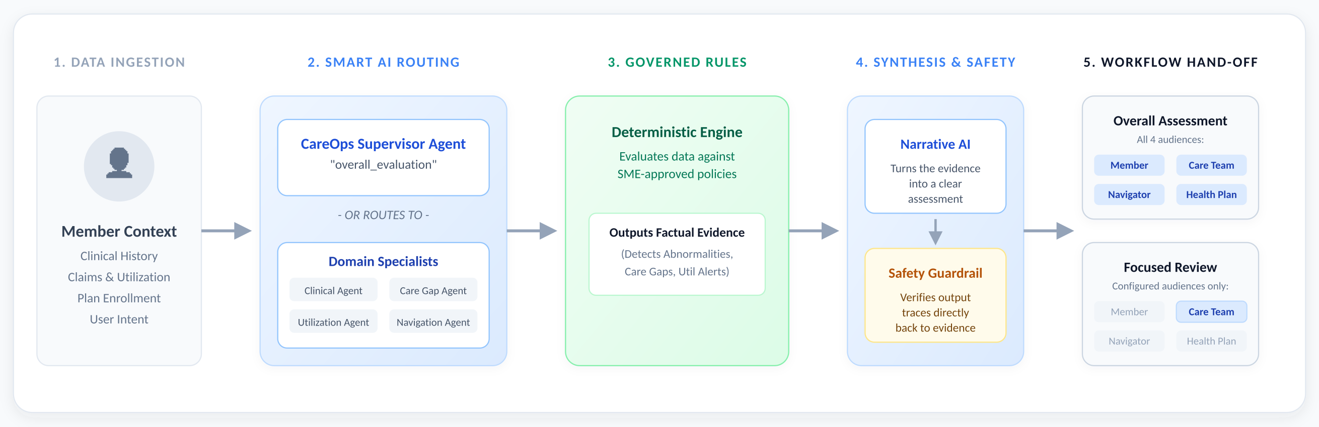



How CareOps works
Smart routing
Evidence-backed findings
Safety guardrail
A supervisor for a holistic view, or a specialist for a focused review.
Every finding comes from approved policy and carries an Evidence ID.
Output must trace back to evidence before it is handed off.

Slide 4
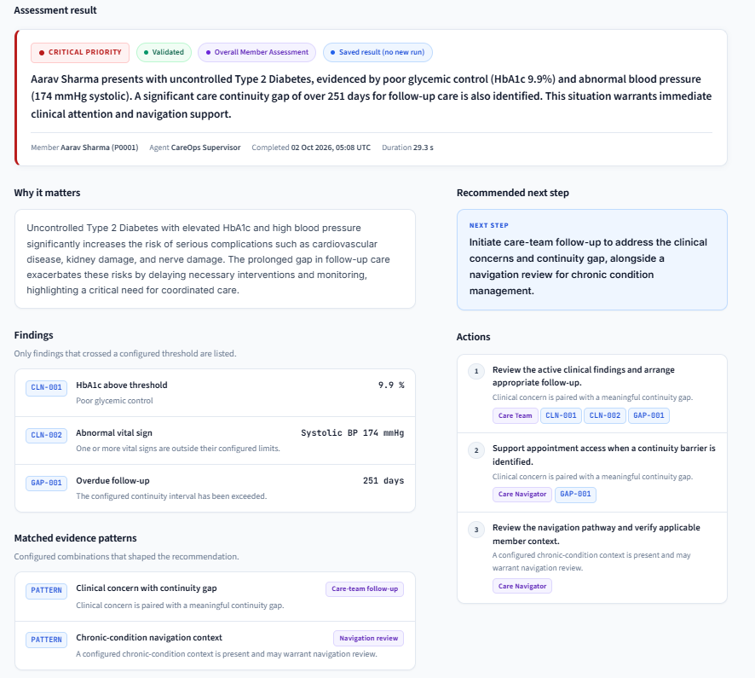




What CareOps produces
ASSESSMENT RESULT
STAKEHOLDER VIEWS · SAME DECISION, EACH AUDIENCE
Member
Care Team
Personalized follow-up
Review and act
Your recent health data shows high blood sugar and blood pressure, and it's been a while since your last follow-up. Your care team will reach out to help you get back on track with your Type 2 Diabetes management.
Aarav Sharma (P0001) has uncontrolled Type 2 Diabetes (HbA1c 9.9%, BP 174 mmHg) and an overdue follow-up (251 days). Please review clinical findings and arrange follow-up.
Navigator
Health Plan
Access and navigation
Status and oversight
Aarav Sharma (P0001) has uncontrolled Type 2 Diabetes and a significant care gap. Support appointment access and review navigation pathway for chronic condition management.
Member P0001, Aarav Sharma, has uncontrolled Type 2 Diabetes with clinical concerns (HbA1c 9.9%, BP 174 mmHg) and a 251-day care continuity gap. Care team and navigation follow-up initiated.

Slide 5





How teams use the output
OUTPUT
BUSINESS USE
Priority and summary
Order the outreach queue so the most urgent members are reviewed first.
Findings and Evidence IDs
Explain why a member was flagged and keep an auditable record for compliance and risk-adjustment documentation.
Clinical thresholds
Give navigators the clinical data (for example, HbA1c) to review C-SNP eligibility and support an SEP.
Recommended actions
Direct each follow-up to the right team: care team, navigator or health plan.
Audience views and API
Share consistent messaging with members and teams, and feed existing workflows through the API.

Slide 6
Thank you
CareOps · From complex data to actionable decisions.

