Slide 1
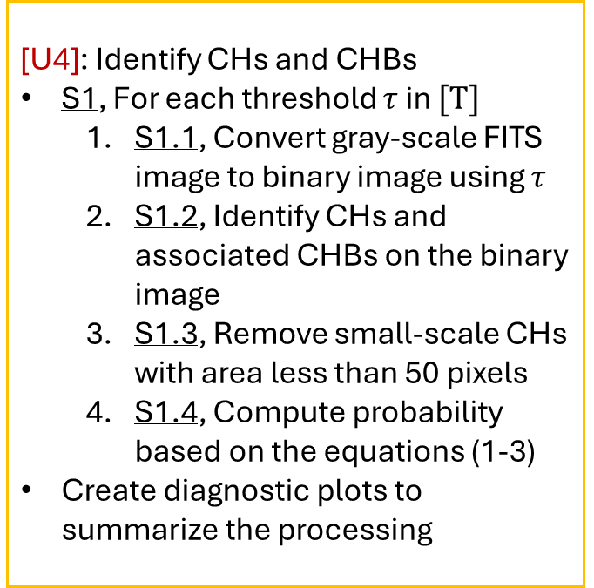
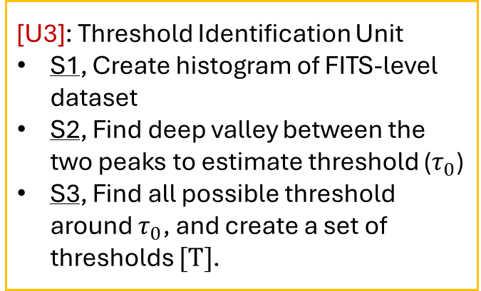
[U3]: Threshold Identification Unit
S1, Create histogram of FITS-level dataset
S2, Find deep valley between the two peaks to estimate threshold ($τ_{0}$)
S3, Find all possible threshold around $τ_{0}$, and create a set of thresholds $[Τ]$.
[Input]: SDO/AIA full-disk images
File Format – FITS
Wavebands – 171Å, 193Å, 211Å
Source: Joint Science Operations Center (JSOC)
[U1]: Preprocessing Unit
Inputs: Full-disk
S1, Applying PSF
S2, Normalize and register
S3, Rotating – Scaling – Translating
S4, Extract image attributes from FITS header
[Input]: SDO/AIA EUV Synoptic maps
File Format – FITS
Wavebands – 171Å, 193Å, 211Å
Source: SDO Webserver
[U4]: Identify CHs and CHBs
S1, For each threshold $τ$ in $[Τ]$
S1.1, Convert gray-scale FITS image to binary image using $τ$
S1.2, Identify CHs and associated CHBs on the binary image
S1.3, Remove small-scale CHs with area less than 50 pixels
S1.4, Compute probability based on the equations (1-3)
Create diagnostic plots to summarize the processing
[U2]: Filtering Unit
Inputs: EUV Synoptic maps, Preprocessed Full-disk maps
S1, Use 2D user-defined Gaussian median – filter to remove noise

