Slide 2
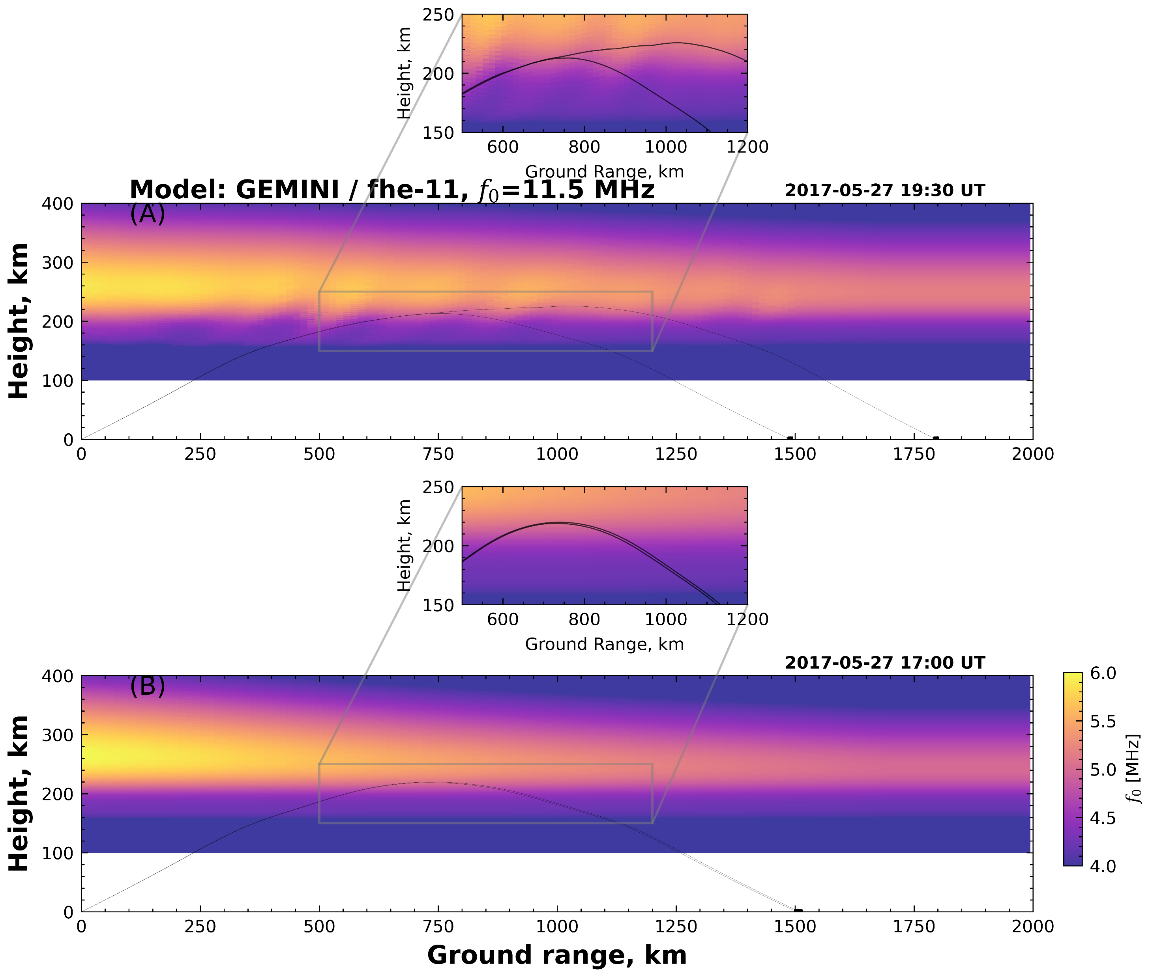
TID structures are 100-1000 km long.
(C.1)
(C.2)

Slide 3
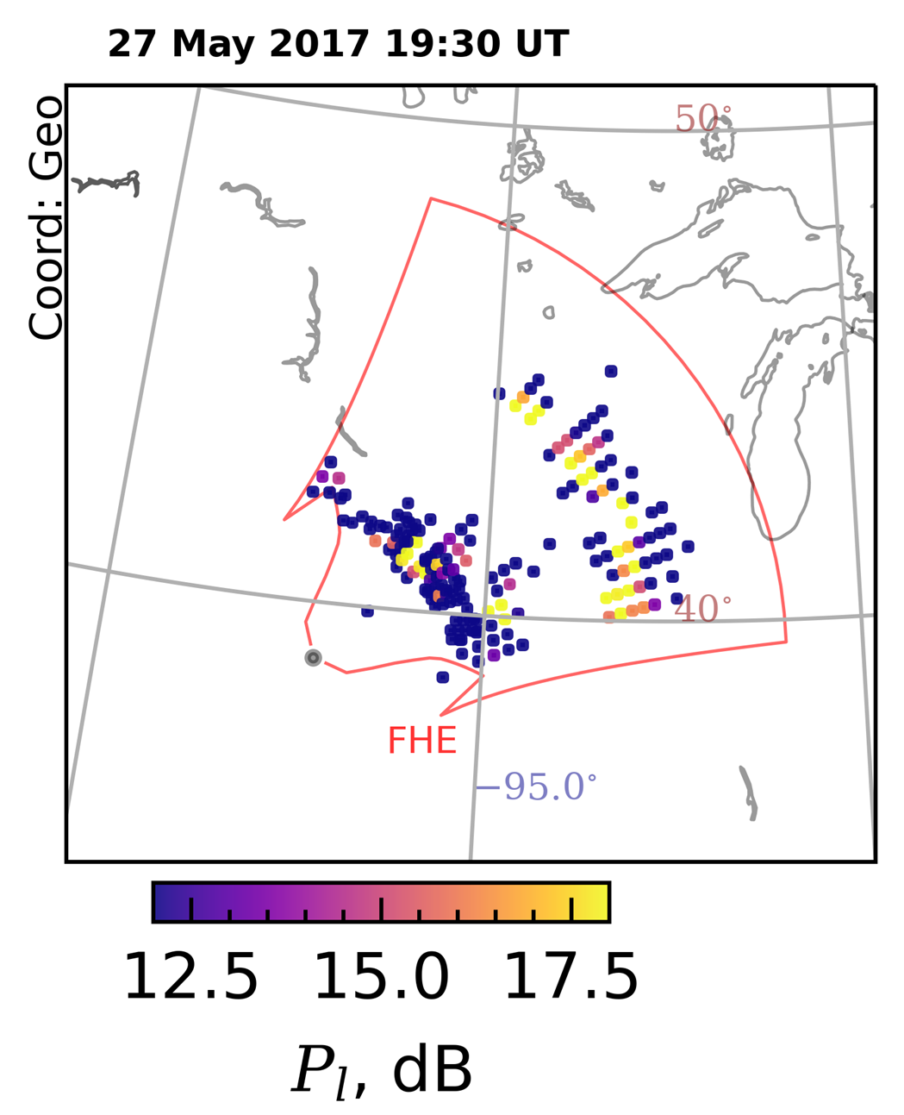
B-field Line
(A)
(B)
Ionospheric Plasma
Irregularities
Ray-3: ½ hop F-region
Ionospheric Scatter
1-hop F Ground Scatter
F-Layer
E-Layer
1-hop E_{s}
Ground Scatter
D-Layer
Ray-1: 1-hop E-region
Ground Scatter
Ray-2: 1-hop F-region
Ground Scatter
SuperDARN

Slide 4
(A)
B-field Line
Ionospheric Plasma
Irregularities
Ray-3: ½ hop F-region
Ionospheric Scatter
F-Layer
E-Layer
D-Layer
Ray-2: 1-hop F-region
Ground Scatter
Ray-1: 1-hop E-region
Ground Scatter
SuperDARN

Slide 5
(A)
B-field Line
(B)
Ionospheric Plasma
Irregularities
Ray-3: ½ hop F-region
Ionospheric Scatter
1-hop F Ground Scatter
F-Layer
E-Layer
1-hop E_{s}
Ground Scatter
D-Layer
Ray-2: 1-hop F-region
Ground Scatter
Ray-1: 1-hop E-region
Ground Scatter
SuperDARN

Slide 6
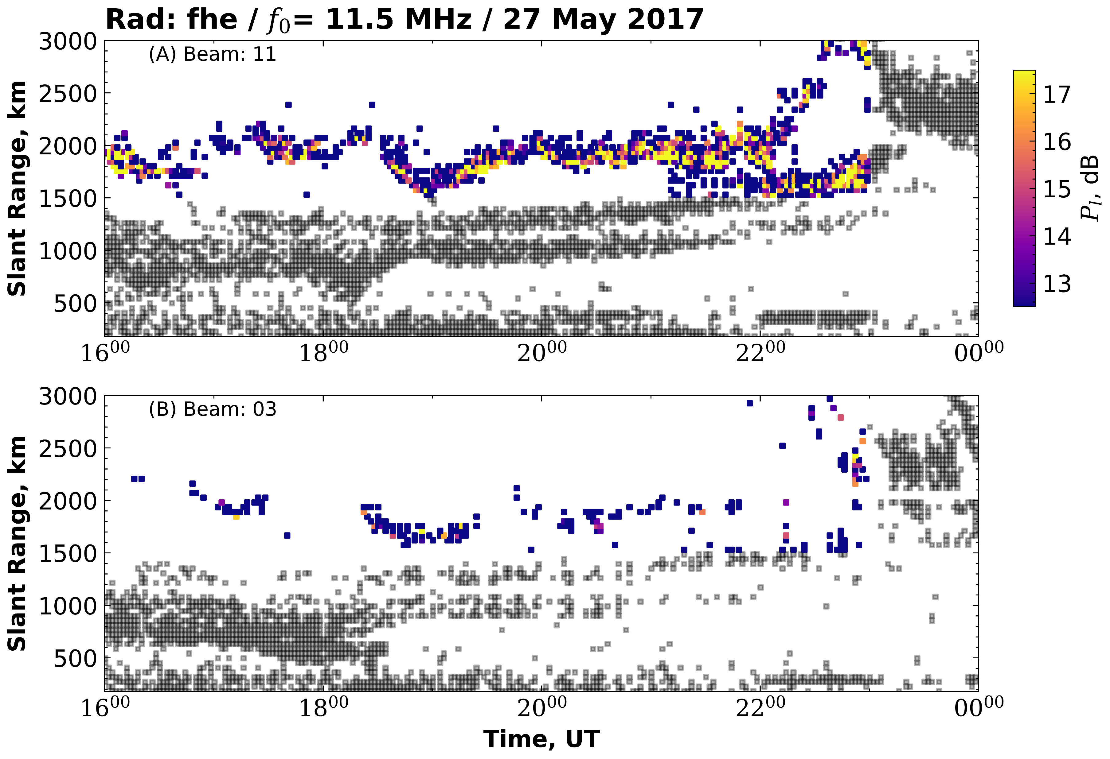

Slide 7
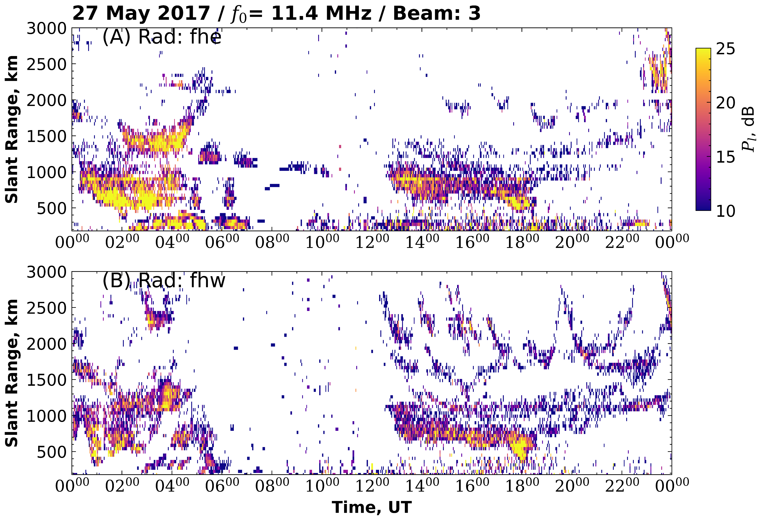

Slide 8
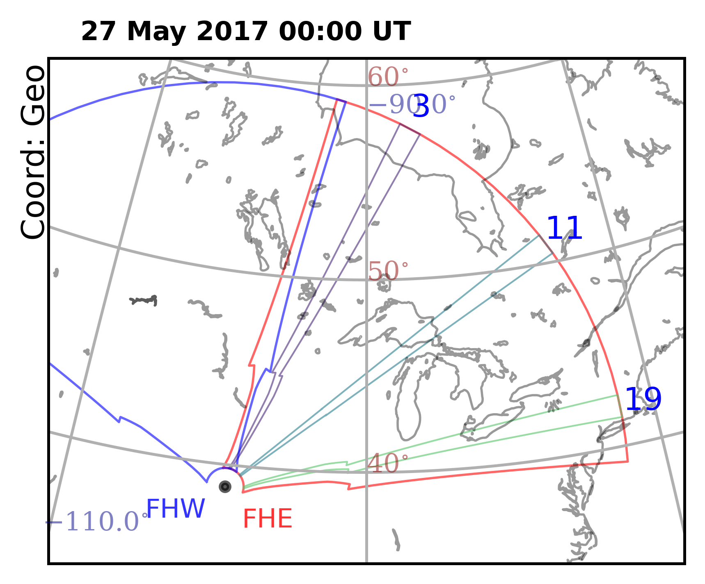
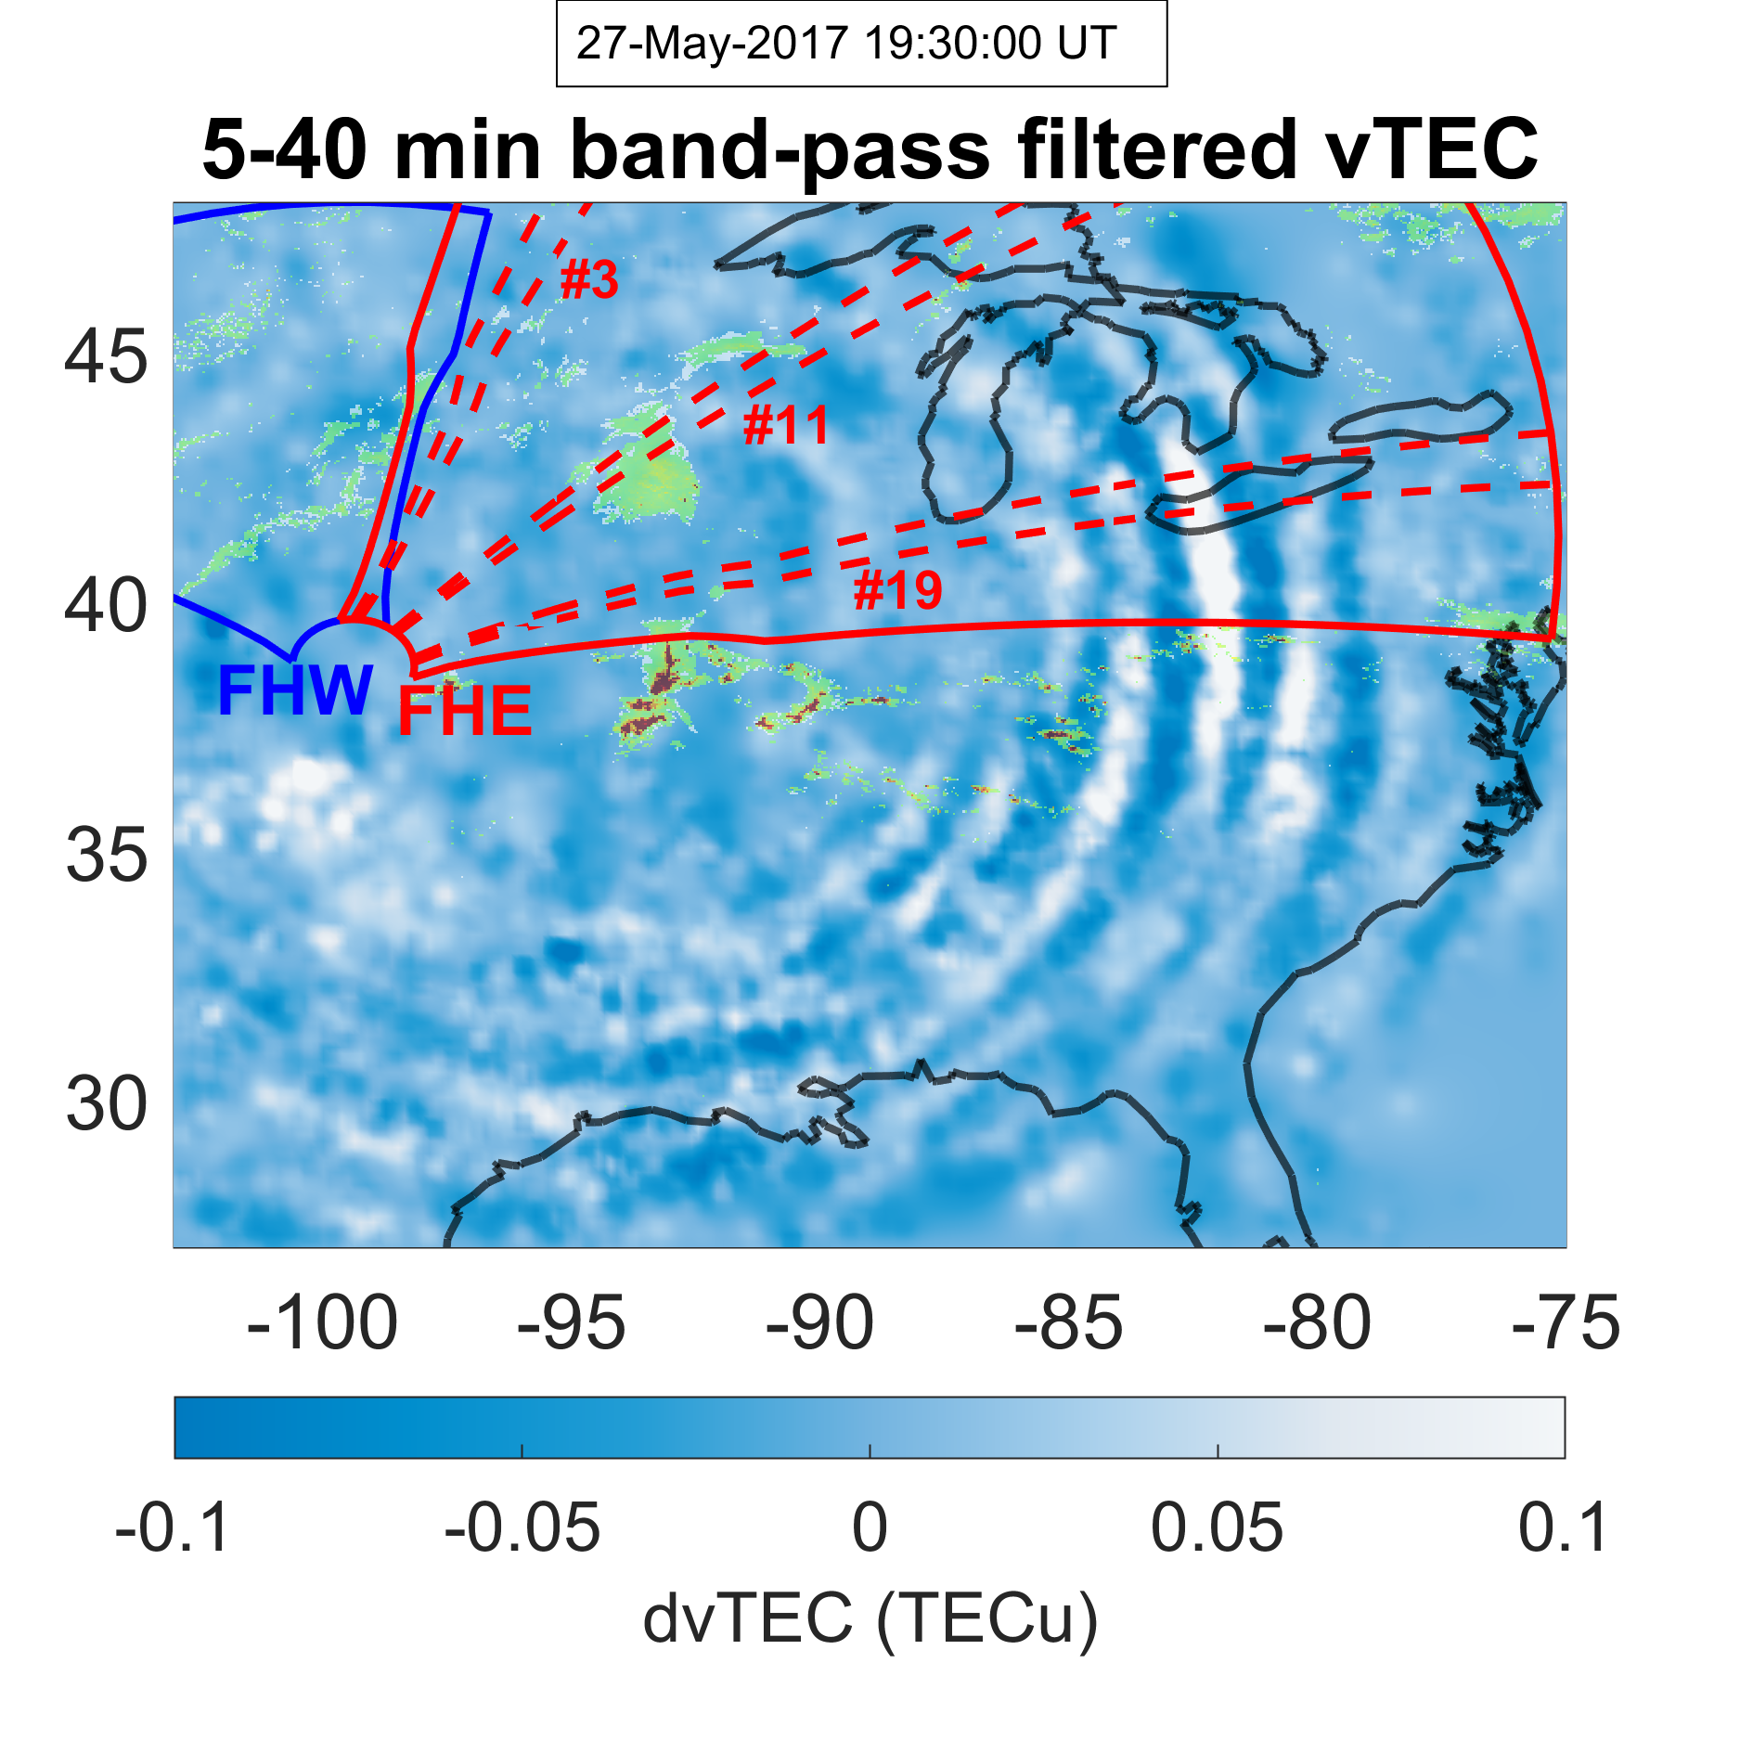
(A)
(B)

Slide 9
